Slide 1





LLM Should Ask Clarifying Questions to Increase Confidence in Generated Code —— On the Communication Skills of LLM Jie JW Wu George Washington University Incoming Postdoc at University of British Columbia @jw_ _wu https://jie-jw-wu.github.io/

Slide 2





Background
Gap
Software engineers
Job:
writing code,
communications,
requirements,
design
…
Job:
Programmer's assistant for
generating code

Slide 3
Motivation
Issues in programming with LLM:
Intent specification, problem decomposition and computational thinking (Sarkar et al. 2022)
Code quality and overconfidence (Johnson et al. 2023, Liu et al. 2023)
Usability issues (Liang et al. 2024)

Slide 4
Motivation
Apply the communication lens to inspect the gap
Question: Does asking clarifying questions increase confidence in code generation?
Compare communication skill of software engineer vs LLM:
Effective communication is a critical skill to accomplish software engineering tasks reliably with high quality
The degree of communication skills is rarely evaluated in code generation

Slide 5


Approach: Communication-Centered Process
Study the potential of LLMs from the dimension of effective communication skills.
Explore a process with 2 LLMs (Coder + Communicator) to ask more clarifying questions to refine the generated code.
Coder (LLM)
Problem description
Generated Code
4. Ask Coder to refine code
1. Find areas with low confidence
1. Find areas with low confidence
Communicator (LLM)
2. Ask clarifying or probing questions
3. Get response from user

Slide 6
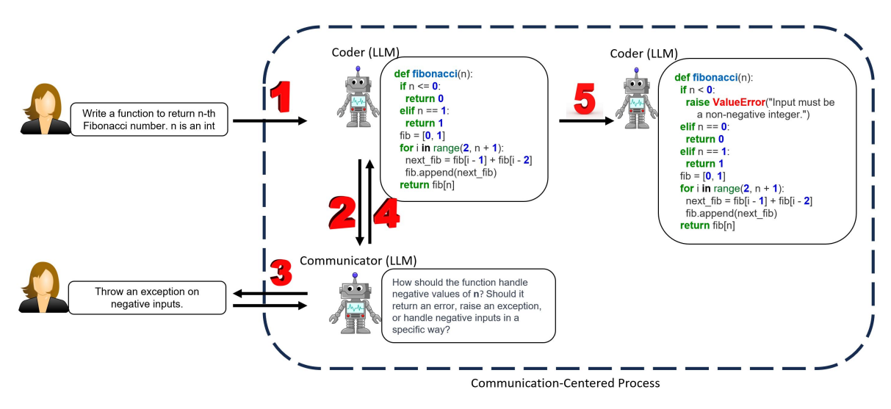
Communication-Centered Process - Example Usage
Key part of the process: how the communicator interacts with the user and the coder.

Slide 7
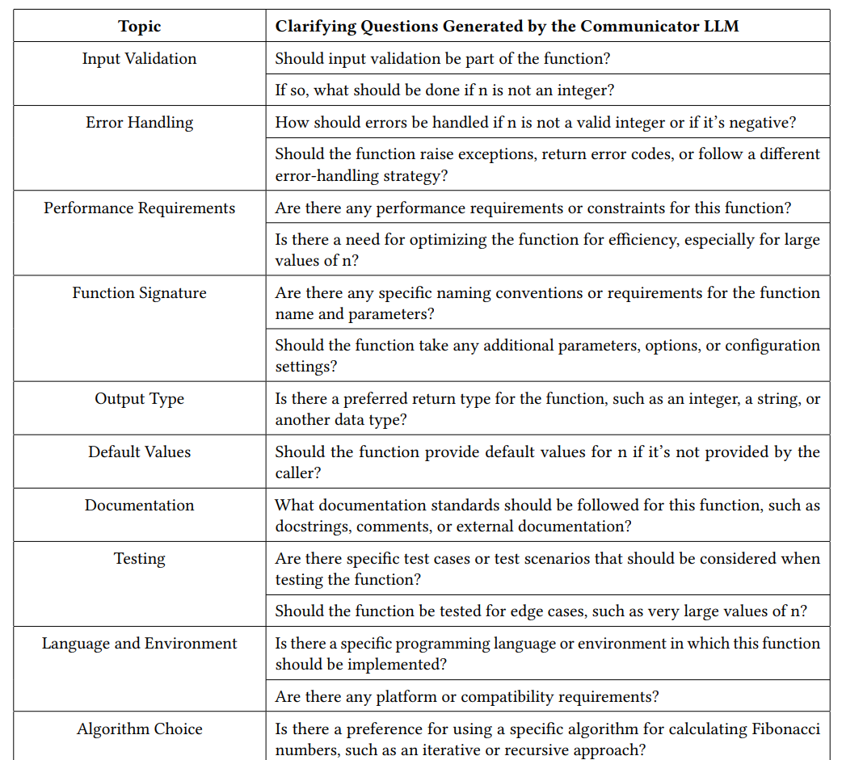
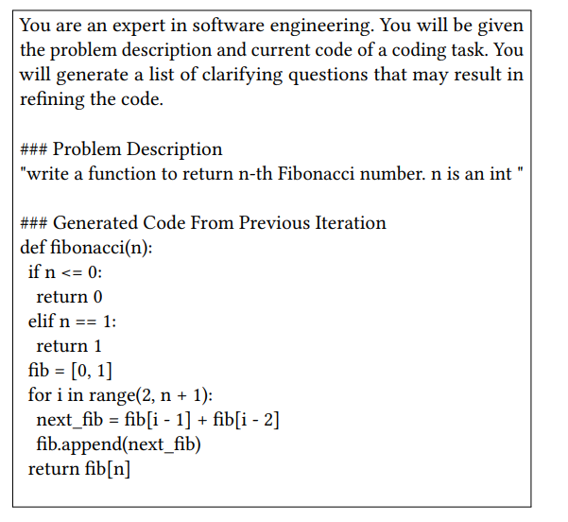
Communication-Centered Process - Example Usage
Prompt and Generated questions of Communicator LLM
...

Slide 8
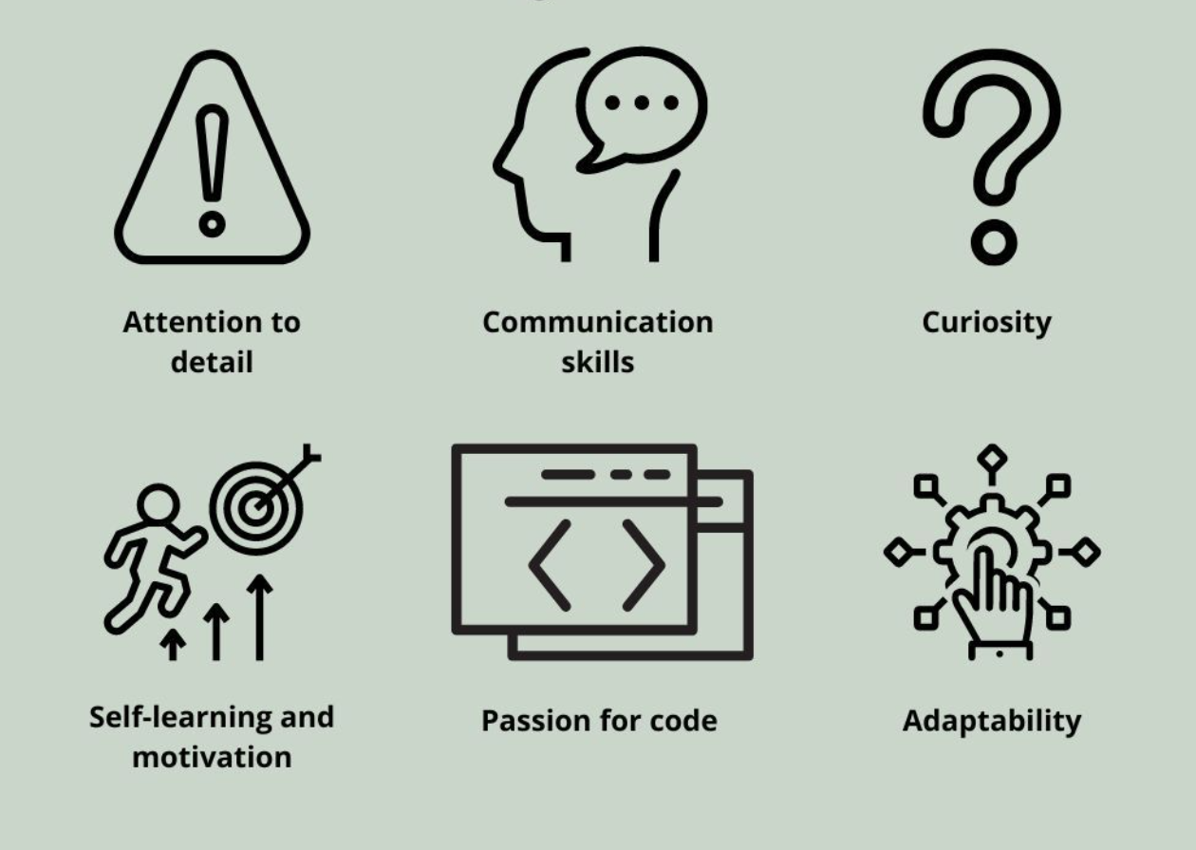
Benchmarking the communication skills of Code LLM
Question: How to effectively evaluate the degree of Code LLM’s communication skills?
Top-Notch Software Engineer:
Deliberately remove information from problem description in job interviews
Check if candidate ask clarifying questions
LLM:
Randomly removing certain parts of the problem descriptions of the existing dataset
Check if LLM asks clarifying questions

Slide 9
Benchmarking the communication skills of Code LLM
Question: How to effectively evaluate the degree of Code LLM’s communication skills?
New benchmark:
HumanEval-C
Top-Notch Software Engineer:
Deliberately remove information from problem description in job interviews
Check if candidate ask clarifying questions
LLM:
Randomly removing certain parts of the problem descriptions of the existing dataset
Check if LLM asks clarifying questions

Slide 10

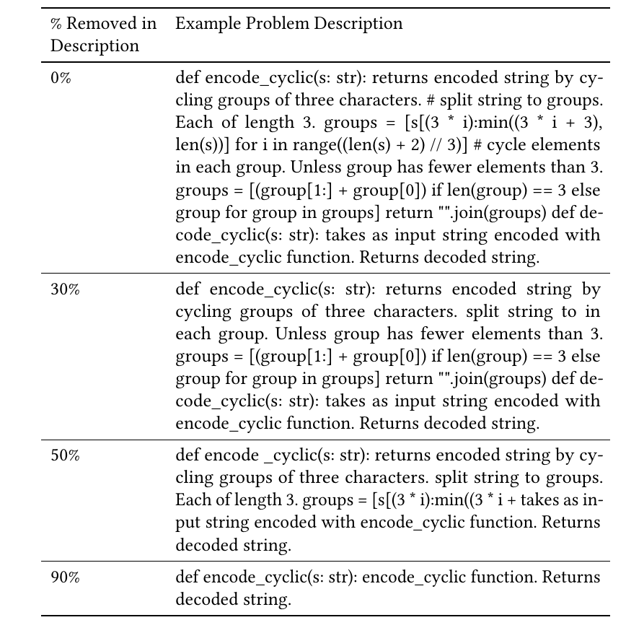

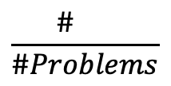
HumanEval-C: Benchmarking the communication skills of Code LLM
Dataset: Randomly remove X% (30%,50%,90%) of consecutive words from the original problem description in HumanEval dataset.
Evaluation: 1) test pass rate, 2) communication rate (comm. rate) =
$$\frac{\# }{\#Problems}$$
Still generates code
Ask clarifying questions

Slide 11
HumanEval-C: Findings
ChatGPT-3.5 is currently very weak at asking clarifying questions when this ability is necessary for trustworthy code generation.
Lower temperature or using GPT-4 does not help much to increase the chance of LLM to ask questions, but the new Communication-Centered Process is effective. (Comm. Rate 5%→64% when X=50%)

Slide 12
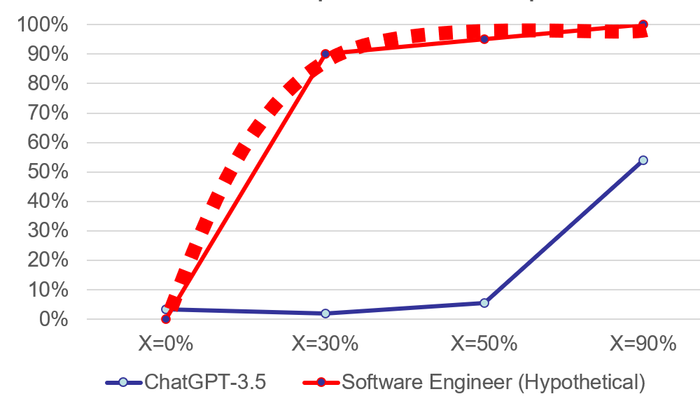
Takeaway
LLM should ask clarifying questions to increase confidence in generated code
ChatGPT is very weak at asking clarifying questions when this ability is necessary for trustworthy code generation
Opportunities: improve evaluation and model of communication skills in LLM
“Asking a good question can be valuable in and of itself, irrespective of the answer. It communicates your respect for the other person.”
- Iowa Peace Institute Message
Research
Opportunities
New benchmark:
HumanEval-C and preprint will be available

