Slide 1





LLM Should Ask Clarifying Questions to Increase Confidence in Generated Code —— On the Communication Skills of LLM Jie JW Wu George Washington University Incoming Postdoc at University of British Columbia @jw_ _wu https://jie-jw-wu.github.io/
Notes:
1. I’m Jie, and I’m glad to have the chance to present here. this work is started near the end of my PhD at GWU, and I will be a postdoc at UBC. In this work, I would like to argue that LLM should ask more clarifying questions to increase confidence in code generation.

Slide 2





Background
Gap
Software engineers
Job:
writing code,
communications,
requirements,
design
…
Job:
Programmer's assistant for
generating code
Notes:
2. As you all know, we are entering a new era of programming where we have LLMs as programmer’s assistant to enhance productivity. However, there is still a substantial gap between LLM as a code generation tool and the software engineer whose responsibility is beyond writing code. This includes effective communications, requirements, design decisions, domain knowledge, etc. So, the current LLMs cannot fully replace professional software developers.

Slide 3
Motivation
Issues in programming with LLM:
Intent specification, problem decomposition and computational thinking (Sarkar et al. 2022)
Code quality and overconfidence (Johnson et al. 2023, Liu et al. 2023)
Usability issues (Liang et al. 2024)
Notes:
3. There are several reported issues in LLM as programmer’s assistants. This include lack of Intent specification, problem decomposition and computational thinking. The end-users have to specify intent in natural language, and have the ability to decompose problems into subproblems.
A second category of issue is in code quality and overconfidence of model prediction, which lead to incorrect code, bugs being introduced and more time spend in checking the code and finding bugs.
A third category of issue is usability issues, such as having trouble controlling and using the tool to generate reliable and useful code.

Slide 4
Motivation
Apply the communication lens to inspect the gap
Question: Does asking clarifying questions increase confidence in code generation?
Compare communication skill of software engineer vs LLM:
Effective communication is a critical skill to accomplish software engineering tasks reliably with high quality
The degree of communication skills is rarely evaluated in code generation
Notes:
4. In this work, I look into the issues from a different angle. I’m interested in applying the communication lens to bridge this gap between LLM and software engineer. The leading question is - Does asking clarifying questions increases confidence in code generation? Let’s take a step back to compare the comm. Skill of software engineer and LLM.
- For a professional software engineer:
Proactive and effective communication is a critical skill in practice to finish their software engineering tasks reliably with high quality
They use various ways of communication, such as asking more questions in 1:1 conversations, group meetings, and Slack channels to get more information and reduce ambiguity about their tasks.
-As for LLMs:
The level of communication skills is rarely emphasized or evaluated in the field of code generation
In the code generation benchmark, typically the problem descriptions are one-off input. Based on the one-off input, the current LLMs are evaluated by generated code in one or multiple attempts, without additional conversational inputs

Slide 5


Approach: Communication-Centered Process
Study the potential of LLMs from the dimension of effective communication skills.
Explore a process with 2 LLMs (Coder + Communicator) to ask more clarifying questions to refine the generated code.
Coder (LLM)
Problem description
Generated Code
4. Ask Coder to refine code
1. Find areas with low confidence
1. Find areas with low confidence
Communicator (LLM)
2. Ask clarifying or probing questions
3. Get response from user
Notes:
5. Inspired by this comparison, in this work, I study the potential of LLMs from the dimension of effective communication skills. I explore a comm-centered process that is formed by 2 LLMs to ask more clarifying questions to refine the code.
The coder LLM generates code from the problem description. The communicator LLM detects the parts with low confidence where questions may help to get additional information from the user. Then the communicator asks clarifying questions and gets the response. Finally, the communicator send the response back to the coder to refine the generated code. The process can be repeated until some condition is met.

Slide 6
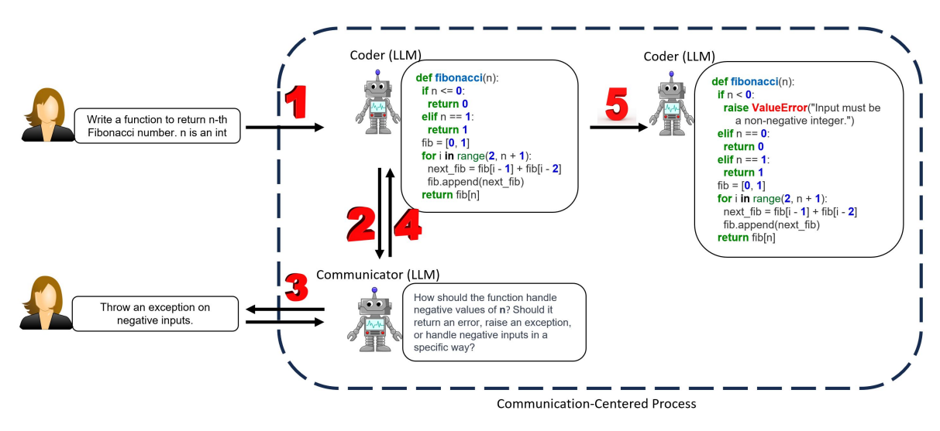
Communication-Centered Process - Example Usage
Key part of the process: how the communicator interacts with the user and the coder.
Notes:
6. Here is an example, in which we use ChatGPT 3.5 as the LLM. A user is looking for a code snippet to return n-th Fibonacci number. In step 1 , the coder LLM first generated an initial code snippet. In step 2, the communicator analyzed the problem description and the initial code to generate some clarifying questions such as how to handle the negative input. In step 3, the user replied: throw exception on negative inputs. Finally, the coder used this additional information from user to refine the code which add the exception when n is negative.

Slide 7
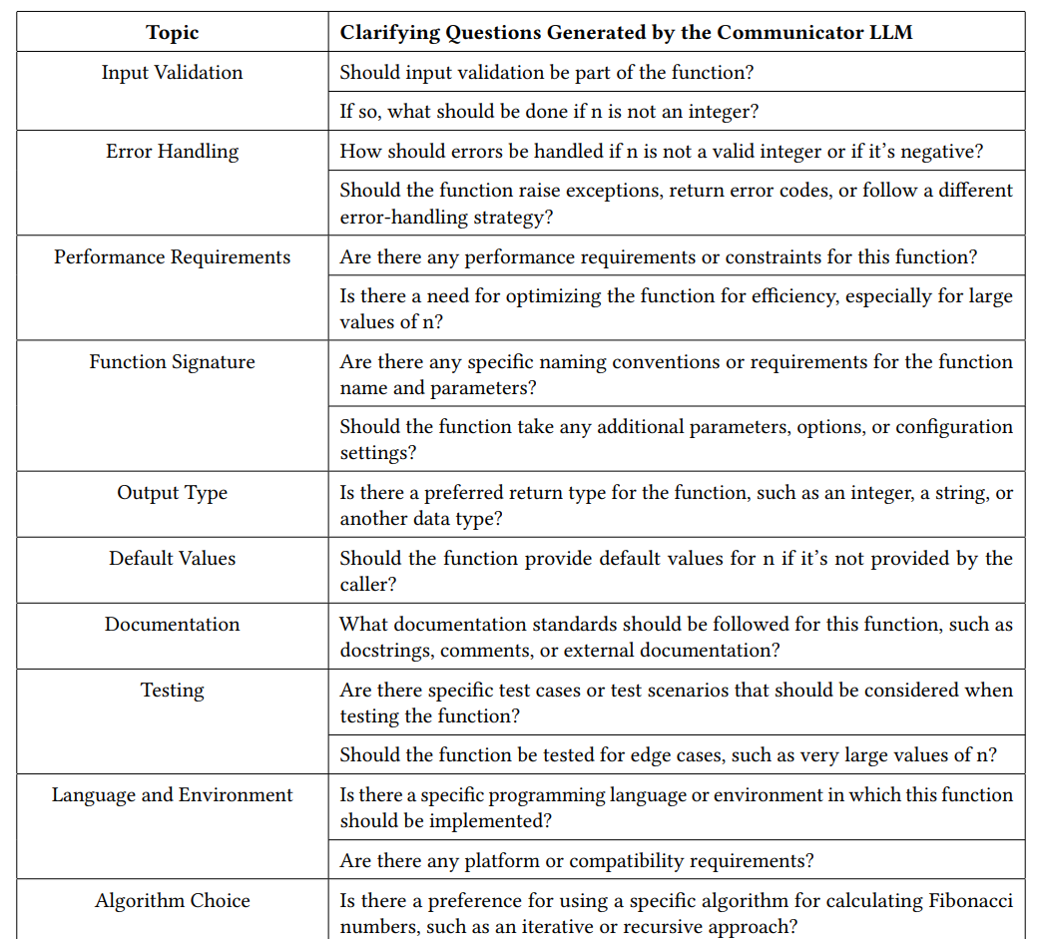
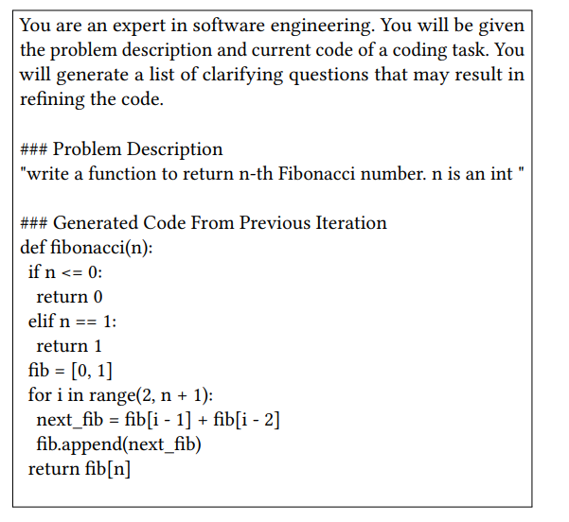
Communication-Centered Process - Example Usage
Prompt and Generated questions of Communicator LLM
...
Notes:
7. The communicator uses one-shot prompting to generate the clarifying questions from the problem description and the code. The example of prompt is on the left side. The output of the prompt is on the right table.
With the simple one-shot prompt, we can see the communicator is already able to cover a number of topics that deserve asking questions. This indicates big potential that boosting communication skills can lead to improvements of the final code output in several topics such as error handling, input validation, documentation, etc.

Slide 8
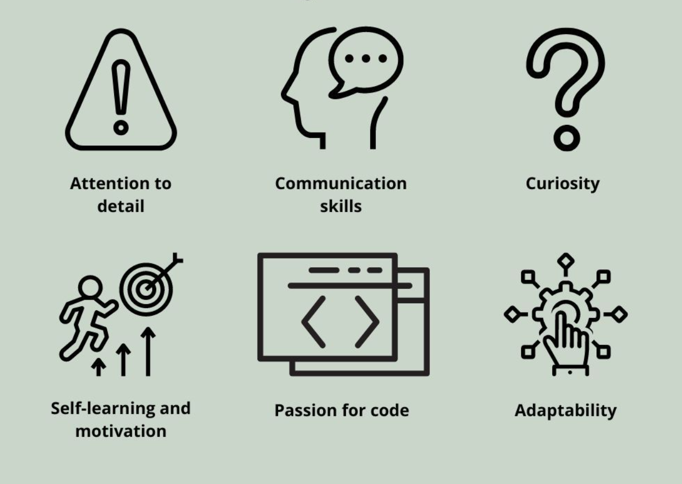
Benchmarking the communication skills of Code LLM
Question: How to effectively evaluate the degree of Code LLM’s communication skills?
Top-Notch Software Engineer:
Deliberately remove information from problem description in job interviews
Check if candidate ask clarifying questions
LLM:
Randomly removing certain parts of the problem descriptions of the existing dataset
Check if LLM asks clarifying questions
Notes:
8. So far I have showed this comm. centered process that has potential to increase the communication skills of the Code LLM by asking clarifying questions. Naturally, the next question is How to effectively evaluate the degree of Code LLM’s communication skills so that we can compare different models? This part of work has not been formally published yet. For this question, let’s again compare software engineer and LLM. I’ve been a software engineer at Snap and MSFT for several years. When I interview a candidate, to evaluate the candidate’s communication skill, I would remove some key information from the problem description. And then see if the candidate ask clarifying question. This technique was also used by other interviewers. So the idea here is to apply this technique to LLM as well. First, certain parts of problem description are removed randomly. Second, check if LLM ask clarifying questions. Techniques similar to this are also used in the field of NLP to better understand the model performance.

Slide 9
Benchmarking the communication skills of Code LLM
Question: How to effectively evaluate the degree of Code LLM’s communication skills?
New benchmark:
HumanEval-C
Top-Notch Software Engineer:
Deliberately remove information from problem description in job interviews
Check if candidate ask clarifying questions
LLM:
Randomly removing certain parts of the problem descriptions of the existing dataset
Check if LLM asks clarifying questions
Notes:
9. And by doing this, a new benchmark, called HumanEval-C, is created

Slide 10

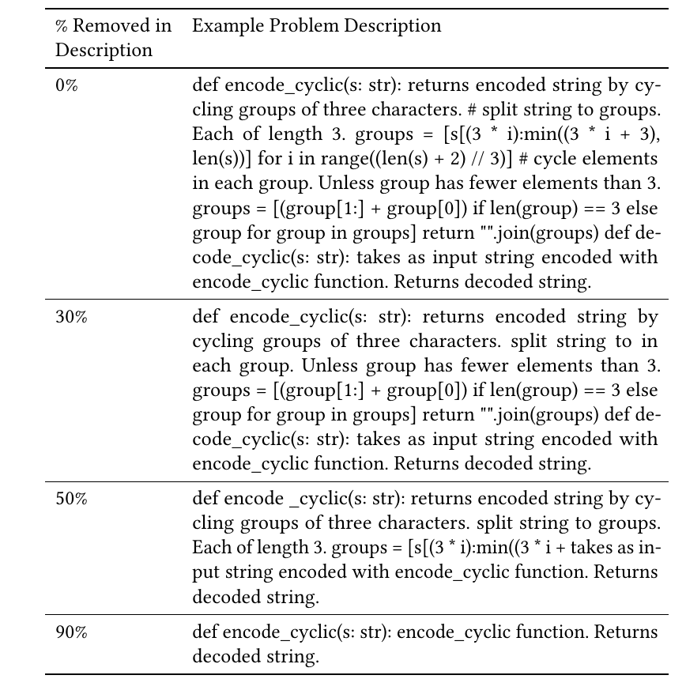

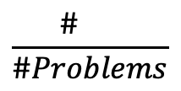
HumanEval-C: Benchmarking the communication skills of Code LLM
Dataset: Randomly remove X% (30%,50%,90%) of consecutive words from the original problem description in HumanEval dataset.
Evaluation: 1) test pass rate, 2) communication rate (comm. rate) =
$$\frac{\# }{\#Problems}$$
Still generates code
Ask clarifying questions
Notes:
10. Specifically, for the HumanEval-C benchmark, I randomly remove X% of consecutive words from the original problem description in HumanEval dataset. Then given the input, the LLM generates results. An example of input is shown on the left side. The model either outputs some clarifying questions or still outputs code which is not good given some information is missing in the input.
Two metrics are used in evaluation. First is the commonly used test pass rate. Second is the communication rate defined as number of output with no code over total number of problems. So the higher the comm rate, the better.

Slide 11
HumanEval-C: Findings
ChatGPT-3.5 is currently very weak at asking clarifying questions when this ability is necessary for trustworthy code generation.
Lower temperature or using GPT-4 does not help much to increase the chance of LLM to ask questions, but the new Communication-Centered Process is effective. (Comm. Rate 5%→64% when X=50%)
Notes:
11. Here is the plot of comm rate for different X. The blue line is ChatGPT 3.5, the red line is hypothetical estimate of top-notch software engineer. We can see that when 30% and 50% of problem description is removed, the comm rate is only less than 10%. When x is increased to 90%, the comm rate increased to 55%. This shows…
Another finding is that changing parameters such as temperature or using model such as gpt4 didn’t help much. But the new comm centered process increased comm rate from 5% to 64% when x=50%

Slide 12
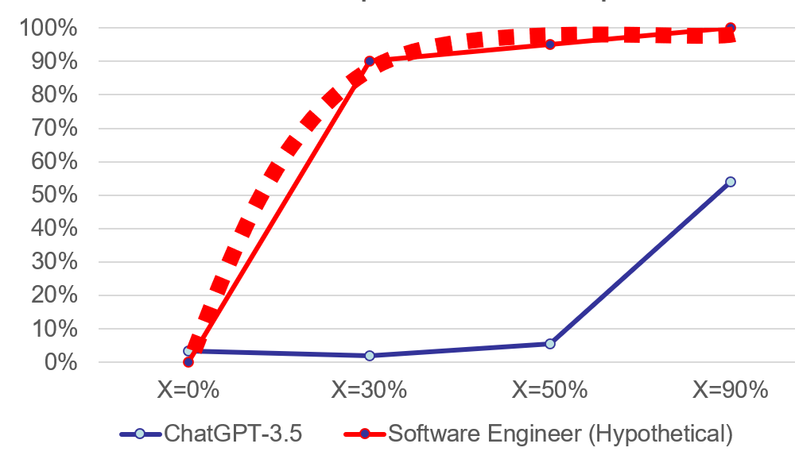
Takeaway
LLM should ask clarifying questions to increase confidence in generated code
ChatGPT is very weak at asking clarifying questions when this ability is necessary for trustworthy code generation
Opportunities: improve evaluation and model of communication skills in LLM
“Asking a good question can be valuable in and of itself, irrespective of the answer. It communicates your respect for the other person.”
- Iowa Peace Institute Message
New benchmark:
HumanEval-C and preprint will be available
@jw_ _wu
Research
Opportunities
Notes:
12. To conclude, I argue that based on the evaluation, … not only to increase quality of generated code, but as described in the quote in green, asking a good question is valuable itself because it shows llm is rigorous and trustworthy.
In evaluation, the current Code LLM is very weak at asking clarifying questions when it’s indeed necessary. The graph shows a big gap and many research opportunities to push the blue line of llm toward the red lines. Besides the model, there is also opportunity to improve the evaluation of communications in LLMs. The benchmark and preprint will be available to support other researchers interested in this topic. Thank you.

