Slide 1

HTML
Lesson 2

Slide 2

HTML Images
In HTML, images are defined with the <img> tag.
The <img> tag is empty, it contains attributes only, and does not have a closing tag.
Images Syntax:
<img src="url">
<img src="1.jpg" alt="apple" width="500" height="600">

Slide 3
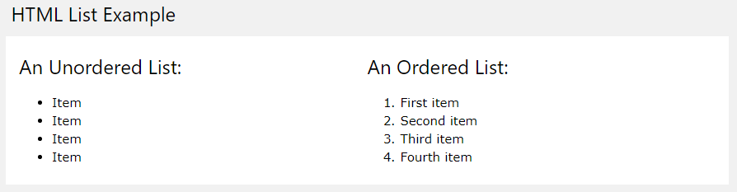
HTML Lists

Slide 4
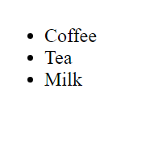
Unordered HTML List
An unordered list starts with the <ul> tag. Each list item starts with the <li> tag.
The list items will be marked with bullets (small black circles) by default
<ul> <li>Coffee</li> <li>Tea</li> <li>Milk</li> </ul>

Slide 5
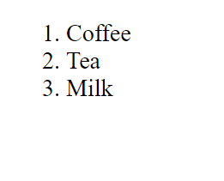
Ordered HTML List
An ordered list starts with the <ol> tag. Each list item starts with the <li> tag.
The list items will be marked with numbers by default:
<ol> <li>Coffee</li> <li>Tea</li> <li>Milk</li> </ol>

Slide 6
Ordered List – Type attribute
The type attribute of the <ol> tag, defines the type of the list item marker:
Type | Description
type="1" | The list items will be numbered with numbers (default)
type="A" | The list items will be numbered with uppercase letters
type="a" | The list items will be numbered with lowercase letters
type="I" | The list items will be numbered with uppercase roman numbers
type="i" | The list items will be numbered with lowercase roman numbers

Slide 7
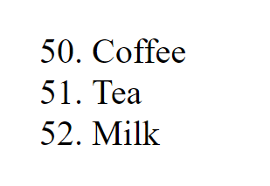
Control List Counting
By default, an ordered list will start counting from 1. If you want to start counting from a specified number, you can use the start attribute:
<ol start="50">
<li>Coffee</li>
<li>Tea</li>
<li>Milk</li>
</ol>

Slide 8
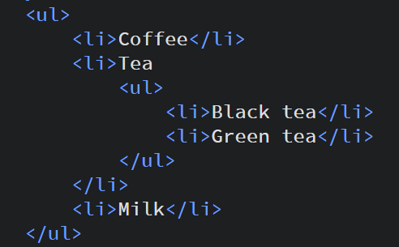
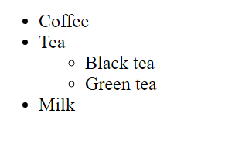
Nested HTML Lists
List can be nested (lists inside lists):

Slide 9
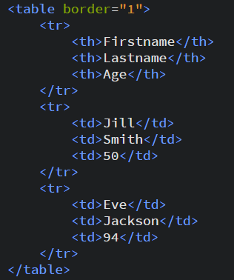
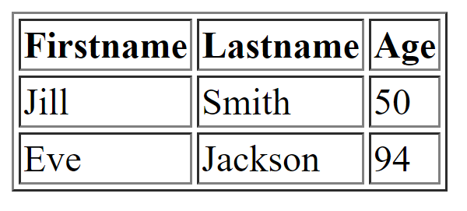
HTML Table
An HTML table is defined with the <table> tag.
Each table row is defined with the <tr> tag.
A table header is defined with the <th> tag.
A table data/cell is defined with the <td> tag.

Slide 10
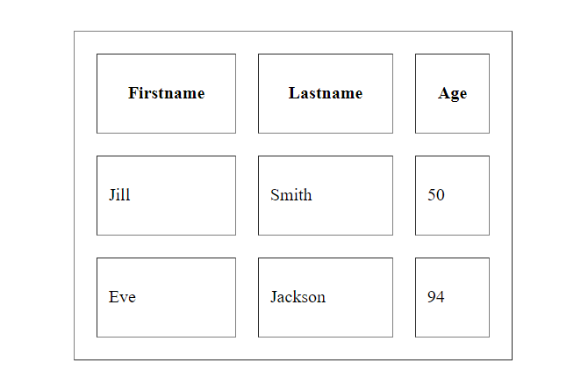
HTML Table Attributes
<table border="1" width="400" height="300" cellpadding="10" cellspacing="20" >

Slide 11
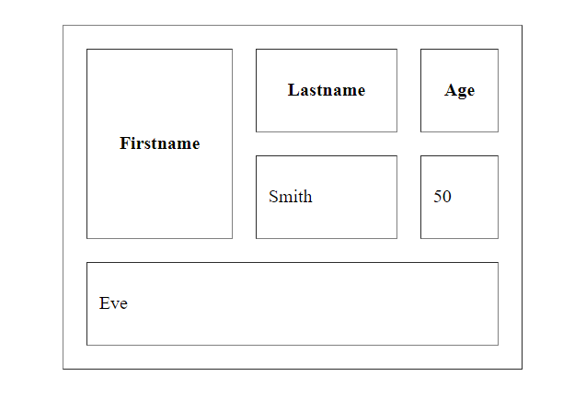
HTML Cell Attributes
<td rowspan="2" colspan="3">

Slide 12
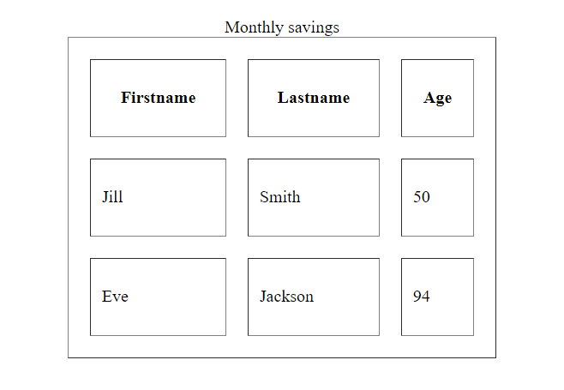
HTML Table Caption
The <caption> tag must be inserted immediately after the <table> tag.

Slide 13

Task:1

Slide 14
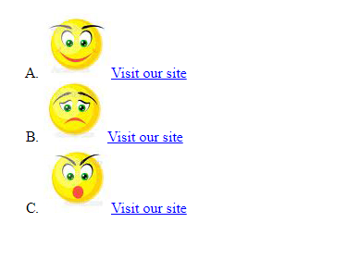
Task:2

Slide 15
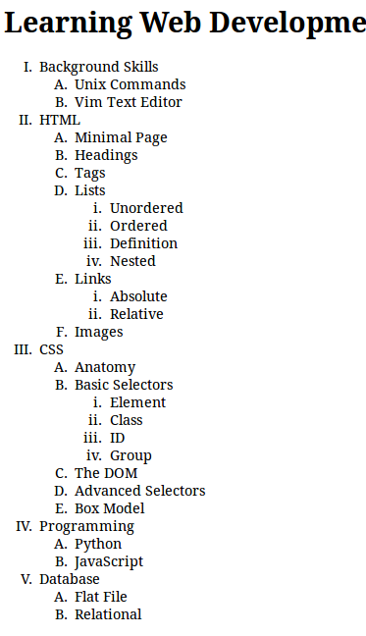
Task:3

Slide 16
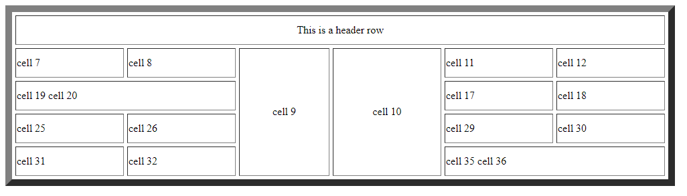
Task:4

Slide 17
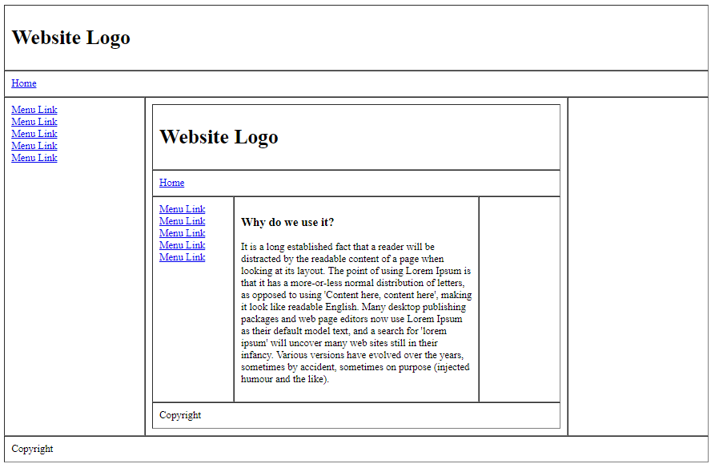
Task:5

