Slide 1

OpenRA
Marian Raad
Amjad Abdelrahman

Slide 2
Introduction
OpenRA is a Libre/Free Real Time Strategy game engine supporting early Westwood games (such as Command & Conquer: Tiberian Dawn, Red Alert and Dune 2000).
OpenRA was created by fans for fans.
The OpenRA team is a group of developers from all over the world, contributing their time to build the best open-source RTS games (Real-time strategy).
updated to use the hardware acceleration of modern video cards using OpenGL and OpenAL.
Support cross platform (It runs on Windows, Linux and Mac OS X).
Notes:
OpenRA was created by fans for fans. Changing the game with mods is encouraged and a major design goal that kept modularity in mind. You will notice that the default mods provided do not recreate the games in terms of being exact clones, but trying to re-imagine them with re-balanced stats, new units and tilesets not found in the original as well as features found in modern real-time strategy games such as Fog of War, right-click orders to avoid misclicks, bounties and unit veterancy. Also new effects like tank husks and aircraft trails have been added. Hard-coded triggers have been replaced by a Lua scripting API and a spectator mode with replays has been integrated for competitive play. The user interface has been modernized with a tabbed build palette. It also features a basic non-cheating AI that starts with the same stats as you do, but is still challenging for newbies. A Steam Workshop inspired website callend "OpenRA Resources" exists to help distribute custom content.

Slide 3
OpenRA philosophy and long term goals
The OpenRA project has two main goals:
Recreating the original 2D Command & Conquer games with enhancements inspired by more modern RTS games. OpenRA should retain the feel and nostalgia of the older games, but remove the frustrating and dated elements.
Create a flexible 2D RTS game engine that others can use to build their own games. The 2D C&C games were well known for being highly moddable, but this flexibility was lost in the transition to the more complicated 3D game engines. The Tiberian Sun and Red Alert 2 modding communities have performed a commendable job at maintaining these original game engines as a platform for modders, but the lifetime and capabilities of these old engines is limited.

Slide 4
Challenge
OpenRA is developed by volunteers in their spare time, and so they do not follow a traditional development process with strictly planned milestones and assigned features (although they do make use of these, especially when preparing a new release).
Instead, specific features are worked on by individual contributors as their time and interest allows; this can lead to what appears to be piecemeal and sporadic development to an outside observer.

Slide 5
Some Gameplay features
Properly handle game desynchronization events, displaying an ingame UI instead of throwing an exception.
Add support for a global chat system that can be accessed from anywhere in the game.

Slide 6
Modding / engine features
Add support for loading 'oramod' packages from the support directory for thirdparty mods.
Moving file parsers for assets and asset containers into mod code to allow other projects to implement their own file types.
Move the mod-specific asset installation code into our common mod chooser.
Improve support for map scripting by exposing more useful gameplay features to the lua scripts.

Slide 7
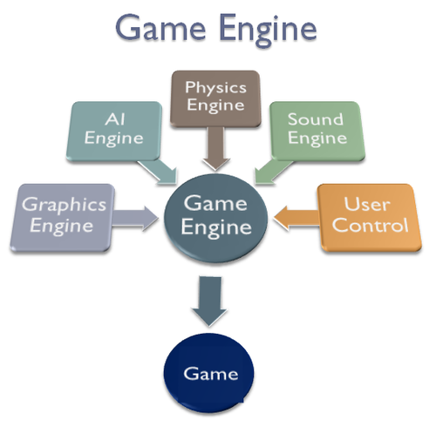
Overall Development
Notes:
Main game program: The actual game logic has of course to be implemented by some algorithms. It is distinct from any rendering, sound or input work.
Rendering engine: The rendering engine does the rendering via the chosen method ( in OpenRA they use OpenGL, OpenAL ).
Audio engine: The audio engine is the componentry which consists of any algorithms related to sound.
Physics engine: The physics engine is responsible for giving the application a realistic sense of the laws of physics in the application.
Artificial intelligence: The A.I. is usually outsourced from the main game program into some special module to be designed and written by software engineers with specialist knowledge.

Slide 8
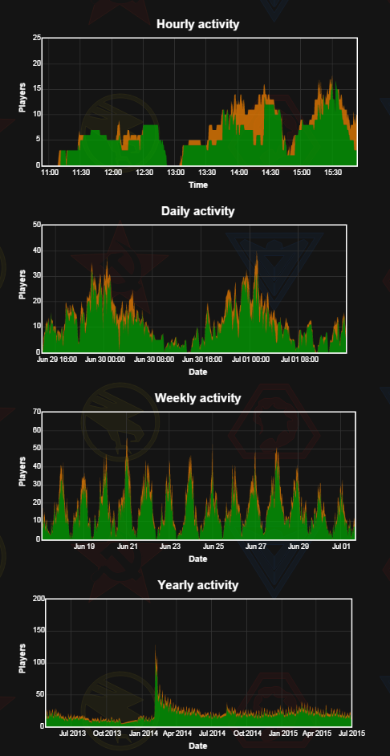
Statistics
Notes:
Player Statistics
Player Activity
View the numbers of gamers playing and waiting over the last fortnight:

Slide 9
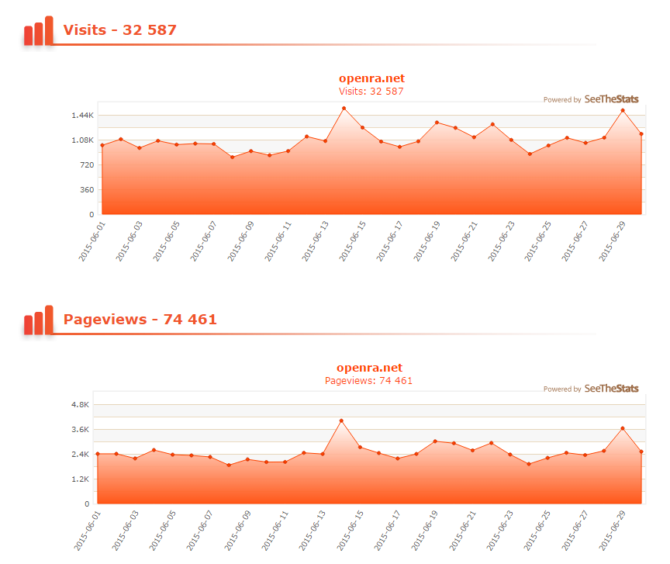

Slide 10
