Slide 1

CS 1550
Lab 1 – Linux/Shell
Basic commands Introduction
Teaching Assistant
Maher Khan
(Slides credited to Henrique Potter)

Slide 2
Recitation TA – Office Hours
Tuesday
2:00pm - 5:00pm
Friday
1:00pm – 4:00pm
Office: SenSq 5802

Slide 3
Recitation slides
On GitHub:
https://github.com/maher460/Pitt_CS1550_recitation_materials

Slide 4



CS 1550 – Introduction to Operating Systems
Common operating systems abstractions and mechanisms

Slide 5
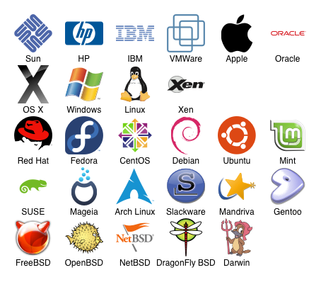


CS 1550 – Introduction to Operating Systems
Common operating systems abstractions and mechanisms
Will provide basic knowledge common to many modern Operating Systems

Slide 6
Projects
Projects have to run in the thoth server
thoth.cs.pitt.edu

Slide 7
SSH Clients
Windows
Putty
MacOS/Ubuntu
Terminal

Slide 8
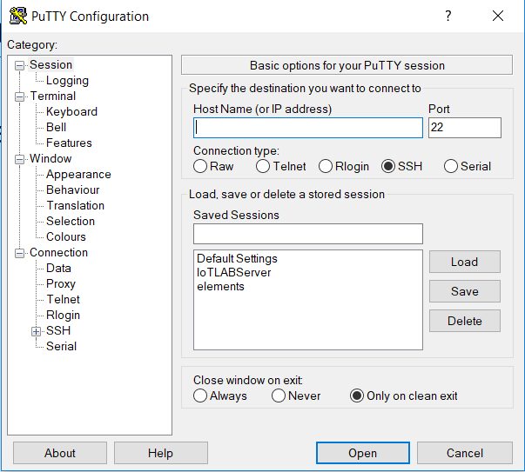
Windows - Putty
Download from www.putty.org
server address:
thoth.cs.pitt.edu at port 22

Slide 9
Windows - Putty
Download from www.putty.org
server address:
thoth.cs.pitt.edu at port 22
Use SSH

Slide 10
Windows - Putty
Download from www.putty.org
server address:
thoth.cs.pitt.edu at port 22
Use SSH
Click Open

Slide 11
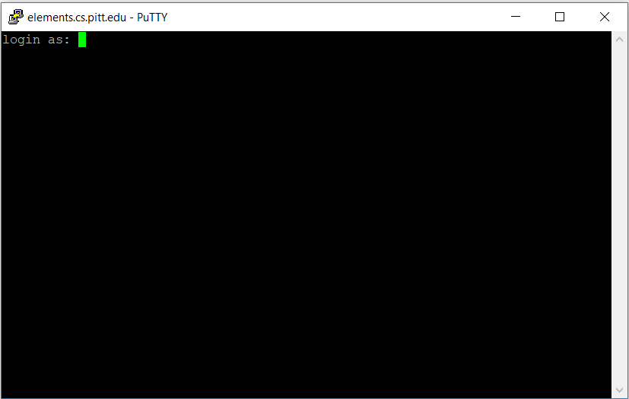
Windows - Putty
Download from www.putty.org

Slide 12
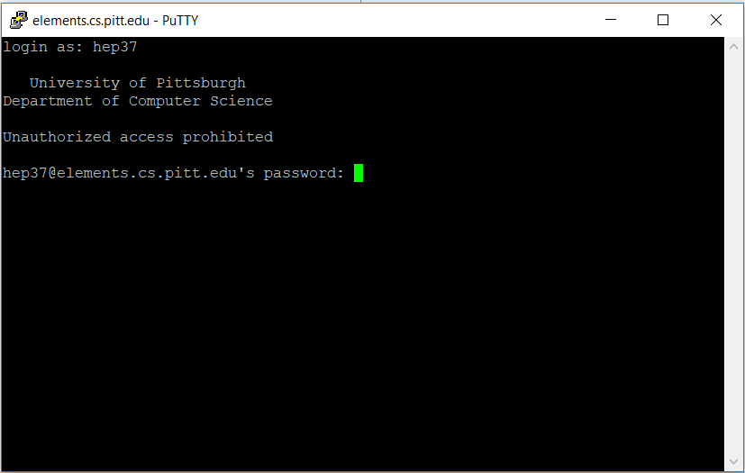
Windows - Putty
Download from www.putty.org

Slide 13
MacOS/Ubuntu - Terminal
Go to Applications > Utilities, and open Terminal.

Slide 14
MacOS/Ubuntu - Terminal
Go to Applications > Utilities, and open Terminal.
henrique in ~home-laptop->$

Slide 15
MacOS/Ubuntu - Terminal
Go to Applications > Utilities, and open Terminal.
henrique in ~home-laptop->$ ssh user@IPaddress:port

Slide 16
MacOS/Ubuntu - Terminal
Go to Applications > Utilities, and open Terminal.
henrique in ~home-laptop->$ ssh user@IPaddress:port
call ssh command
on this IP:Port
server address:
elements.cs.pitt.edu at port 22

Slide 17
MacOS/Ubuntu - Terminal
Go to Applications > Utilities, and open Terminal.
henrique in ~home-laptop->$ ssh hep37@thoth.cs.pitt.edu:22
call ssh command
on this IP:Port

Slide 18
MacOS/Ubuntu - Terminal
Go to Applications > Utilities, and open Terminal.
henrique in ~home-laptop->$ ssh hep37@thoth.cs.pitt.edu:22
University of Pittsburgh
Department of Computer Science
Unauthorized access prohibited
hap44@elements.cs.pitt.edu's password:
Just type and press enter, no cursor will show

Slide 19
Basic Linux Shell commands
Once into a elements machine
Read, create directories and files
Compile C/C++ code
Whatever program/service you install or the OS already offers

Slide 20
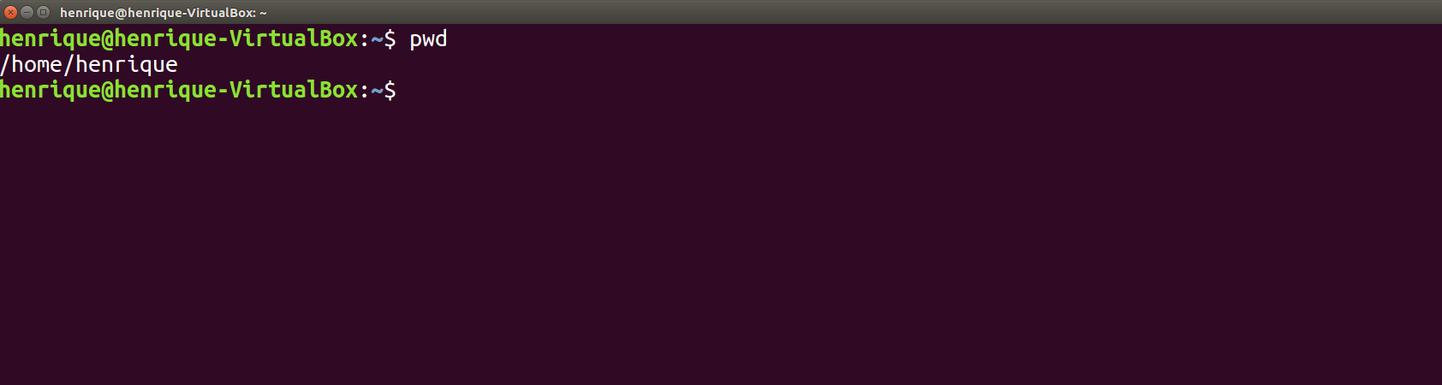
Basic Linux Shell commands
Check Current Directory - pwd

Slide 21
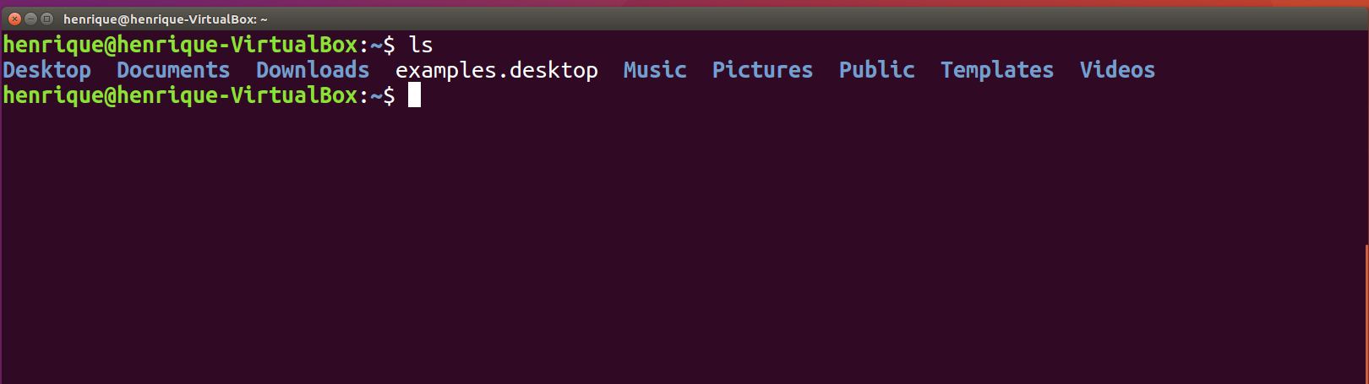
Basic Linux Shell commands
List directories - ls

Slide 22
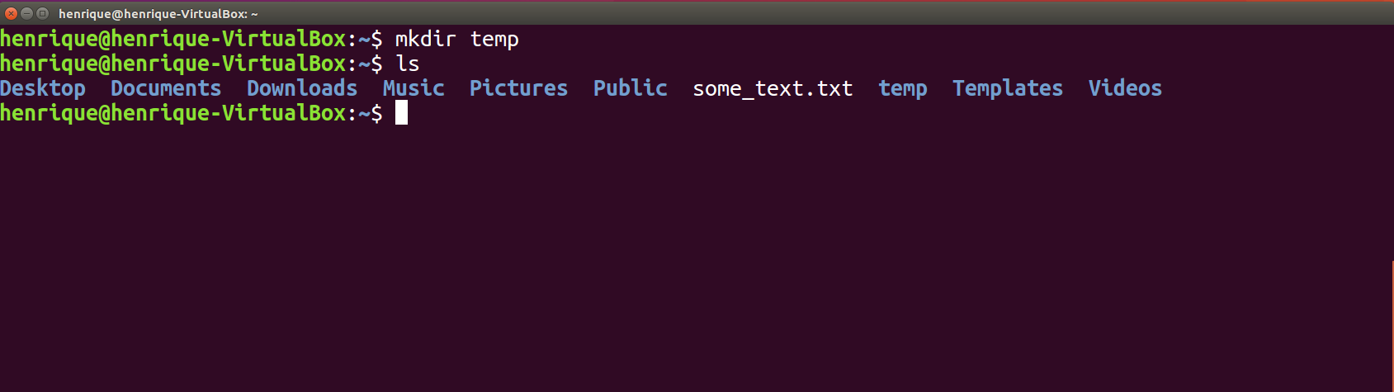
Basic Linux Shell commands
Create/Remove directory – mkdir/rmdir

Slide 23
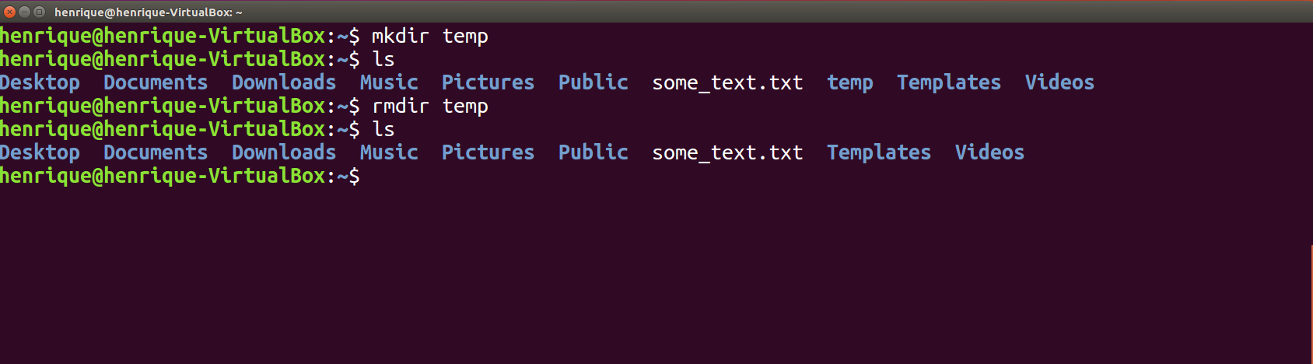
Basic Linux Shell commands
Create/Remove directory – mkdir/rmdir

Slide 24
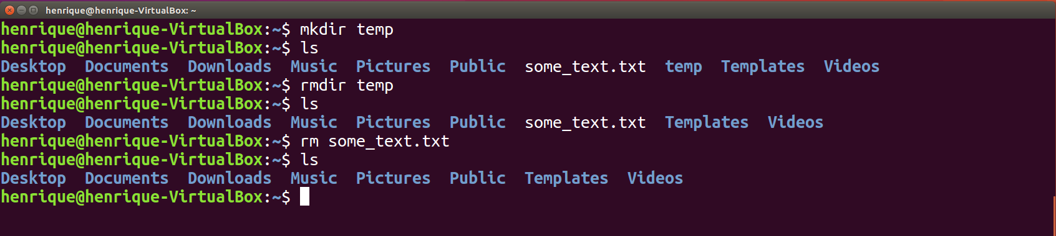
Basic Linux Shell commands
Remove files – rm

Slide 25
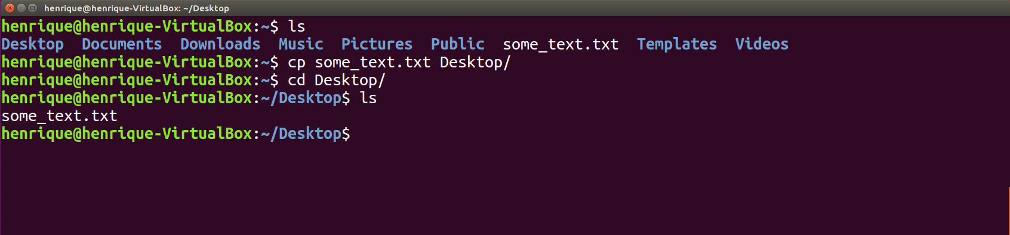
Basic Linux Shell commands
Copy files from anywhere to anywhere – cp
From here
to here

Slide 26
Basic Linux Shell commands
Move files from anywhere to anywhere – mv
mv <current path> <new path>
mv some_text.txt Desktop/

Slide 27
Environment variables
Environment variables can hold textual information stored within the system that can be used by OS programs
env – Lists all of the environment variables in the shell
printenv – Prints all (if no environment variable is specified) of environment variables and definitions of the current environment
export – Assigns or defines an environment variable
unset – Deletes the environment variable

Slide 28
The Makefile
Small programs
single file

Slide 29
The Makefile
Small programs (easy to compile)
single file
~home-laptop->$ gcc main.c –o calculator

Slide 30
The Makefile
Small programs (easy to compile)
single file
Bigger programs
multiple files
main.c
sum.c
sum.h

Slide 31
The Makefile
calculator (exe)

Slide 32
The Makefile
calculator (exe)
main.c
sum.h
sum.c
sum.h

Slide 33
The Makefile
calculator (exe)
main.o
sum.o
main.c
sum.h
sum.c
sum.h

Slide 34
The Makefile
calculator (exe)
main.o
sum.o
main.c
sum.h
sum.c
sum.h

Slide 35
The Makefile
calculator: main.o sum.o
gcc –o calculator main.o sum.o

Slide 36
The Makefile
calculator: main.o sum.o
gcc –o calculator main.o sum.o
main.o: main.c sum.h
gcc –c main.c

Slide 37
The Makefile
calculator: main.o sum.o
gcc –o calculator main.o sum.o
main.o: main.c sum.h
gcc –c main.c
sum.o: sum.c sum.h
gcc –c sum.c

Slide 38
The Makefile
calculator: main.o sum.o
gcc –o calculator main.o sum.o
main.o: main.c sum.h
gcc –c main.c
sum.o: sum.c sum.h
gcc –c sum.c

Slide 39
The Makefile
sum: main.o sum.o
gcc –o sum main.o sum.o
calculator (exe)
main.o
sum.o
main.c
sum.h
sum.c
sum.h
main.o: main.c sum.h
gcc –c main.c
sum.o: sum.c sum.h
gcc –c sum.c

Slide 40
The Makefile
Running “make”
~home-laptop->$ make calculator

Slide 41
The Makefile
calculator: main.o sum.o
gcc –o calculator main.o sum.o
main.o: main.c sum.h
gcc –c main.c
sum.o: sum.c sum.h
gcc –c sum.c
clean:
-rm -f *.o

Slide 42
The Makefile
Running “make”
~home-laptop->$ make clean

Slide 43
GUI based FTP Clients
FileZilla – Windows/MacOS
Copy files with drag and drop
Create directories
Delete files

Slide 44
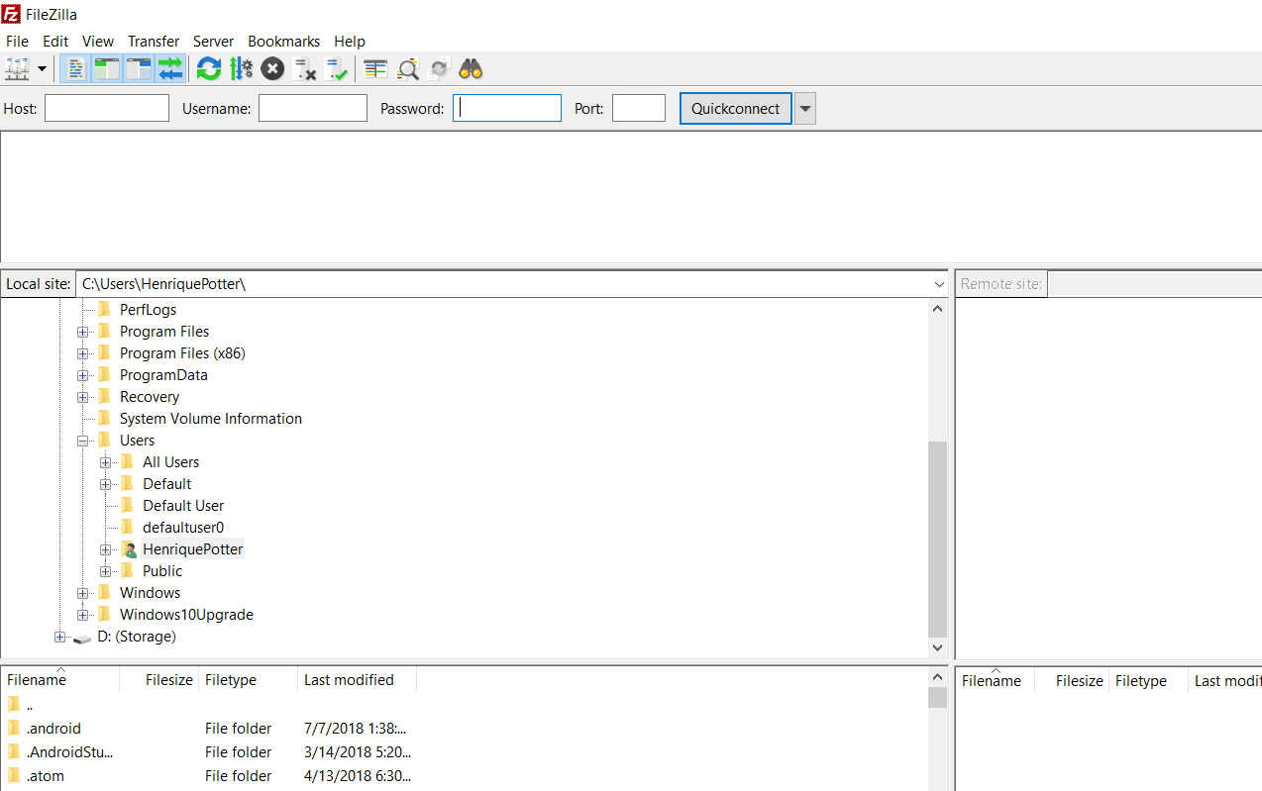
GUI based FTP Clients

Slide 45
GUI based FTP Clients

Slide 46
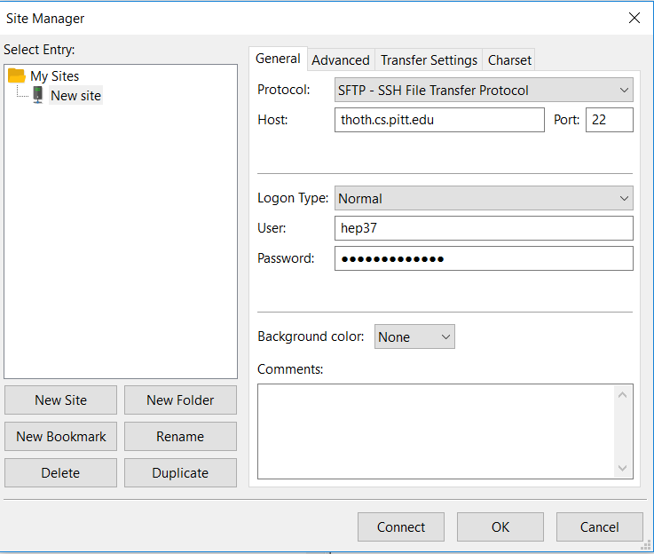
GUI based FTP Clients

Slide 47
GUI based FTP Clients
Select SFTP

Slide 48
GUI based FTP Clients
Select SFTP
Use thoth.cs.pitt.edu

Slide 49
GUI based FTP Clients
Select SFTP
Use thoth.cs.pitt.edu
Select normal Logon

Slide 50
GUI based FTP Clients
Select SFTP
Use thoth.cs.pitt.edu
Select normal Logon
Select Connect

Slide 51
CS 1550
Lab 1 – Linux/Shell
Basic commands Introduction
Teaching Assistant
Maher Khan
(Slides credited to Henrique Potter)

