Slide 1

CS 1550
Lab 2 – xv6 Introduction
Setup and exercise
Teaching Assistant
Maher Khan
(Slides credited to Henrique Potter)

Slide 2
Recitation TA – Office Hours
Tuesday
2:00pm - 5:00pm
Friday
1:00pm – 4:00pm
Office: SenSq 5802

Slide 3

Slides on GitHub!
https://github.com/maher460/Pitt_CS1550_recitation_materials

Slide 4

CS 1550 – Kernel Space vs User Space
OS manages hardware, services and user processes
CPU
Memory (Address space)
I/O devices (Disk, mouse, video card, sound, network, etc.)
Operating System
Hardware

Slide 5
CS 1550 – Kernel Space vs User Space
OS manages hardware, services and user processes
CPU
Memory (Address space)
I/O devices (Disk, mouse, video card, sound, network, etc.)
User program
Operating System
Hardware

Slide 6
CS 1550 – Kernel Space vs User Space
OS is just another software
User program
Operating System
Hardware

Slide 7
CS 1550 – Kernel Space vs User Space
OS is just another software
User applications should not change the kernel(OS software)
User program
Operating System
Hardware

Slide 8
CS 1550 – Kernel Space vs User Space
User space
Less privileged memory space where user processes execute
Kernel space
Privileged memory space where the OS main process resides
No User application should be able to change

Slide 9
CS 1550 – Kernel Space vs User Space
User space
Less privileged memory space where user processes execute
Kernel space
Privileged memory space where the OS main process resides
No User application should be able to change
User Space
Kernel Space
Hardware

Slide 10
CS 1550 – Kernel Space vs User Space
System Call
User processes have to do system calls to access the OS resources and Hardware
User Space
User process 3
User process 1
User process 2

Slide 11
CS 1550 – Kernel Space vs User Space
System Call
User processes have to do system calls to access the OS resources and Hardware
User Space
User process 3
User process 1
User process 2
System calls

Slide 12
CS 1550 – Kernel Space vs User Space
System Call
User processes have to do system calls to access the OS resources and Hardware
User Space
Kernel Space
User process 3
OS process
User process 1
User process 2
System calls

Slide 13
CS 1550 – Kernel Space vs User Space
System Call (OS function)
User processes have to do system calls to access the OS resources and Hardware
User Space
Kernel Space
Hardware
User process 3
OS process
CPU
User process 1
User process 2
I/O devices
System calls
Device
Driver

Slide 14
System Call - exercise

Slide 15
CS 1550 – xv6
Simple Unix-like teaching operating system from MIT
Provides basic services to running programs
xv6

Slide 16
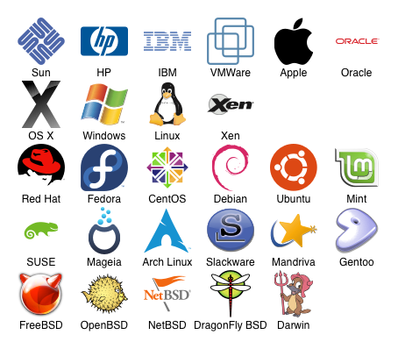

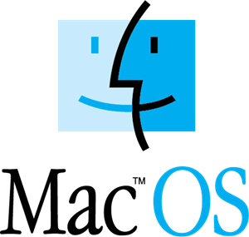


CS 1550 – Unix is everywhere
Most operating systems are based on Linux

Slide 17
CS 1550 – xv6
Simple Unix-like teaching operating system from MIT
Has a subset of traditional system calls
fork() Create process
exit() Terminate current process
wait() Wait for a child process
kill(pid) Terminate process pid
getpid() Return current process’s id sleep(n)
Sleep for n time units exec(filename, *argv)
Load a file and execute it sbrk(n)
….
Notes:
No network capabilities

Slide 18
CS 1550 – xv6
Compile and Run xv6 in a cs pitt server
Since it is an OS how can we run it?
xv6
Run where?
Notes:
If xv6 is a OS where can we run it?

Slide 19
CS 1550 – xv6
Compile and Run xv6 in a cs pitt server
xv6
Run where?
Notes:
If xv6 is a OS where can we run it?

Slide 20
CS 1550 – xv6
Compile and Run xv6 in a cs pitt server
xv6

Slide 21
CS 1550 – xv6
Compile and Run xv6 in a cs pitt server
PC hardware Emulator
(Virtual Machine)
xv6

Slide 22
CS 1550 – xv6
Compile and Run xv6 in a cs pitt server
PC hardware Emulator
(Virtual Machine)
xv6
Remote server
linux.cs.pitt.edu

Slide 23


CS 1550 – xv6
Compile and Run xv6 in a cs pitt server
Remote server
linux.cs.pitt.edu
PC hardware Emulator
(Virtual Machine)
xv6

Slide 24
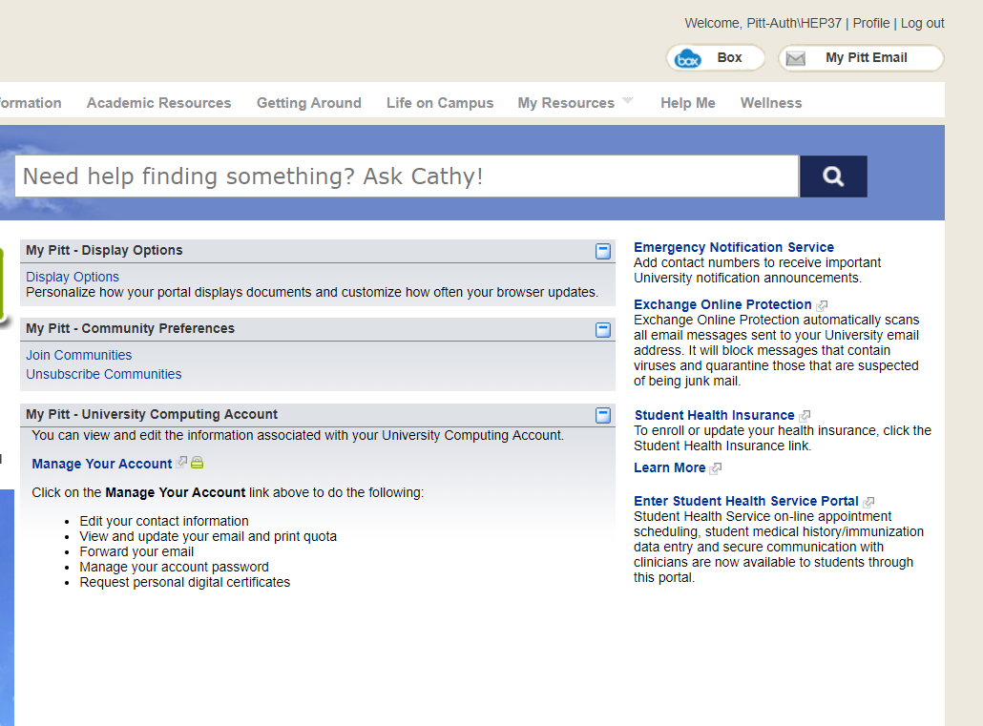
CS 1550 – Compile and Run xv6
Extend disk Quota, if you have less then 500mb free space
Log in to https://my.pitt.edu
Click on "Profile" at the top of the screen
Click on "Manage Your Account"
Click on "Manage Email Quota"
Click on "Increase My UNIX Quota"

Slide 25
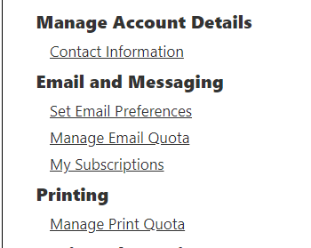
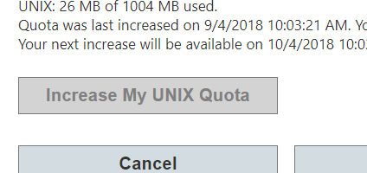
CS 1550 – Compile and Run xv6
Extend disk Quota, if you have less then 500mb free space
Log in to https://my.pitt.edu
Click on "Profile" at the top of the screen
Click on "Manage Your Account"
Click on "Manage Email Quota"
Click on "Increase My UNIX Quota"

Slide 26
CS 1550 – xv6
Connect to Pulse (campus VPN) first if connected to non-Pitt wifi.
Log in to linux.cs.pitt.edu
ssh user_name@linux.cs.pitt.edu
Use Terminal(MacOS/Ubunto)
Use Putty/Powershell (Windows)

Slide 27

CS 1550 – xv6
Go into the private folder
cd private
Download the xv6 source code from github
git clone git://github.com/mit-pdos/xv6-public.git

Slide 28
CS 1550 – xv6
Go into the cloned xv6 source code folder
cd xv6-public
Compile and run the code with
make qemu-nox

Slide 29
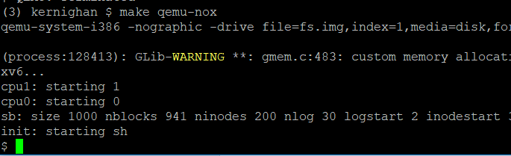
CS 1550 – xv6

Slide 30
CS 1550 – xv6
Compile and run the code with
make qemu-nox
Compiles and run xv6 with qemu

Slide 31
CS 1550 – xv6
Compile and Run xv6 in a cs pitt server
Remote server
linux.cs.pitt.edu
PC hardware Emulator
(Virtual Machine)
xv6

Slide 32
CS 1550 – xv6
Compile and Run xv6 in a cs pitt server
Remote server
linux.cs.pitt.edu
PC hardware Emulator
(Virtual Machine)
xv6

Slide 33
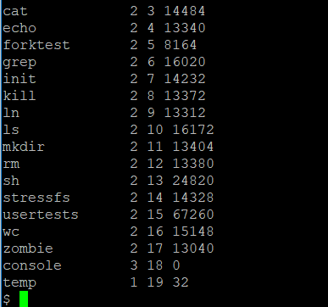
CS 1550 – xv6
Once in xv6 you can call ls

Slide 34
Exiting xv6
To exit xv6:
Control+a
Then, x

Slide 35
My xv6 Github
Before you start changing the code, it’s better to have the code accessible through your own private GitHub repository.
Go to www.github.com
Create an account if you don’t have one already, otherwise login.
Create a new repository

Slide 36
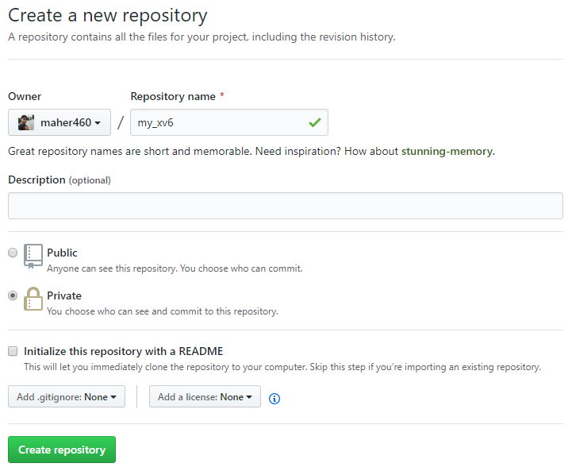

Slide 37
My xv6 Github
Inside the xv6-public folder in linux.cs.pitt.edu machine:
Set the git remote URL to your newly created private repo
git remote set-url origin https://github.com/maher460/my_xv6.git
Next you will have to remove a tag from your local git in order to avoid a pointer conflict:
git tag –d master
Now, we are ready to push all the code to the private repo!
git push –u origin master
Check your private GitHub repo to make sure all the code is there.

Slide 38
My xv6 GitHub
You want to clone the GitHub repo to your own local machine
In your Terminal/PowerShell (in a new window/tab to keep the ssh of linux.cs.pitt.edu still running):
git clone https://github.com/maher460/my_xv6.git
Now, you can use your favourite IDE to code and upload all the changes to your private git:
git add –A
git commit –m “comment about the changes you made”
git push
Pull all the uploaded changes in the linux.cs.pitt.edu:
git pull

Slide 39
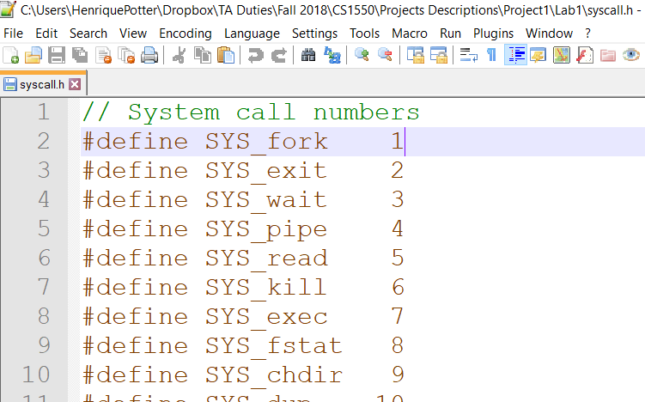
CS 1550 – xv6 – Adding a custom Syscall
First we need to define our new call and its number at
syscall.h

Slide 40
CS 1550 – xv6 – Adding a custom Syscall
First we need to define our new call and its number at
syscall.h
Add
#define SYS_getday 22

Slide 41
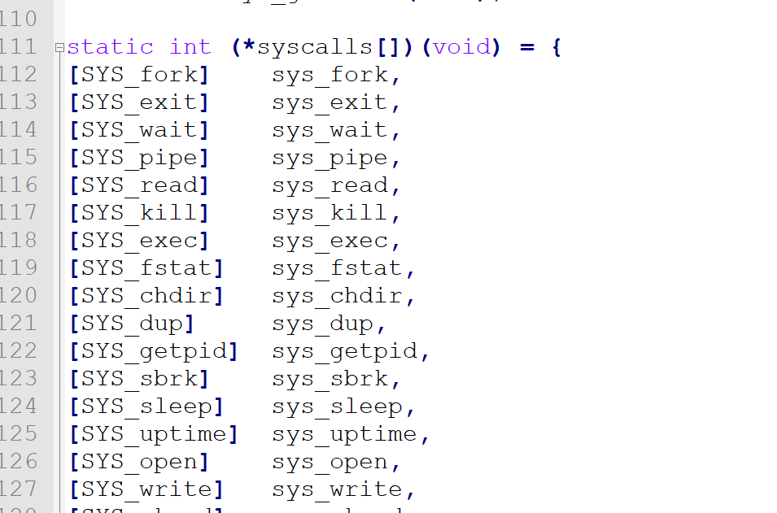
CS 1550 – xv6 – Adding a custom Syscall
Next we need to map the new call in the array pointer of system calls
syscall.c
Add
[SYS_getday] sys_getday,

Slide 42
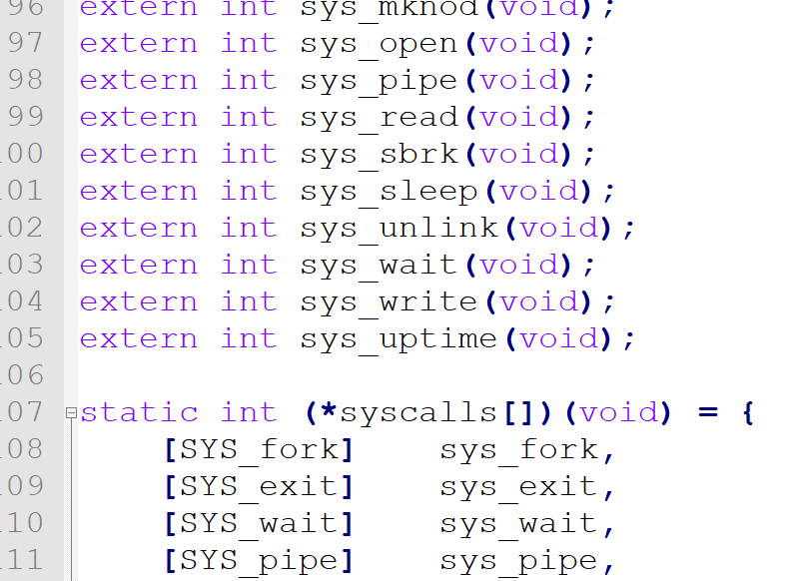
CS 1550 – xv6 – Adding a custom Syscall
Next we need to map the new call in the array pointer of system calls
syscall.c
Add
extern int sys_getday(void);

Slide 43
CS 1550 – xv6 – Adding a custom Syscall
Then we need to implement the actual method
In xv6 this is organized in two files.
sysfile.c -> file related system calls
sysproc.c -> all the other syscalls

Slide 44
CS 1550 – xv6 – Adding a custom Syscall
Then we need to implement the actual method
In xv6 this is organized in two files.
sysfile.c -> file related system calls
sysproc.c -> all the other syscalls

Slide 45
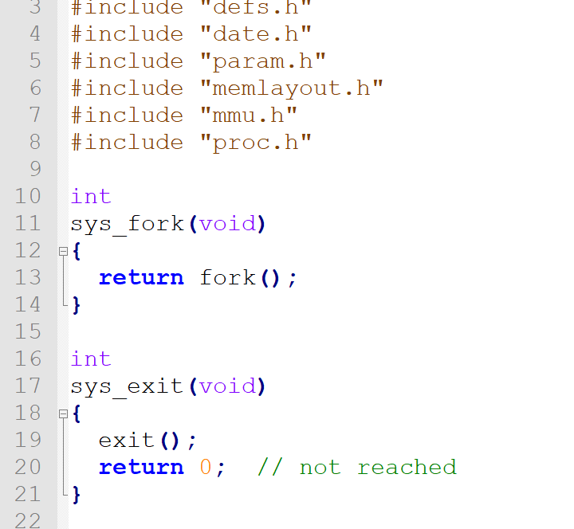
CS 1550 – xv6 – Adding a custom Syscall
Then we need to implement the actual method
In xv6 this is organized in two files.
sysfile.c -> file related system calls
sysproc.c -> all the other syscalls

Slide 46
CS 1550 – xv6 – Adding a custom Syscall
Then we need to implement the actual method
In xv6 this is organized in two files.
sysfile.c -> file related system calls
sysproc.c -> all the other syscalls
Add the following to sysproc.c:
int
sys_getday(void)
{
return 6;
}

Slide 47
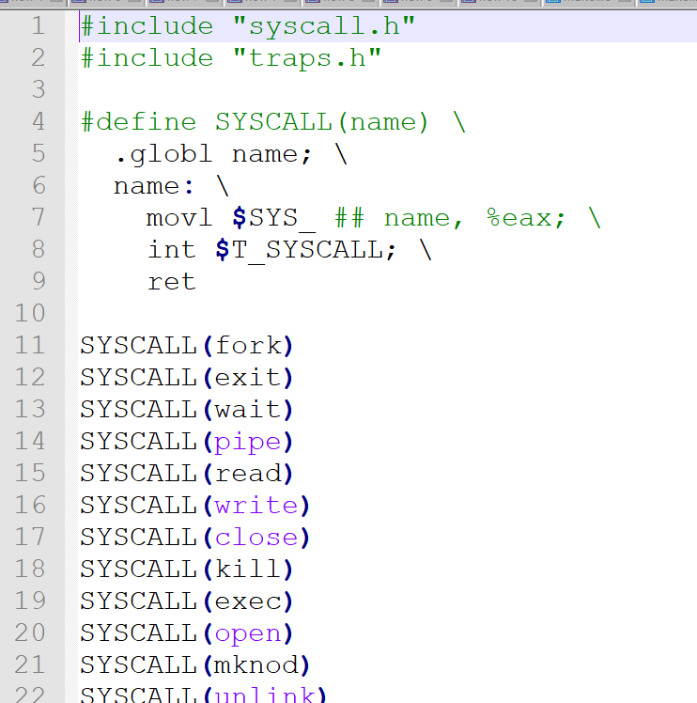
CS 1550 – xv6 – Adding a custom Syscall
Afterwards we define the interface for user programs to call
Open usys.S
Add
SYSCALL(getday)

Slide 48
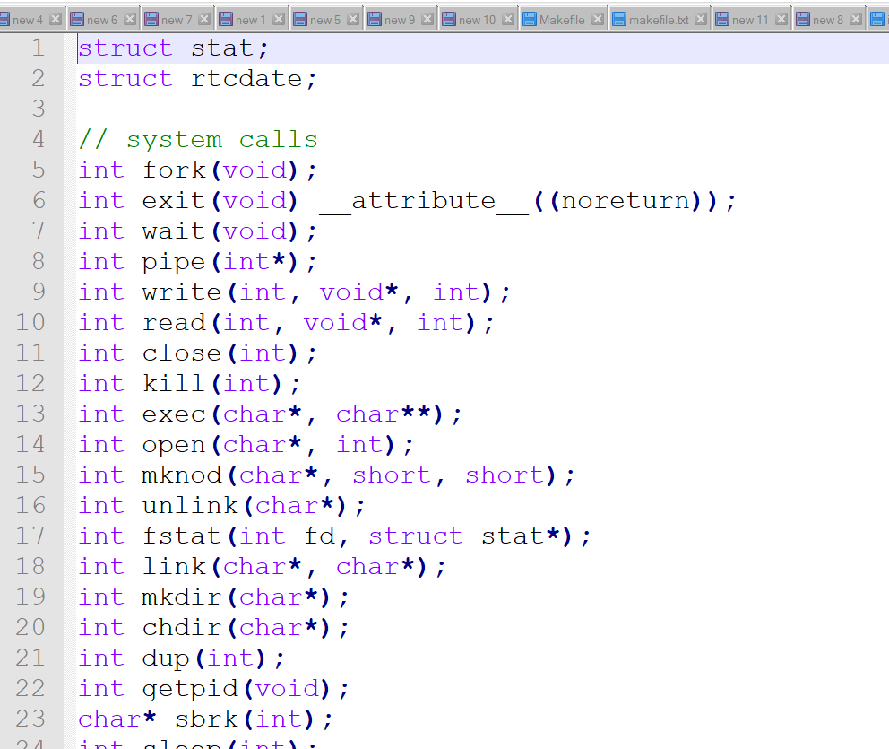
CS 1550 – xv6 – Adding a custom Syscall
Finally we open
user.h
Add
int getday(void);

Slide 49
CS 1550 – xv6 – Adding a custom Syscall
Example user program
todays_date.c
#include "types.h"
#include "stat.h"
#include "user.h"
int main(void) {
printf(1, "Today is %d\n", getday());
exit();
}

Slide 50
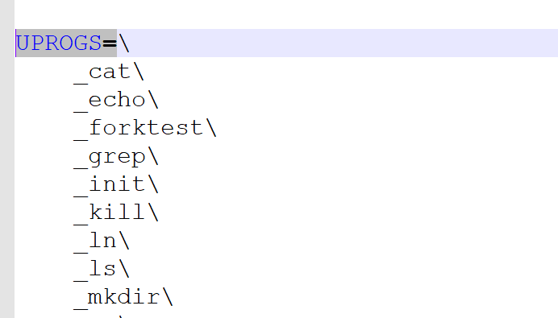
CS 1550 – xv6 – Adding a custom Syscall
Adding an user program
Open makefile
Add
_todays_date\

Slide 51
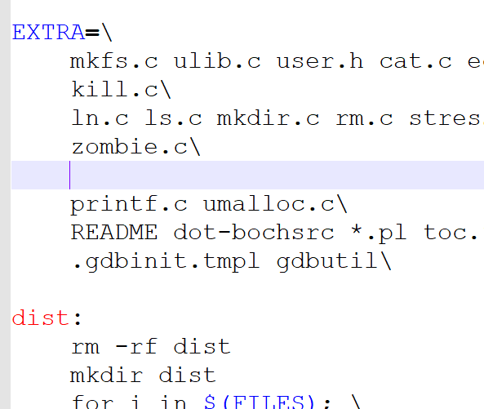
CS 1550 – xv6 – Adding a custom Syscall
Adding an user program
Open makefile
and also add
todays_date.c\

Slide 52
CS 1550 – xv6 – Done!
Now, you can fire up your ssh to linux.cs.pitt.edu, then:
git pull
make qemu-nox
todays_date (run this inside the xv6)
You get this slide and code at :
https://github.com/maher460/Pitt_CS1550_recitation_materials

Slide 53
CS 1550 – Project
Due: Wednesday, September 19, 2018
Late: Friday, September 21, 2018
10% reduction per late day

Slide 54
CS 1550
Lab 2 – xv6 Introduction
Setup and exercise
Teaching Assistant
Maher Khan
(Slides credited to Henrique Potter)

