Slide 1

CS 1550
Week 7 – Priority Scheduling with xv6
Teaching Assistant
Maher Khan

Slide 2
Scheduling of processes
Switch processes during their execution.
Currently, processes run in Round Robin inside your XV6
CPU
P1
P2
P3
P1
P2
Time

Slide 3
Scheduling of processes
Switch processes during their execution.
Currently, processes run in Round Robin inside your XV6
CPU
P1
P2
P3
P1
P2
Time
What is the little gap?

Slide 4
Scheduling of processes
Switch processes during their execution.
Currently, processes run in Round Robin inside your XV6
CPU
P1
P2
P3
P1
P2
Time
What is the little gap?
The OS Scheduler is called when a timer interrupt occurs, and the kernel calls yield

Slide 5
Priority scheduling of processes
What if processes have different priorities?
CPU
P1
P2
P3
P1
P2
Time
Medium priority
Low priority
High priority

Slide 6
Priority scheduling of processes
Is this a better arrangement of processes? Can we do better?
CPU
P2
P3
P1
P2
P1
Time
Medium priority
Low priority
High priority

Slide 7
Priority scheduling of processes
Let all the higher priority processes finish before moving to lower priority ones
CPU
P2
P2
P3
P1
P1
Time
Medium priority
Low priority
High priority

Slide 8
Priority scheduling of processes
Even better: Don’t yield if the current process is the only one of its priority!
This is the bonus part of your lab!
CPU
P2
P3
P1
Time
Medium priority
Low priority
High priority

Slide 9
Processes with same priorities
What if different processes have the same priorities?
CPU
P1
P2
P3
P4
P5
Time
Priority: 0
Priority: 2
Priority: 1
Priority: 0
Priority: 2

Slide 10
Processes with same priorities
Group processes with the same priorities together!
CPU
P2
P4
P5
P1
P3
Time
Priority: 0
Priority: 0
Priority: 1
Priority: 2
Priority: 2

Slide 11
Processes with same priorities
Processes with same priority should run in Round Robin!
Round Robin part 1
Round Robin part 2
Round Robin part 3
CPU
P2
P4
P2
P4
P2
P5
P5
P5
P1
P3
P1
P3
P3
Time
Priority: 0
Priority: 1
Priority: 2

Slide 12
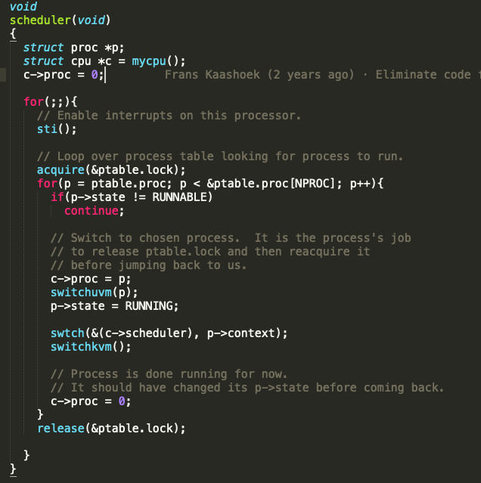
The scheduler function
Per-CPU process scheduler.
Each CPU calls scheduler() after setting itself up.
Scheduler never returns. It loops, doing:
choose a process to run
call swtch() to start running that process
eventually that process transfers control
via swtch back to the scheduler.
P1
P2
a(pt_lock)
Sched()
r(pt_lock)
a(pt_lock)
Sched()
r(pt_lock)
In proc.c

Slide 13
The scheduler function
Per-CPU process scheduler.
Each CPU calls scheduler() after setting itself up.
Scheduler never returns. It loops, doing:
choose a process to run
call swtch() to start running that process
eventually that process transfers control
via swtch back to the scheduler.
P1
P2
a(pt_lock)
Sched()
r(pt_lock)
a(pt_lock)
Sched()
r(pt_lock)
In proc.c

Slide 14
The scheduler function
Per-CPU process scheduler.
Each CPU calls scheduler() after setting itself up.
Scheduler never returns. It loops, doing:
choose a process to run
call swtch() to start running that process
eventually that process transfers control
via swtch back to the scheduler.
P1
P2
a(pt_lock)
Sched()
r(pt_lock)
a(pt_lock)
Sched()
r(pt_lock)
In proc.c

Slide 15
The scheduler function
Per-CPU process scheduler.
Each CPU calls scheduler() after setting itself up.
Scheduler never returns. It loops, doing:
choose a process to run
call swtch() to start running that process
eventually that process transfers control
via swtch back to the scheduler.
P1
P2
a(pt_lock)
Sched()
r(pt_lock)
a(pt_lock)
Sched()
r(pt_lock)
In proc.c

Slide 16
The scheduler function
Per-CPU process scheduler.
Each CPU calls scheduler() after setting itself up.
Scheduler never returns. It loops, doing:
choose a process to run
call swtch() to start running that process
eventually that process transfers control
via swtch back to the scheduler.
P1
P2
a(pt_lock)
Sched()
r(pt_lock)
a(pt_lock)
Sched()
r(pt_lock)
In proc.c

Slide 17
The scheduler function
Per-CPU process scheduler.
Each CPU calls scheduler() after setting itself up.
Scheduler never returns. It loops, doing:
choose a process to run
call swtch() to start running that process
eventually that process transfers control
via swtch back to the scheduler.
P1
P2
a(pt_lock)
Sched()
r(pt_lock)
a(pt_lock)
Sched()
r(pt_lock)
In proc.c

Slide 18
The scheduler function
Per-CPU process scheduler.
Each CPU calls scheduler() after setting itself up.
Scheduler never returns. It loops, doing:
choose a process to run
call swtch() to start running that process
eventually that process transfers control
via swtch back to the scheduler.
P1
P2
a(pt_lock)
Sched()
r(pt_lock)
a(pt_lock)
Sched()
r(pt_lock)
In proc.c

Slide 19
The scheduler function
Per-CPU process scheduler.
Each CPU calls scheduler() after setting itself up.
Scheduler never returns. It loops, doing:
choose a process to run
call swtch() to start running that process
eventually that process transfers control
via swtch back to the scheduler.
P1
P2
a(pt_lock)
Sched()
r(pt_lock)
a(pt_lock)
Sched()
r(pt_lock)
In proc.c

Slide 20
The scheduler function
Per-CPU process scheduler.
Each CPU calls scheduler() after setting itself up.
Scheduler never returns. It loops, doing:
choose a process to run
call swtch() to start running that process
eventually that process transfers control
via swtch back to the scheduler.
P1
P2
a(pt_lock)
Sched()
r(pt_lock)
a(pt_lock)
Sched()
r(pt_lock)
In proc.c

Slide 21
The scheduler function
Per-CPU process scheduler.
Each CPU calls scheduler() after setting itself up.
Scheduler never returns. It loops, doing:
choose a process to run
call swtch() to start running that process
eventually that process transfers control
via swtch back to the scheduler.
P1
P2
a(pt_lock)
Sched()
r(pt_lock)
a(pt_lock)
Sched()
r(pt_lock)
In proc.c

Slide 22
The scheduler function
Per-CPU process scheduler.
Each CPU calls scheduler() after setting itself up.
Scheduler never returns. It loops, doing:
choose a process to run
call swtch() to start running that process
eventually that process transfers control
via swtch back to the scheduler.
P1
P2
a(pt_lock)
Sched()
r(pt_lock)
a(pt_lock)
Sched()
r(pt_lock)
In proc.c

Slide 23
The scheduler function
Per-CPU process scheduler.
Each CPU calls scheduler() after setting itself up.
Scheduler never returns. It loops, doing:
choose a process to run
call swtch() to start running that process
eventually that process transfers control
via swtch back to the scheduler.
P1
P2
a(pt_lock)
Sched()
r(pt_lock)
a(pt_lock)
Sched()
r(pt_lock)
In proc.c

Slide 24
The scheduler function
Per-CPU process scheduler.
Each CPU calls scheduler() after setting itself up.
Scheduler never returns. It loops, doing:
choose a process to run
call swtch() to start running that process
eventually that process transfers control
via swtch back to the scheduler.
P1
P2
a(pt_lock)
Sched()
r(pt_lock)
a(pt_lock)
Sched()
r(pt_lock)
In proc.c

Slide 25
The scheduler function
Per-CPU process scheduler.
Each CPU calls scheduler() after setting itself up.
Scheduler never returns. It loops, doing:
choose a process to run
call swtch() to start running that process
eventually that process transfers control
via swtch back to the scheduler.
P1
P2
a(pt_lock)
Sched()
r(pt_lock)
a(pt_lock)
Sched()
r(pt_lock)
In proc.c

Slide 26
The scheduler function
Per-CPU process scheduler.
Each CPU calls scheduler() after setting itself up.
Scheduler never returns. It loops, doing:
choose a process to run
call swtch() to start running that process
eventually that process transfers control
via swtch back to the scheduler.
P1
P2
a(pt_lock)
Sched()
r(pt_lock)
a(pt_lock)
Sched()
r(pt_lock)
In proc.c

Slide 27
The scheduler function
Per-CPU process scheduler.
Each CPU calls scheduler() after setting itself up.
Scheduler never returns. It loops, doing:
choose a process to run
call swtch() to start running that process
eventually that process transfers control
via swtch() back to the scheduler.
P1
P2
a(pt_lock)
Sched()
r(pt_lock)
a(pt_lock)
Sched()
r(pt_lock)
In proc.c

Slide 28

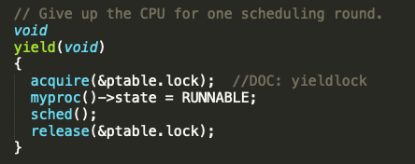
Yield in trap
Force process to give up CPU on clock tick.
IRQ stands for Interrupt Requests
The timer interrupt occurs after the current process’s quantum is over
The kernel takes over and calls yield() in the trap.c
Yield() acquires ptable lock and then calls sched()
In trap.c:
In proc.c:

Slide 29
Lab 3 is out!
Due: 11:59 PM Friday (March 8th )

Slide 30
CS 1550
Week 7 – Priority Scheduling with xv6
Teaching Assistant
Maher Khan

