Slide 1

Programme B.Tech
Course Code – BCSE497J
Adaptive Per-Patient Gesture and Gaze Control with Continuous Cardiac and Neural Monitoring
Team members:
Adithiya S R (23BDS0045)
Raaj Akshit R (23BCE2136)
Aadhithya A (23BAI0048)
Faculty guide :
GUNAVATHI C

Slide 2
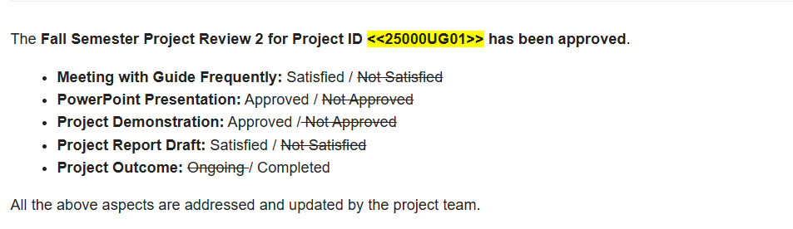
Approval Mail From Guide
Get the approval for the following points from your guide through mail before 01-09-2026.(sample attached below)

Slide 3
Aim
To build a hands-free assistive system that lets bedridden patients control their environment through hand gestures and eye gaze, where the recognition adapts to each individual patient over time, while cardiac signals are monitored continuously and independently in the background.

Slide 4
Abstract
Bedridden and mobility-limited patients cannot reliably use switches, apps or voice control. This project delivers a working vision-based assistive system in which a webcam drives face authentication, hand-gesture recognition and gaze recognition, and every recognised command must survive a 3-second continuous hold before it executes.
Validated commands are sent over serial to an ESP32, which drives a fan through an L298N driver, two indicator lights and an emergency buzzer. Gaze dwell generates caregiver requests (water, nurse assistance) that appear on a multi-patient caregiver dashboard alongside live video, device states, patient state and an event log persisted in SQLite.
An AD8232 ECG pathway runs on its own thread, fully independent of the camera: acquisition, signal-quality assessment and filtering continue even if the vision pipeline fails.
The system is built so that per-patient continual learning (EWC, replay) can be added on the existing base-model interface without redesign, which is the research contribution to be evaluated next.

Slide 5
Literature Review
Paper | Objective | Methodology | Pros / Cons | Findings
1. Lightweight and Interpretable Edge Intelligence AI with Intrusion Detection for Trustworthy Cardiac Arrhythmia in Medical IoT (CLARITY-AI 2.0) | Detect heart rhythm problems on a small device, explain the decision, and stay safe from network attacks. | Small feature-based model. SHAP explains the output; an LLM turns it into plain English for clinicians. Tested on an ESP32 chip. | + Combines explanation, small size and security. + Turns explanations into readable text, useful for our caregiver dashboard. − SHAP is added after training, so it is slow. | Achieved 92.8% F1-score with low memory and fast processing, making it suitable for real-time edge devices.
2. xECGArch: A Trustworthy Deep Learning Architecture for Interpretable ECG Analysis Considering Short-Term and Long-Term Features | Build an ECG model whose design itself shows which part of the signal it is using. | Two CNNs — one reads a single heartbeat, one the whole 10-second rhythm. 13 explanation methods compared on 4 databases. | + The split design is itself an explanation. + The 13-method comparison tells us which explainer to pick. − Only detects atrial fibrillation. | Reached 95.43% F1-score and showed that the choice of explanation method greatly affects interpretability.
3. EXGnet: An Explainable Artificial Intelligence Framework for Trustworthy Arrhythmia Detection from Heart Rhythm Data | Get accuracy and explainability together, without adding a separate tool after training. | Trained to explain itself via an attention-based loss. Relevance regions are derived automatically from heart-rate variability, with no manual labelling. | + Explanation built in during training. + Needs no hand-marked regions, important for us, as we have no clinician annotators. − Single-lead ECG only. | Achieved 98.76% and 96.93% accuracy on two datasets, proving that built-in explainability can improve performance.
4. ProtoECGNet: Case-Based Interpretable Deep Learning for Multi-Label ECG Classification with Contrastive Learning | Explain a decision by showing a real past recording that looks similar, instead of a heatmap. | Three prototype branches — rhythm, shape, abnormality. Every prototype is a real ECG segment. | + The explanation is an actual signal a person can read. + Prototypes suit per-patient storage, which fits our personalisation design. − Still a preprint. | Prototype-based explanations were effective and can support personalized ECG interpretation.
21-07-2026
SCOPE
Notes:
Papers 1-4: interpretable cardiac monitoring.
Numbers worth knowing: CLARITY-AI 8.1 ms / 350 KB / F1 0.928. xECGArch F1 95.43%. EXGnet 98.76%.
Paper 3 matters most for us practically: it derives its explanation regions automatically from heart-rate variability, so it needs no clinician to mark up training data. We have no annotators, so that is the approach we can actually copy.
Paper 4's prototypes are worth flagging - a prototype is stored per patient, which fits our personalisation design naturally.

Slide 6
5. Exploration of an Intrinsically Explainable Self-Attention Based Model for Prototype Generation on Single-Channel EEG Sleep Stage Classification | Check whether a prototype-based explainable design built for ECG also works on brain signals. | Self-attention prototype model on single-channel EEG. Compared against EEGNet, a strong black box. Explanation quality scored with AOPC. | + Same accuracy as the black box, but explainable. + Shows one design can serve heart and brain signals our exact situation. − Time domain only. | Prototype-based explanations matched sleep stage patterns while maintaining high classification accuracy.
6. LightSeizureNet: A Lightweight Deep Learning Model for Real-Time Epileptic Seizure Detection | Run real-time seizure detection from raw EEG on a low-power wearable. | Dilated 1D convolutions, global average pooling and pruning. General and per-patient versions. Tested on CHB-MIT. | + Provides a per-patient variant directly relevant to our personalization. + Works from raw EEG, no hand-built features. − One dataset only. | Achieved real-time seizure detection with high accuracy and low computational cost, making it suitable for wearable devices.
7. Automated Stress Detection with Explainable-AI Transformer TabNet Technique and Physiological Signals | Detect stress from wearable signals, comparing built-in explanation directly against SHAP and LIME. | TabNet (self-explaining via attention) vs. SVM and XGBoost on four wearable datasets, using heart rate and skin conductance. | + Rare head-to-head test of built-in vs. added-on explanation. + Four datasets, so not a fluke. − Feature-based, not raw waveform. | TabNet outperformed traditional models while providing built-in explanations for its predictions.
8. Explainable Detection of Myocardial Infarction Using Deep Learning Models with Grad-CAM Technique on ECG Signals | Detect heart attacks from ECG and show which part of the signal caused the decision. | A CNN with Grad-CAM applied directly to the ECG waveform. | + The standard reference for Grad-CAM on physiological signals. + Simple to reproduce in our pipeline. − The heatmaps are coarse and blurry. | Grad-CAM highlighted important ECG regions but produced coarse explanations with limited precision.
21-07-2026
SCOPE
Notes:
Papers 5-8: the same ideas on brain and other signals.
Paper 5 is our transfer evidence: a design built for ECG worked on EEG with no accuracy loss. That is why we can monitor both channels with one approach.
Paper 6 has a per-patient variant - point to it when asked whether personalisation is established.
Paper 8 sets honest expectations for Grad-CAM: roughly right region, too coarse for fine reasoning.

Slide 7
Research Gap
What already exists
Vision-based gesture and gaze systems that control appliances.
Models tuned to an individual patient at enrolment, a one-time calibration.
Accurate cardiac monitoring.
What is missing
Assistive systems ship a fixed model. A patient's movement changes with recovery, fatigue or progressive illness, and the model silently becomes less accurate for exactly the users who can least afford it.
Continual learning is well studied for physiological signals but has not been applied to assistive vision-based control.
The gap
No assistive control system keeps adapting to the individual patient after deployment while retaining what it already learned, with cardiac monitoring running alongside.

Slide 8
Objectives
1. Build the hands-free control pipeline.
  Face authentication, hand-gesture and gaze recognition with a hold-time threshold to suppress involuntary movement, driving appliances through an embedded controller.
2. Make the model adapt to each patient continually.
  Enroll a base model per patient, then update it from their own interaction data using continual learning (EWC, replay and related methods).
3. Show that adapting does not erase earlier learning.
  Measure accuracy over time against a fixed-model baseline, and measure forgetting on earlier gestures after adaptation.
4. Monitor cardiac and neural signals in parallel.
  ECG for irregular heart activity running independently of the control path so a patient who cannot gesture is still monitored.
5. Explain decisions and alerts to the caregiver.
  Apply and compare explanation methods, reporting localization, fidelity and stability rather than presenting heatmaps alone.
21-07-2026
SCOPE
Notes:
Five objectives, each testable.
Objective 3 is the one that carries the paper. It commits you to reporting the forgetting rate even if the result is unflattering. Panels respect that.
Objective 5 is why the explanation papers are in the review - if asked, this is the link.
SDG boxes below: SDG 3 (Good Health and Well-being) primary; SDG 10 (Reduced Inequalities) fits the accessibility angle.

Slide 9

Identified Sustainable Goal Alignment:
SDG 3 — Good Health & Well-being
SDG 9 — Industry, Innovation & Infrastructure
Expected Outcomes :
Journal(Scopus)

Slide 10
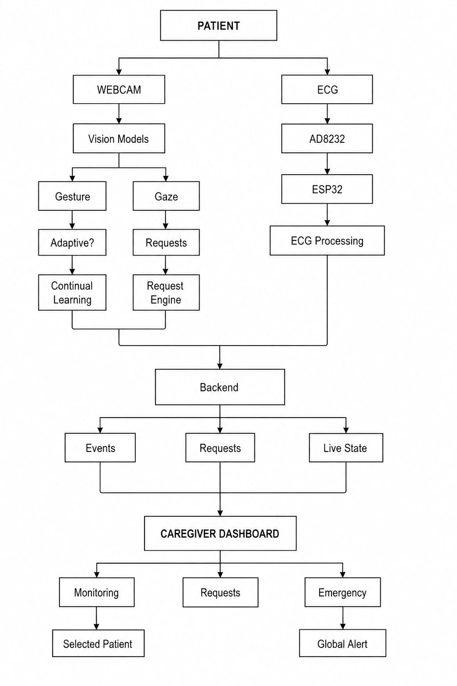
Framework/Architecture/Block Diagram

Slide 11
Functional Requirements
Authenticate the patient from the live camera and identify which registered patient is present; refuse unknown and ambiguous faces.
Execute a device command only after a recognised gesture is held continuously for 3.0 seconds of wall-clock time, and only once per hold.
Block every command when no registered patient is authenticated.
Generate a caregiver request after 2.0 seconds of stable gaze, and allow the same request to be raised again after returning to centre.
Raise a global emergency alert on a held closed fist, visible to the caregiver regardless of which patient they are viewing.
Acquire and assess ECG continuously, independently of the camera.
Show live camera, authentication state, device states, requests, patient state and ECG for a caregiver-selected patient among several.
Persist every authentication, gesture, gaze, request, device and emergency event with timestamp and patient identity.
Continue running when the ESP32, the camera or the ECG source is absent.

Slide 12
Modules
1. Face authentication — OpenCV LBPH over enrolled patients, with a distance threshold and a best-vs-runner-up margin so an unknown or ambiguous face is refused rather than assigned to the nearest patient.
2. Gesture recognition — MediaPipe hand landmarks, geometric classifier (thumbs up / thumbs down / victory / open palm / closed fist), all normalised by palm length.
3. Intent validation — elapsed-time 3-second hold, execute-once, require-release; authentication gate before any command.
4. Gaze control — MediaPipe face and iris landmarks, LEFT / CENTER / RIGHT with a 2-second dwell and re-arm through centre.
5. Command router and ESP32 interface — logical commands translated to the board's serial protocol; simulated backend for hardware-free testing.
6. ECG pathway — source abstraction (simulated / file / AD8232 serial), acquisition thread, rolling buffer, signal-quality gate, analyzer hook.
7. Caregiver dashboard — multi-patient selector, live MJPEG camera, global request board, global emergency alerts, device and ECG panels.
8. Event logging — SQLite store shared by both pathways.

Slide 13
Experiments and Results
Gesture hold (safety-critical) — execution requires 3.0 s of elapsed wall-clock time, verified FPS-independent at 45 and 60 FPS; a held gesture executes exactly once; releasing before 3 s cancels.
Closed-fist recognition — a real fist rests the thumb across the fingers, which the classifier read as thumbs-up. Separated using thumb-to-knuckle distance: measured 0.25–0.34 palm lengths for a fist against 0.73–2.06 for a thumbs-up. On 188 live frames the previous code was wrong 100% of the time; the corrected classifier is right 100% of the time.
ESP32 hardware — verified on the physical board over COM3 at 115200 baud: 13 of 13 commands acknowledged, fan, both lights and the emergency buzzer toggling as specified, with host and board device state agreeing.
ECG pathway — measured 249.9 Hz against a configured 250 Hz with 0 dropped samples over 18,179 samples; signal quality reported as VALID; analysis correctly reported NOT AVAILABLE (no trained model).
Pathway independence — ECG continues with the vision pipeline stopped, and gesture control continues with the ECG source failing.
Authentication — calibrated on the live camera (314 frames): the enrolled patient measures 58.8–79.1 distance while a different enrolled patient measures 44–57. The ranges overlap, so enrolment quality, not the threshold, is the limiting factor — recorded as future work.

Slide 14
Conclusion
A complete hands-free assistive control system has been built and verified end to end on real hardware: a registered patient is authenticated from the camera, a gesture held for 3 seconds drives the fan, lights or emergency alert through the ESP32, and a 2-second gaze dwell raises a caregiver request on a multi-patient dashboard.
ECG acquisition and signal-quality assessment run independently of the camera, and the analysis layer is deliberately left as an extension point — no cardiac finding is claimed without a validated model.
Safety behaviour is measured rather than asserted: the 3-second hold is elapsed-time and FPS-independent, unauthenticated users execute nothing, and a failed hardware write never reports a device as changed.
Remaining work — per-patient continual learning (EWC and replay) with forgetting measured against a fixed-model baseline; explainability evaluated on localization, fidelity and stability; improved face enrolment; and EEG integration once suitable hardware is available.

Slide 15
References
[1] "Lightweight and interpretable edge intelligence AI with intrusion detection for trustworthy cardiac arrhythmia in medical IoT," Scientific Reports, 2026, doi: 10.1038/s41598-026-43578-6.
[2] M. Goettling, A. Hammer, H. Malberg, and M. Schmidt, "xECGArch: a trustworthy deep learning architecture for interpretable ECG analysis considering short-term and long-term features," Scientific Reports, vol. 14, art. no. 13122, 2024, doi: 10.1038/s41598-024-63656-x.
[3] T. T. Showrav, S. I. Lincoln, and M. K. Hasan, "An explainable artificial intelligence framework for trustworthy arrhythmia detection from heart rhythm data," Healthcare Analytics, 2026, doi: https://doi.org/10.1016/j.health.2026.100455.
[4] "ProtoECGNet: Case-based interpretable deep learning for multi-label ECG classification with contrastive learning," arXiv preprint arXiv:2504.08713, 2025.
[5] "Exploration of an intrinsically explainable self-attention based model for prototype generation on single-channel EEG sleep stage classification," Scientific Reports, vol. 14, 2024, doi: 10.1038/s41598-024-79139-y.
[6] "LightSeizureNet: A lightweight deep learning model for real-time epileptic seizure detection," IEEE Journal of Biomedical and Health Informatics, 2022, PMID: 36417737.
[7] "Automated stress detection with explainable-AI transformer TabNet technique and physiological signals," Biomedical Signal Processing and Control, 2025.
[8] V. Jahmunah, E. Y. K. Ng, R.-S. Tan, S. L. Oh, and U. R. Acharya, "Explainable detection of myocardial infarction using deep learning models with Grad-CAM technique on ECG signals," Computers in Biology and Medicine, vol. 146, art. no. 105550, 2022, doi: 10.1016/j.compbiomed.2022.105550.

