Slide 1
ROAD DAMAGE DETECTION
Multi-Class Road Damage Detection & Cross-Regional
Generalization Analysis Using Deep Neural Networks
BCSE332L — Deep Learning — Course-Based Design Project — VIT Vellore
Base paper: Lin et al., “DA-RDD: Toward Domain Adaptive Road Damage Detection Across Different Countries,” IEEE T-ITS, 2023

Slide 2
2 / 12
Research Question
Section 1 — Project Motivation
Does a road-damage detector trained on some countries
generalize to countries it has never seen — and how much
does accuracy degrade, per country, per architecture?
WHY IT MATTERS
THE DIAGNOSTIC GAP
Automated road inspection is only deployable if a model trained in one region still works in another.
DA-RDD assumes the gap exists and jumps to fixing it with adversarial adaptation. This project measures the gap first, per country, per architecture — the step DA-RDD skips.
RDD2022 — DA-RDD baseline
RDD2022 — DA-RDD baseline

Slide 3
3 / 12
Base Paper — DA-RDD
Lin, Tian, Duan, Zhou, Zhao, Cao — IEEE Trans. Intelligent Transportation Systems, 2023
DA-RDD DOES
THIS PROJECT DOES
Assumes a cross-country domain gap exists
Measures the gap first — zero-shot, no adaptation, no target-country data touched during training
Uses a Faster R-CNN backbone (RPN + RoI losses)
Reproduces DA-RDD's own Faster R-CNN backbone AS a baseline (no adaptation machinery)
Fixes the gap via adversarial domain adaptation
Adds a second, architecturally different baseline — YOLOv8 (one-stage)
Built on RDD2020 (this dataset's predecessor)
Reports the gap per country, evaluated on RDD2022, never averaged away
RDD2022 — DA-RDD baseline
RDD2022 — DA-RDD baseline

Slide 4
4 / 12
Dataset — RDD2022
Multi-national road-damage image dataset — verified directly against the downloaded files, not assumed
38,385
7
4
0
labeled images
country subsets
damage classes used
orphaned files / parse errors
DAMAGE CLASSES (CRDDC-2022 standard set)
Code | Damage Type
D00 | Longitudinal crack
D10 | Transverse crack
D20 | Alligator crack
D40 | Pothole
Other codes present in the raw data (D43, D44, D50, “Repair”, “Block crack”, …)
were filtered out and counted — not silently dropped.
9,656
non-standard boxes dropped from SOURCE
countries alone, logged for the report
RDD2022 — DA-RDD baseline
RDD2022 — DA-RDD baseline

Slide 5
5 / 12
Country Split — Source vs. Target
Fixed, seed = 42 — TARGET countries are never touched during training
SOURCE — trained on
TARGET — zero-shot only, never trained on
India + Japan
Country | Images | Note
Czech | 2,829
Norway | 8,161 | high-res, masked vehicles
United States | 4,805
China — Drone | 2,401 | aerial capture
China — MotorBike | 1,977 | vehicle-mounted
Split | Images
Train | 12,748
Val | 2,732
Test (in-domain eval) | 2,732
18,212 images → split 70 / 15 / 15 at image level, per-country then merged (keeps the India:Japan ratio consistent across every split)
China's two capture modalities are kept SEPARATE — not merged — since drone vs. vehicle-mounted is a genuinely different domain.
RDD2022 — DA-RDD baseline
RDD2022 — DA-RDD baseline

Slide 6
6 / 12
Preprocessing Pipeline
01
02
03
04
Verify
Convert
Split
Sanity-check
Walk the raw dataset directly — confirm per-country image/annotation counts. Zero orphaned files, zero XML parse failures found.
Pascal VOC XML (pixel boxes) → YOLO normalized format. Coordinates clamped to [0,1]; 0 boxes needed clamping — clean data.
70/15/15 SOURCE split at image level, seed 42, done per-country then merged so ratios stay consistent.
20+ converted labels rendered back onto their images and visually inspected — including Norway's non-square resolution. No conversion bugs found.
RDD2022 — DA-RDD baseline
RDD2022 — DA-RDD baseline

Slide 7
7 / 12
Two Paradigms, Three Trained Models
Not an upgrade path — one-stage vs. two-stage trade accuracy for speed differently
Faster R-CNN
YOLOv8n
Reference baseline — reproduces DA-RDD's own backbone
Comparison baseline — CRDDC-2022's winning paradigm
Paradigm
Two-stage
Paradigm
One-stage
Backbone
ResNet-50 + FPN
Backbone
CSPDarknet-style
Framework
torchvision
Framework
ultralytics
Parameters
41.37 M
Parameters
3.01 M
+ YOLO26n third trained model — a newer one-stage detector (2.51 M params, the lightest of the three). Same paradigm as YOLOv8n, same SOURCE split / seed 42 / 100-epoch schedule; batch 8 the only change. Adds a second one-stage line, so “which one-stage design generalizes best” becomes answerable.
RDD2022 — DA-RDD baseline
RDD2022 — DA-RDD baseline

Slide 8
8 / 12
Training Configuration
Global seed = 42 everywhere — all three trained on Google Colab (free T4 GPU)
YOLOv8n
Faster R-CNN
Epochs | 100
Image size | 640
Batch size | 16
Optimizer | auto (AdamW)
Early stop | patience 20
Augmentation | on (mosaic, HSV, flips)
Epochs | 12 (1× schedule)
Image size | 640
Batch size | 4
Optimizer | SGD, lr 0.005, mom. 0.9
LR schedule | ×0.1 step decay @ epoch 8
Weight decay | 0.0005
YOLO26n: identical to the YOLOv8n column above — 100 epochs, 640px, optimizer auto, patience 20, augmentation on — with one deliberate change: batch 8 (vs. 16), for memory headroom on the free T4. Trained in 10 resumable 10-epoch chunks.
RDD2022 — DA-RDD baseline
RDD2022 — DA-RDD baseline

Slide 9
9 / 12
Results — In-Domain Baseline
SOURCE test split (India + Japan), 2,732 images — all three models scored by one shared metric implementation
Metric | YOLOv8n | YOLO26n | Faster R-CNN
mAP@0.5 | 0.494 | 0.486 | 0.507
mAP@0.5:0.95 | 0.217 | 0.213 | 0.213
Precision | 0.596 | 0.595 | 0.277
Recall | 0.471 | 0.471 | 0.717
F1 | 0.526 | 0.525 | 0.399
Parameters | 3.01 M | 2.51 M | 41.37 M
THE TRADE-OFF
Faster R-CNN: much higher recall, far lower precision — finds more damage but floods with false positives.
YOLOv8n vs. YOLO26n: near-identical in-domain (mAP 0.494 vs 0.486, F1 0.526 vs 0.525) — YOLO26n gets there with 17% fewer parameters.
No model “wins” outright — as the one-stage vs. two-stage literature predicts.
RDD2022 — DA-RDD baseline
RDD2022 — DA-RDD baseline

Slide 10
10 / 12
Results — Cross-Country Generalization
Zero-shot mAP@0.5 per country, all three models — the headline experiment
READING THIS CHART
No one-stage winner. YOLO26n vs YOLOv8n is a wash: YOLO26n better on US (0.40 vs 0.38), worse on China-MB (0.20 vs 0.21), a hair apart elsewhere.
Faster R-CNN still leads on China-MB (subsample). Norway is the floor for all three — its high-res, vehicle-masked images.
China (Drone): YOLOv8n only, mAP@0.5 = 0.211 (evaluated before this country was dropped; not run for the other two). Faster R-CNN's Norway / US / China (MotorBike) figures are a 1,500-image seeded subsample — preliminary, time-boxed. YOLOv8n and YOLO26n ran the full target sets.
RDD2022 — DA-RDD baseline
RDD2022 — DA-RDD baseline

Slide 11
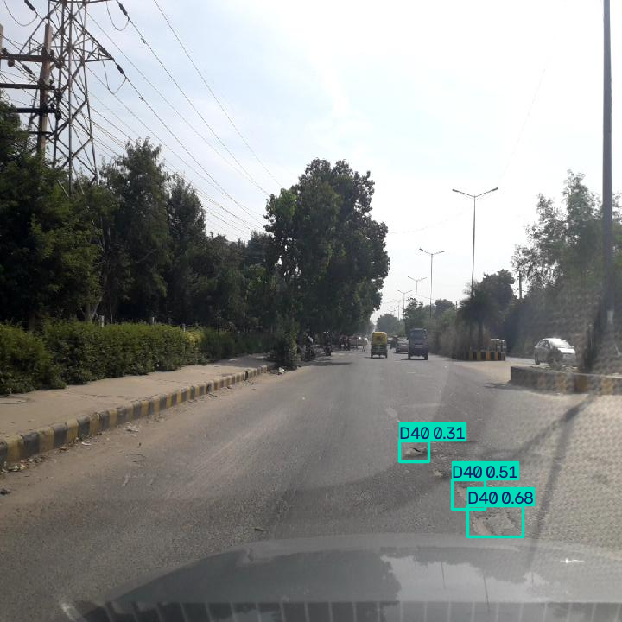
11 / 12
Demo Dashboard
A single-page tool: drop in a road photo, get back labeled detections — built and verified locally
U
Upload
Drag and drop, or click to choose, a JPG/PNG road photo.
D
Detect
The trained YOLOv8n checkpoint runs inference in the browser session.
A
Annotate
Boxes are drawn on the image; each is labeled with damage type and confidence.
R
Review
A table lists every detection alongside the annotated image.
Only shows the model's already-measured offline metrics as context — never a live-computed accuracy for the uploaded photo.
Live detection output — 3 potholes correctly located and labeled
RDD2022 — DA-RDD baseline
RDD2022 — DA-RDD baseline

Slide 12
12 / 12
Status & Next Steps
DONE
NEXT
✓
Phase 1–2: Data verified, converted, split — complete
Re-run Faster R-CNN's preliminary countries
(Norway, US, China-MotorBike) at full scale
✓
Phase 3a: Three models trained, reviewed — Faster R-CNN,
YOLOv8n, YOLO26n — complete
Decide on Phase 3b — coordinate attention
(module already built & verified, not yet trained)
✓
Phase 4: Cross-country eval — YOLOv8n + YOLO26n full-scale,
Faster R-CNN (preliminary subsample on 3 countries)
Run Phase 5 hyperparameter ablations at full scale
✓
Phase 6: Reporting tables & figures — auto-generated
Host the demo dashboard
✓
Phase 7: Demo dashboard — built, verified locally
Write final report
Deliverable: research report + trained models + cross-country analysis + hosted Tier-1 demo dashboard

