Slide 1
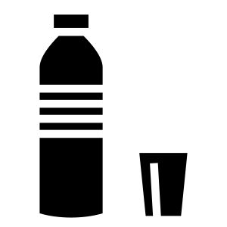




PLASTIC AWARENESS PROGRAM
YOUR DAILY
PLASTIC RECEIPT
EVERY BOTTLE, BAG AND WRAPPER GETS ITEMIZED
82.8g
450 YRS
CO2 PER SINGLE
PLASTIC BOTTLE
FOR ONE BOTTLE TO
BREAK DOWN IN NATURE
BOTTLE
BAG
STRAW
CUP
WRAPPER
82.8g CO2 · 450 yr
10.0g CO2 · 20 yr
1.5g CO2 · 200 yr
15.0g CO2 · 50 yr
6.0g CO2 · 100 yr
If your class of 40 students each uses just 5 plastic items a day, that's ~5.3 kg of CO2 and 200+ items of waste — every single day.
REDUCE · REUSE · REFUSE
TRY YOUR OWN PLASTIC RECEIPT
Answer 5 quick questions → see your CO2 footprint instantly.
Ask your facilitator for today's link, or scan the QR code on screen.

