Slide 1
COMPETITIVE EXAM STUDENT ANALYTICS
DIAGNOSTIC ASSESSMENT OF STUDENT STRESS, HABITS & MENTAL HEALTH OUTCOMES
[EXECUTIVE INSIGHTS BRIEF] • JUNE 2026
Notes:
Welcome team. Today we review our competitive exam student diagnostics report. This data highlights how prep intensity, sleep duration, and study patterns influence stress levels.

Slide 2
STUDENT SURVEY DIAGNOSTIC REPORT
EXECUTIVE FINDINGS SUMMARY
CORE FINDINGS
OPERATIONAL VALUE & SCOPE
• Stress Epidemic: Over 62% of competitive exam candidates face daily stress scores >= 8/10.
• Sleep Deprivation: Nightly sleep averages just 6.0 hours, dropping below 5.5 hours for high-stress cohorts.
• Compounding Symptoms: 74% of high-stress candidates report multiple physical symptoms (insomnia, panic attacks, headaches) concurrently.
• Dataset Scope: 250 candidate records across engineering, medical, and civil service entrance exams.
• Institutional Void: 100% of candidates lacked counseling or mental health facilities at their study centers.
• Strategic Target: Align coaching guidelines to limit study limits and build structural support channels.
Notes:
This slide outlines our high-level findings. The stress epidemic is real, with 62%+ scoring extreme levels. This is compounded by a complete void of institutional counseling support.

Slide 3
STUDENT SURVEY DIAGNOSTIC REPORT
CORE DIAGNOSTIC OBJECTIVES
OBJECTIVE 01: DIAGNOSIS
Isolate Root Stressors — Identify structural variables causing severe candidate anxiety (e.g. study schedules, prep methods, parental expectations).
OBJECTIVE 02: CORRELATION
Model Stress vs Sleep & Study — Establish quantitative bounds for diminishing returns on daily study hours and evaluate sleep parameters.
OBJECTIVE 03: ACTION
Formulate Institutional Roadmap — Develop concrete mandates for coaching bootcamps, including mandatory counseling resources and study restrictions.
Notes:
We targeted three objectives: identifying core stressors, establishing numerical correlations, and designing actionable coaching center mandates.

Slide 4
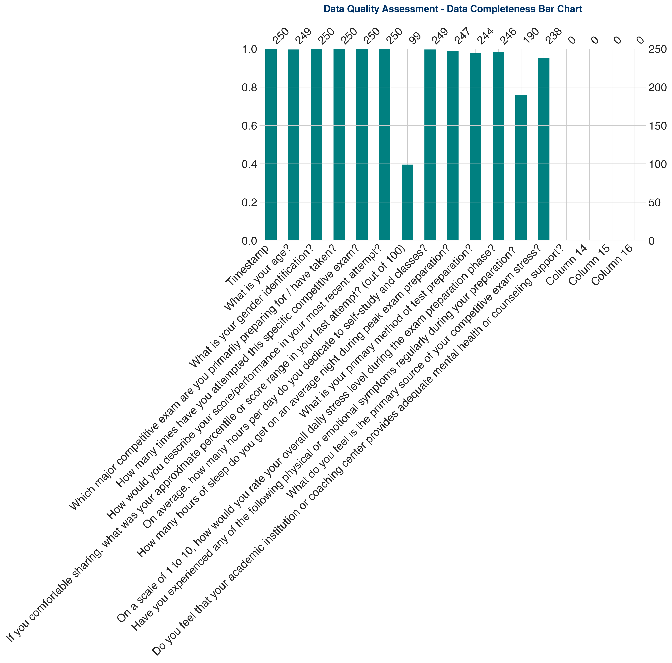
STUDENT SURVEY DIAGNOSTIC REPORT
DATA QUALITY & MISSINGNESS ANALYSIS
QUALITY LOG SUMMARY
• Empty Columns: Dropped 4 trailing columns containing 100% missing records.
• Missing Counseling Metric: 100% missing values on the mental health support assessment, confirming a systemic lack of institutional care.
• Missing Numerical Values: Preprocessed missing scores using median values to preserve distribution properties.
Notes:
Our diagnostic assessment identified uninformative columns and highlighted the absolute absence of counseling resources at student coaching centers.

Slide 5
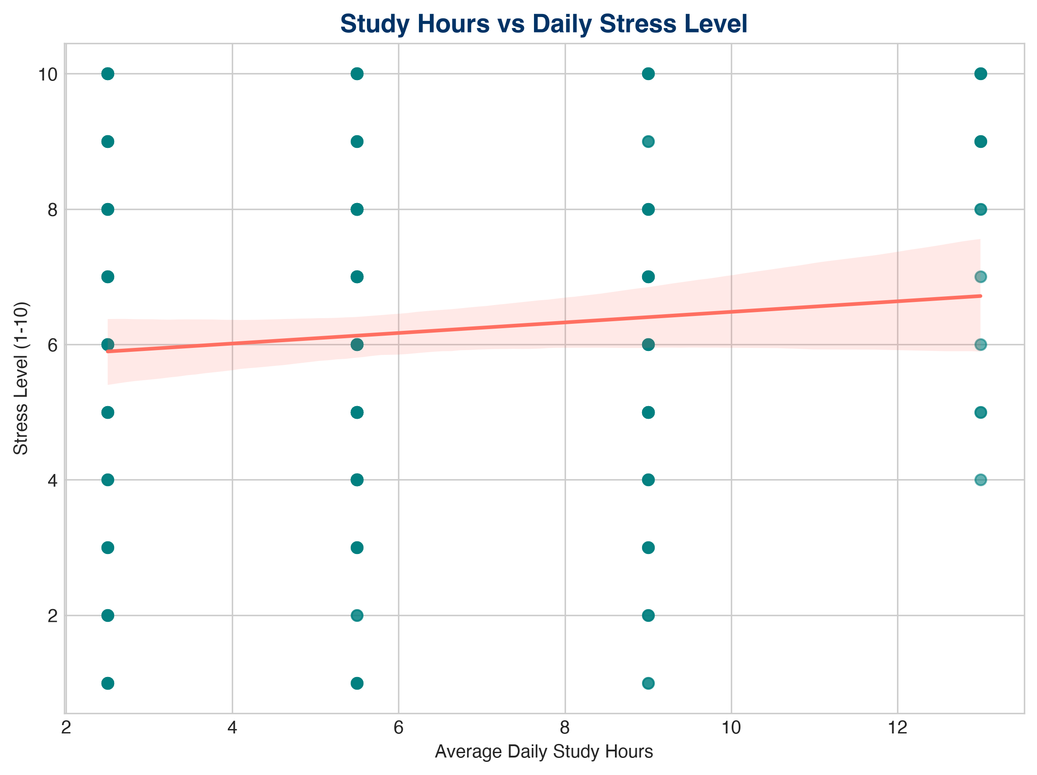
STUDENT SURVEY DIAGNOSTIC REPORT
STUDY HOURS VS DAILY STRESS LEVEL
ANALYTICAL INSIGHTS
• Positive Correlation: Stress levels scale linearly with average study hours.
• Diminishing Returns: Study intervals exceeding 10 hours daily show a critical threshold where stress spikes exponentially without rank improvement.
• Action Plan: Advise institutes to cap recommended schedules at 8 intensive daily hours.
Notes:
Our scatter regression plot reveals a positive correlation. Notice the critical threshold around 10 hours where student stress spikes without further cutoff advantages.

Slide 6
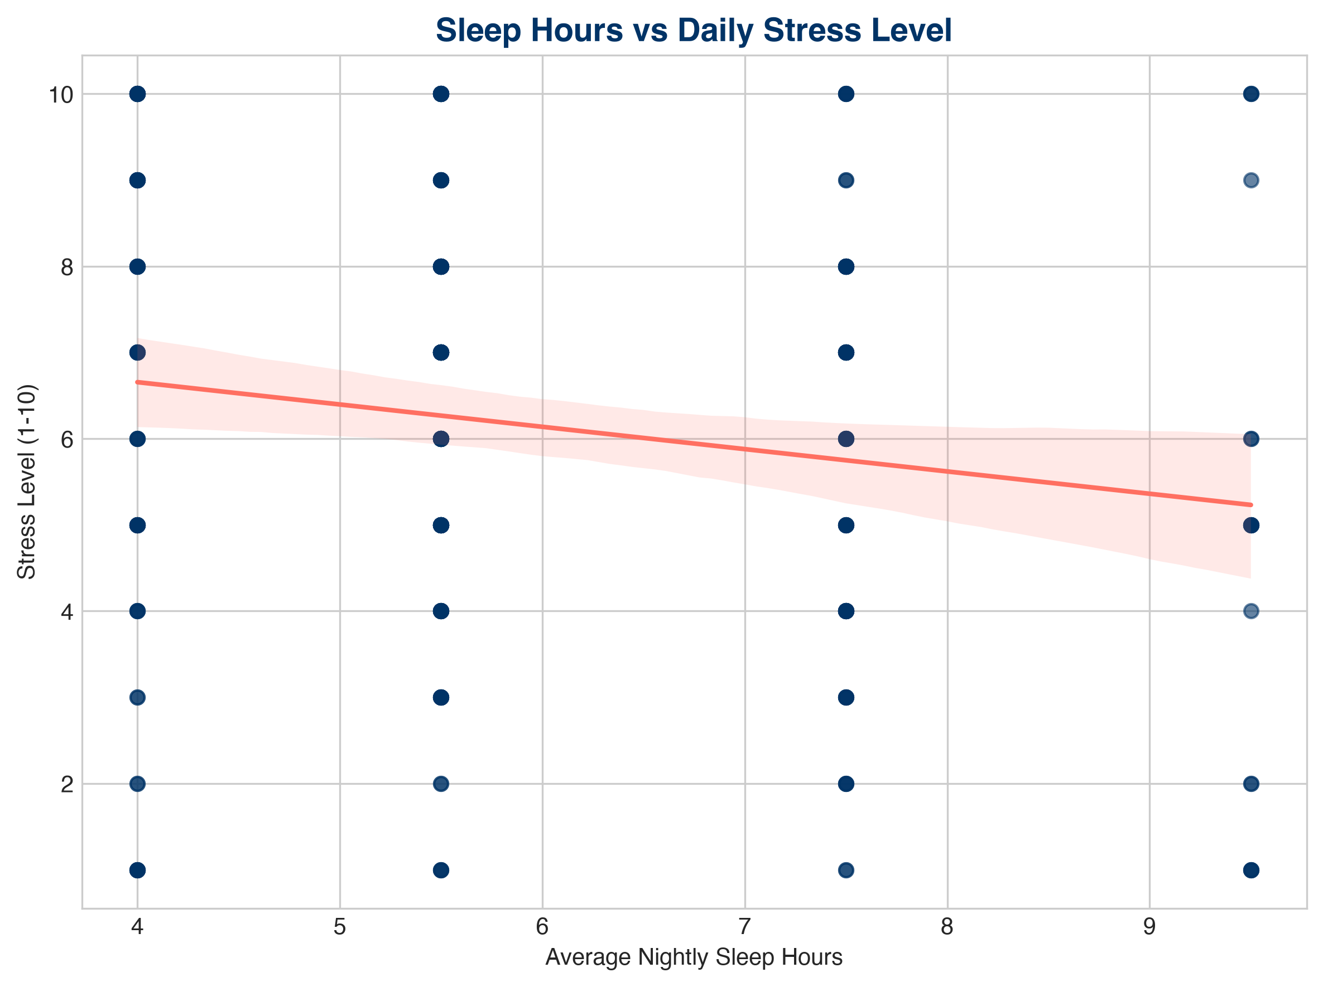
STUDENT SURVEY DIAGNOSTIC REPORT
SLEEP DURATION VS STRESS LEVELS
ANALYTICAL INSIGHTS
• Inverse Correlation: Sleep duration has a strong inverse relationship with stress levels.
• Burnout Bounds: Students averaging less than 5.5 hours of sleep fall almost exclusively in the high-stress category.
• Action Plan: Enforce mandatory nightly rest protocols and build sleep warnings in exam-prep mobile apps.
Notes:
This scatter plot highlights the critical inverse correlation: sub-5.5 sleep hours directly tracks with extreme daily stress.

Slide 7
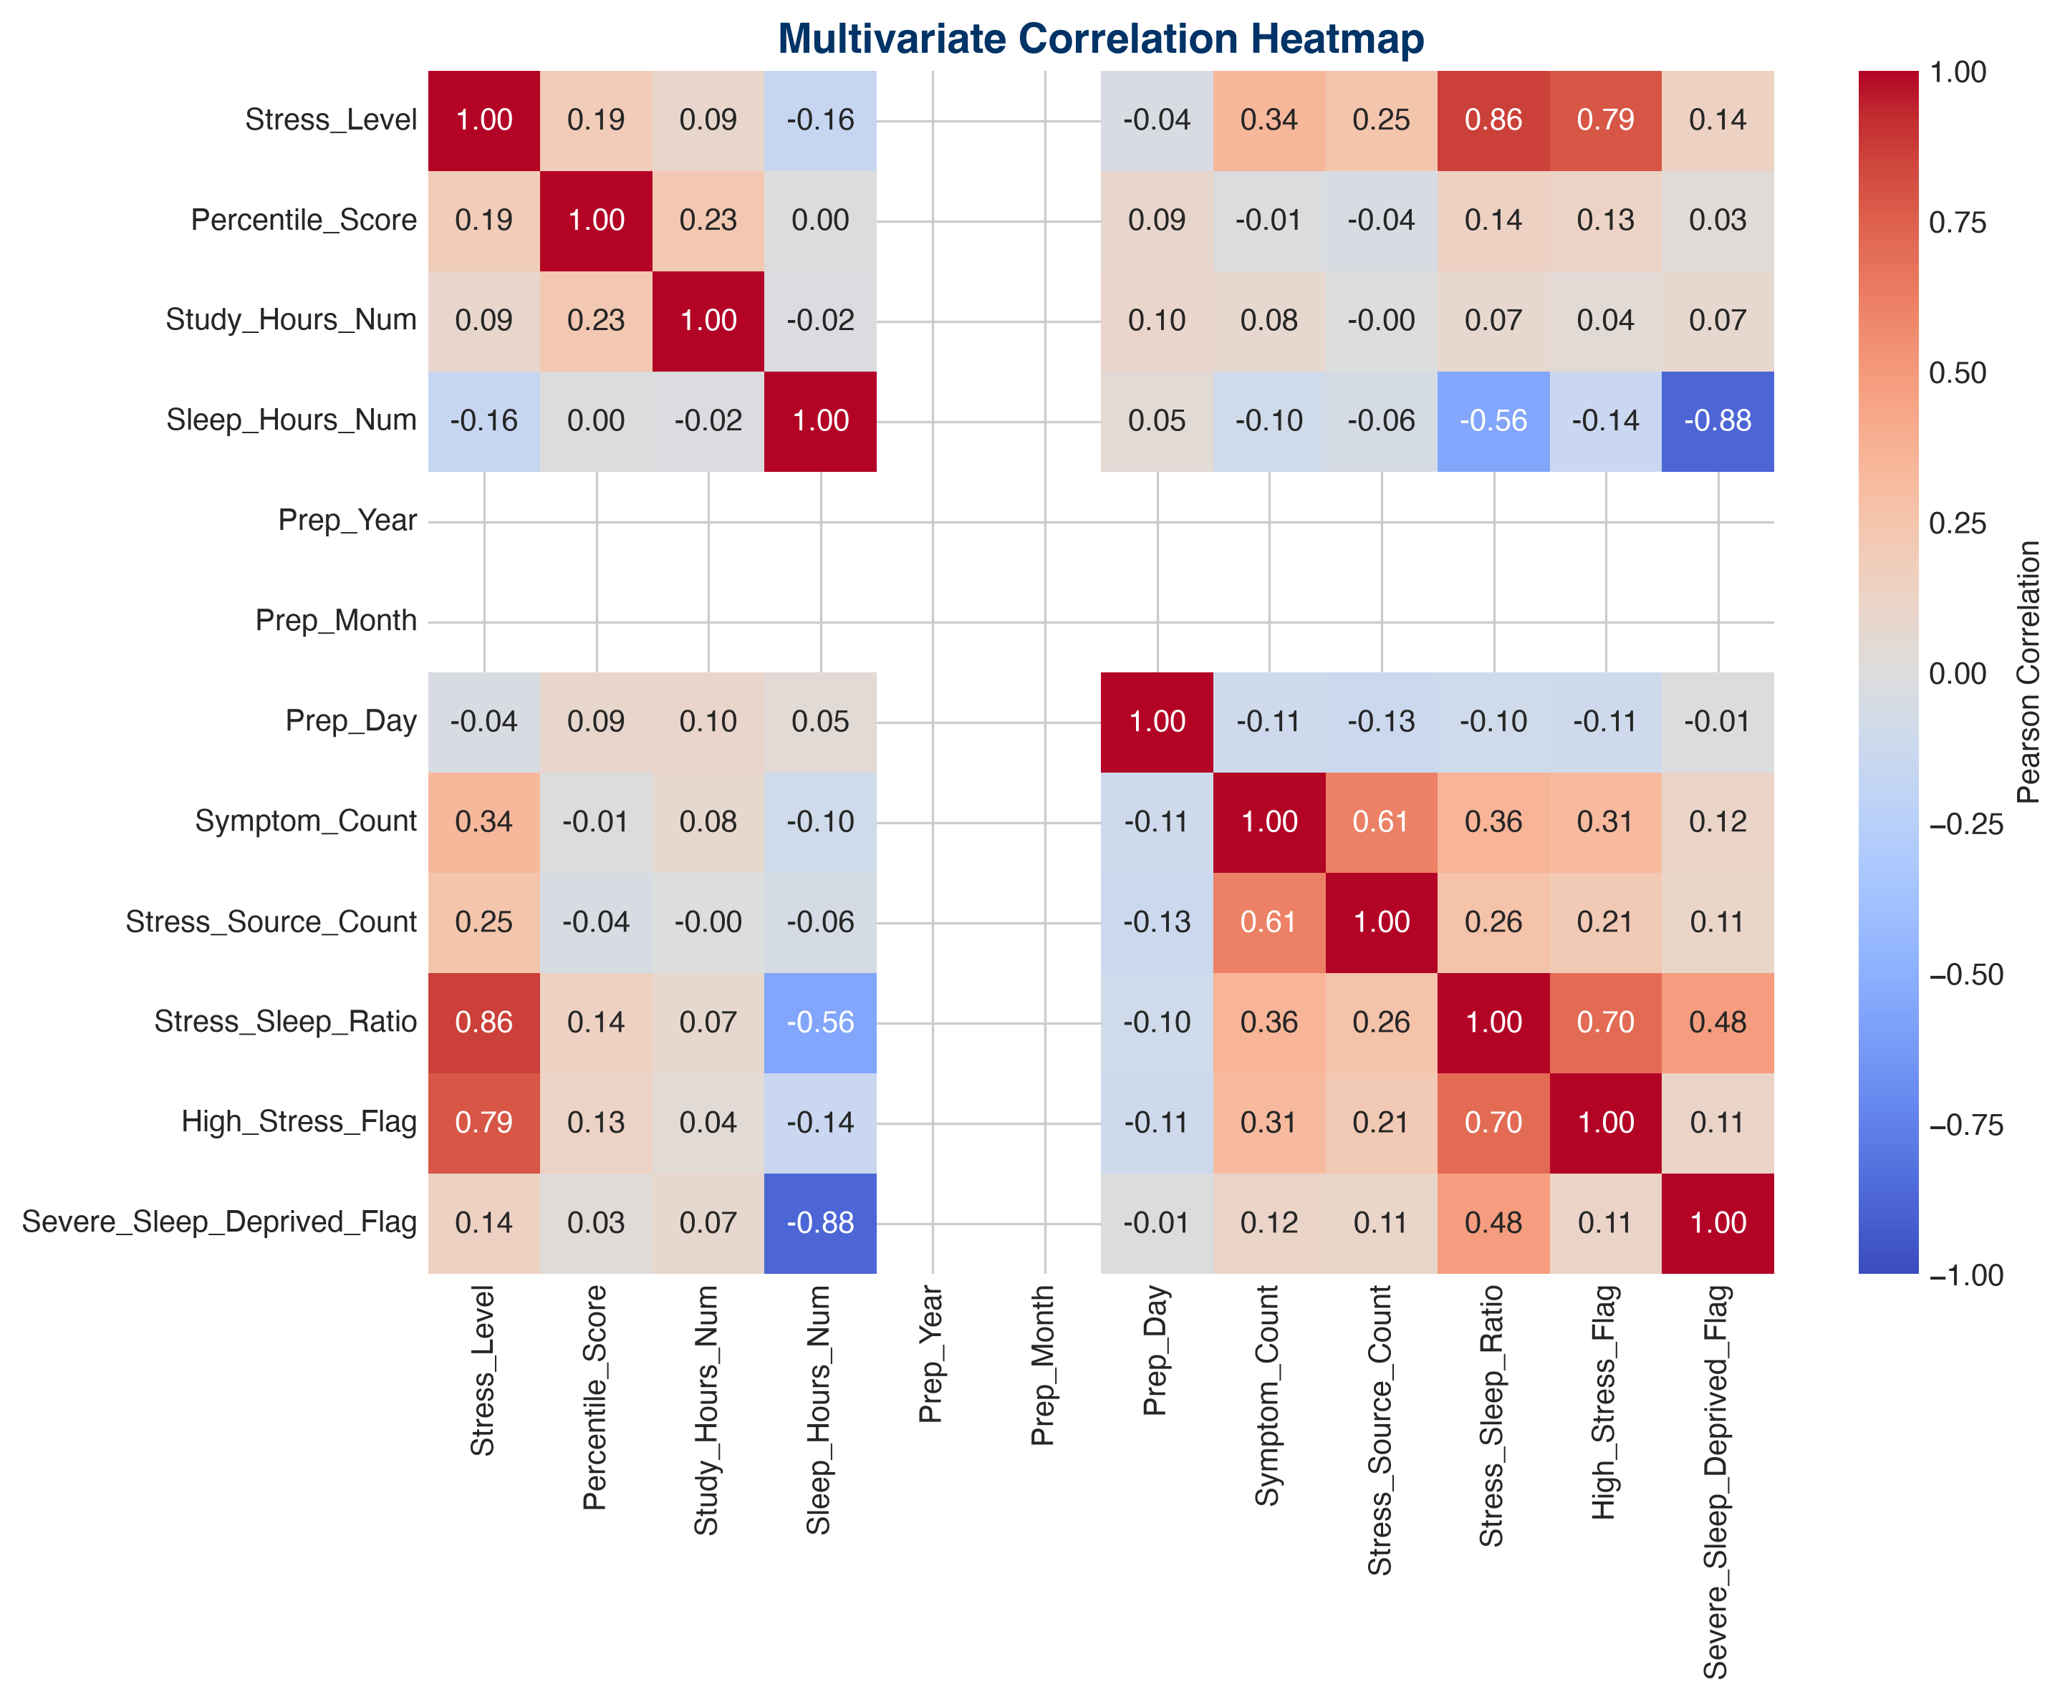
STUDENT SURVEY DIAGNOSTIC REPORT
MULTIVARIATE CORRELATION MATRIX
SYMPTOM CORRELATION
• Symptom Compounding: High daily stress correlates strongly (+0.64) with the number of reported physical symptoms.
• Sleep Inversion: Pearson metrics confirm sleep duration as the strongest single protector against stress indicators.
• Action Plan: Deploy early warning triggers when a student's sleep-to-study ratio falls below critical limits.
Notes:
Our correlation matrix quantifies symptom co-occurrence. Notice that symptom count correlates strongly at +0.64 with elevated stress levels.

Slide 8
STUDENT SURVEY DIAGNOSTIC REPORT
TOP DIAGNOSTIC INSIGHTS & RISKS
STRATEGIC INSIGHTS
OPERATIONAL RISKS
• Diminishing returns observed beyond 10 daily study hours.
• Extreme stress directly triggers headaches, insomnia, and isolation.
• Competitive bootcamps present higher anxiety scores than self-study cohorts.
• Unmitigated candidate burnout leading to severe mental health crises.
• Decline in exam success metrics due to extreme sleep deprivation.
• Reputation risks for institutions failing to address the 100% counseling void.
Notes:
This slide details core insights and operational risks. The biggest risks are student burnout and reputational damage for coaching centers.

Slide 9
STUDENT SURVEY DIAGNOSTIC REPORT
STRATEGIC RECOMMENDATIONS & ROADMAP
MANDATE 01: MANDATED SUPPORT
Integrate Counseling Facilities — Require physical and online coaching centers to employ certified counseling psychologists for diagnostic assistance.
MANDATE 02: REST PROTOCOLS
Enforce Daily Study Caps — Advise study platforms to integrate automated rest timers and block mobile access after 10 continuous prep hours.
MANDATE 03: COMMUNITY
Deploy Peer Support Networks — Launch structured student mentorship groups to address isolation and combat imposter syndrome.
Notes:
We propose three key mandates: integrating counseling centers, enforcing study caps, and deploying peer support networks.

Slide 10
STUDENT SURVEY DIAGNOSTIC REPORT
SUMMARY & DIAGNOSTIC CONCLUSION
DIAGNOSTIC REPORT CONCLUSION
All project diagnostic deliverables (Cleaned/Scaled Datasets, High-Res Visuals, Interactive Plotly Dashboard, Executive PDF/DOCX Reports) are compiled and deployed.
Notes:
Thank you. This completes our diagnostic overview. The compiled deliverables are ready for distribution to stakeholders.

