Slide 1

Android Hackathon Project Submission
Welcome to our Android hackathon submission.
Project Name –: EXPENSE TRACKER APP

Slide 2
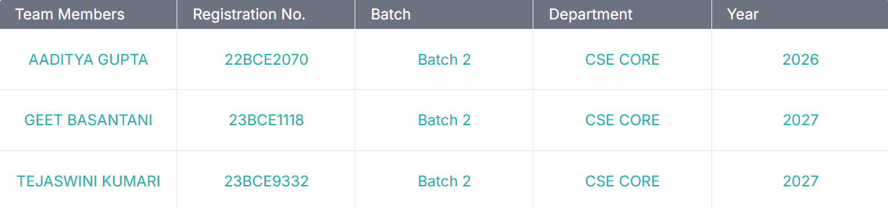




Team & Project Identity
Team Name -: HAKERZ
Team Lead Details
Aaditya Gupta
22BCE2070

Slide 3
Team Members Contribution
Tejaswini Kanuri -: Addition of new Expenditure
Geet Basantani -: The UI part that how the app will look like
Aaditya Gupta -: To update the total expenditure every time the new expenditure is added

Slide 4
Problem Overview
A clear understanding of the problem is crucial for developing an effective Android solution. This section outlines the key challenges your project addresses.
Problem Identification
User Impact
Many users struggle to track and manage daily expenses efficiently, often leading to overspending and poor financial planning.
Without an easy way to log expenses, users lose visibility into their spending habits, making it harder to save or budget effectively.
Market Gap Analysis
Problem Validation
Most existing apps are either too complex or cluttered with ads. There's a need for a simple, clean, and offline-friendly expense tracker.
Surveys and user feedback show growing demand for minimalistic tools that allow quick expense logging with features like totals and categorization.

Slide 5
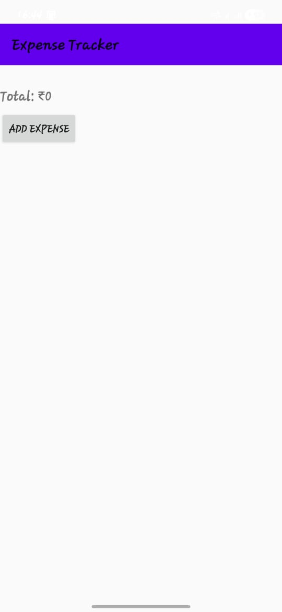
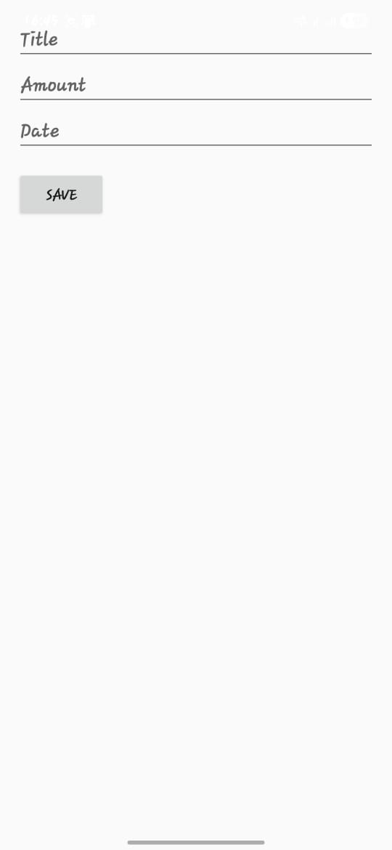
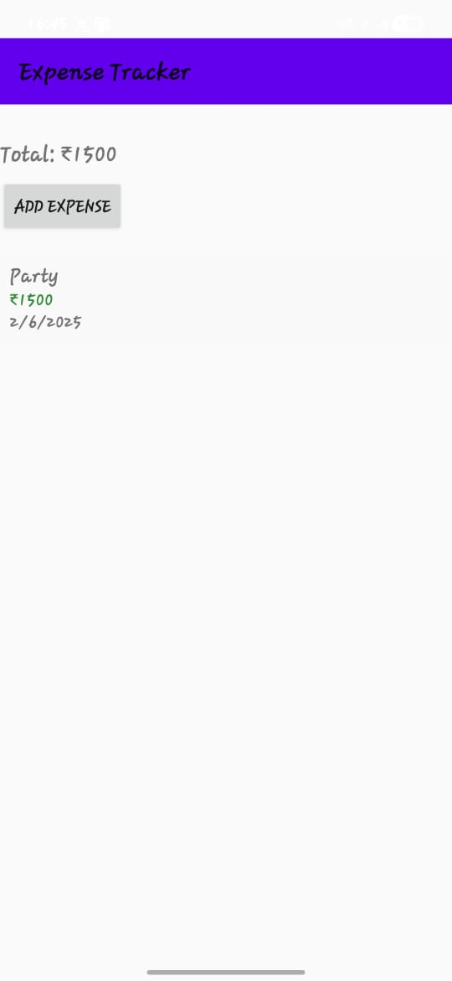
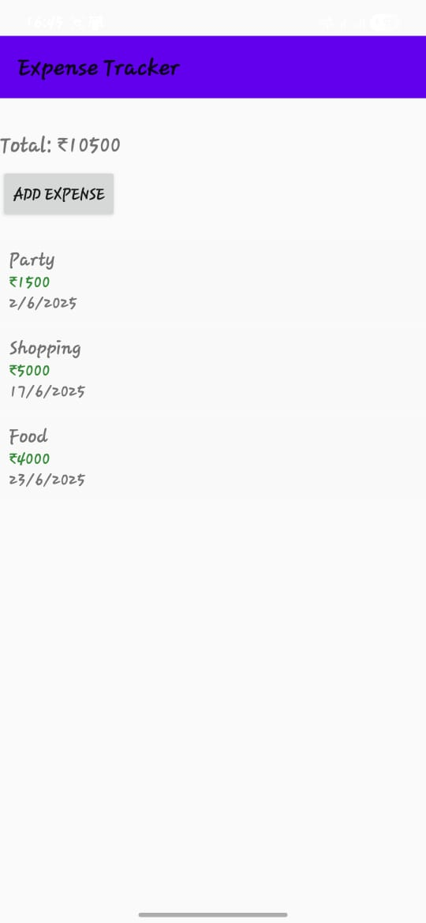
OUTPUT

Slide 6



Solution Overview
Core Innovation
Key Benefits
Technical Edge
A lightweight, intuitive mobile app that allows users to log daily expenses with ease. It features a clean UI, quick data entry, and offline support—making budgeting more accessible to everyone. Unlike complex apps, it focuses solely on core functionality without distractions or ads.
Users gain clear insights into their spending habits, track total expenses in real-time, and develop better financial discipline. The app’s simplicity ensures a low learning curve and high daily usability. By focusing on essentials, it reduces user frustration and increases long-term engagement and trust.
Built using Android SDK and RecyclerView for efficient data display, the app is optimized for performance on low-end devices. Its modular architecture supports easy scalability and future upgrades, including categorization, analytics, and cloud sync capabilities.
A simple, user-friendly Android app that allows users to track daily expenses, manage their budget efficiently, and store data using SQLite for persistence. We've focused on creating a user-centred experience that delivers real value.

Slide 7
Technical Implementation
ConstraintLayout, LinearLayout, and RecyclerView form the backbone of the user interface in this app. ConstraintLayout enables flexible and responsive screen designs by allowing complex positioning of UI elements. LinearLayout offers a straightforward way to arrange items vertically or horizontally. RecyclerView, paired with custom adapters, efficiently displays scrollable lists and dynamically updates content, ensuring smooth user experiences even with large data sets.

Slide 8
Thank You Sir For Your Guidance Throughout the Course

