Slide 1
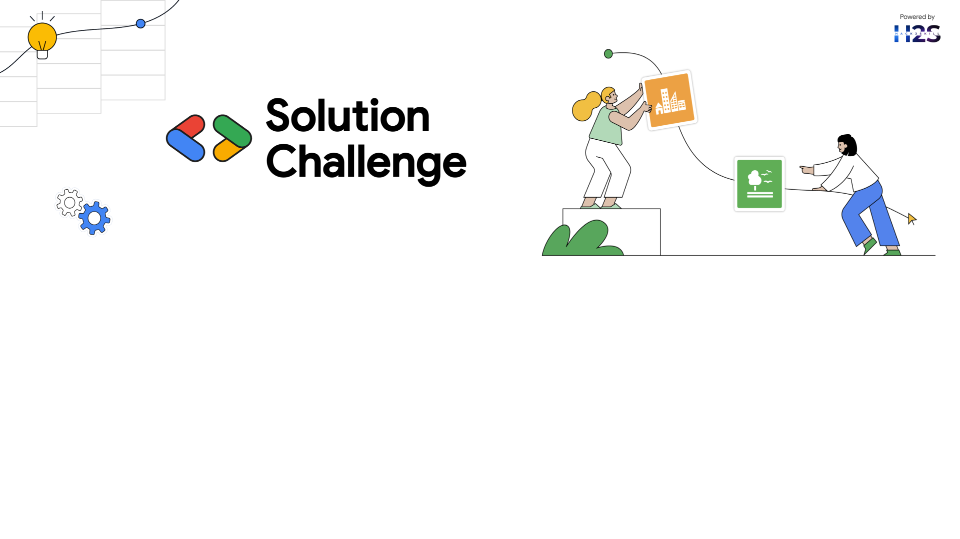
Team Details
Team name: STACKURAI
Team leader name: Aadish Rakesh Shah
Problem Statement: Lack of access to quality education in underserved communities.

Slide 2

Brief about your solution:
Our solution is an AI-powered mobile application designed to provide personalized, accessible, and practical education for underserved Indian communities. It integrates AI-driven news analysis to prevent misinformation, basic education modules covering essential subjects and skills, a constitutional rights chatbot for legal awareness, and a banking & finance assistant to guide users through government schemes. With multi-language support and speech recognition, the app ensures inclusivity for non-literate users.
Beyond traditional learning by offering profession and location-specific insights, ensuring users receive relevant and actionable knowledge tailored to their daily lives. The AI-powered chatbot simplifies complex topics, making education interactive and easy to understand. Real-time assistance helps users navigate financial and legal processes, ensuring they can access government benefits and protections effortlessly
Built using Gemini API, LangChain, FastAPI, and MongoDB, it offers a scalable, intelligent, and user-friendly approach to bridging knowledge gaps and empowering communities.

Slide 3
Opportunities
How different is it from any of the other existing ideas? Most platforms neglect underserved communities. Our AI-driven, localized solution tailors content, explains relevance, enables voice interaction, combats misinformation, and provides step-by-step guidance on government schemes, ensuring real impact.
How will it be able to solve the problem? AI-driven solution bridges the knowledge gap with profession-specific education, empowers communities with reliable information, enhances digital accessibility, drives financial inclusion by simplifying government benefits, and promotes civic awareness to reduce exploitation.

Slide 4
Opportunities
USP of the proposed solution. AI-powered, localized education with speech-enabled, multi-language support, misinformation detection, practical life learning, and step-by-step assistance for government benefits.

Slide 5
List of features offered by the solution
AI-Powered News Section : Our AI-driven platform delivers location and profession-based news while explaining its relevance. The chatbot ensures users get only verified information, preventing misinformation.
Basic Education Section : Covering math, general knowledge, health, and professions, this section emphasizes women's health and public welfare. Voice-enabled learning ensures accessibility for low-literacy users.
Constitutional Rights AI Bot : This AI bot simplifies legal rights, government policies, and dispute resolution, providing clear, actionable insights to empower citizens.
Banking & Finance Solutions : Our AI explains financial schemes, guides users through eligibility checks, and assists in applying for loans, subsidies, and welfare benefits.
Multi-Language Support & Speech Recognition : Supporting regional languages with text-to-speech and speech-to-text, our platform enables easy interaction for users with low or no literacy.

Slide 6
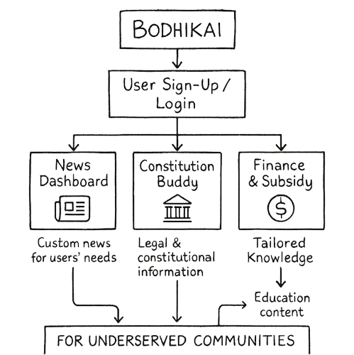
Process flow diagram or Use-case diagram

Slide 7
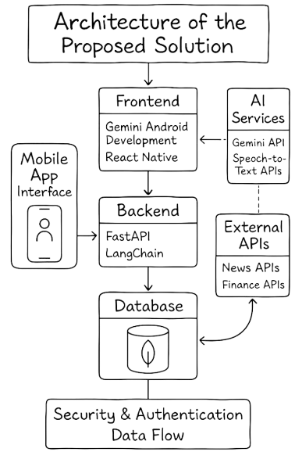
Architecture diagram of the proposed solution

Slide 8
Technologies to be used in the solution
Frontend: Gemini Android Development React Native (Optional, for iOS compatibility)
Backend: FastAPI + LangChain (for AI-powered responses)
Database: MongoDB (for user data and AI training models)
AI Services: Gemini API (for AI chatbots)Speech-to-Text APIs (for accessibility)
News Integration: External APIs (for location and profession-based news)
Finance API: Government scheme APIs (for real-time updates on banking and welfare schemes)

Slide 9
Estimated implementation cost
App Development:₹2-5 lakhs (depending on complexity)
Server & AI Processing Costs:₹1-3 lakhs per year
Marketing & Deployment:₹50,000 - ₹1 lakh (initial awareness campaigns)
Funding Options:Government grantsNGO partnershipsCSR funding

Slide 10
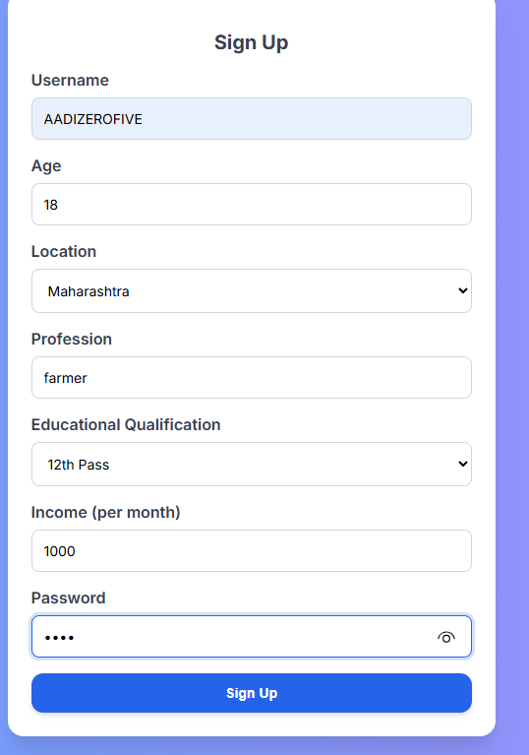
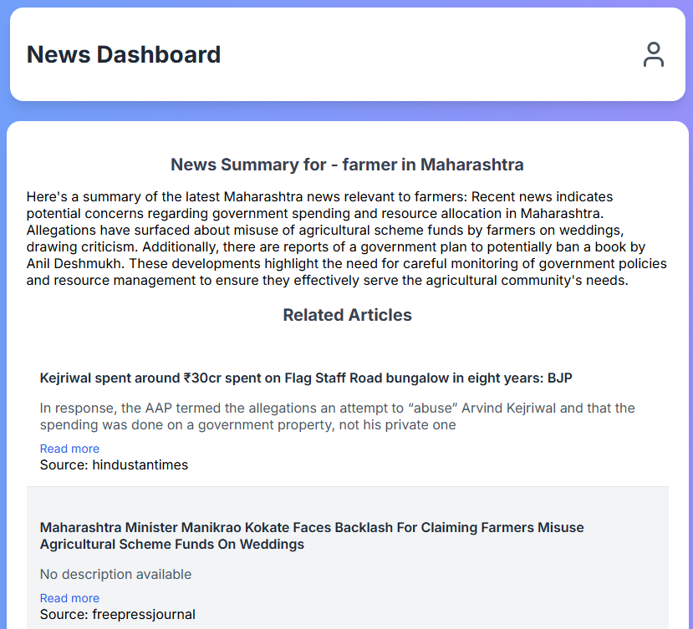
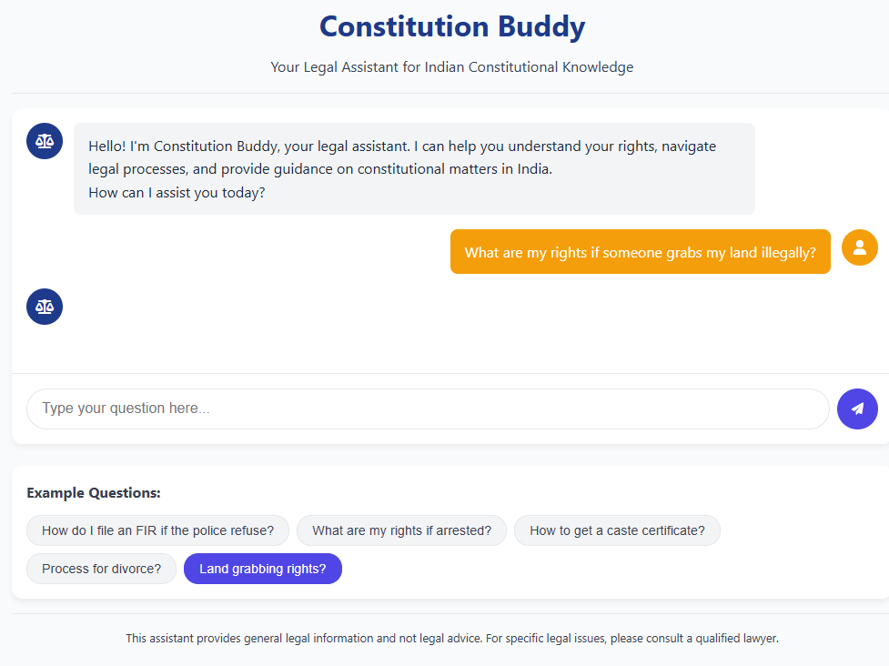
Snapshots of the MVP :

Slide 11
Additional Details/Future Development:
Expanding AI Capabilities: AI-powered live tutoring integration. Advanced AI fact-checking for news to combat misinformation.
Integrating Offline Support: Development of offline content and AI chatbot caching. Addressing low internet access in backward communities.
Partnerships with NGOs & Government: Collaboration with government agencies to facilitate benefit claims. Strategic partnerships with NGOs for community outreach programs.

Slide 12
Provide links to your:
GitHub Public Repository: BODHIKAI
Demo Video Link (3 Minutes): MVP_VIDEO
MVP Link:BODHIKAI_MVP

Slide 13
