Slide 1
How to Build a Website
Level: n00b
Workshop by Alexandra DeLucia

Slide 2
Goal: Barebones Portfolio Site

Slide 3
Workshop Requirements
A web browser
Just not Internet Explorer. Please.
A text editor
Notepad++ (Windows only, sorry)
Atom
Sublime

Slide 4
Workshop Scope
Covered
Not Covered (See Resources and Next Steps)
HTML5
CSS3
Bootstrap
Server-side scripting (Node.js, PHP, etc)
Web hosting
Getting a domain

Slide 5
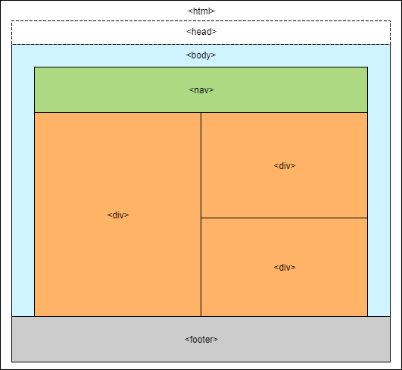
HTML Structure Tags
Use open <> and closing </> tags to build an HTML structure. Important tags:
<html></html>
<head></head>
<body></body>
<img>
<h1>…<h6>
<div></div>
<p></p>
<a></a>
Full tag list here: W3 Schools

Slide 6
HTML File Example
<!DOCTYPE html>
<html>
<head>
<title></title>
</head>
<body>
<h1></h1>
<div>
</div>
</body>
</html>
HTML files have a .html extension:
file.html

Slide 7
First Webpage: Head
Open the file in your browser (refreshing the file after each step)
Open the index.html in your text editor
Note: you will have to use “open with”
Fill in the metadata and title tags in the head
Add a description, “example web page” in quotes next to content=
Add a title inbetween the <title> tags, like <title>My Portfolio</title>. Note: do not use quotes
Add a favicon
<link rel="shortcut icon" href="media/favicon.ico" />

Slide 8
First Webpage: Body
Add a heading for About Me
<h1>About Me</h1>
Note: the number on the tag corresponds to the size of the text, with 1 as largest and 6 as smallest
Add an image of yourself (or use media/portrait.jpg)
<img src=“media/portrait.jpg” />
Add a bio under About Me
<p>some text</p>

Slide 9
First Webpage: Navigation
Locate the <nav></nav> section under <body>
Add a link to the nav section for xckd
<a href=“https://xkcd.com”>External Link</a>
Add a link to the nav section to download media/answer_to_life.txt
<a href=“media/answer_to_life.txt” download>Local Link</a>
Copy the xckd link and set it to open in a new tab
<a href=“https://xkcd.com” target=“_blank”>New Tab Link</a>

Slide 10
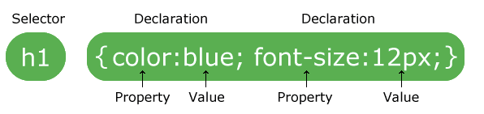
Cascading Style Sheet (CSS)
A separate file that is linked to the HTML file
Separates the design from the content
Allows a style to be applied easily to multiple tags
More information: W3 CSS

Slide 11
Beautification: Attempt 1
Open the stylesheet css/styles.css
Link the stylesheet to index.html in head
<link rel="stylesheet" href="css/styles.css">
Change the background color of body (reference guide, color codes)
background-color: lightblue;
Give your About Me image an id and resize it
<img id="about-img" src="media/portrait.jpg" />
#about-img {width: 200px;}

Slide 12
CSS in HTML
Can use CSS in an HTML element tag
Copy the portrait image and remove the id
Apply a style to it in the HTML file
Use the style attribute
<img style="width:30px;" src="media/portrait.jpg" />

Slide 13
Hacking a Template
Download a basic free template here
Open the template and explore
Create a new stylesheet my-styles.css and copy the contents of resume.css
Change the navigation (.bg-primary) and background color (section.resume-section)
Fill in your personal information

Slide 14
Next Steps
Hosting
Github Pages (recommended for beginner)
Amazon Web Services
Helpful tutorial for a static website here
Domain Name
Google Domains
Name Cheap

Slide 15
Resources
Frameworks
Jekyll
Design
Materialize
Bootstrap
Skeleton
Server Side (link)
PHP
SQL
Node.js

