Slide 1
How to Build a Website
Level: n00b
Workshop by Alexandra DeLucia

Slide 2
Goal: Barebones Portfolio Site

Slide 3
Workshop Requirements
A web browser
Just not Internet Explorer. Please.
A text editor
Notepad++ (Windows only, sorry)
Atom
Sublime

Slide 4
Workshop Scope
Covered
Not Covered (See Resources and Next Steps)
HTML5
CSS3
Bootstrap
Server-side scripting (Node.js, PHP, etc)
Web hosting
Getting a domain

Slide 5
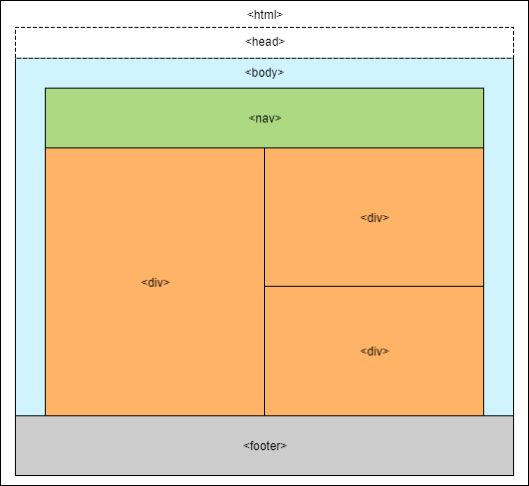
HTML Structure Tags
Use open <> and closing </> tags to build an HTML structure. Tags:
<html></html>
<head></head>
<body></body>
Full list here

Slide 6
Baby’s First Webpage
Open the index.html in your text editor
Fill in the metadata and title tags
Open the file in your browser (refreshing the file after each step)
Add empty links to the nav section for Local Link, External Link, New Tab Link
Add a heading for About Me
Add an image of yourself (or of your robot self) and add a bio
Fill in the links and try them

Slide 7
Beautification: Attempt 1
Create a file called styles.css
Link the file to index.html in head
Change the background color of body (reference guide, color codes)
Give img an id and resize it
Change the color of h1

Slide 8
Hacking a Template
Download a basic free template here
Open the template and explore
Create a new stylesheet my-styles.css and copy the contents of resume.css
Change the navigation (.bg-primary) and background color (section.resume-section)
Fill in your personal information

Slide 9
Next Steps
Hosting
Github Pages (recommended for beginner)
Amazon Web Services
Domain Name
Google Domains
Name Cheap

Slide 10
Resources
Frameworks
Jekyll
Design
Materialize
Bootstrap
Skeleton
Server Side (link)
PHP
SQL
Node.js

