Slide 1
How to Build a Website
Level: n00b
Workshop by Alexandra DeLucia

Slide 2
Goal: Barebones Portfolio Site

Slide 3
Workshop Requirements
A web browser
Just not Internet Explorer. Please.
A text editor
Notepad++ (Windows only, sorry)
Atom
Sublime

Slide 4
Workshop Scope
Covered
Not Covered (See Resources and Next Steps)
HTML5
CSS3
Bootstrap
Server-side scripting (Node.js, PHP, etc)
Web hosting
Getting a domain

Slide 5
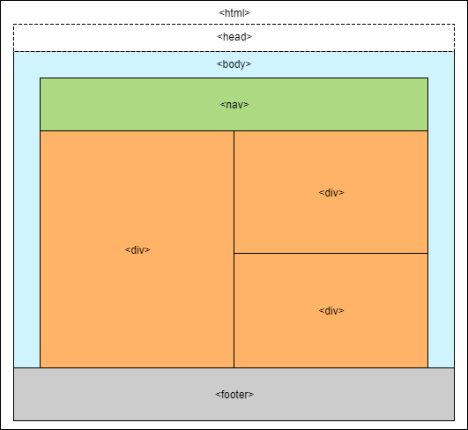
HTML Structure Tags
Use open <> and closing </> tags to build an HTML structure. Tags:
<html></html>
<head></head>
<body></body>
Full list here

Slide 6
HTML File Example
<!DOCTYPE html>
<html>
<head>
<title></title>
</head>
<body>
<h1></h1>
<div>
</div>
</body>
</html>
HTML files have a .html extension:
file.html

Slide 7
First Webpage
Open the index.html in your text editor
Note: you will have to use “open with”
Fill in the metadata and title tags
Open the file in your browser (refreshing the file after each step)
Add empty links to the nav section for Local Link, External Link, New Tab Link
Add a heading for About Me
Add an image of yourself (or of your robot self) and add a bio
Fill in the links and try them

Slide 8
First Webpage: Head
Open the file in your browser (refreshing the file after each step)
Open the index.html in your text editor
Note: you will have to use “open with”
Fill in the metadata and title tags in the head
Add a description, “example web page” in quotes next to “content=”
Add a title inbetween the <title> tags, like <title>My Portfolio</title>. Note: do not use quotes

Slide 9
First Webpage: Body
Add a heading for About Me
<h1>About Me</h1>
Note: the number on the tag corresponds to the size of the text, with 1 as largest and 6 as smallest
Add an image of yourself (or use media/portrait.jpg)
<img src=“media/portrait.jpg”>
Add a bio under About Me
<p>some text</p>

Slide 10
First Webpage: Navigation
Locate the <nav></nav> section under <body>
Add a link to the nav section for xckd
<a href=“https://xkcd.com”>External Link</a>
Add a link to the nav section for
<a href=“media/answer_to_life.txt”>Local Link</a>
Copy the xckd link and set it to open in a new tab
<a href=“https://xkcd.com” target=“_blank”>New Tab Link</a>

Slide 11
Beautification: Attempt 1
Create a file called styles.css
Link the file to index.html in head
Change the background color of body (reference guide, color codes)
Give img an id and resize it
Change the color of h1

Slide 12
Hacking a Template
Download a basic free template here
Open the template and explore
Create a new stylesheet my-styles.css and copy the contents of resume.css
Change the navigation (.bg-primary) and background color (section.resume-section)
Fill in your personal information

Slide 13
Next Steps
Hosting
Github Pages (recommended for beginner)
Amazon Web Services
Domain Name
Google Domains
Name Cheap

Slide 14
Resources
Frameworks
Jekyll
Design
Materialize
Bootstrap
Skeleton
Server Side (link)
PHP
SQL
Node.js

