Slide 1

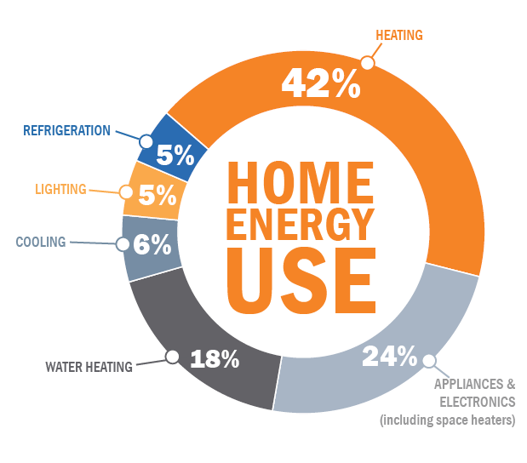

Course Project [CP 331 Energy Data Analytics]
Machine Learning-Based Energy Consumption Prediction: A Model Comparison
Aditya Anand Gupta (23693)
Yuvraj Singh (23109)

Slide 2
Contents
Introduction
Dataset Description
Training and Evaluation Setup
Various Models Results
Conclusion

Slide 3
Introduction
Problem Statement:
Energy consumption prediction plays a vital role in optimizing energy management and sustainability.
Accurate forecasting leads to informed decisions for grid stability.
Improved energy efficiency and reduced costs.
Project Scope:
Compare machine learning models for energy consumption prediction.
Identify the best model based on accuracy and efficiency.
Provide insights for practical applications in energy management.

Slide 4
Dataset Description
Parameters Suitable for 2–3 Weeks Forecast: Temperature-Related ( tempmax, tempmin, temp, feelslikemax, feelslikemin, feelslike, dew ), humidity Precipitation-Related ( precipprob, precipcover) , Wind ( windspeed, winddir), sealevelpressure, cloudcover
Less Reliable but Possible with Trends: Precipitation Amount( precipitation, snow, snow depth ), windgust, visibility, solarradiation, solarenergy, uvindex
Very Short-Term or Stochastic Variables: Specific Weather Conditions (Partially cloudy, Clear, Fog, Overcast, Rain ), Extreme Conditions (preciptype_rain, windgust, snowdepth)
Astronomical Features: Sunrise/Sunset: sunrise_sin, sunrise_cos, sunset_sin, sunset_cos, moonphase
Day-wise Consumption
Day-wise weather features
Combined dataset
No. of consumption features: 9
No. of weather features: 23
Row Selection Methodology:
Select row closest to median of energy consumption (t_kWh).
Ensures selected value is least affected by outliers, providing a typical representative value.
(Weather Dataset Source: www.visualcrossing.com)

Slide 5
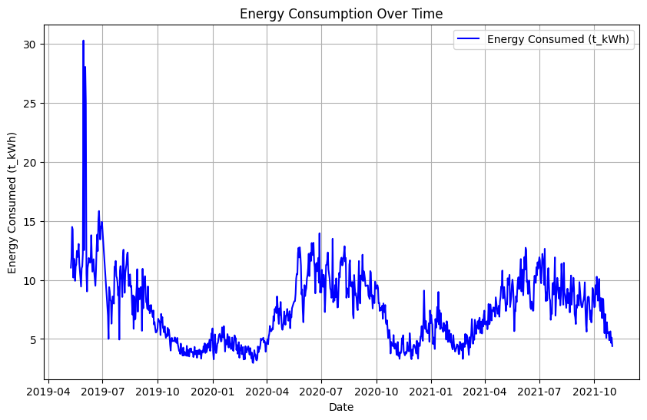
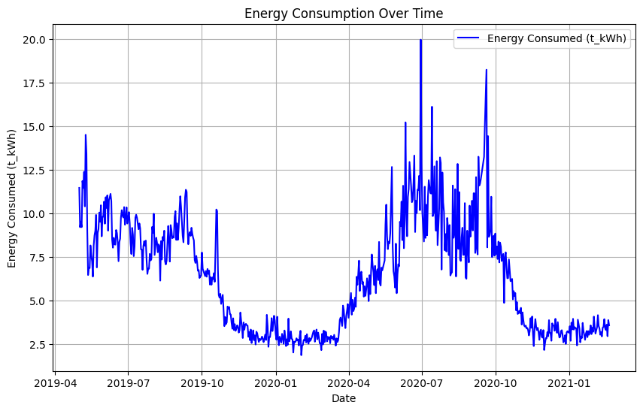
Dataset Description
Bareily Dataset (Source: CEEW)
Mathura Dataset (Source: CEEW)

Slide 6
Training and Evaluation Setup
Voltage, Current, Frequency (1/2/3-day lag)
Weather features
Model Training
Train-Test Split Methodology:
Data Combination: Combine features, target, and dates into a single Data Frame.
Lag Features: Created 1-day lag features for voltage, current and frequency columns.
Train-Test Split: Last 1/2/3 weeks used for test data; remaining data used for training.
Feature and Target Separation: Split features and target for train and test sets.
Training
3-lag days voltage, current, frequency
Forecasted weather for tomorrow
Trained Model
Model Evaluation Metrics:
RMSE: Root Mean Square Error for accuracy.
MAE: Mean Absolute Error to measure average error.
R² Score: Determines goodness of fit for the model.
Tomorrow’s predicted load
Evaluation

Slide 7
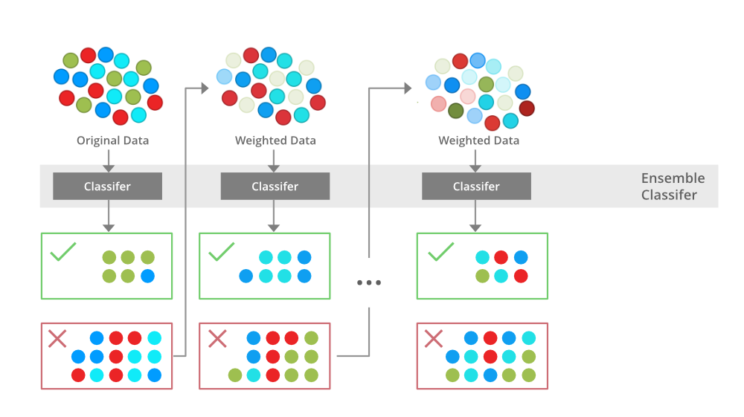
XGBoost
Parameter | Value
n_estimators | 300
learning_rate | 0.01
max_depth | 10
random_state | 42
reg_alpha | 0.1
reg_lambda | 0.1
Efficient Gradient Boosting: Provides efficient and accurate predictions through gradient boosting.
Handles Missing Values: Automatically manages missing values, useful for real-world datasets.
Suitable for Tabular Data: Popular for structured/tabular data, offering good bias-variance trade-off and feature importance analysis.

Slide 8
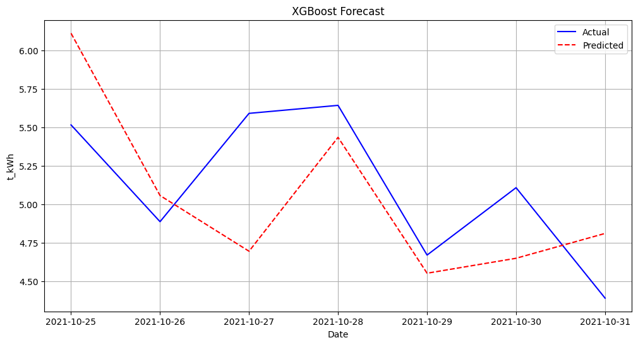
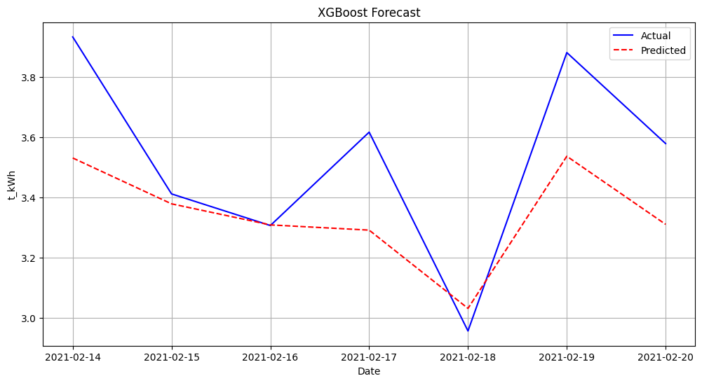
XGBoost
Bareilly
Mathura
Day of Week | Actual Avg Load | Predicted Avg Load | RMSE | MAE | MAPE
Monday | 5.515 | 6.110601 | 0.595601 | 0.595601 | 10.799655
Tuesday | 4.886 | 5.05596 | 0.16996 | 0.16996 | 3.478514
Wednesday | 5.59 | 4.693988 | 0.896012 | 0.896012 | 16.02884
Thursday | 5.642 | 5.434055 | 0.207945 | 0.207945 | 3.685655
Friday | 4.669 | 4.551032 | 0.117968 | 0.117968 | 2.526621
Saturday | 5.107 | 4.648214 | 0.458786 | 0.458786 | 8.983467
Sunday | 4.389 | 4.809695 | 0.420695 | 0.420695 | 9.585219
Day of Week | Actual Avg Load | Predicted Avg Load | RMSE | MAE | MAPE
Monday | 3.412 | 3.379051 | 0.032949 | 0.032949 | 0.965688
Tuesday | 3.307 | 3.309113 | 0.002113 | 0.002113 | 0.063888
Wednesday | 3.617 | 3.291766 | 0.325234 | 0.325234 | 8.991818
Thursday | 2.957 | 3.031989 | 0.074989 | 0.074989 | 2.535994
Friday | 3.881 | 3.536951 | 0.344049 | 0.344049 | 8.86495
Saturday | 3.579 | 3.310888 | 0.268112 | 0.268112 | 7.491266
Sunday | 3.933 | 3.531231 | 0.401769 | 0.401769 | 10.21534

Slide 9
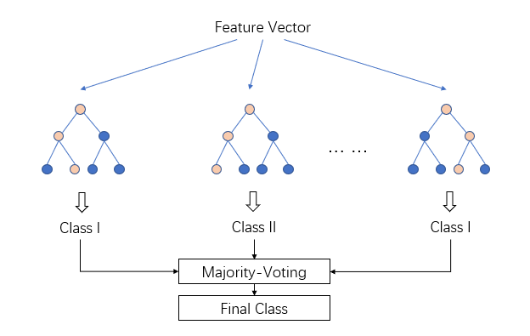
LightGBM
Parameter | Value
n_estimators | 2000
learning_rate | 0.01
max_depth | 50
random_state | 42
reg_alpha | 0.1
reg_lambda | 0.1
Leaf-wise Growth: Faster training compared to traditional level-wise methods, especially effective on large datasets.
Supports Categorical Features: Handles categorical features directly without the need for explicit encoding.
High-Dimensional Efficiency: Efficiently manages high-dimensional data, making it suitable for complex feature sets

Slide 10
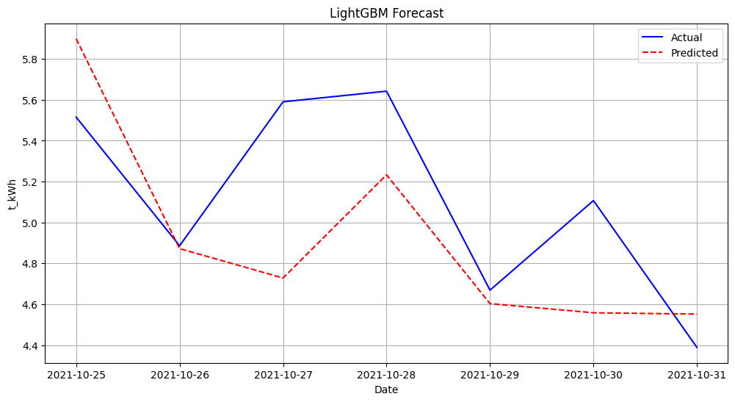
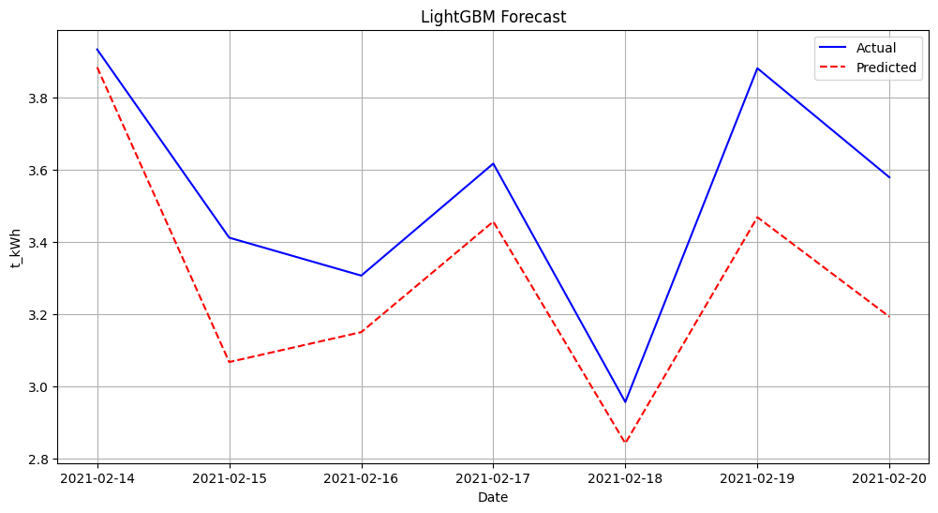
LightGBM
Bareilly
Mathura
Day of Week | Actual Avg Load | Predicted Avg Load | RMSE | MAE | MAPE
Monday | 5.515 | 5.898371 | 0.383371 | 0.383371 | 6.951429
Tuesday | 4.886 | 4.872144 | 0.013856 | 0.013856 | 0.283582
Wednesday | 5.59 | 4.728397 | 0.861603 | 0.861603 | 15.413297
Thursday | 5.642 | 5.233016 | 0.408984 | 0.408984 | 7.248912
Friday | 4.669 | 4.603074 | 0.065926 | 0.065926 | 1.411987
Saturday | 5.107 | 4.558429 | 0.272029 | 0.272029 | 5.326598
Sunday | 4.389 | 4.551975 | 0.162975 | 0.162975 | 3.713263
Day of Week | Actual Avg Load | Predicted Avg Load | RMSE | MAE | MAPE
Monday | 3.412 | 3.067722 | 0.344278 | 0.344278 | 10.090213
Tuesday | 3.307 | 3.150486 | 0.156514 | 0.156514 | 4.732803
Wednesday | 3.617 | 3.45649 | 0.16051 | 0.16051 | 4.437646
Thursday | 2.957 | 2.842687 | 0.114313 | 0.114313 | 3.86584
Friday | 3.881 | 3.4686 | 0.4124 | 0.4124 | 10.626128
Saturday | 3.579 | 3.193109 | 0.385891 | 0.385891 | 10.782087
Sunday | 3.933 | 3.883711 | 0.049289 | 0.049289 | 1.253211

Slide 11
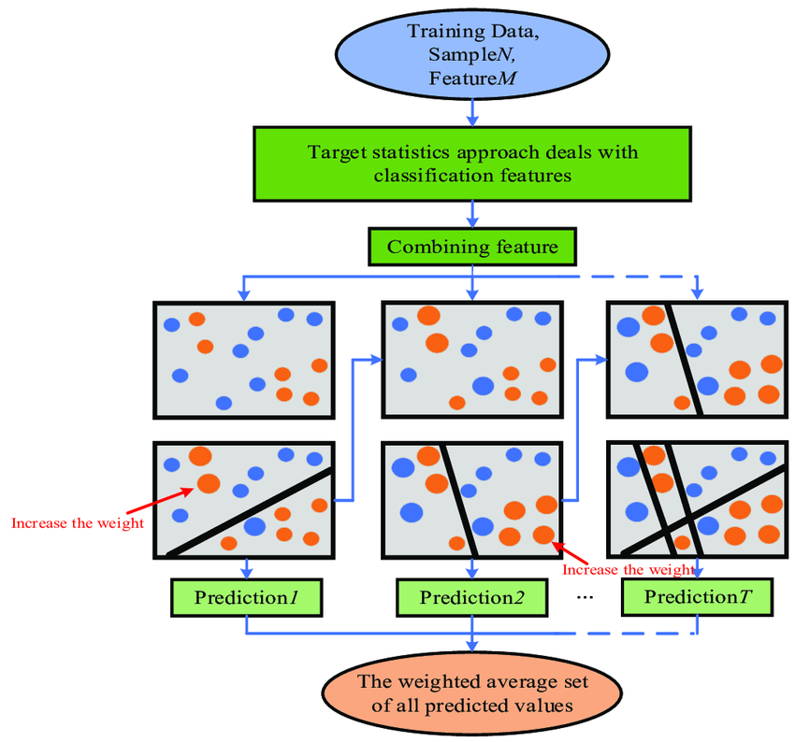
CatBoost
Parameter | Value
iterations | 500
learning_rate | 0.01
max_depth | 10
random_state | 42
l2_leaf_reg | 3
Effective Handling of Categorical Features: Built-in support for categorical features with minimal preprocessing.
Ordered Boosting: Reduces overfitting by using ordered boosting to avoid data leakage.
Versatile Performance: Performs well on both classification and regression tasks across diverse datasets.

Slide 12
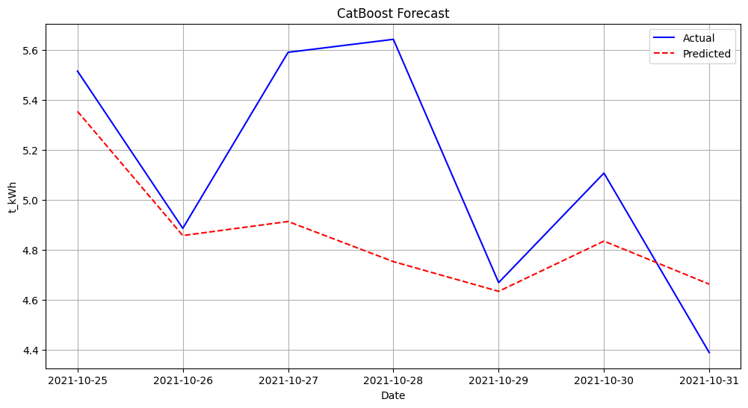
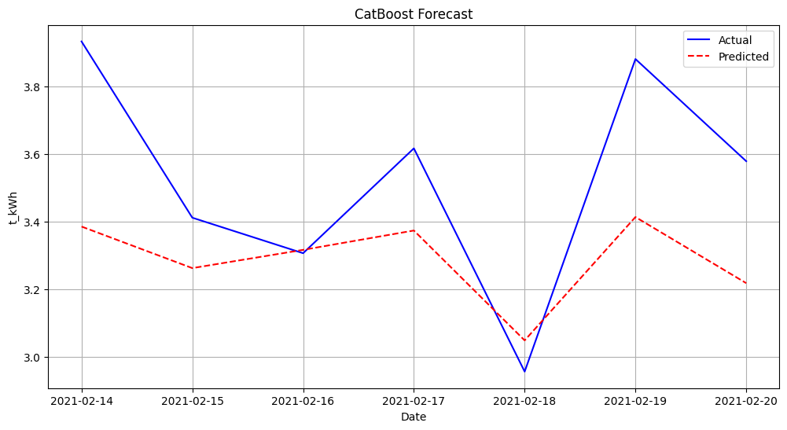
CatBoost
Bareilly
Mathura
Day of Week | Actual Avg Load | Predicted Avg Load | RMSE | MAE | MAPE
Monday | 5.515 | 5.353972 | 0.161028 | 0.161028 | 2.919821
Tuesday | 4.886 | 4.857162 | 0.028838 | 0.028838 | 0.590208
Wednesday | 5.59 | 4.913373 | 0.676627 | 0.676627 | 12.104234
Thursday | 5.642 | 4.752886 | 0.889114 | 0.889114 | 15.758836
Friday | 4.669 | 4.634096 | 0.034904 | 0.034904 | 0.747565
Saturday | 5.107 | 4.834971 | 0.272029 | 0.272029 | 5.326598
Sunday | 4.389 | 4.662728 | 0.273728 | 0.273728 | 6.236678
Day of Week | Actual Avg Load | Predicted Avg Load | RMSE | MAE | MAPE
Monday | 3.412 | 3.262951 | 0.149049 | 0.149049 | 4.368389
Tuesday | 3.307 | 3.3169 | 0.0099 | 0.0099 | 0.299363
Wednesday | 3.617 | 3.374082 | 0.242918 | 0.242918 | 6.716001
Thursday | 2.957 | 3.049299 | 0.092299 | 0.092299 | 3.121381
Friday | 3.881 | 3.41391 | 0.46709 | 0.46709 | 12.035303
Saturday | 3.579 | 3.218503 | 0.360497 | 0.360497 | 10.072566
Sunday | 3.933 | 3.38579 | 0.54721 | 0.54721 | 13.913292

Slide 13
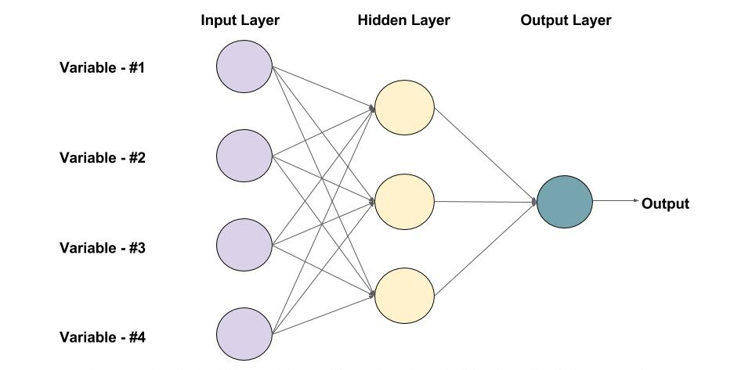
Feed Forward Neural Network
Parameter | Value
iterations | 5000
learning_rate | 0.001
hidden layers | 3
random_state | 42
early_stopping | enabled (500)
Standard Deep Learning Model: Used for structured/tabular data, learning complex relationships between input features.
Multiple Layers: Uses multiple hidden layers and nonlinear activation functions to model complex dependencies.
Flexible Architecture: Easily adaptable for different types of prediction tasks, from regression to classification.

Slide 14
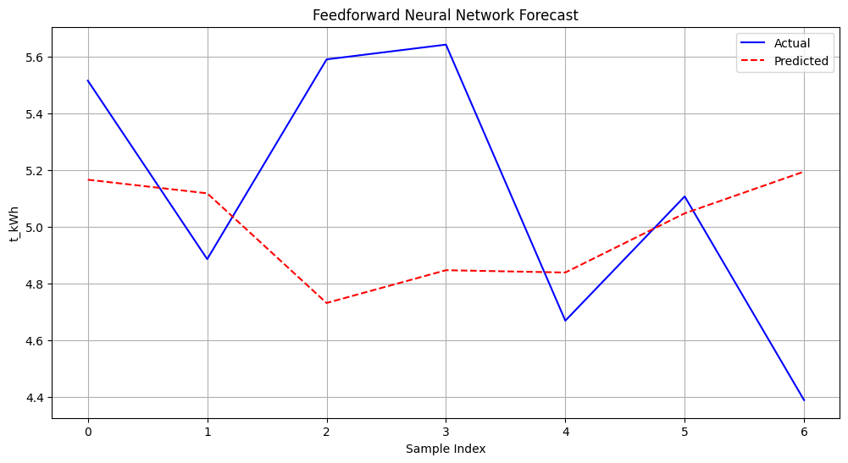
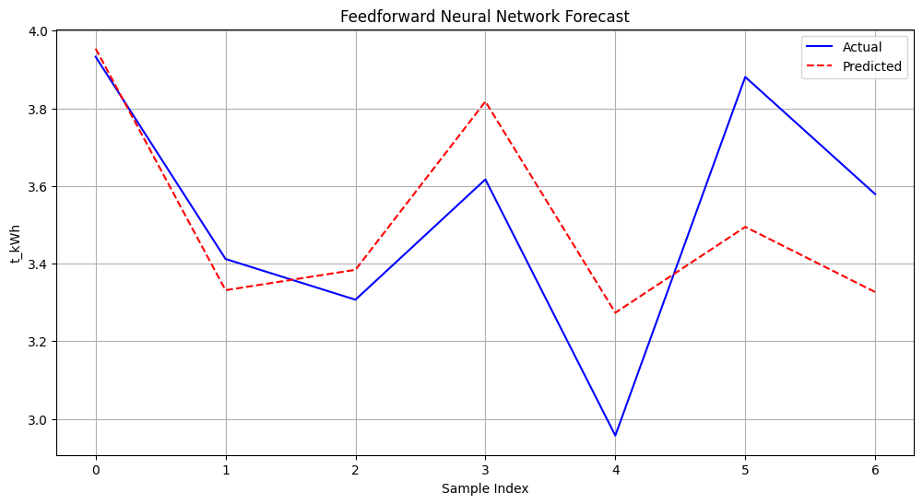
Feed Forward Neural Network
Bareilly
Mathura
Day of Week | Actual Avg Load | Predicted Avg Load | RMSE | MAE | MAPE
Monday | 5.515 | 5.165873 | 0.349127 | 0.349127 | 6.330506
Tuesday | 4.886 | 5.117946 | 0.231946 | 0.231946 | 4.747148
Wednesday | 5.59 | 4.731394 | 0.858606 | 0.858606 | 15.359681
Thursday | 5.642 | 4.846947 | 0.795053 | 0.795053 | 14.091692
Friday | 4.669 | 4.838832 | 0.169832 | 0.169832 | 3.637447
Saturday | 5.107 | 5.047357 | 0.059643 | 0.059643 | 1.167866
Sunday | 4.389 | 5.194476 | 0.805476 | 0.805476 | 18.352145
Day of Week | Actual Avg Load | Predicted Avg Load | RMSE | MAE | MAPE
Monday | 3.412 | 3.331581 | 0.080419 | 0.080419 | 2.356957
Tuesday | 3.307 | 3.384084 | 0.077084 | 0.077084 | 2.330927
Wednesday | 3.617 | 3.817669 | 0.200669 | 0.200669 | 5.547931
Thursday | 2.957 | 3.273462 | 0.316462 | 0.316462 | 10.702141
Friday | 3.881 | 3.494655 | 0.386345 | 0.386345 | 9.95477
Saturday | 3.579 | 3.32678 | 0.25222 | 0.25222 | 7.047211
Sunday | 3.933 | 3.954061 | 0.021061 | 0.021061 | 0.535489

Slide 15
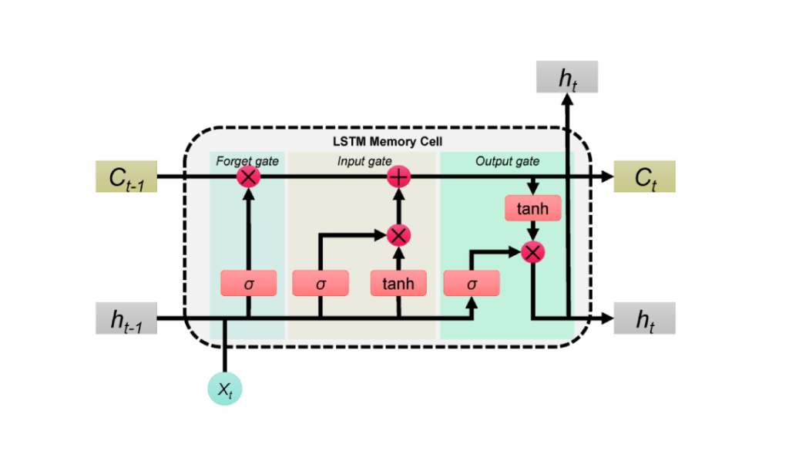
Time Aware LSTM
Parameter | Value
iterations | 5000
learning_rate | 0.001
hidden layers | 3
random_state | 42
early_stopping | enabled (500)
Handles Irregular Time Intervals: Incorporates time gaps between observations, making it suitable for irregularly spaced data.
Enhanced Temporal Modeling: Adjusts gate calculations using time information to better capture temporal dependencies.
Ideal for Time-Series Forecasting: Particularly effective in scenarios where time intervals between data points vary.

Slide 16
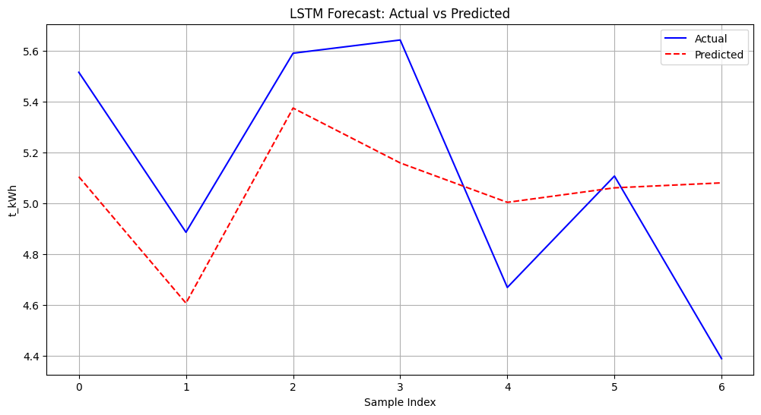
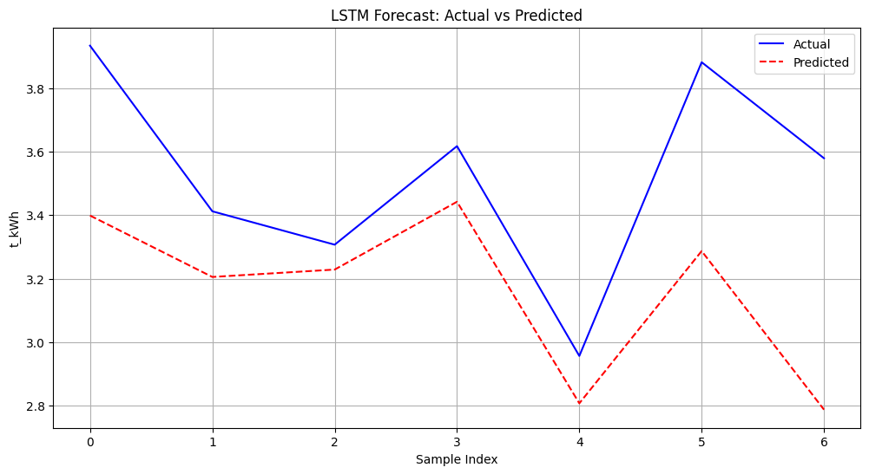
Time Aware LSTM
Bareilly
Mathura
Day of Week | Actual Avg Load | Predicted Avg Load | RMSE | MAE | MAPE
Monday | 5.515 | 5.104367 | 0.410633 | 0.410633 | 7.445752
Tuesday | 4.886 | 4.607265 | 0.278735 | 0.278735 | 5.704769
Wednesday | 5.59 | 5.37438 | 0.21562 | 0.21562 | 3.857243
Thursday | 5.642 | 5.158633 | 0.483367 | 0.483367 | 8.567295
Friday | 4.669 | 5.003614 | 0.334614 | 0.334614 | 7.166726
Saturday | 5.107 | 5.060707 | 0.046293 | 0.046293 | 0.906469
Sunday | 4.389 | 5.080221 | 0.691221 | 0.691221 | 15.748945
Day of Week | Actual Avg Load | Predicted Avg Load | RMSE | MAE | MAPE
Monday | 3.412 | 3.205476 | 0.206524 | 0.206524 | 6.052864
Tuesday | 3.307 | 3.228729 | 0.078271 | 0.078271 | 2.366828
Wednesday | 3.617 | 3.442013 | 0.174987 | 0.174987 | 4.837904
Thursday | 2.957 | 2.807973 | 0.149027 | 0.149027 | 5.039815
Friday | 3.881 | 3.286949 | 0.594051 | 0.594051 | 15.30665
Saturday | 3.579 | 2.788095 | 0.790905 | 0.790905 | 22.098478
Sunday | 3.933 | 3.398676 | 0.534324 | 0.534324 | 13.585656

Slide 17
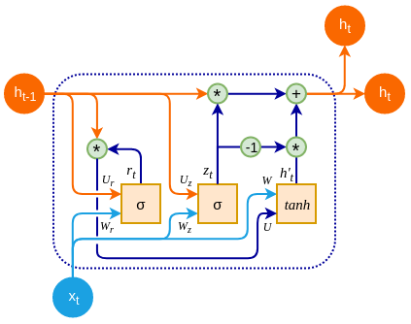
GRU
Parameter | Value
iterations | 5000
learning_rate | 0.001
hidden layer | 2
random_state | 42
early_stopping | enabled (500)
Simplified Recurrent Neural Network: Similar to LSTM but uses fewer gates, resulting in lower computational cost.
Update and Reset Gates: Uses these gates to effectively capture dependencies in sequential data.
Efficient for Time-Series Forecasting: Well-suited for sequential data with faster training compared to LSTMs.

Slide 18
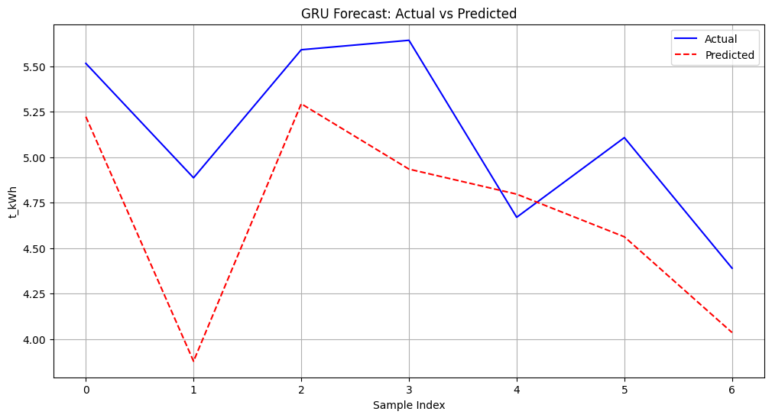
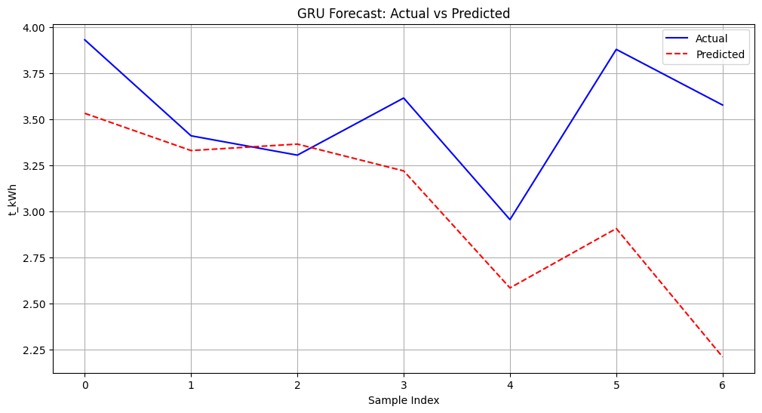
GRU
Bareilly
Mathura
Day of Week | Actual Avg Load | Predicted Avg Load | RMSE | MAE | MAPE
Monday | 5.515 | 5.221915 | 0.293085 | 0.293085 | 5.31432
Tuesday | 4.886 | 3.877542 | 1.008458 | 1.008458 | 20.639746
Wednesday | 5.59 | 5.292861 | 0.297139 | 0.297139 | 5.315546
Thursday | 5.642 | 4.933697 | 0.708303 | 0.708303 | 12.554108
Friday | 4.669 | 4.796175 | 0.127175 | 0.127175 | 2.723827
Saturday | 5.107 | 4.561547 | 0.545453 | 0.545453 | 10.680492
Sunday | 4.389 | 4.035266 | 0.353734 | 0.353734 | 8.05956
Day of Week | Actual Avg Load | Predicted Avg Load | RMSE | MAE | MAPE
Monday | 3.412 | 3.331873 | 0.080127 | 0.080127 | 2.348376
Tuesday | 3.307 | 3.366956 | 0.059956 | 0.059956 | 1.81301
Wednesday | 3.617 | 3.221472 | 0.395528 | 0.395528 | 10.935263
Thursday | 2.957 | 2.586318 | 0.370682 | 0.370682 | 12.535761
Friday | 3.881 | 2.90849 | 0.97251 | 0.97251 | 25.05824
Saturday | 3.579 | 2.211716 | 1.367284 | 1.367284 | 38.202957
Sunday | 3.933 | 3.534073 | 0.398927 | 0.398927 | 10.143075

Slide 19
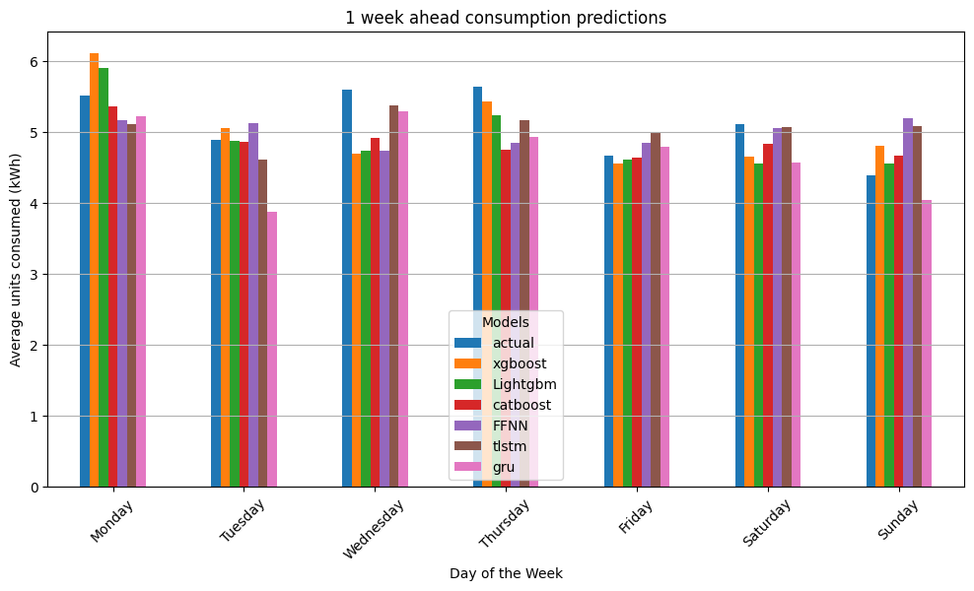
Weekly forecast
Bareilly

Slide 20
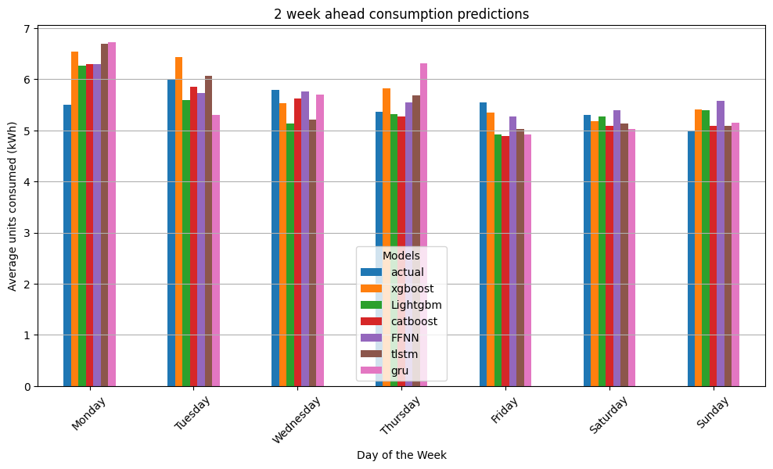
Weekly forecast
Bareilly

Slide 21
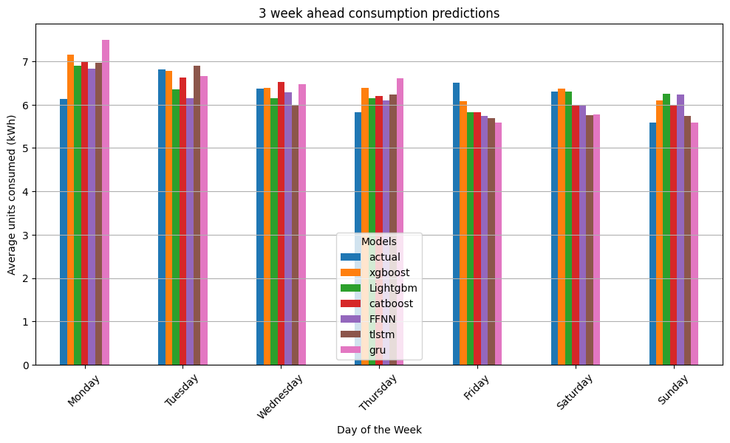
Weekly forecast
Bareilly

Slide 22
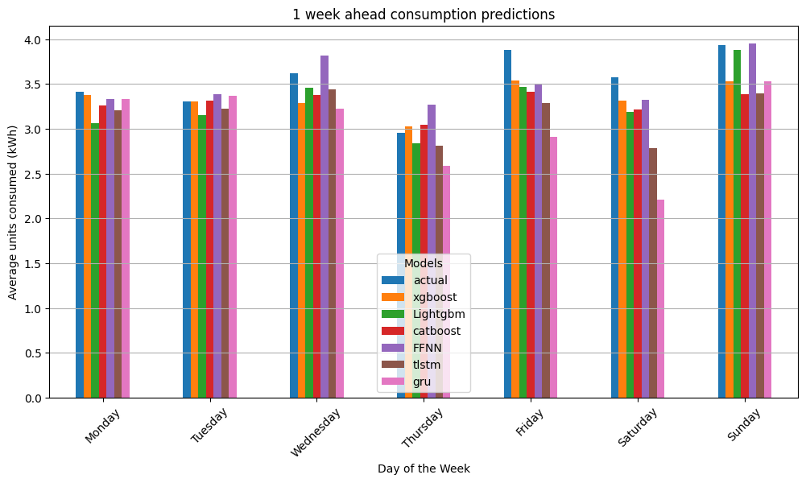
Weekly forecast
Mathura

Slide 23
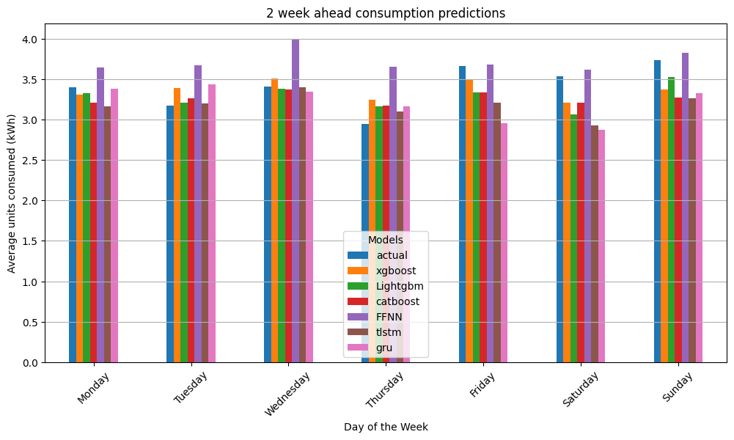
Weekly forecast
Mathura

Slide 24
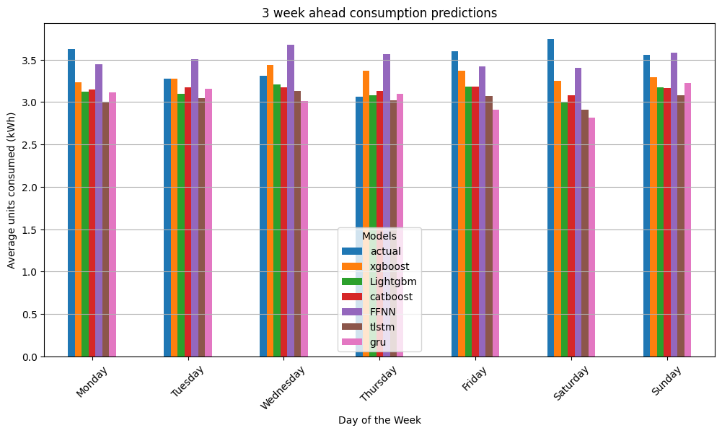
Weekly forecast
Mathura

Slide 25
Conclusion
LSTM and GRU model performed better for 1-week predictions
Monday’s predictions and mid weekdays predictions were much better
For 2/3-week predictions, middle weekdays trend were captured more accurately by all the models
Due to resource constraint and experimental purpose, free weather daily data was used compared to minute data.
Neural networks performed much better compared to boosting models.
Among boosting models, XG boost performed well.
Time-LLM was also done to capture the temporal features, but the forecasting was very poor.
Future scope includes weighted averages of the best performing models for higher accuracy.

Slide 26


