Slide 1
AAGI
Analytics for the Australian Grain Industry

Slide 2
Table of contents
An AAGI pptx Theme for Quarto
Bullet point
Tables
Example
Basic Figures
Figures with {ggplot2}
Slides With Columns
Thank You

Slide 3
An AAGI pptx Theme for Quarto
This Quarto extension allows you to create your slides using a theme that follows AAGI typography and colour styles and provides the official AAGI logo and cover image for the title slide.

Slide 4
Bullet point
Point 1
Point 2

Slide 5
Tables
For tables, we suggest paring with the R package {AAGIThemes} to provide AAGI themed tables using theme_ft_aagi, that offers more flexibility in formatting.

Slide 6
Example
Ozone | Solar.R | Wind | Temp | Month | Day | Month Name
41 | 190 | 7.4 | 67 | 5 | 1 | May
36 | 118 | 8.0 | 72 | 5 | 2 | May
12 | 149 | 12.6 | 74 | 5 | 3 | May
18 | 313 | 11.5 | 62 | 5 | 4 | May
 |  | 14.3 | 56 | 5 | 5 | May
28 |  | 14.9 | 66 | 5 | 6 | May

Slide 7
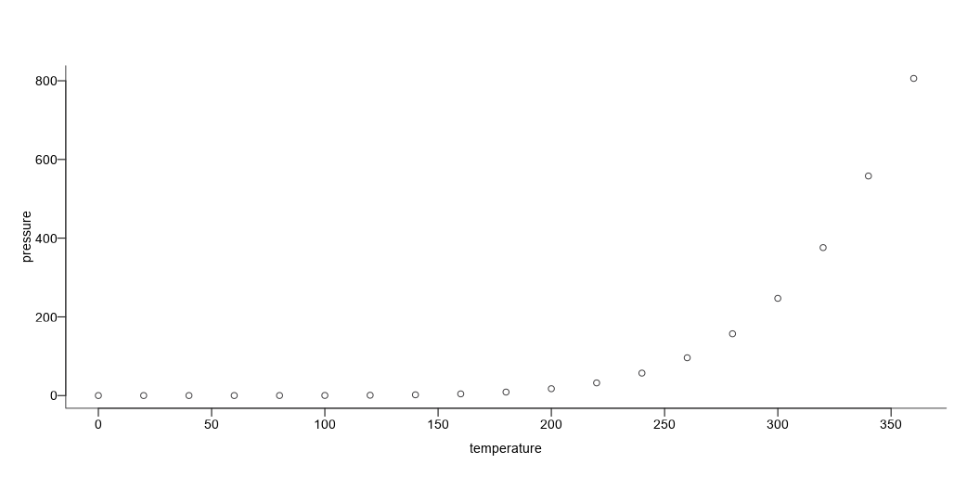
Basic Figures
{AAGIThemes} also provides support for theming basic figures in R, for example.

Slide 8
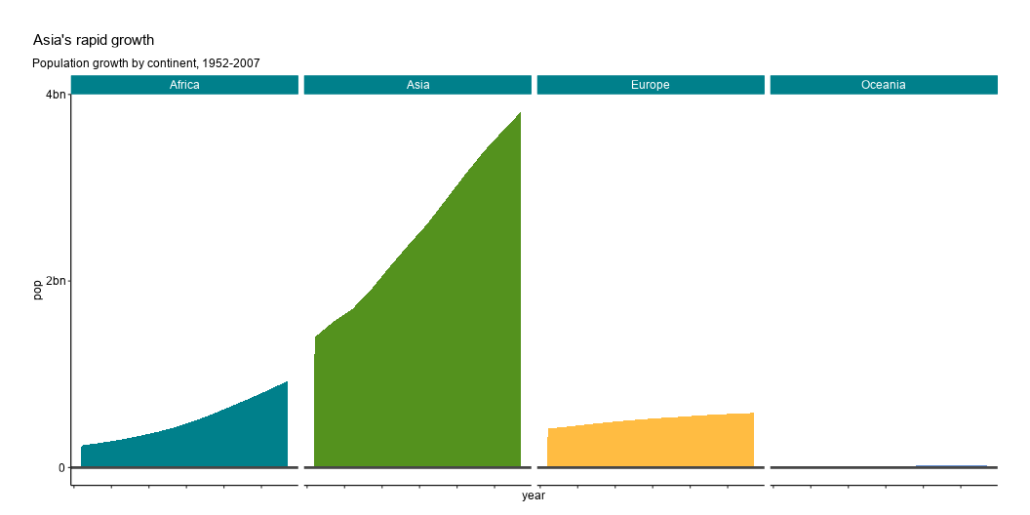
Figures with {ggplot2}
{AAGIThemes} also provides support for theming {ggplot2} outputs in R, for example.

Slide 9
Slides With Columns
This is a column on the left.
This is a column on the right.

Slide 10
Thank You

