Slide 1
AAGI PPTX Presentation
Adam Sparks

Slide 2
Table of contents
An AAGI pptx Theme for Quarto
Bullet point
Tables
Example
Basic Figures
Figures with {ggplot2}
Slides With Columns
Thank You

Slide 3
An AAGI pptx Theme for Quarto
This Quarto extension allows you to create slides using an AAGI-styled theme.

Slide 4
Bullet point
Point 1
Point 2

Slide 5
Tables
For tables, we suggest using {AAGIThemes} with theme_ft_aagi.

Slide 6
Example
Ozone | Solar.R | Wind | Temp | Month | Day | Month Name
41 | 190 | 7.4 | 67 | 5 | 1 | May
36 | 118 | 8.0 | 72 | 5 | 2 | May
12 | 149 | 12.6 | 74 | 5 | 3 | May
18 | 313 | 11.5 | 62 | 5 | 4 | May
 |  | 14.3 | 56 | 5 | 5 | May
28 |  | 14.9 | 66 | 5 | 6 | May

Slide 7
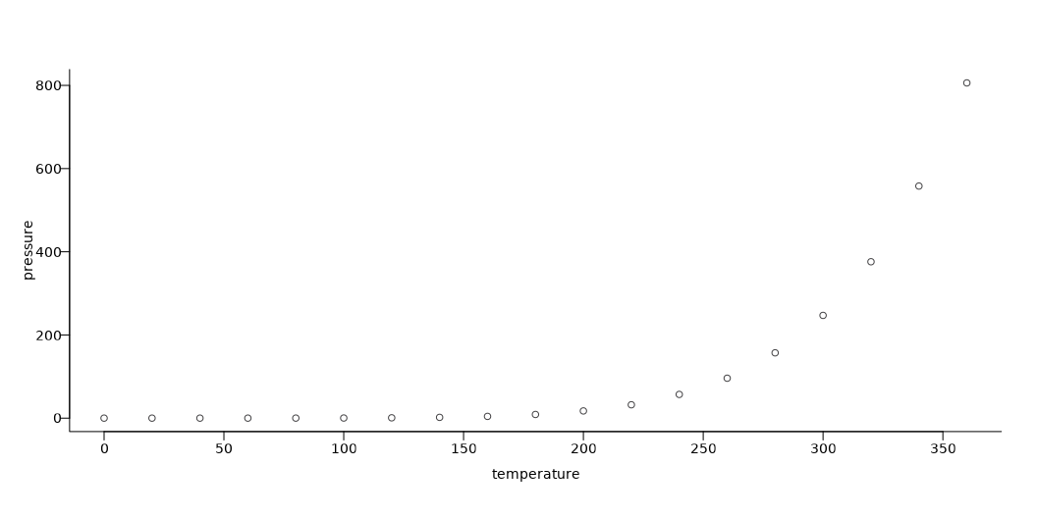
Basic Figures

Slide 8
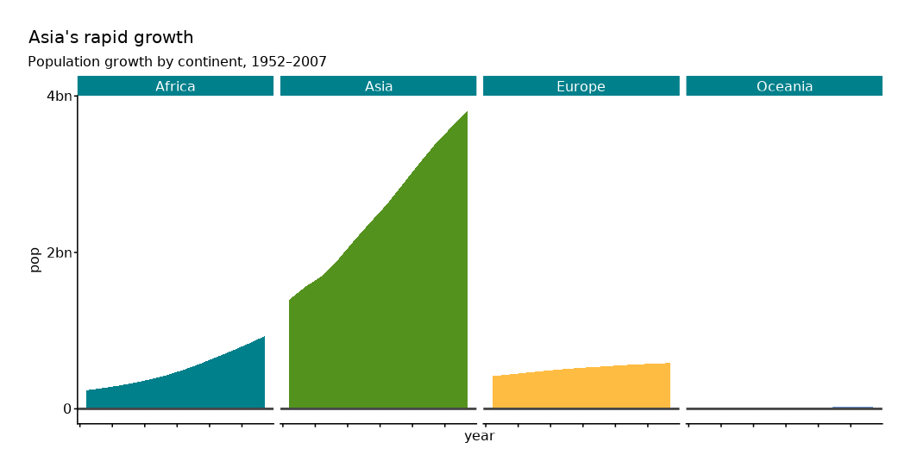
Figures with {ggplot2}

Slide 9
Slides With Columns
This is a column on the left.
This is a column on the right.

Slide 10
Thank You

