Slide 1


Timeless

Slide 2
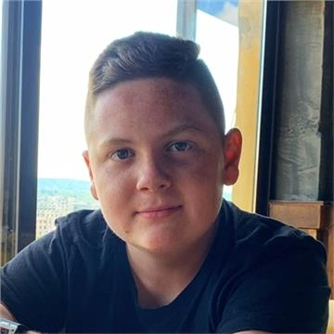
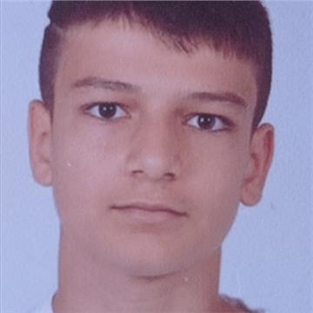
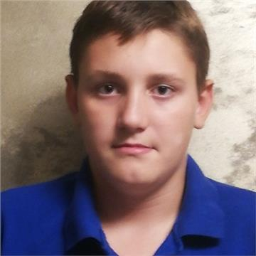
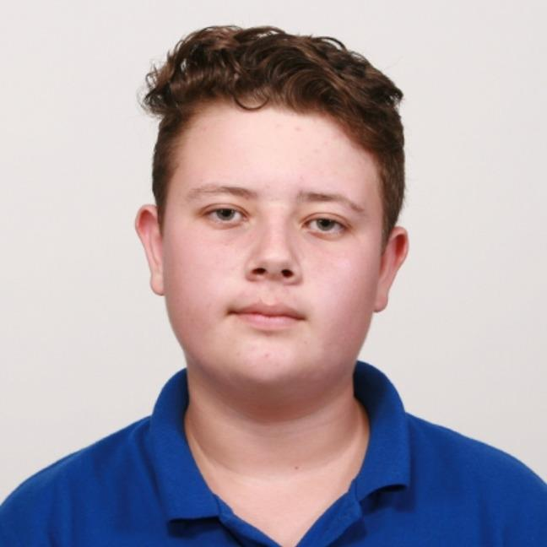
Our team
01
02
04
03
Anton Goreshtilov – Scrum Trainer
Daniel Mihalev - Designer
Yusmen Osman – BackEnd Developer
Nikolay Zabirov– FrontEnd Developer

Slide 3



Stages of development

Slide 4











Technologies that we used

Slide 5
Let’s jump to the project

