Slide 1


An Extensive Study on Model Architecture and Program Representation in the Domain of Learning-based Automated Program Repair
Dániel Horváth, Viktor Csuvik, Tibor Gyimóthy, László Vidács
The research presented in this paper was supported in part by the ÚNKP-22-3-SZTE New National Excellence Program of the Ministry for Culture and Innovation from the source of the National Research, Development and Innovation fund and by the European Union project RRF-2.3.1-21-2022-00004 within the framework of the Artificial Intelligence National Laboratory. The national project TKP2021-NVA-09 also supported the work. Project no. TKP2021-NVA-09 has been implemented with the support provided by the Ministry of Innovation and Technology of Hungary from the National Research, Development and Innovation Fund, financed under the TKP2021-NVA funding scheme.
APR
^{4th} International Workshop on Automated Program Repair
APR 2023 | Department of Software Engineering
16.05.2023

Slide 2
Goal of Study
Compare program representations
Compare performance of different pretrained, and empty models
Compare performance on different datasets of various languages
APR 2023 | Department of Software Engineering
16.05.2023

Slide 3
Experiments
Models
T5-base
CodeT5-base
RoBERTa + Graph Encoder
Representations
Text
Command Sequence
AST + Text
Datasets
Java
JavaScript
APR 2023 | Department of Software Engineering
16.05.2023

Slide 4
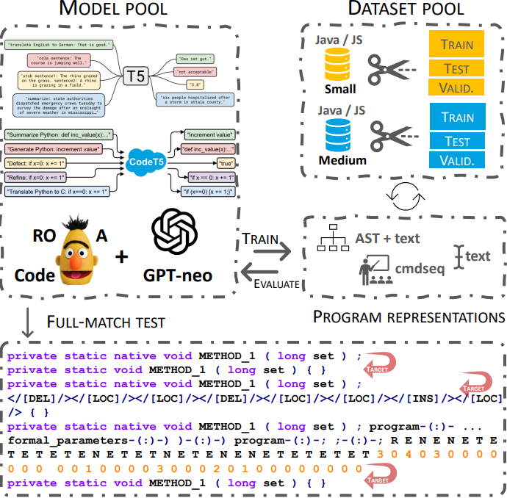
Data Representations
Text
public java.lang.Boolean METHOD_1(java.lang.String id) { return VAR_1.METHOD_1(id); }
public java.lang.Boolean METHOD_1(java.lang.String id) { return VAR_1.METHOD_1(java.lang.Integer.parseInt(id)); }
private static native void METHOD_1(long set);
private static void METHOD_1(long set) {
}
APR 2023 | Department of Software Engineering
16.05.2023

Slide 5
Data Representations – AST + text
1
2
5
(1:1) -> (1:2) -> (2:2) -> (2:3) -> (3:3) -> (2:4) -> (4:4) -> (1:5) -> (5:5)
R -> E -> N -> E -> T -> E -> T -> E -> T
2 -> 0 -> 2 -> 0 -> 0 -> 0 -> 0 -> 0 -> 0
3
4
nodes & edges
type info (R, E, N, T)
number of children
public java.lang.Boolean METHOD_1(java.lang.String id) { return VAR_1.METHOD_1(id); }
program-(:)-program program-(:)-local_variable_declaration local_variable_declaration-(:)-local_variable_declaration ... argument_list-(:)-) )-(:)-) return_statement-(:)-; ;-(:)-; block-(:)-} }-(:)-}
R E N E N E T E N E N E T E T E T E T E T E ... T E N E T E N E T E N E T E T E T E N E T E T E T E T E T
3 0 4 0 1 0 0 0 3 0 3 0 0 0 0 0 0 0 0 0 0 0 ... 0 0 3 0 0 0 3 0 0 0 4 0 0 0 0 0 0 0 3 0 0 0 0 0 0 0 0 0 0
public java.lang.Boolean METHOD_1(java.lang.String id) { return VAR_1.METHOD_1(java.lang.Integer.parseInt(id)); }
APR 2023 | Department of Software Engineering
16.05.2023

Slide 6
Data Representations – Command Sequence
public java.lang.Boolean METHOD_1(java.lang.String id) { return VAR_1.METHOD_1(id); }
public java.lang.Boolean METHOD_1(java.lang.String id) { return VAR_1.METHOD_1(java.lang.Integer.parseInt(id)); }
</[INS]/></[LOC]/> java.lang.Integer.parseInt (</[INS]/></[LOC]/> )
?
?
private static native void METHOD_1(long set);
private static void METHOD_1(long set) {
}
</[DEL]/></[LOC]/></[LOC]/></[DEL]/></[LOC]/></[LOC]/></[INS]/></[LOC]/> { }
?
?
?
?
?
APR 2023 | Department of Software Engineering
16.05.2023

Slide 7
Experiments and Results - Java
Model | Repr. | Pretrained | Dataset | Accuracy | 100% accuracy | Epochs
T5-base, LM | text | Yes | Java small | 0.9104 | 0.0000 | 42
T5-base, LM | text | Yes | Java medium | 0.8577 | 0.0000 | 25
T5-base, empty | text | No | Java small | 0.9371 | 0.0524 | 27
T5-base, empty | text | No | Java medium | 0.9795 | 0.0652 | 31
T5-base | text | Yes | Java small | 0.9756 | 0.1491 | 9
T5-base | text | Yes | Java medium | 0.9864 | 0.0588 | 9
CodeT5-base | text | Yes | Java small | 0.9684 | 0.1988 | 9
CodeT5-base | text | Yes | Java medium | 0.9817 | 0.1187 | 9
T5-base, empty | cmdseq-token | No | Java small | 0.7884 | 0.2598 | 12
T5-base, empty | cmdseq-token | No | Java medium | 0.7476 | 0.1488 | 15
T5-base | cmdseq-token | Yes | Java small | 0.8201 | 0.2946 | 16
T5-base | cmdseq-token | Yes | Java medium | 0.8107 | 0.1733 | 18
CodeT5-base | cmdseq-token | Yes | Java small | 0.8371 | 0.3064 | 12
CodeT5-base | cmdseq-token | Yes | Java medium | 0.8051 | 0.1853 | 10
RoBERTa-base, CodeBERT-base, gpt-neo-125M | text + ast | Yes | Java small | 0.3862 | 0.0077 | 18
RoBERTa-base, CodeBERT-base, gpt-neo-125M | text + ast | Yes | Java medium | 0.2783 | 0.0000 | 13
APR 2023 | Department of Software Engineering
16.05.2023

Slide 8
Experiments and Results - FixJS
Model | Repr. | Pretrained | Dataset | Accuracy | 100% accuracy | Epochs
T5-base, empty | text | No | FixJS small | 0.8264 | 0.0030 | 24
T5-base, empty | text | No | FixJS medium | 0.8107 | 0.0000 | 18
T5-base | text | Yes | FixJS small | 0.9245 | 0.0496 | 1
T5-base | text | Yes | FixJS medium | 0.9369 | 0.0262 | 16
CodeT5-base | text | Yes | FixJS small | 0.9078 | 0.0754 | 9
CodeT5-base | text | Yes | FixJS medium | 0.9207 | 0.0464 | 9
T5-base, empty | cmdseq-token | No | FixJS small | 0.6917 | 0.0714 | 21
T5-base, empty | cmdseq-token | No | FixJS medium | 0.6924 | 0.0149 | 21
T5-base | cmdseq-token | Yes | FixJS small | 0.6502 | 0.0000 | 17
T5-base | cmdseq-token | Yes | FixJS medium | 0.7265 | 0.0184 | 30
CodeT5-base | cmdseq-token | Yes | FixJS small | 0.6190 | 0.0000 | 13
CodeT5-base | cmdseq-token | Yes | FixJS medium | 0.7045 | 0.0639 | 16
RoBERTa-base, CodeBERT-base, gpt-neo-125M | text + ast | Yes | FixJS small | 0.2073 | 0.0010 | 24
RoBERTa-base, CodeBERT-base, gpt-neo-125M | text + ast | Yes | FixJS medium | 0.1504 | 0.0000 | 19
APR 2023 | Department of Software Engineering
16.05.2023

Slide 9

Conclusion
DATA
APR 2023 | Department of Software Engineering
16.05.2023

Slide 10
Thank You for Your Attention!
The research presented in this paper was supported in part by the ÚNKP-22-3-SZTE New National Excellence Program of the Ministry for Culture and Innovation from the source of the National Research, Development and Innovation fund and by the European Union project RRF-2.3.1-21-2022-00004 within the framework of the Artificial Intelligence National Laboratory. The national project TKP2021-NVA-09 also supported the work. Project no. TKP2021-NVA-09 has been implemented with the support provided by the Ministry of Innovation and Technology of Hungary from the National Research, Development and Innovation Fund, financed under the TKP2021-NVA funding scheme.
APR 2023 | Department of Software Engineering
16.05.2023

