Slide 1

AAI-540
Machine Learning operation
By:
Aaron Ramirez
Andrew roehr
Luis Lopez

Slide 2
Agenda
Business case, Architecture, Feature Store, Model & Model Registry – Aaron
Infrastructure Monitoring, Model and Data Monitoring, Monitoring Dashboard – Luis
Model Deployment, Endpoint Invocation and Output, CI/CD - Andrew

Slide 3

Overview & Initial Design
Business Case Architecture and modeling

Slide 4
Business Case
Problem:
Unexpected vehicle breakdowns disrupt operations and increase costs, especially for fleet managers.
Traditional maintenance is reactive, leading to higher repair expenses and downtime.
Solution
Develop a machine learning model to predict maintenance needs
Leverage key vehicle data like maintenance history, mileage, engine type etc
Model to drive reduce operational cost, proactive maintenance and data driven insights.
Key Metrics
Accuracy, precision, recall, F1
Notes:
By creating a SageMaker model quality monitor object, this is used to run jobs the establish baseline quality metrics for the model to later monitor those metrics in production. This object configures the compute resources and permissions needed to run your model quality checks
Suggest baseline runs a "baselining job” by taking the training or validation dataset via the baseline URI and computes key quality metrics (like accuracy, precision, recall, F1/F2 score, etc.) for the model using the provided attributes.
The problem type is set to "BinaryClassification", meaning the job expects a binary (two-class) classification problem.
- The Inference attribute, probability attribute, and ground truth attribute tell SageMaker which columns in the data are the model predictions, the predicted probabilities, and the actual labels.

Slide 5
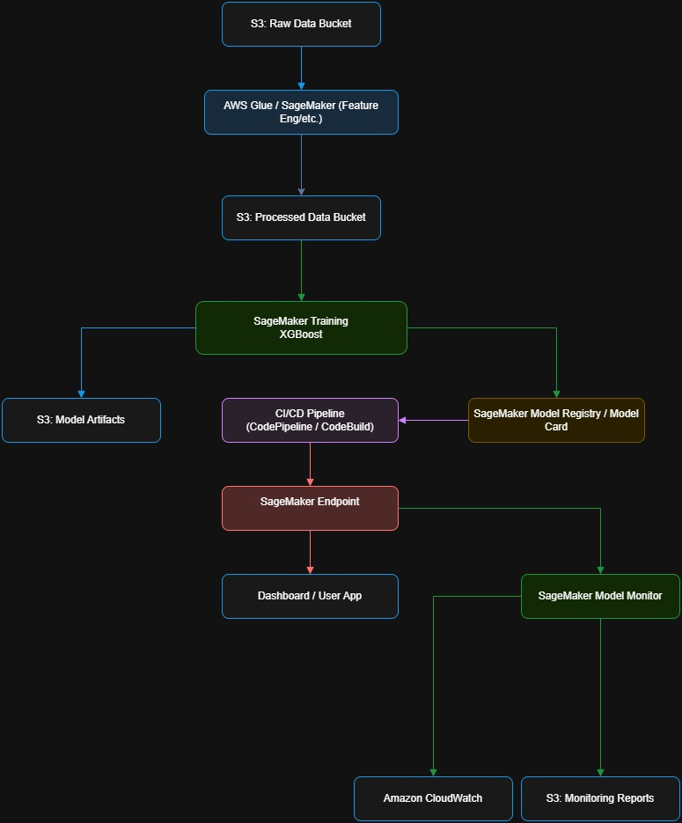
Architecture
Notes:
By creating a SageMaker model quality monitor object, this is used to run jobs the establish baseline quality metrics for the model to later monitor those metrics in production. This object configures the compute resources and permissions needed to run your model quality checks
Suggest baseline runs a "baselining job” by taking the training or validation dataset via the baseline URI and computes key quality metrics (like accuracy, precision, recall, F1/F2 score, etc.) for the model using the provided attributes.
The problem type is set to "BinaryClassification", meaning the job expects a binary (two-class) classification problem.
- The Inference attribute, probability attribute, and ground truth attribute tell SageMaker which columns in the data are the model predictions, the predicted probabilities, and the actual labels.

Slide 6
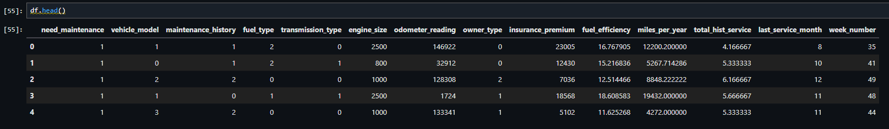
EDA & Feature Engineering
Grouped related features: Combined service, accident, and reported issues, and aggregated tire, brake, and battery status as health indicators.
Engineered new features: Created miles per year, total historical service, last service date, and last service week for richer insights.
Categorical encoding & normalization: Encoded categorical variables (model, fuel, transmission, owner type) and scaled numerical data for consistency.

Slide 7
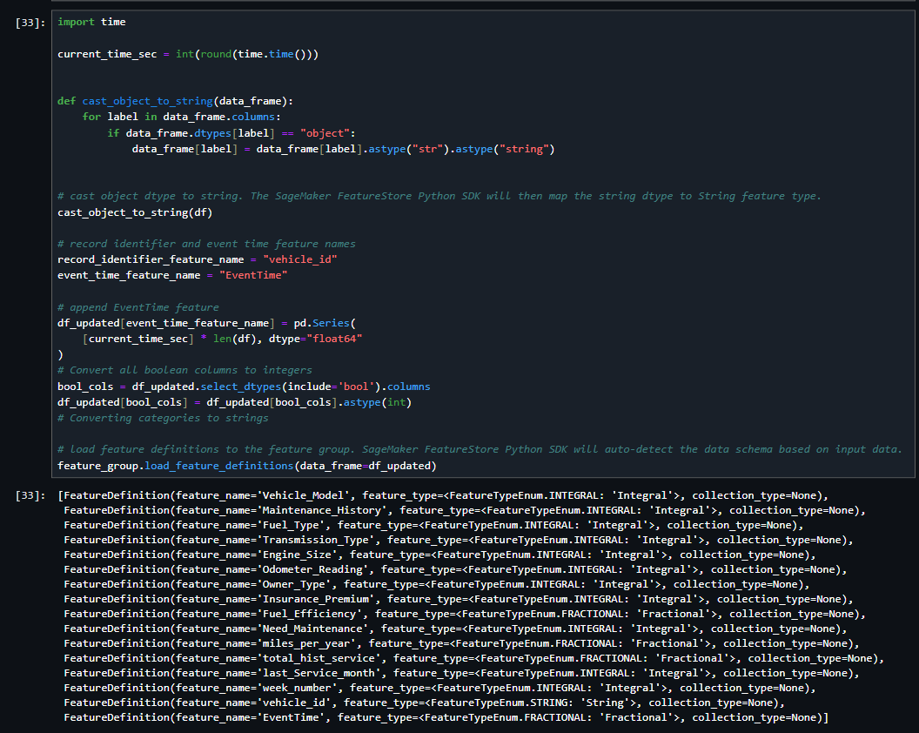
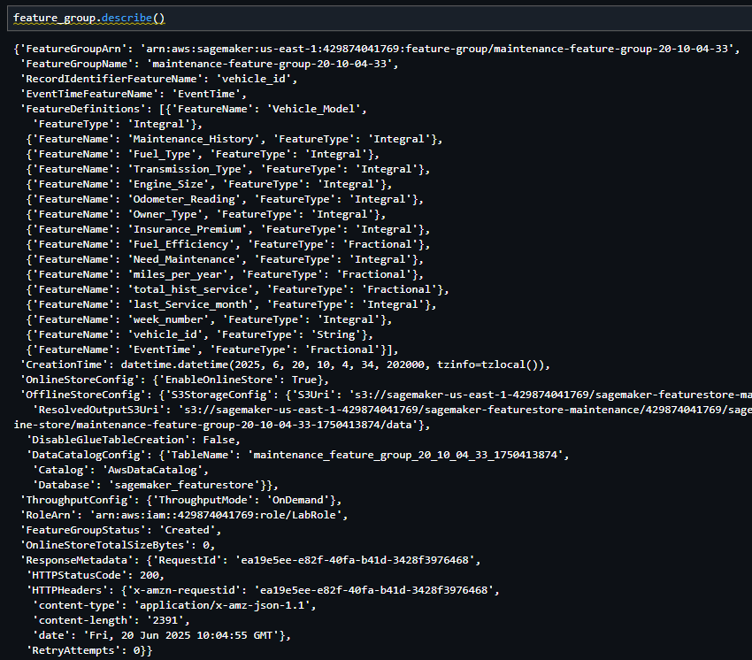
Feature Store

Slide 8
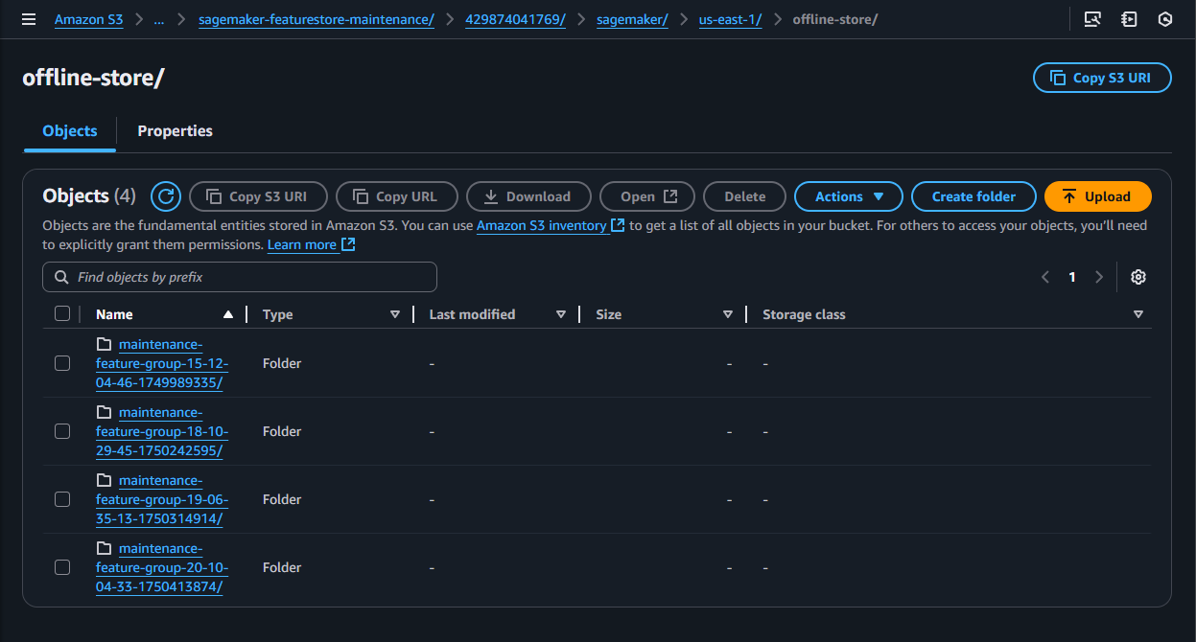
Feature Store

Slide 9
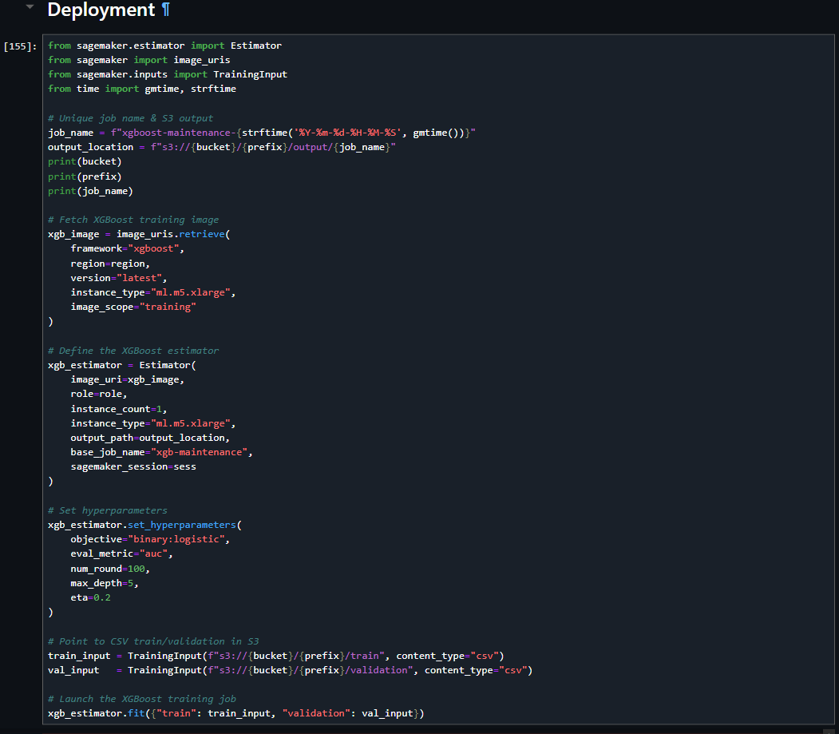
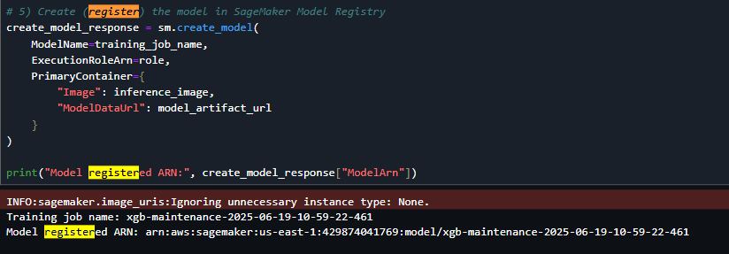

Model & Model Registry

Slide 10
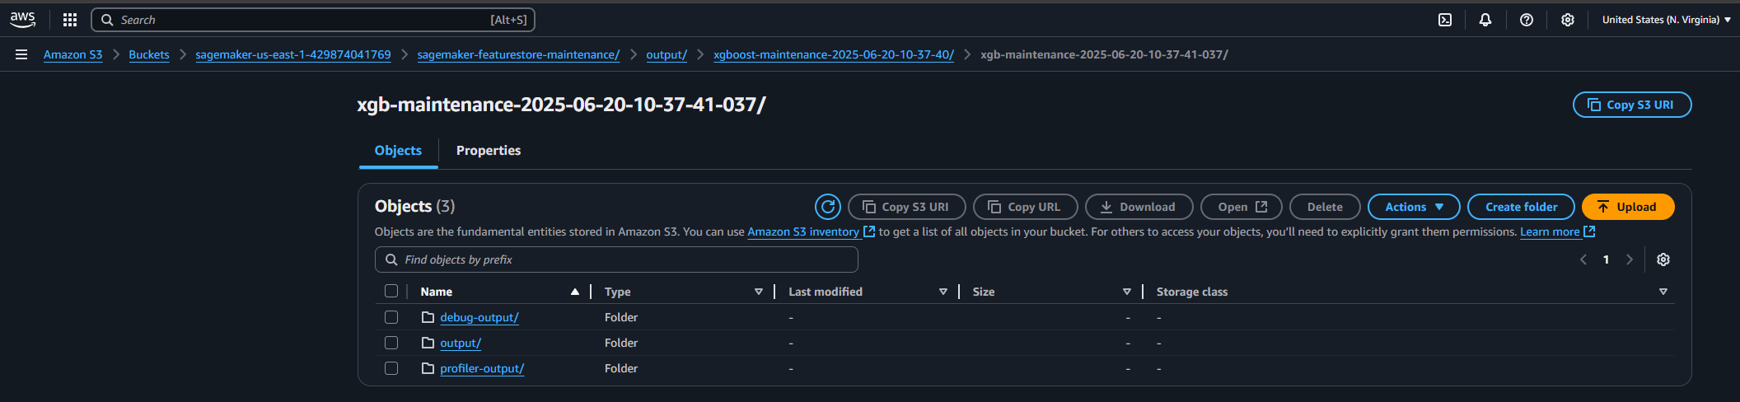
Model & Model Registry

Slide 11

System optics
Monitoring

Slide 12
Monitoring
Monitoring in AWS is a foundational practice for cloud architects, enabling continuous visibility into critical system and model metrics.
In the era of cloud-driven transformation, it’s essential to maintain transparency not only on a model’s predictive performance but also on resource utilization and operational efficiency.
Effective collaboration across teams ensures the identification and tracking of key metrics that drive cost optimization, inform business strategy, and deliver meaningful results for stakeholders and end users alike.
Notes:
When deploying machine learning models in AWS, it’s crucial to proactively select and track metrics that directly support your project’s goals. This focus enables meaningful monitoring and ongoing optimization.
One critical aspect of monitoring is not only to see resource allocation or performance metrics but also evaluate whether or not your data is shifting. Data is never constant in Machine Learning, historical data used to train these models change over time and we have to constantly monitor if there are any shifts in live data so we can address these issues promptly.

Slide 13
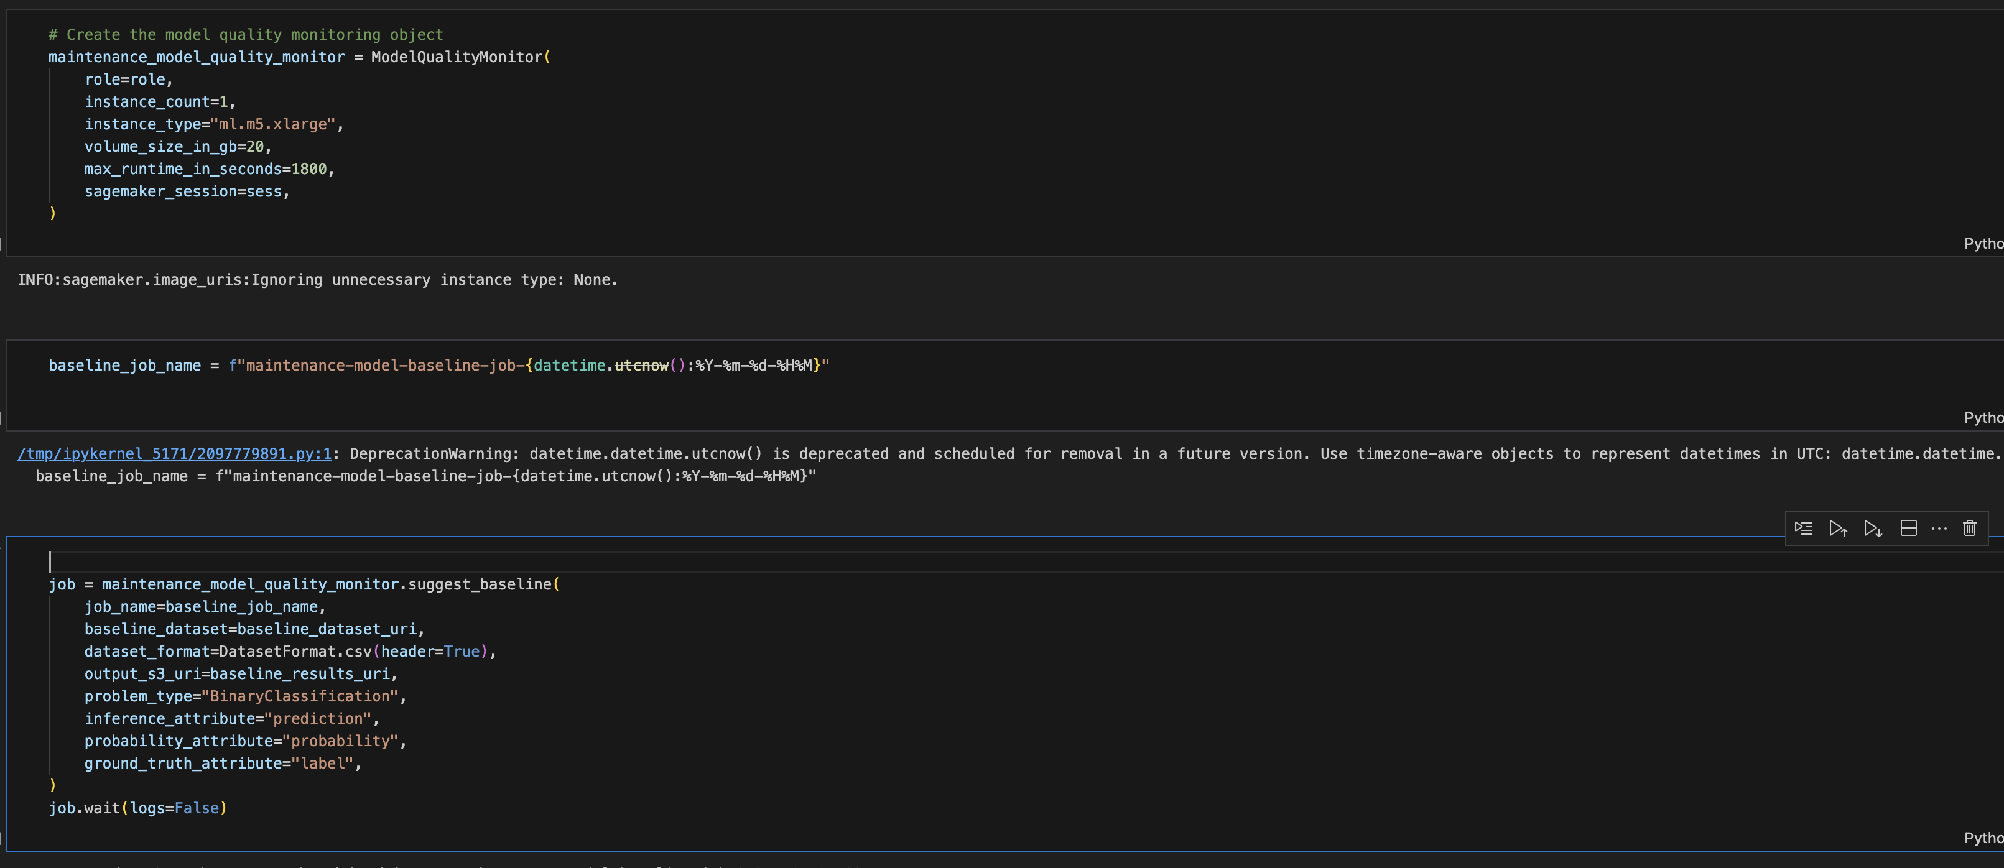
Code Quality Monitoring
Notes:
By creating a SageMaker model quality monitor object, this is used to run jobs the establish baseline quality metrics for the model to later monitor those metrics in production. This object configures the compute resources and permissions needed to run your model quality checks
Suggest baseline runs a "baselining job” by taking the training or validation dataset via the baseline URI and computes key quality metrics (like accuracy, precision, recall, F1/F2 score, etc.) for the model using the provided attributes.
The problem type is set to "BinaryClassification", meaning the job expects a binary (two-class) classification problem.
- The Inference attribute, probability attribute, and ground truth attribute tell SageMaker which columns in the data are the model predictions, the predicted probabilities, and the actual labels.

Slide 14
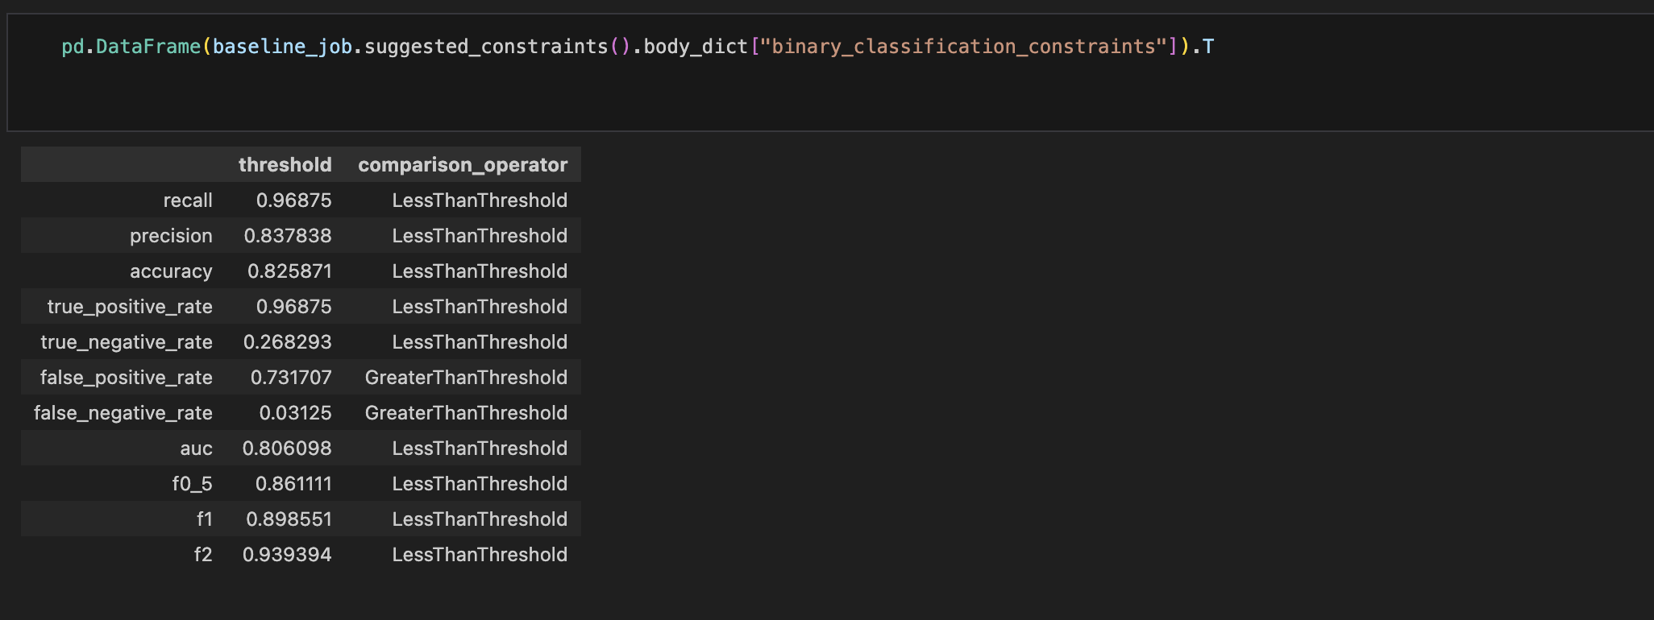
Calculated metrics result
Notes:
From the Results we can see how each metric is compared to their corresponding threshold and described by the comparison operator column

Slide 15
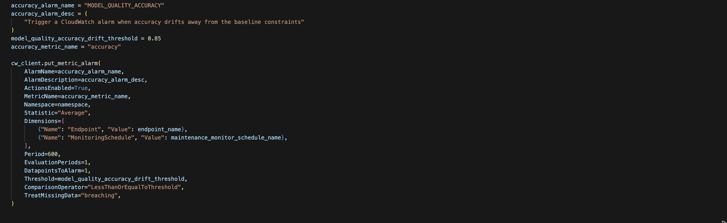
Model Performance
Notes:
In practice, we can create custom dashboards and deploy them to Amazon CloudWatch to monitor key model metrics in real time. As demonstrated in the code above, we have the flexibility to define drift thresholds for metrics such as accuracy. Whenever a monitored metric falls below its threshold, CloudWatch triggers an alert.
These alerts can be fully customized by selecting the appropriate metric, setting the evaluation period, and specifying other criteria, enabling proactive monitoring and rapid response to changes in model performance.

Slide 16
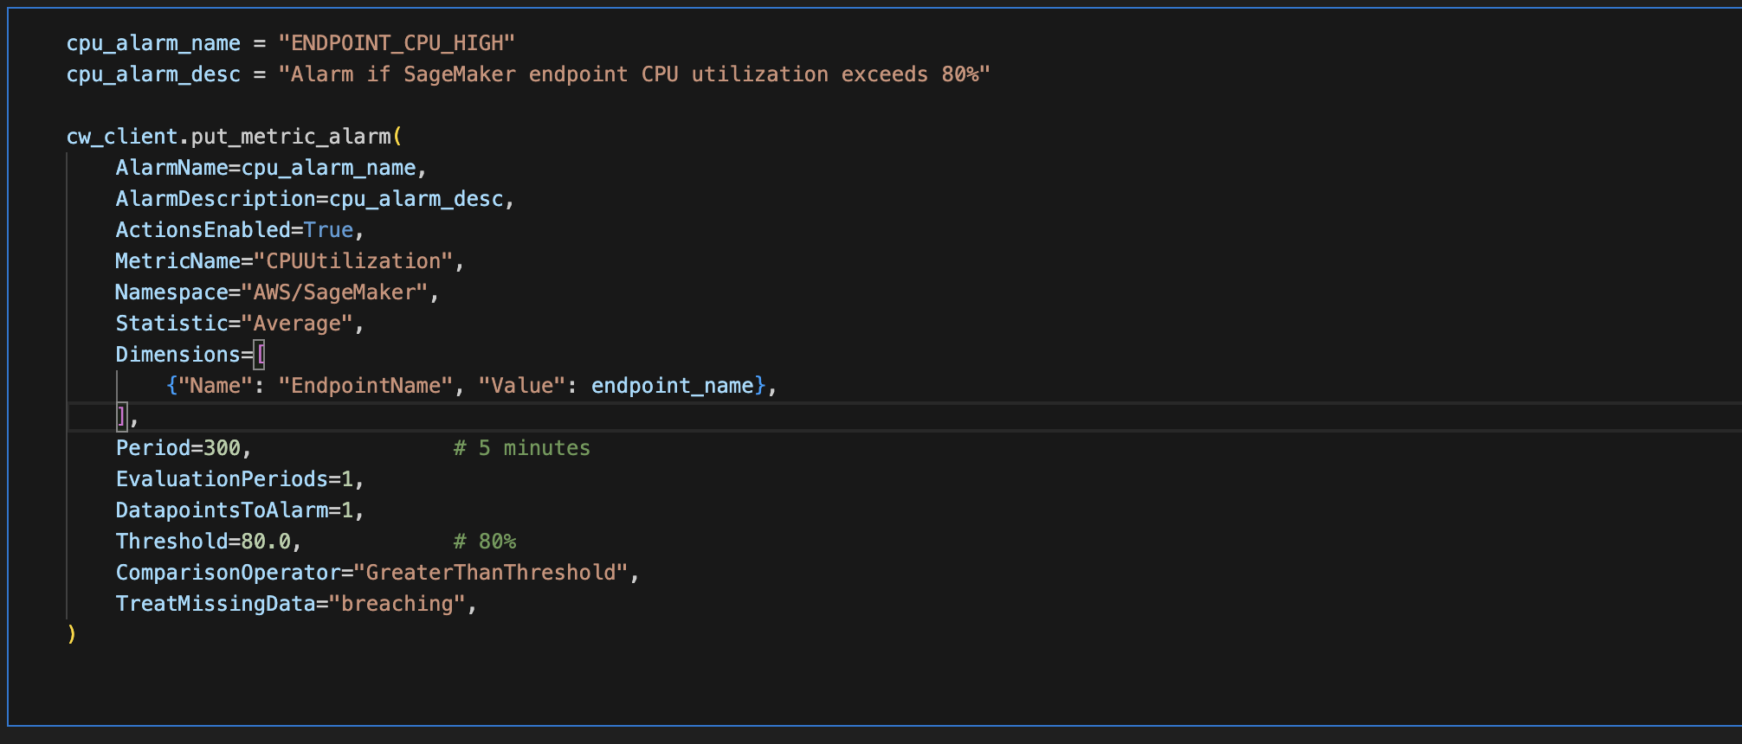
Model Performance (Contd.)
Notes:
Similarly, we can create CloudWatch alarms to monitor key resource performance metrics such as CPU utilization, latency, endpoint invocations, and server-side errors. By actively tracking these metrics, we can better manage physical resources and ensure that our endpoints consistently deliver reliable results to end users.
In a business context, minimizing operational costs is essential for maximizing profit. Proactive monitoring enables us to respond quickly to performance issues, maintain high model quality, and optimize operations throughout deployment and production.

Slide 17
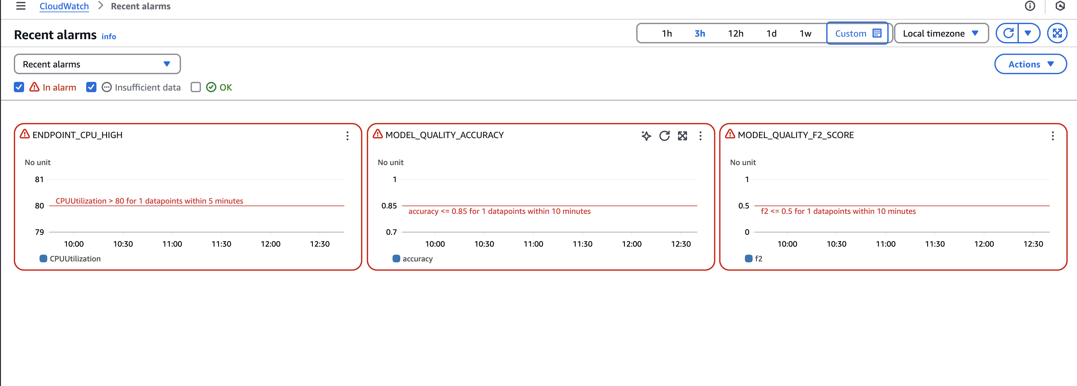
Dashboard
Notes:
From this Dashboard we can monitor our CPU utilization, Our Accuracy and F2 performance metrics. We can also see our preset threshold to monitor fluctuation below this marker and then alert us.

Slide 18
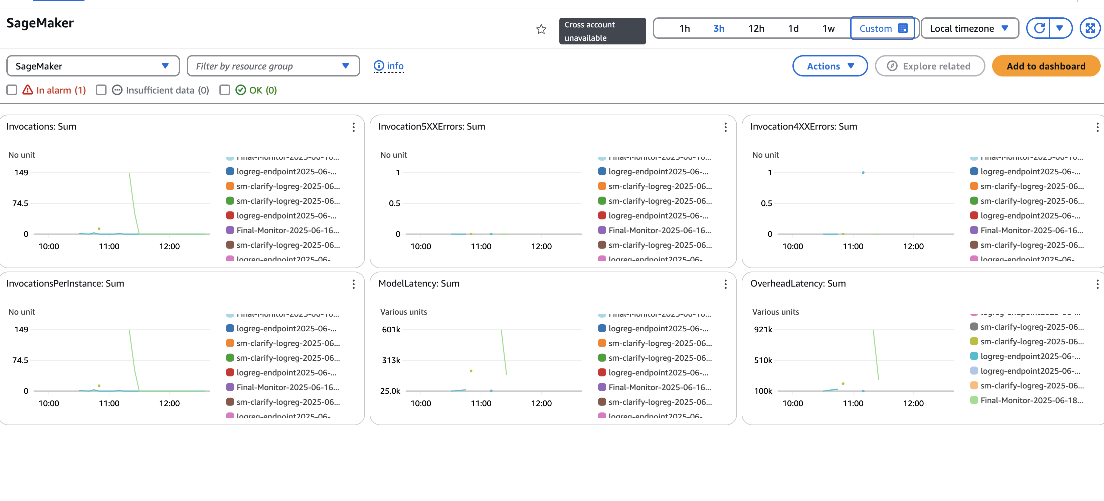
Dashboard (Contd)
Notes:
In this Dashboard we can see more detail about our model such as Endpoint Invocations and Invocation Errors due to Server, Latency which is the time it takes for our model to make inferences, Overhead Latency and persistence the total number of invocations handled by each instance behind your endpoint.
By leveraging live monitors and dashboards, we can transform complex numerical outputs from our models into intuitive visualizations, enabling a deeper understanding of real-time model performance. This proactive monitoring empowers us to identify and address issues early, before they escalate into reputational or financial problems.
Thank you
Now I will let Andrew take it from here and talk about model deployment and Mlops pipelines.

Slide 19
Model Deployment
Model Packaging & Registration: Final trained artifacts are containerized into a Docker image and pushed to Amazon ECR.
Automated CI/CD Deployment: A CodePipeline/CodeBuild workflow builds the image and updates a SageMaker Endpoint, exposing a real-time inference API.
Monitoring & Drift Detection: CloudWatch gathers endpoint metrics while SageMaker Model Monitor profiles incoming data for drift, writing monitoring reports to S3.
Dashboard Visualization: The live endpoint status and Model Monitor outputs feed into a user dashboard for continuous validation and governance.

Slide 20
Endpoint Invocation & Output
Real-time Inference Calls: Preprocessed features are sent as JSON to SageMaker via the InvokeEndpoint API, returning probability vectors and predicted labels.
Response Parsing & Profiling: The notebook parses each JSON response into a Pandas DataFrame, logging invocation latency and payload size for performance analysis.
Audit & Validation: Raw response payloads are saved S3 and used to compute aggregate accuracy and calibration metrics, ensuring inference quality.

Slide 21
CI/CD Pipeline
Pipeline Trigger & Build: On every Git commit, CodePipeline invokes CodeBuild to install dependencies, run unit/integration tests, and build the model-serving Docker image.
Image Publishing & Infra Provisioning: CodeBuild pushes the image to Amazon ECR and creates a CloudFormation change set to update the SageMaker Endpoint definition.
Deployment Execution: Upon approval, the change set is executed and SageMaker rolls out the new container to the production endpoint.
Monitoring & Notifications: CloudWatch logs build/test/deploy details and SNS delivers real-time status alerts.

Slide 22
Thank you

