Slide 1
Nibiru Mobile
A multiplatform Mobile and Web
development framework.

Slide 2
Current mobile development issues
Heterogeneous environments
  Android, iOS, Windows Phone, RIM, etc.
Problems
  Same application developed for different platforms. Little or no code reuse at all.
  Different programming skills needed. Larger development teams required.

Slide 3
Solutions
PhoneGap / Apache Cordova
  Uses a web-based approach.
Problems
  Performance.
  Non native apps restrictions (look and feel, etc.).
  JavaScript language:
    Weak typing.
    Non full OO support.

Slide 4
Solutions
Appcelerator
  Compiles JavaScript into native app.
Problems
  No web development support.
  JavaScript language:
    Weak typing.
    Non full OO support.
  Proprietary software license.

Slide 5
Solutions
Xamarin
  .NET based framework.
Problems
  No web development support.

Slide 6
Nibiru Mobile
Goals
  Platform unification.
    Enterprise friendly.
    With high libraries/frameworks availability.
    Widely known language.
  Native and Web (portable) development reusing code.
  Common component and services (unified API).

Slide 7
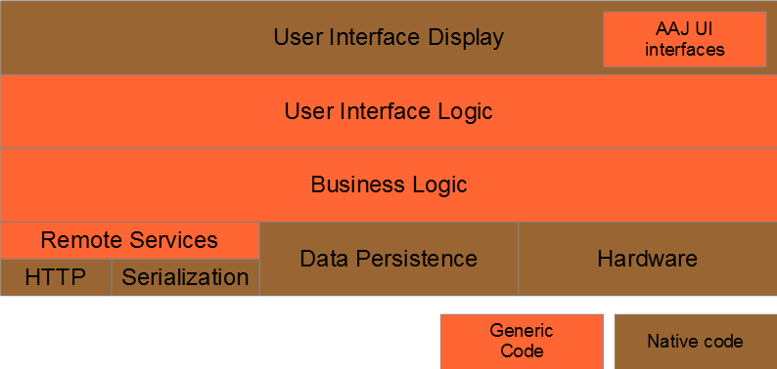
Nibiru Mobile
High level architecture

Slide 8
Nibiru Mobile
General features
  Java language.
  Native iOS and Android development.
  HTML5 development.
  Unified dependency injection.
  Code reuse.
  Common (native) services and components.

Slide 9
Nibiru Mobile
Java-to-native translation
  Android: just using Dalvik.
  HTML: JavaScript conversion using GWT.
  iOS: LLVM conversion using RoboVM.
No extra VM is required!

Slide 10
Nibiru Mobile
Pattern based approach
  Dependency injection.
    Acts as component glue, using Java standards (JSR330)
  MVP.
    Allows UI logic reuse, while allowing native (thin) view implementation.
  DAO.
    Transparent data access implementation.
  DTO / REST.
    For server communication.

Slide 11
Nibiru Mobile
Common components
  Event bus.
  Preferences.
  HTTP and remote service access.
  Serialization (used for DTOs).
  UI: navigation, internationalization, etc.
Planned for future:
  Session, common UI API, IDE extensions.

Slide 12
Nibiru Mobile
 | PhoneGap | Appcelerator | Xamarin | Nibiru Mobile
Native app | No | Yes | Yes | Yes
Web app | Yes | No | No | Yes
Typed, OO language | No | No | Yes | Yes
Runs as native code | No | Yes | Yes (debug requires Mono) | Yes
Common components | Yes | Yes | Yes | Yes
IDE | No | Yes | Yes | Planned
Pattern-oriented | No | No | No | Yes
License | Apache 2.0 | Proprietary | Proprietary (MIT for the SDK) | Apache 2.0

