Slide 1
DIGITAL SIGNAL PROCESSING · LAB PROJECT
Catching AI images
with a Fourier transform
A reproduction and interactive study of MaskSim — detecting synthetic images by masked spectrum similarity analysis (Li et al., CVPRW 2024)
Presented by · Aakarshit Singh
Notes:
One-line framing: we are not asking a neural network to look at the picture. We are measuring a specific, predictable signal-processing artifact that every image generator leaves behind.

Slide 2
The problem
Synthetic images are now indistinguishable to the human eye
< 1
0 %
7
grey level out of 255 — the size of the trace a generator leaves behind
of people can tell the two apart by eye at that amplitude
generators this project can identify individually, by name
Why not just look harder?
Semantic cues — extra fingers, wrong text, broken reflections — are being fixed month by month, and a detector built on them expires.
Metadata and watermarks are trivially stripped, and open-weight models never add them.
What does not expire is physics: every generator ends by upsampling, and upsampling leaves a measurable signal-processing artifact.
Notes:
The key move: stop looking at content, start measuring the manufacturing process.

Slide 3
Project synopsis
What was built, in one slide
1
Reproduce the method
The one-sentence version
Ran the published MaskSim pipeline end to end on the authors' seven trained detectors.
Traced every stage in the source and documented the DSP reasoning behind each one.
Re-implemented the whole method from scratch in ~400 lines of JavaScript, trained live in the browser.
A generator’s decoder is a fixed filter. A fixed filter leaves a fixed, periodic trace. The Fourier transform concentrates that trace into a few coefficients, and a learned per-frequency mask decides which of them are worth listening to.
2
Make it inspectable
No CNN classifier. The entire trainable model is two maps of numbers — one per frequency bin — plus seventeen other parameters. You can look at what it learned.
A local web application: upload an image, get a verdict plus every intermediate tensor.
An interactive explainer that teaches the frequency domain on your own photograph.
Notes:
Emphasise: this is a signal-processing project, not a deep-learning project.

Slide 4
Why this method
Three candidate approaches; one of them is a DSP problem
End-to-end CNN
Watermarking
Spectral — MaskSim
Train a ResNet on real-vs-fake pixels.
The generator signs its own output.
Measure the artifact the decoder leaves.
Needs 100k+ images
Learns the dataset, not the generator
Completely opaque
Most reliable — when present
Needs the generator to cooperate
Stripped by a re-save
Trains on a few hundred images
Grounded in multirate DSP
You can see what it learned
Chosen because it is the only one of the three that is a signal-processing problem — and because the failure modes can be derived rather than discovered.
Notes:
If asked "why not a CNN": because a CNN would learn whatever separates the two folders, including the camera. And we could not explain what it learned.

Slide 5
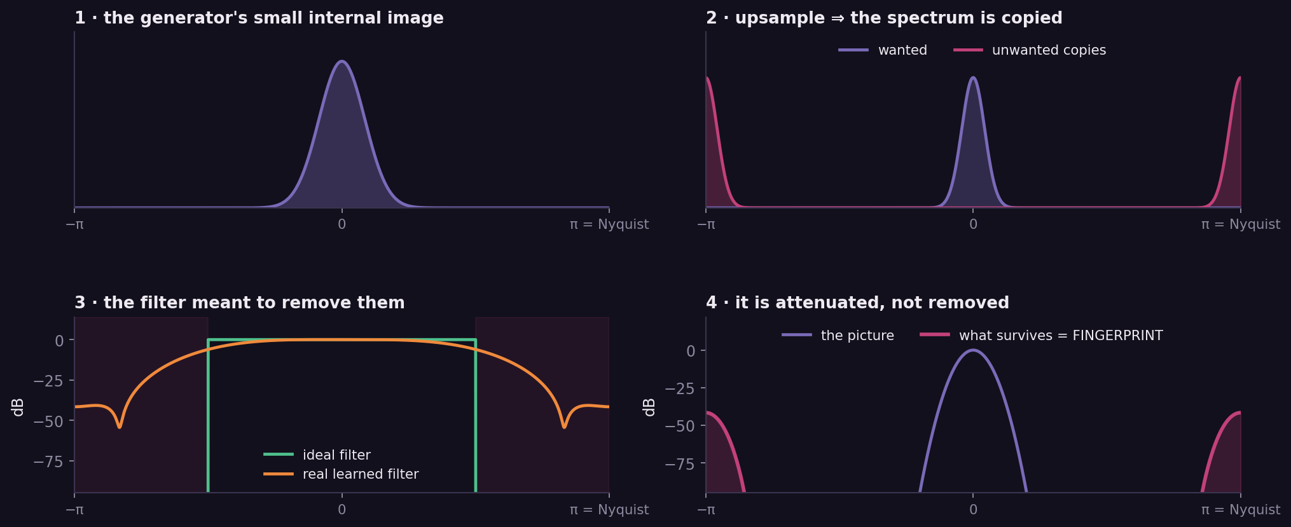
Where the fingerprint comes from
Standard multirate signal processing — upsampling by L creates L copies of the spectrum
The chain: insert zeros → X(ω) becomes X(Lω), so L copies appear → an ideal filter would remove them → but an ideal filter is infinitely long → a real, learned filter leaves them ~40 dB down, at fixed frequencies, in every image the model makes.
Notes:
This is the slide to be able to derive on a board. Zero insertion gives X(Lw) — exact, one line of algebra. Everything else follows.

Slide 6
Why the frequency domain
The artifact is periodic — and the DFT is what concentrates periodic energy
In the image
After the transform
−12 dB
+42 dB
signal-to-noise per pixel — the artifact is far below the sensor noise
signal-to-noise per frequency bin — the same signal, now unmissable
Where the 54 dB comes from
The artifact is coherent: all N² samples add in phase into one bin, so its amplitude there grows as N².
The noise is incoherent: it adds in power, so its amplitude per bin grows only as N.
The ratio therefore improves by a factor of N = 512. This is coherent processing gain — the same principle a radar or a lock-in amplifier uses.
Notes:
Do not say "Fourier is good at frequencies". Say: the signal is periodic and the DFT is the matched basis, and here is the 54 dB that buys us.

Slide 7
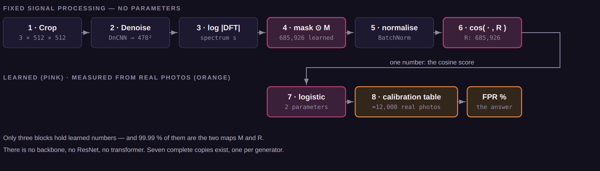
The pipeline at a glance
Eight stages — only three hold learned numbers
1,371,869
trainable numbers — 99.99 % of them the two maps
0
convolutional feature extractors anywhere in the model
~3 h
to train one detector, on a single GPU
Notes:
Point at the two pink boxes. Those are the model. Everything else is either fixed DSP or a lookup table.

Slide 8
Dataset collection
Two classes — and one trap that invalidates the whole result
Synthetic — the positive class
Pristine — the negative class
Synthbuster — images from all seven generators, same prompts and scenes for each.
Must be unmodified generator output: never re-saved, never resized.
Camera photographs: RAISE, COCO, FlickrFaces.
Used twice — as training negatives, and later as the ~12,000-image calibration set per detector.
!
The dataset-bias trap
If the real images come from one camera and the fakes from one generator, then everything differs between the folders — sharpening, tone curves, JPEG history, even subject matter. A model trained naively learns “this looks like a Canon JPEG”, reports 99 % accuracy on its own test split, and fails on everything else. Most published numbers in this field that look too good are exactly this failure.
→ Both defences appear later: matched datasets, and one deliberate change to the loss.
Notes:
About 30 GB total. data_preparation.sh in the repo downloads and organises it.

Slide 9
Preprocessing
1
Crop and colour — three decisions, each defensible
x ← centre-crop(image, 512), origin snapped to a multiple of 8; then RGB → YCbCr, scaled to [0,1]
Fixed 512×512, never resized
A bin index means cycles per crop. Change the crop size and the same physical artifact lands in a different bin, so a fixed mask could not exist. Resizing would also destroy the artifact outright.
Origin aligned to an 8-pixel grid
JPEG compresses in 8×8 blocks, so its blocking artifact is itself periodic with period 8. Aligning the crop puts that artifact on the same bins every time, where the mask can learn to ignore it.
Converted to YCbCr
JPEG and WebP quantise in YCbCr and subsample chroma. Working in the same basis keeps compression effects confined to the channels where they happen instead of smearing into all three.
Notes:
If asked why not resize everything to a standard size: because that is exactly the operation that destroys the evidence. Slide 20 shows it.

Slide 10
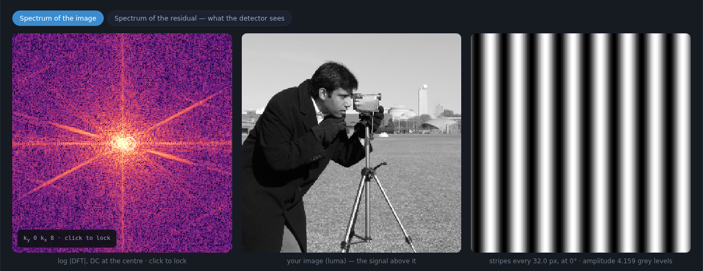
Throw the picture away
2
A denoiser is used backwards — we keep the noise
r = DnCNN( x ) ← the network’s output IS the noise estimate
DnCNN (Zhang et al. 2017): 17 layers, 3×3 kernels, 64 channels — trained with residual learning, so it predicts the noise rather than the clean image.
MaskSim keeps that noise and discards the clean image. The denoiser is being used as a content suppressor.
Why: the fingerprint is ~40 dB below the scene. Leaving the content in means the mask would be fitted on data dominated by what the picture is of.
512 becomes 478 because a 17-layer 3×3 network has a 17-pixel invalid border — those pixels depend on padding, not on real data.
The weights are frozen. Only the head is trained, and all seven detectors share this one denoiser.
Left: the spectrum of the image — one blazing blob of content. Middle: the image. Right: one frequency, drawn alone.
The cost: this single frozen network is ~146 billion multiply-accumulates per image — essentially the entire runtime. The learned part costs 1.4 million.
Notes:
Good place to be honest: the model is tiny, the system is not. The expense is the pre-trained denoiser in front of it.

Slide 11
Into the frequency domain
3
Three decisions hidden in two lines of code
S = fftshift( FFT2(r) ) s = log( |S| + ε )
Take the magnitude,
discard the phase
Take the logarithm
fftshift
Shifting an image multiplies every coefficient by a unit-magnitude complex number: the phase changes, the magnitude does not. Since the crop position is arbitrary and only presence matters, magnitude buys exact invariance to the nuisance we want gone.
It compresses six decades of dynamic range — but more importantly, the artifact is a multiplicative gain, and log turns multiplication into addition. Only then is “average the fakes, average the reals, subtract” a meaningful operation.
Pure re-indexing: it moves DC from the corner to the centre so that distance from the middle means frequency. No value changes.
The cost of discarding phase: we can say a fingerprint is present, but not where. That is why partially inpainted images are out of scope.
Notes:
The log point is the one examiners like — it is not just for display, it linearises the problem.

Slide 12
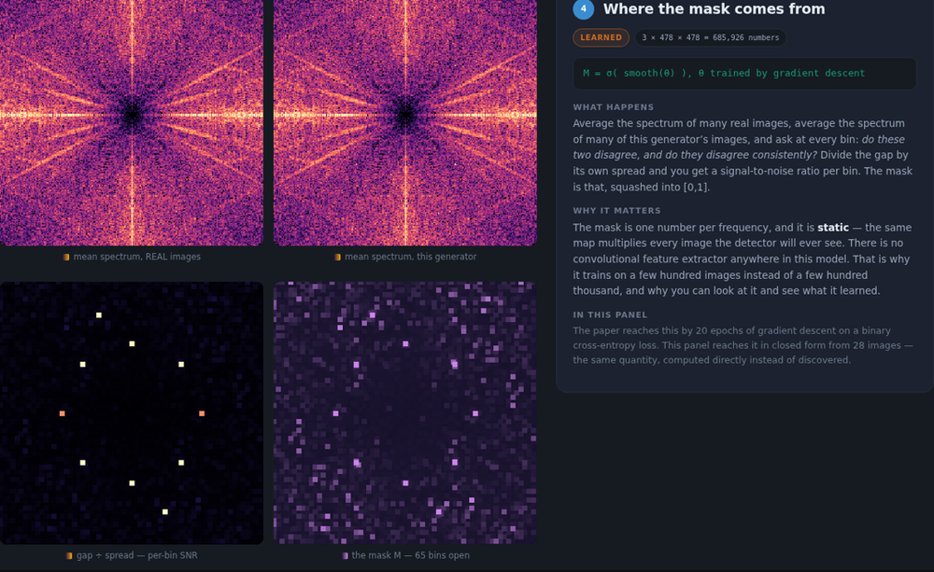
The mask — the model itself
4
One number per frequency bin, and not one number more
M = σ( boxblur₃ₓ₃( θ ) ) v = M ⊙ s
θ : 3 × 478 × 478 free parameters, initialised N(0, 0.01²)
Sigmoid bounds every entry to (0,1) — a bin can be open, closed, or anything between.
Initialised near zero, so M ≈ 0.5 everywhere: the mask starts with no preference at all.
A fixed, non-trainable 3×3 box blur couples each bin to its neighbours — a smoothing prior that costs zero parameters.
It is static: the same map multiplies every image this detector will ever see. That is why a few hundred training images suffice.
The two class-average spectra are indistinguishable by eye. Their difference, divided by its own spread, is not — ten fingerprint bins appear out of what looks like noise.
At the optimum the mask is a per-bin signal-to-noise ratio — a classical matched filter.
Notes:
Spend time here. This is the slide that makes the method comprehensible.

Slide 13
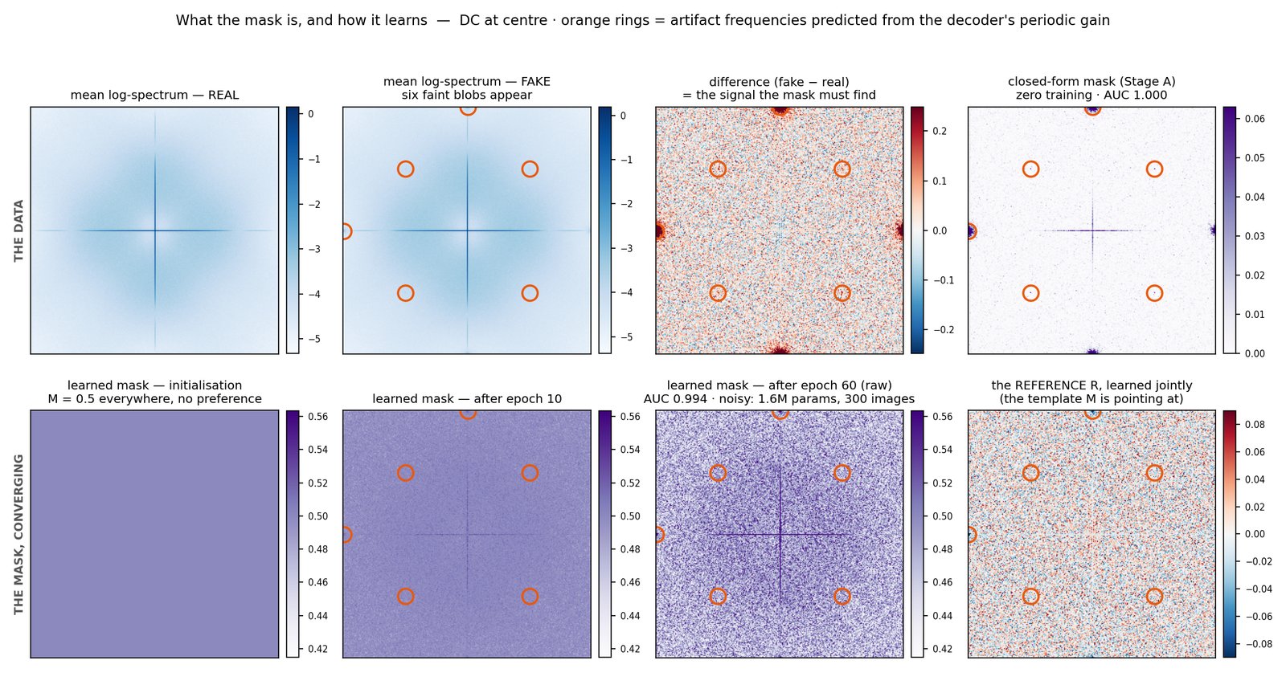
Compare with the reference
5
A second learned map, and one cosine — which is a matched filter in disguise
v̂ = BatchNorm( M ⊙ s ) c = ⟨ v̂ , R ⟩ / ( ‖v̂‖ ‖R‖ )
Why a cosine and not a distance
A cosine ignores scale. Brightness, exposure and overall noise level all multiply the masked spectrum — and all cancel.
With the mean removed and the vector standardised, this is exactly a Pearson correlation.
Correlating against a known template is the matched filter — the optimal linear detector under Gaussian noise.
R says what the fingerprint should look like; M says which bins to trust. Both are learned jointly.
Top: the data. Bottom: the mask at initialisation (flat — no preference), after 10 epochs, after 60, and the jointly learned reference R.
Because the cosine is a sum over bins, its terms can be drawn as a picture — the similarity map is the model explaining its own decision.
Notes:
The similarity map summing to the score is unusual and worth pointing out — no hidden layers to hide behind.

Slide 14
From a score to an answer
6
The output is a false-alarm rate, not a probability — deliberately
p = σ( eᵃ · c + b )
FPR = 1 − rank( p ) / n
A two-parameter logistic. It looks like a probability — and that is the trap. It was fitted on one training set with one class balance. Change the balance, the camera or the compression and 0.9 no longer means 90 %.
Score ~12,000 photographs known to be real, sort them, and report where this image lands. The answer is the share of genuine photos that would score at least this high.
Why that is the better output
It is actionable: “3 %” means three false accusations in every hundred. A raw score of 0.87 means nothing without a table.
It transfers: recalibrate on photographs from the camera you actually care about and the operating point follows — no retraining.
It states the asymmetry honestly. A false accusation costs far more than a miss, and a false-positive rate is the natural language for that.
The generic model is not the max of seven raw scores: each is calibrated, the maximum is taken, then that maximum is calibrated again — because a max over seven inflates every image, including real ones.
Notes:
The last bullet is the multiple-comparisons correction. Examiners with a stats background will appreciate it being named.

Slide 15
Training
And the one change to the loss that makes the whole thing work
The setup
The loss — and the trick
Optimiser
Adam
synthetic → drive cos( v̂, R ) to +1
pristine → drive | cos( v̂, R ) | to 0
Learning rate
1 × 10⁻² (head)
Note the absolute value.
Epochs
≈ 20
Driving real images to −1 would ask the model to anti-correlate with the fingerprint — which is most easily achieved by building a template of what real images look like. That is how a detector quietly becomes a dataset classifier.
Driving |cos| to 0 asks only for orthogonality: no alignment in either direction. That is the correct statement of “this generator left no trace”, and it removes the incentive to learn the camera instead of the decoder.
Augmentation
JPEG at random quality 65–100, re-rolled every epoch
Time
≈ 3 h per detector, one GPU
Bottleneck
disk I/O and the frozen denoiser — not the maths
Notes:
If you make only one technical point about the paper, make this one.

Slide 16
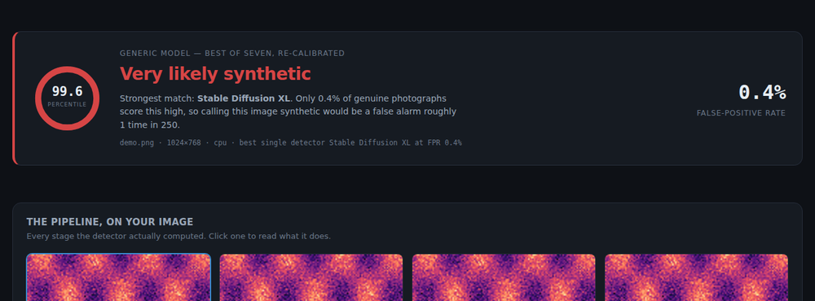
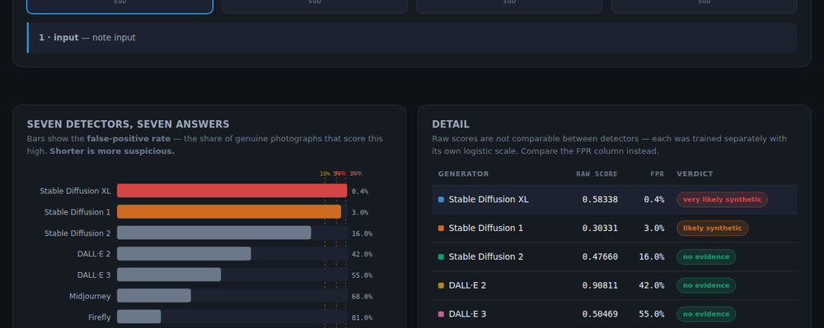
What we built
A local application: upload an image, get a verdict and every tensor behind it
Runs the repository’s own code for every number, so the web page and the command-line tool always agree.
Shows all four pipeline stages computed on your image, plus each detector’s similarity map, trained mask and masked spectrum.
Reports a false-positive rate per detector, never a yes/no.
A second page teaches the frequency domain interactively on your own photograph, and trains a miniature MaskSim live in the browser — 400 lines, no libraries, its own FFT.
One engineering win: the seven detectors share one frozen denoiser, so the residual is computed once instead of fourteen times — about a minute down to five seconds per image on CPU.
Interface screenshots — test data, not measured results.
Notes:
Be explicit that the screenshot numbers are from a test harness. Real numbers come from running it live.

Slide 17
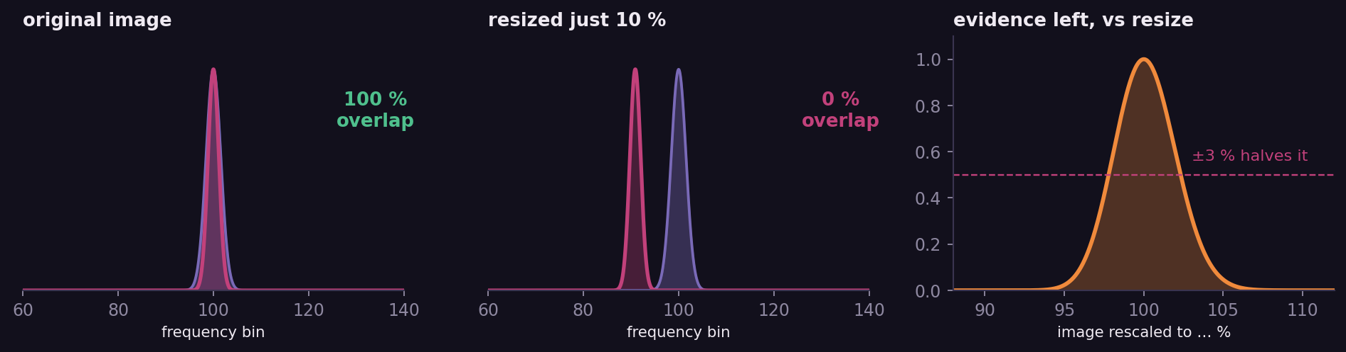
The honest headline
Resizing an image by a few percent defeats the method completely
Δk ≈ k · ( s − 1 )
Why this matters in practice
A peak at bin 100, in an image enlarged 10 %, moves nine bins. The mask’s open regions are two or three bins wide.
Almost every image that has passed through a social network has been resized. This is why a method that scores excellently on benchmarks is not deployed as a public verdict service.
Notes:
Volunteer this rather than waiting to be asked. It follows directly from the scaling theorem — it is a property of the method, not a bug in our implementation.

Slide 18
What else it cannot do
Every one of these follows from the design
It fails silently
“No evidence” ≠ authentic
An image from a generator no detector was trained on scores like a photograph. A false negative is the safe direction to fail in — but nothing signals that the detector is out of its depth.
Seven narrow questions, seven negative answers. That is silence, not an alibi. A positive result is strong evidence; a negative one is almost none.
Whole images only
An adversary defeats it easily
If only part of an image was generated, the fingerprint covers only that region while the DFT averages over the whole crop — and phase was discarded, so there is no way to localise it.
Resample by 1 %, add noise at the right frequencies, or low-pass slightly. The method assumes unmodified generator output and offers no adversarial robustness.
It is a decoder detector, not an “AI image detector”. Stating the narrower claim ourselves is better than having it pointed out.
Notes:
Trained on SD-2 it transfers well to SD-XL — same VAE family — and poorly to DALL·E 2.

Slide 19
Next steps — images
In order of value per hour of work
1
Quantitative evaluation
ROC curves, AUC, and a 7×7 cross-generator matrix. Turns a reproduction into an experiment.
2
Robustness sweep
AUC against JPEG quality and against resize factor. This is the measurement that directly tests the scaling theorem.
3
Ablations
Remove the denoiser; open the mask fully; use linear magnitude instead of log. Four runs, each isolating one design decision.
4
Periodic-plus-smooth
Implement the fix the paper names and declines to apply, and measure whether removing the wrap-around cross helps.
The fourth is the interesting one: the paper cites the fix, does not apply it, and it is cheap to test — a small original contribution on top of a published method.

Slide 20
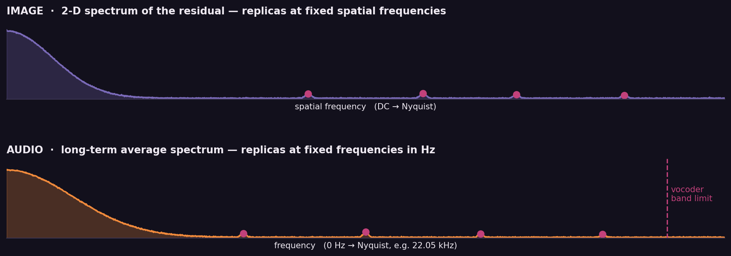
Does this transfer to audio?
Neural vocoders upsample too — by a factor of 256, not 8
The same derivation applies. A vocoder such as HiFi-GAN takes a mel-spectrogram at roughly 86 frames per second and upsamples it with transposed convolutions to 22,050 samples per second — the identical multirate structure, with far larger factors. Upsampling artifacts in neural audio synthesis are a documented phenomenon (Pons et al., ICASSP 2021).
Notes:
Verify the Pons reference before citing it aloud. The phenomenon is well documented; the exact paper title is worth checking.

Slide 21
A MaskSim for audio
What would change, and what would get easier
The proposed pipeline
Easier than images
Resample to a fixed rate — non-negotiable, for the same reason images are never resized
No denoiser needed — averaging hundreds of STFT frames removes the content, because speech and music vary while the artifact does not.
Far more processing gain: a 30-second clip is 1.3 million samples against an image’s 260,000 pixels.
STFT: 2048-point window, Hann, 50 % overlap
Magnitude, then log — phase discarded, as before
Average over all frames → long-term average spectrum
Harder than images
Learned mask over frequency bins
MP3 low-passes at 16–20 kHz — and vocoder artifacts often live in exactly that top octave, so the codec may erase the evidence.
Sample-rate conversion (44.1 → 48 kHz) moves every peak by 8.8 %: the resize problem, now routine.
Cosine against a learned reference
Calibrate against real recordings → FPR
Notes:
A strong, well-scoped follow-on project: the theory is identical, the datasets exist (LibriSpeech and VCTK for real speech, any TTS system for synthetic), and nobody has to train a generator.

Slide 22
Four things to take away
1
It is signal processing, not pattern matching.
2
The model is small enough to understand.
Every design decision — the crop, the denoiser, the log, the cosine, the refusal to resize — follows from a property of the discrete Fourier transform.
Two maps of numbers, one per frequency bin, plus seventeen other parameters. No backbone. You can look at what it learned and say why it learned it.
3
The output is a false-alarm rate, not a verdict.
4
The limitation is fundamental, not fixable.
That is the honest form for a decision where a wrong accusation costs far more than a miss — and it recalibrates to a new camera without retraining.
A method anchored to fixed frequencies cannot survive resampling. Knowing exactly why is worth more than a number that looks good on a benchmark.
Thank you · questions welcome
Notes:
Close on the limitation. Conceding it deliberately reads as understanding, not weakness.

Slide 23
References
Y. Li, Q. Bammey, M. Gardella, T. Nikoukhah, J.-M. Morel, M. Colom, R. Grompone von Gioi
MaskSim: Detection of synthetic images by masked spectrum similarity analysis. CVPRW 2024. — the method reproduced here
K. Zhang, W. Zuo, Y. Chen, D. Meng, L. Zhang
Beyond a Gaussian denoiser: residual learning of deep CNN for image denoising. IEEE TIP, 2017. — the DnCNN used as the content suppressor
A. Odena, V. Dumoulin, C. Olah
Deconvolution and checkerboard artifacts. Distill, 2016. — why transposed convolutions leave periodic gain
L. Moisan
Periodic plus smooth image decomposition. JMIV, 2011. — the fix for the wrap-around cross that the paper cites and does not apply
J. Pons et al.
Upsampling artifacts in neural audio synthesis. ICASSP, 2021. — the audio analogue of the same phenomenon
Q. Bammey
Synthbuster — the dataset of images from each major generator used for training and evaluation
Implementation, figures and the interactive application were built for this project. The seven trained checkpoints and calibration tables are the paper authors’ work.

