Slide 1




CAPSTONE PROJECT HOTEL BOOKING ANALYSIS-EDA PRESENTED BY: AAMIR KHAN-T JOHN INSTITUTE OF TECHNOLOGY-CSE DEPARTMENT

Slide 2

OUTLINE:
PROBLEM STATEMENT
PROPOSED SYSTEM AND SOLUTION
SYSTEM DEVELOPMENT APPROACH
ALGORITHM & DEPLOYMENT
RESULT
CONCLUSION
FUTURE SCOPE
REFERENCES

Slide 3

PROBLEM STATEMENT
Have you ever wondered when the best time of year to book a hotel room is? Or the optimal length of stay in order to get the best daily rate? What if you wanted to predict whether or not a hotel was likely to receive a disproportionately high number of special requests? This hotel booking dataset can help you explore those questions! This data set contains booking information for a city hotel and a resort hotel, and includes information such as when the booking was made, length of stay, the number of adults, children, and/or babies, and the number of available parking spaces, among other things. All personally identifying information has been removed from the data. Explore and analyse the data to discover important factors that govern the bookings.

Slide 4
PROPOSED SOLUTION Best Time to Book a Hotel Room: Analyze booking date vs. stay date to determine when the bookings are made. Identify trends in booking lead times and their relationship with room rates. Optimal Length of Stay: Calculate the average daily rate (ADR) for different lengths of stay. Determine if there is a particular length of stay that offers a lower average daily rate. Predicting Special Requests: Use features such as booking date, lead time, number of guests, etc., to build a predictive model. Identify patterns in bookings that are more likely to have special requests. step-by-step approach to analyze the data:

Slide 5
Step 1: Load the Dataset If you have the dataset file (CSV, Excel, etc.), upload it so I can load it and perform the analysis. Step 2: Data Preprocessing Clean the dataset by handling missing values and incorrect data types. Feature engineering to create new useful features. Step 3: Exploratory Data Analysis (EDA) Visualize booking trends over time. Analyze the distribution of stay lengths and their corresponding average daily rates. Investigate the number of special requests and factors influencing them. Step 4: Modeling Use statistical or machine learning models to predict special requests based on booking features.

Slide 6
Step 5: Insights and Recommendations Summarize findings and provide actionable insights. SYSTEM APPROACH : (1)SYSTEM REQUIREMENTS : -WINDOWS->7/8/10/11 -BIT->64 -PROCESSOR->INTEL/RYZEN -RAM->4/8 GB (2)LIBRARY REQUIRED TO BUILD: -NUMPY AND AST -PANDAS AND DATETIME -MATPLOTLIP.PYPLOT AND SEABORN

Slide 7
ALGORITHM & DEPLOYMENT STEP1: THE FIRST PROCESS IS TO OPEN THE SEARCH ENGINE AND TYPE THE GOOGLE COLAB. STEP2: THE SECOND STEP IS OPEN THE FOLLOWING LINK WITH https://colab.google/ STEP3: THE THIRD STEP IS TO SIGN UP USING ANY OF THE FOLLOWING ACCOUNTS OR ALSO YOU CAN REGISTER AS NEW ACCOUNT. STEP4: THE FOURTH STEP IS TO UPLOAD THE FOLLOWING DATASET FOR THE ANALYSIS. STEP5: THE FIFTH STEP IS TO RUN THE SERVER AND PERFORM THE FOLLOWING OPERATION. STEP6: THE SIXTH STEP IS PERFORMING SOME OPERATION ON DATASET AND VISUALIZE IN FORM OF CHARTS AND GRAPHS. STEP7:THE FINAL STEP IS TO DEPLOY IT WHEN THE ANALYSIS ARE PERFORMED.

Slide 8
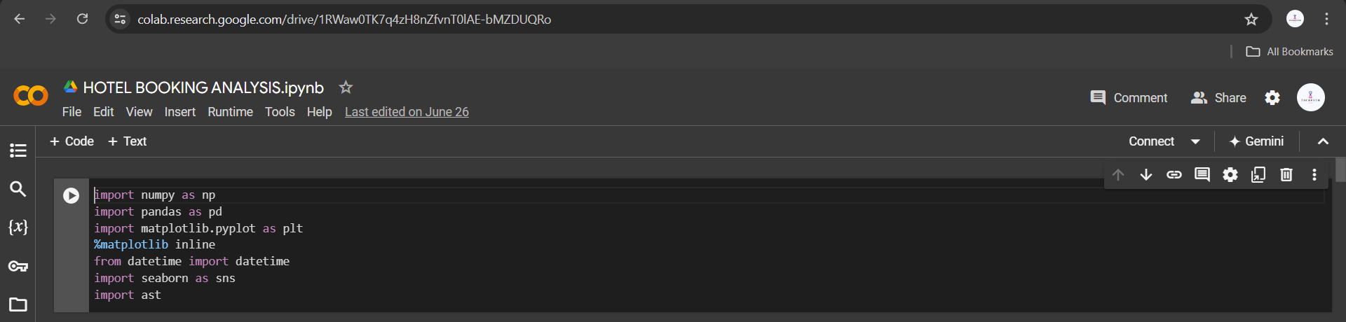
RESULT: Q)WHAT ARE THE LIBRARY FUNCTION ARE USED?

Slide 9
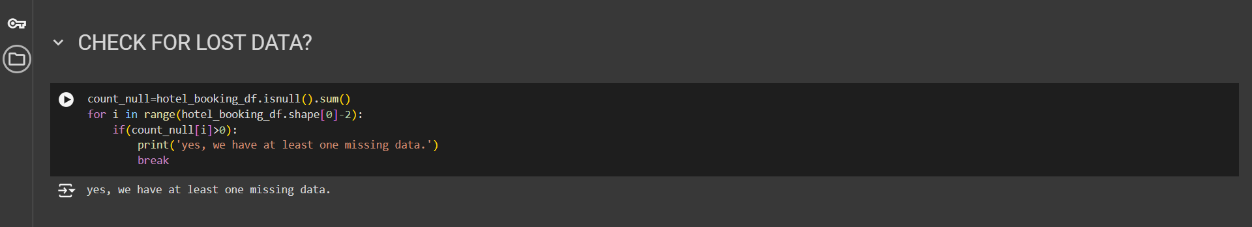
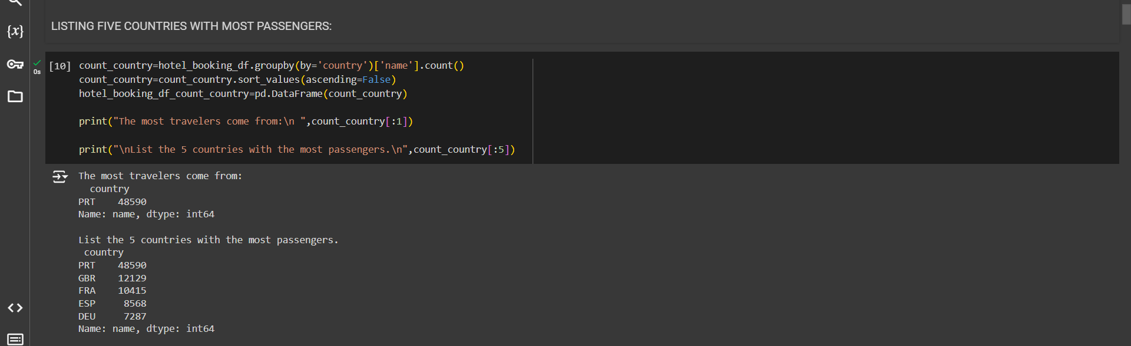
Q) CHECK FOR LOST DATA? Q) LISTING 5 COUNTRIES WITH MOST PASSENGER

Slide 10
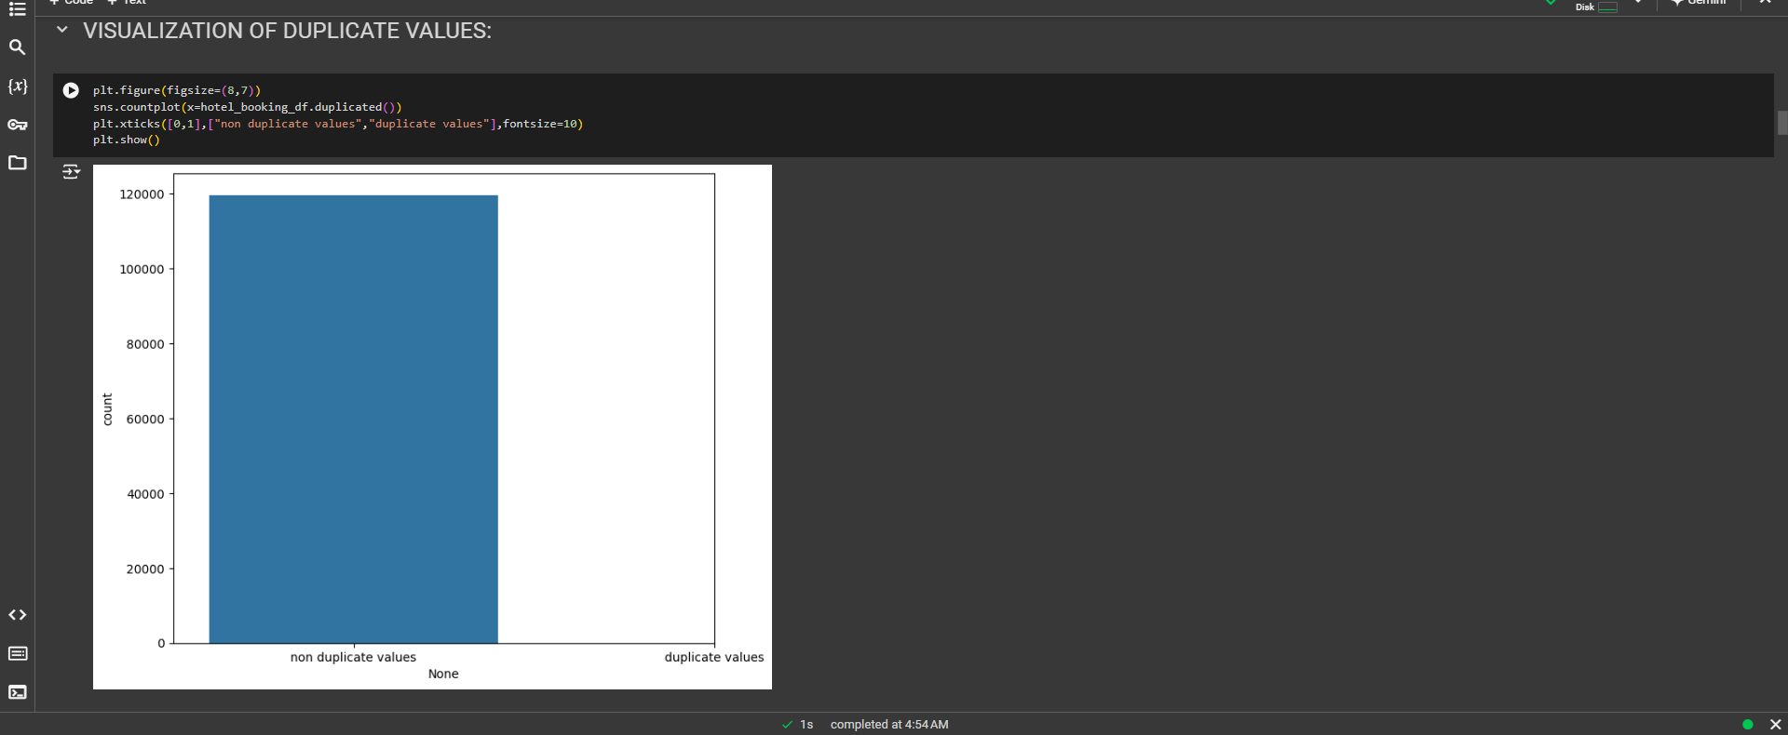
Q)VISUALIZATION OF DUPLICATE VALUES?

Slide 11
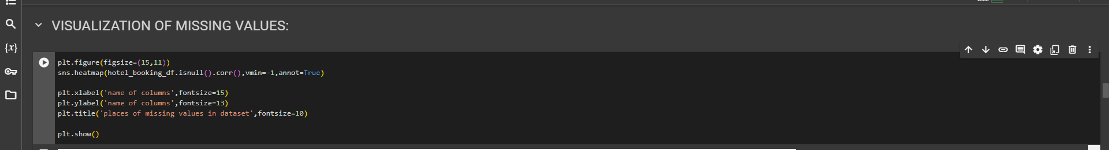
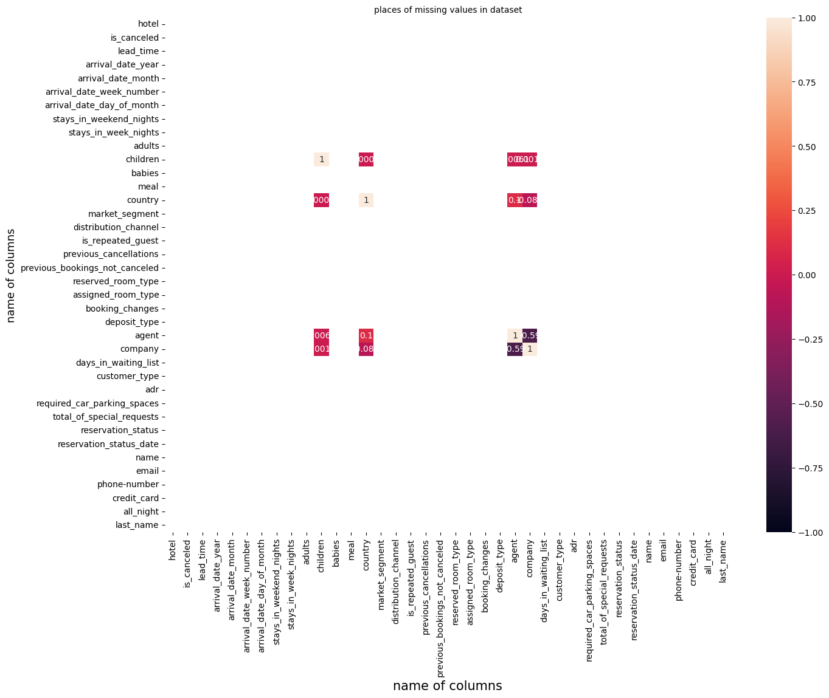
Q)VISUALIZATION OF MISSING VALUES?

Slide 12
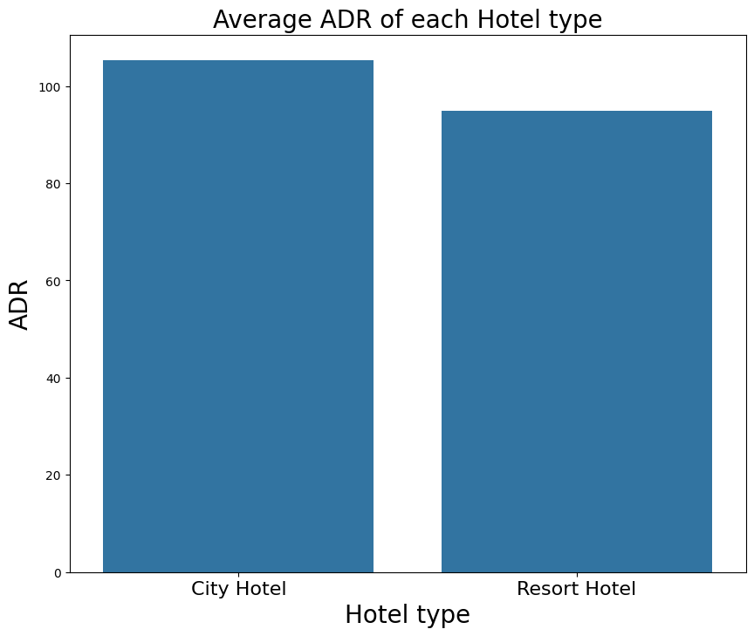
Q)AVERAGE ADR OF EACH HOTEL TYPE?

Slide 13
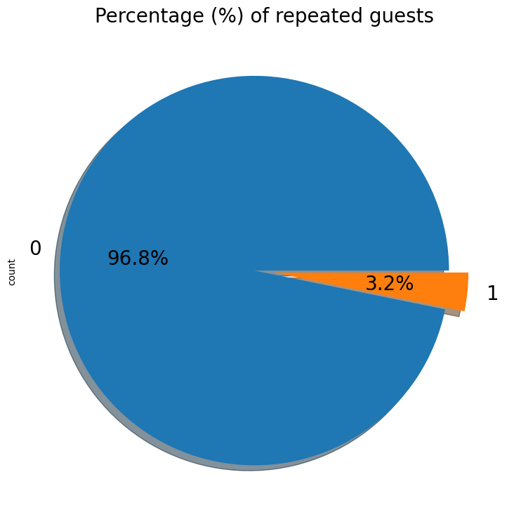
Q)PERCENTAGE OF REPEATED GUEST

Slide 14
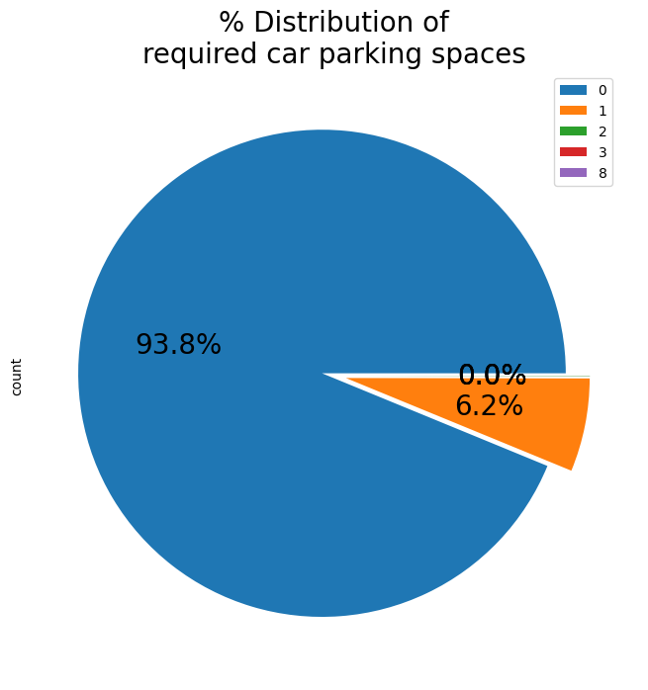
Q)PERCENTAGE DISTRUBUTION OF REQUIRED CAR PARKING SPACES

Slide 15
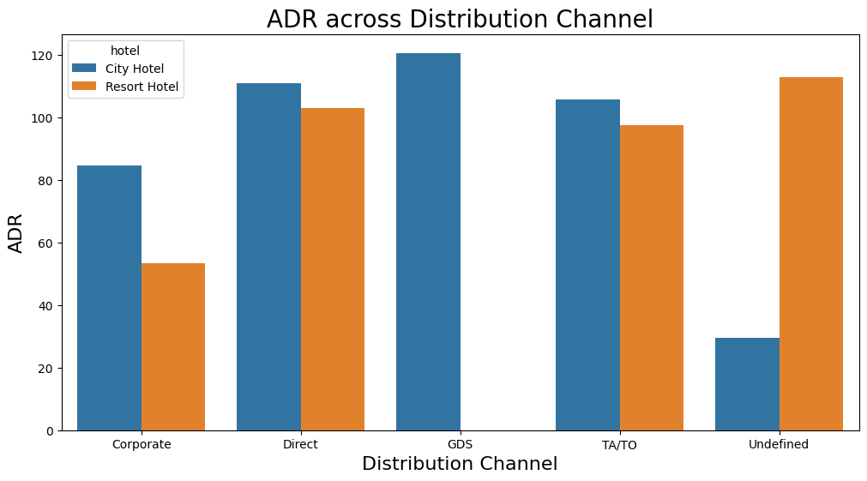
Q)ADR ACROSS DISTRIBUTION CHANNEL

Slide 16
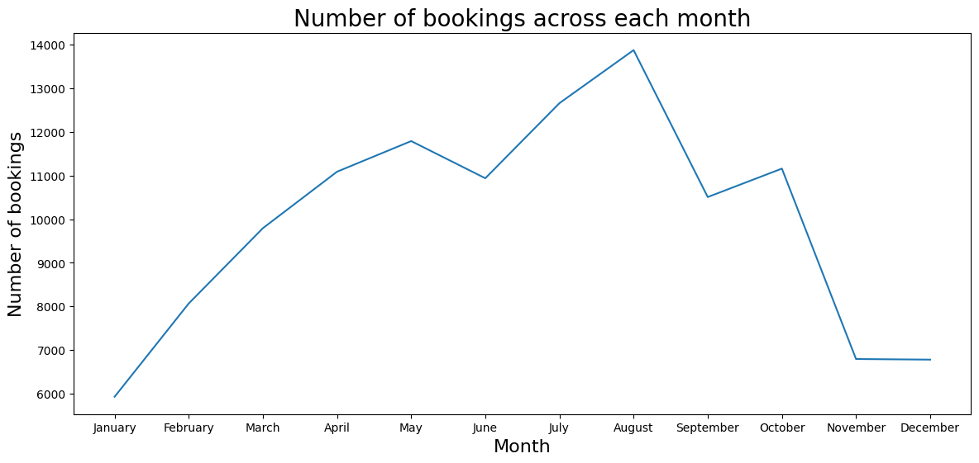
Q)NUMBERS OF BOOKING ACROSS EACH MONTH

Slide 17
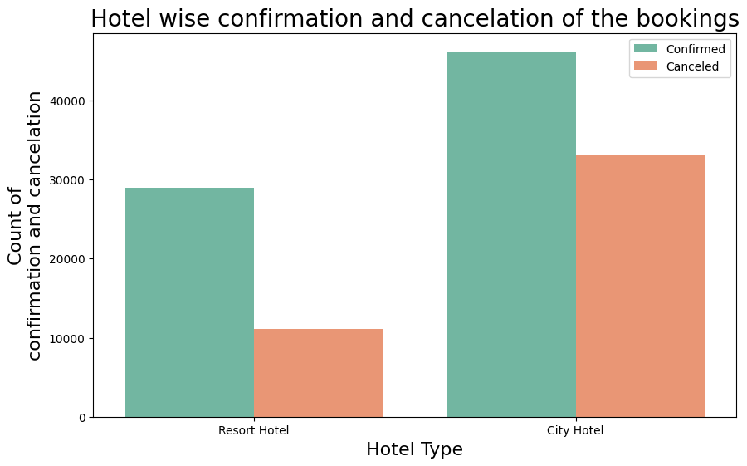
Q)HOTEL WISE CONFIRMATION AND CANCELLATION OF THE BOOKINGS

Slide 18
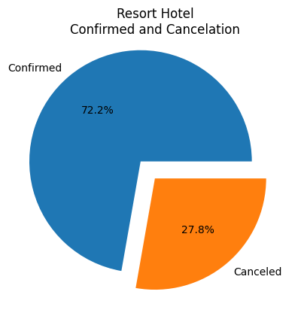
Q)RESORT HOTEL CONFIRMED AND CANCELLATION

Slide 19
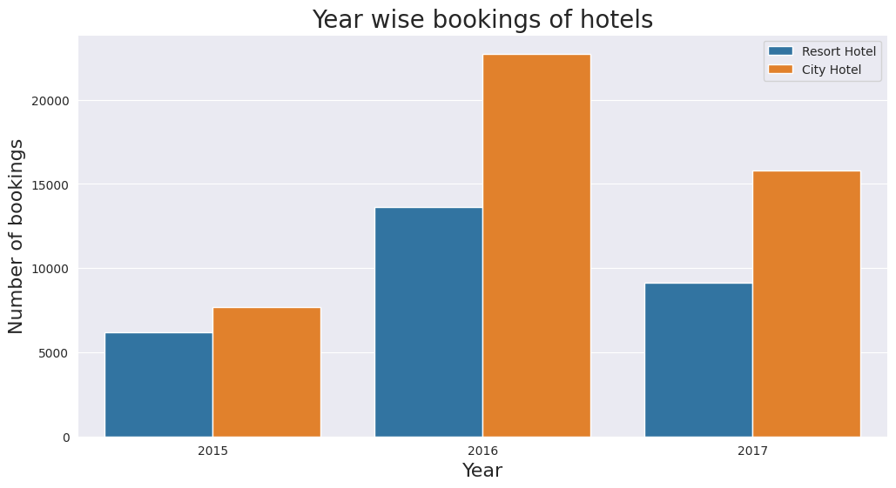
Q)YEAR WISE BOOKING OF HOTEL

Slide 20
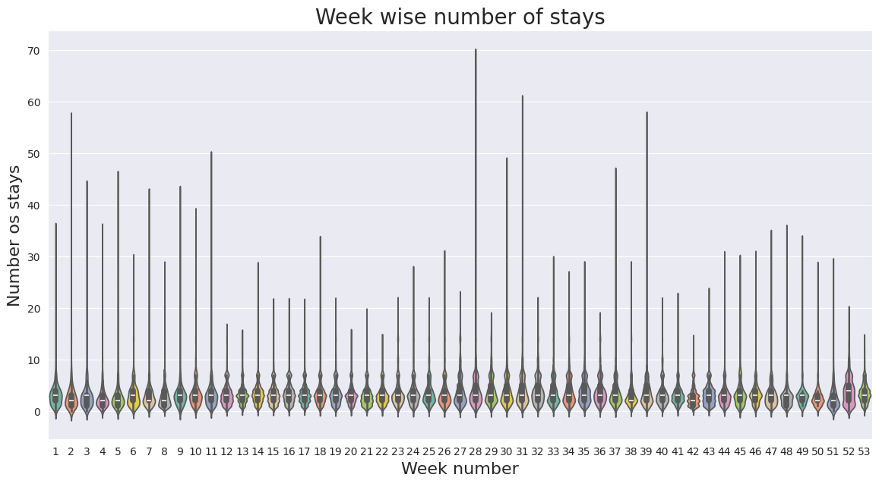
Q)WEEK WISE NUMBER OF STAYS

Slide 21
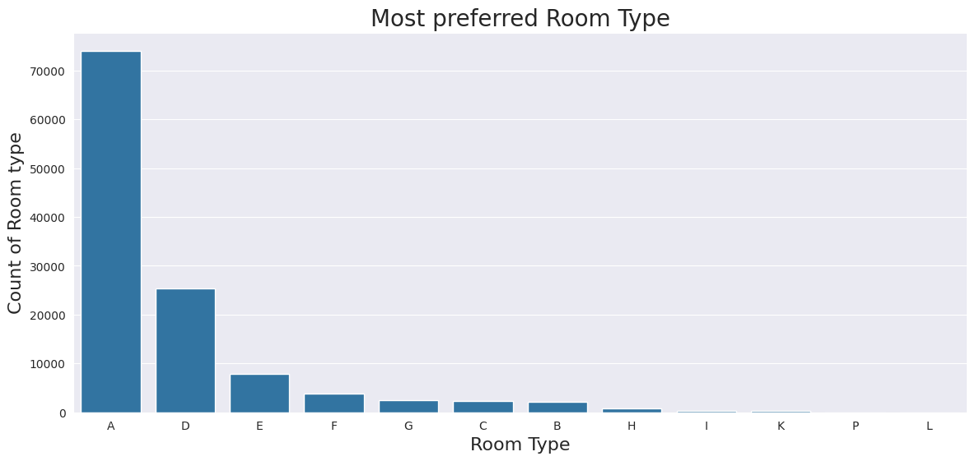
Q)MOST PREFFERED ROOM TYPE

Slide 22
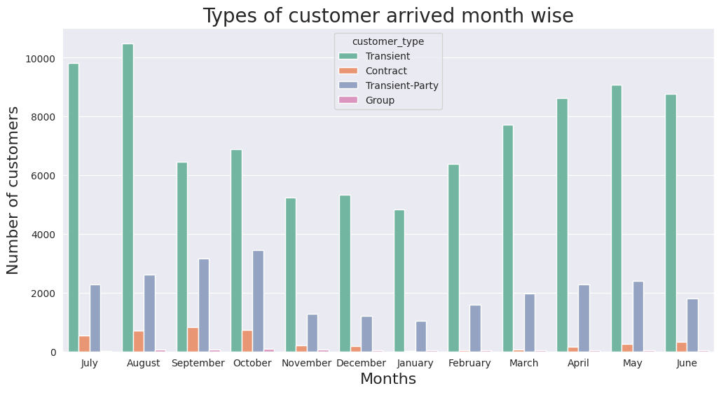
Q)TYPES OF CUSTOMER ARRIVED MONTHS WISE

Slide 23
CONCLUSION: The hotel booking analysis has provided valuable insights into various aspects of customer behavior and booking trends. Key conclusions from the analysis are as follows: 1. Booking Patterns: Seasonality: There is a significant increase in bookings during peak seasons, such as holidays and summer months. Off-season periods show lower occupancy rates. Booking Window: Most bookings are made within a specific window prior to the stay, with notable percentage being last-minute bookings. 2. Customer Preferences: Room Types: Deluxe rooms and suites are more popular among guests, especially during peak seasons. Standard rooms see higher occupancy during off-peak periods. Amenities: Amenities such as free Wi-Fi, complimentary breakfast, and access to a gym or pool are highly valued by customers, influencing their booking decisions.

Slide 24
3. Revenue Trends: Revenue Per Available Room (RevPAR): RevPAR is highest during peak seasons and weekends. Implementing dynamic pricing strategies has helped optimize revenue. Average Daily Rate (ADR): The ADR shows a steady increase year-over-year, indicating effective pricing strategies and an increase in the perceived value of the hotel's offerings. 4. Marketing Effectiveness: Online Channels: A majority of bookings are made through online travel agencies (OTAs) and the hotel’s website. Social media and email marketing campaigns have proven effective in driving direct bookings. Customer Retention: Loyalty programs and personalized marketing efforts have resulted in higher repeat bookings, contributing to stable long-term revenue.

Slide 25
5. Customer Satisfaction: Feedback and Reviews: Positive reviews and high ratings are strongly correlated with higher occupancy rates. Addressing customer feedback promptly has improved overall guest satisfaction and loyalty. Service Quality: Continuous training and development of staff have enhanced service quality, leading to better customer experiences and higher satisfaction scores. FUTURE SCOPE 1. Advanced Predictive Analytics 2. Personalization and Customer Experience 3. Revenue Management and Dynamic Pricing 4. Operational Efficiency 5. Market and Competitor Analysis 6.Customer Feedback and Sentiment Analysis 7. Sustainability and Corporate Social Responsibility (CSR) 8. Integration with Emerging Technologies 9. Enhancing Direct Bookings

Slide 26
REFERENCES: Academic Journals and Papers Industry Reports Websites and Online Resources Revenue Management for the Hospitality Industry by David K. Hayes Hotel Management and Operations by Michael J. O'Fallon

Slide 27


