Slide 1

Functions
Mina Gabriel

Slide 2
Function?
In the context of programming, a function is a named sequence of statements that performs a computation. When you define a function, you specify the name and the sequence of statements. Later, you can “call” the function by name.

Slide 3
Code Reuse?
Rule : If a piece of code is used more than once in a program, separate it in a method.
This way it can be called many times, thus enabling reuse of the same code without rewriting it.
The program will be more readable and well structured.

Slide 4
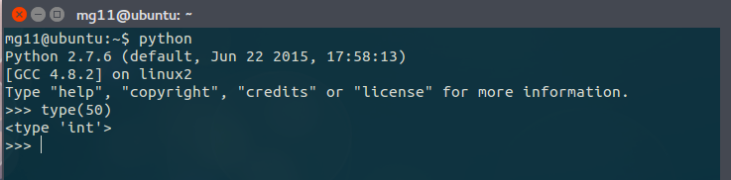
Function Calls
We have already seen one example of a function call:
The name of the function is type.
The expression in parentheses is called the argument of the function.
The result, for this function, is the type of the argument.

Slide 5
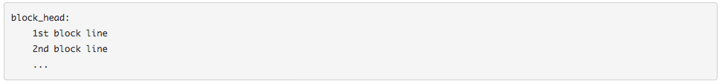
How do you write function in python?
Python makes use of blocks. A block is a area of code written in the format of:

Slide 6
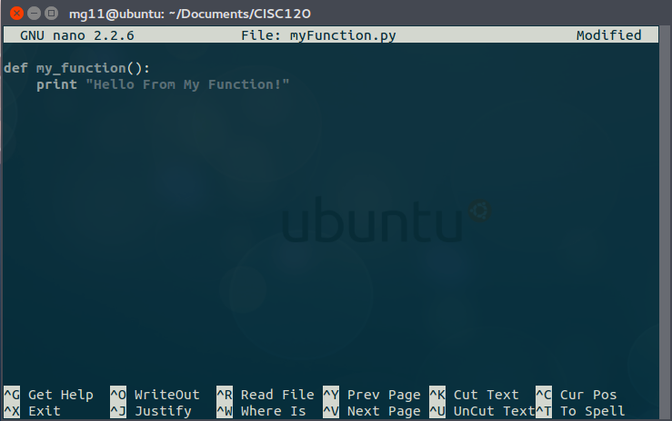
Functions in python are defined using the block keyword "def", followed with the function's name as the block's name.
For example:

Slide 7
Exercise
inside your ~/Documents/CISC120 directory create a new python file
add a new function give it a name
make this function print a string
save you changes
run your python file

Slide 8
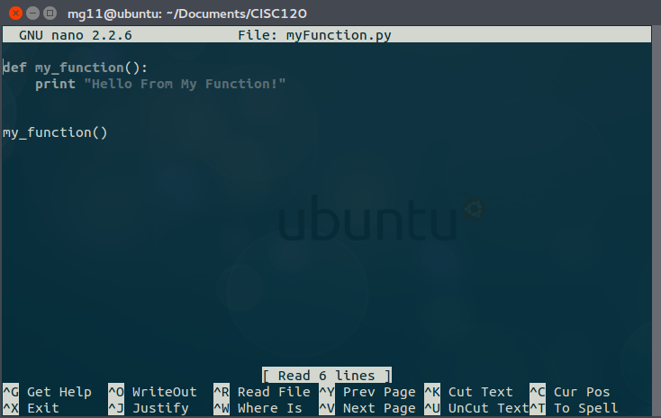
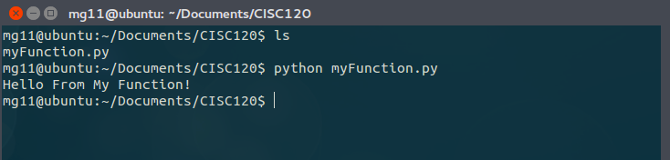
How do you call a function in Python
Simply write the function's name followed by ()

Slide 9
Exercise
now open your file and call the function you just created.

Slide 10
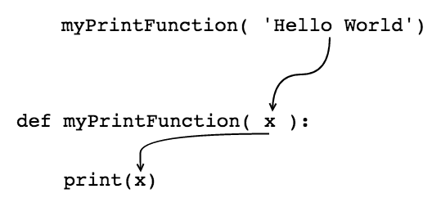
Argument
It is common to say that a function “takes” an argument and “returns” a result. The result is also called the return value..

Slide 11
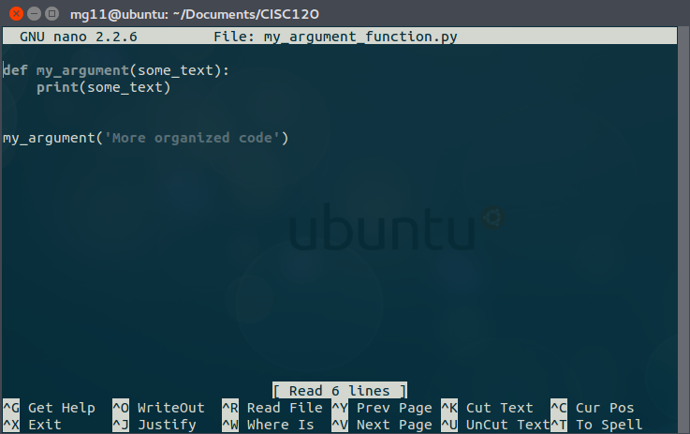
Example

Slide 12
Exercise
create a new python file
add a new function that takes one argument and print it
call this function
save your file
execute your file

Slide 13
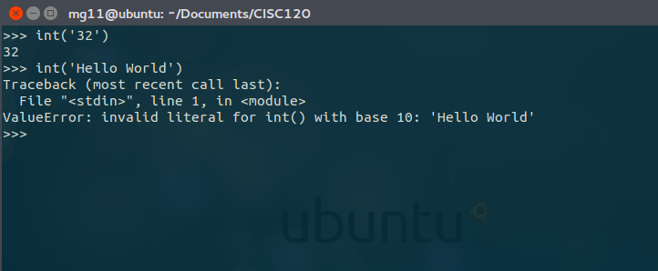
Python provides functions that convert values from one type to another.
The int function takes any value and converts it to an integer, if it can, or complains otherwise:

Slide 14
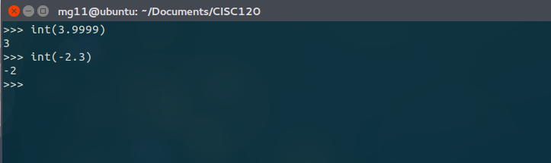
int can convert floating-point values to integers, but it doesn’t round off; it chops off the fraction part:

Slide 15
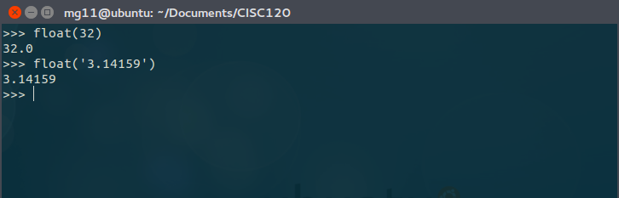
float converts integers and strings to floating-point numbers:

Slide 16
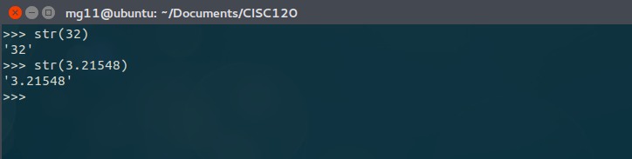
Finally, str converts its argument to a string:

Slide 17
Math Functions
Python has a math module that provides most of the familiar mathematical functions.
A module is a file that contains a collection of related functions.
Before we can use the functions in a module, we have to import it with an import statement:
This statement creates a module object named math. If you display the module object, you get some information about it:
>>> import math
>>> math
<module 'math' (built-in)>

Slide 18
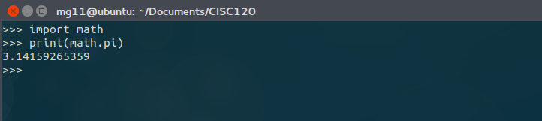
The module object contains the functions and variables defined in the module. To access one of the functions, you have to specify the name of the module and the name of the function, separated by a dot (also known as a period). This format is called dot notation.

Slide 19
Let’s go back to adding new functions
So far, we have only been using the functions that come with Python, but it is also possible to add new functions.
A function definition specifies the name of a new function and the sequence of statements that run when the function is called.
Here is an example:
def print_lyrics():
print("I'm a lumberjack, and I'm okay.")
print("I sleep all night and I work all day.")

Slide 20
def print_lyrics():
print("I'm a lumberjack, and I'm okay.")
print("I sleep all night and I work all day.")
def is a keyword that indicates that this is a function definition.
The name of the function is print_lyrics.
The rules for function names are the same as for variable names: letters, numbers and underscore are legal, but the first character can’t be a number.
You can’t use a keyword as the name of a function, and you should avoid having a variable and a function with the same name.

Slide 21
def print_lyrics():
print("I'm a lumberjack, and I'm okay.")
print("I sleep all night and I work all day.")
The empty parentheses after the name indicate that this function doesn’t take any arguments.

Slide 22
def print_lyrics():
print("I'm a lumberjack, and I'm okay.")
print("I sleep all night and I work all day.")
The first line of the function definition is called the header; the rest is called the body.
The header has to end with a colon and the body has to be indented.
By convention, indentation is always four spaces.
The body can contain any number of statements.
Head
Body

Slide 23
def print_lyrics():
print("I'm a lumberjack, and I'm okay.")
print("I sleep all night and I work all day.")
The strings in the print statements are enclosed in double quotes. Single quotes and double quotes do the same thing.

Slide 24
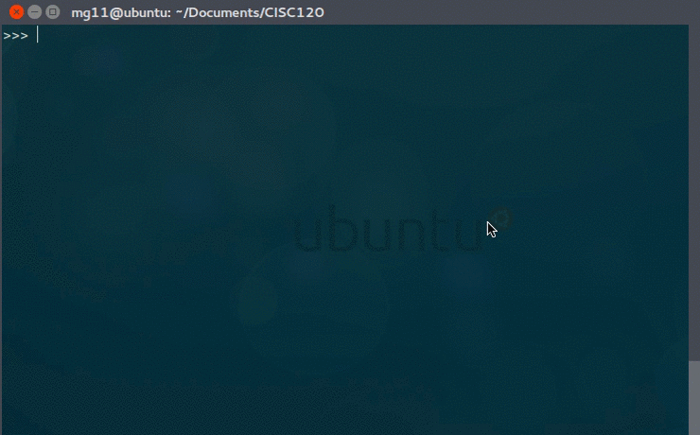
If you type a function definition in interactive mode, the interpreter prints dots (...) to let you know that the definition isn’t complete:

Slide 25
The syntax for calling the new function is the same as for built-in functions:
def print_lyrics():
print("I'm a lumberjack, and I'm okay.")
print("I sleep all night and I work all day.")
>>> print_lyrics()
I'm a lumberjack, and I'm okay.
I sleep all night and I work all day.

Slide 26
Once you have defined a function, you can use it inside another function. For example, to repeat the previous refrain, we could write a function called repeat_lyrics:
def print_lyrics():
print("I'm a lumberjack, and I'm okay.")
print("I sleep all night and I work all day.")
def repeat_lyrics():
print_lyrics()
print_lyrics()
repeat_lyrics()

Slide 27
Flow of Execution
To ensure that a function is defined before its first use, you have to know the order statements run in, which is called the flow of execution.
Execution always begins at the first statement of the program. Statements are run one at a time, in order from top to bottom.

Slide 28
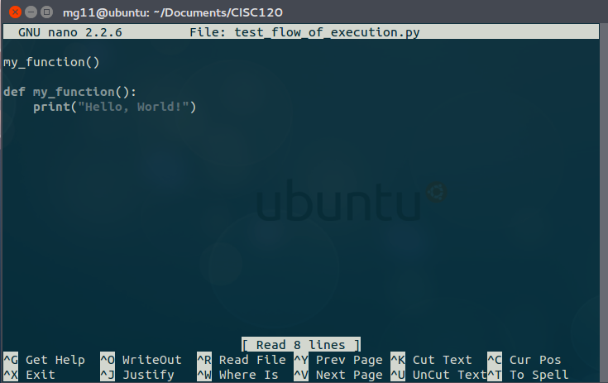
Will this run?

Slide 29
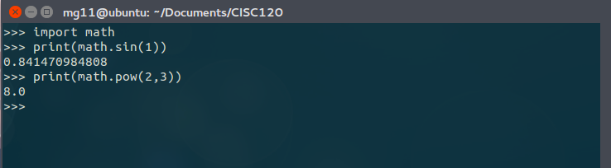
Parameters and Arguments
Some of the functions we have seen require arguments. For example, when you call math.sin you pass a number as an argument. Some functions take more than one argument: math.pow takes two, the base and the exponent.

Slide 30
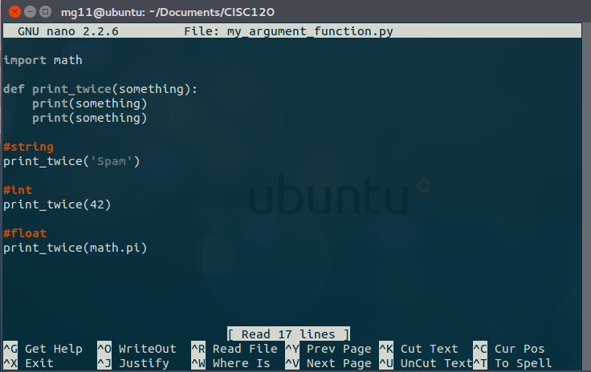
Inside the function, the arguments are assigned to variables called parameters. Here is a definition for a function that takes an argument:

Slide 31
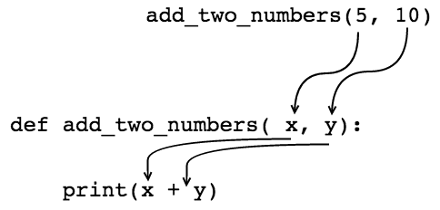
functions multiple arguments
functions can accept any number of arguments :

Slide 32
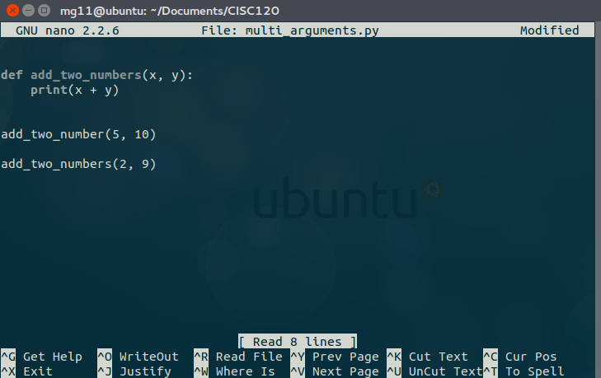
Example:

Slide 33
Exercise
create a function that accepts two arguments and print the multiplication of the two arguments.

Slide 34
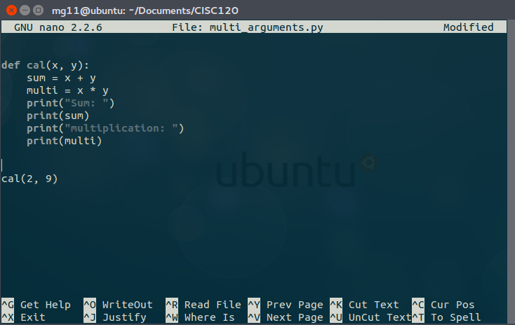
Variables and Parameters Are Local
you can create variables inside functions. For example:

Slide 35
Stack Diagrams
To keep track of which variables can be used where, it is sometimes useful to draw a stack diagram. Like state diagrams, stack diagrams show the value of each variable, but they also show the function each variable belongs to.

Slide 36
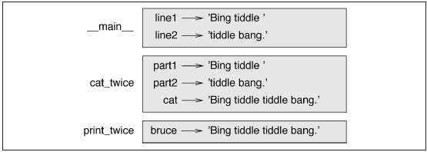
The frames are arranged in a stack that indicates which function called which, and so on. In this example, print_twice was called by cat_twice, and cat_twice was called by __main__, which is a special name for the topmost frame. When you create a variable outside of any function, it belongs to __main__.

Slide 37
Each parameter refers to the same value as its corresponding argument. So, part1 has the same value as line1, part2 has the same value as line2, and bruce has the same value as cat.

Slide 38
If an error occurs during a function call, Python prints the name of the function, the name of the function that called it, and the name of the function that called that, all the way back to __main__.

Slide 39
For example, if you try to access cat from within print_twice, you get a NameError:
Traceback (innermost last):
File "test.py", line 13, in __main__
cat_twice(line1, line2)
File "test.py", line 5, in cat_twice
print_twice(cat)
File "test.py", line 9, in print_twice
print(cat)
NameError: name 'cat' is not defined

Slide 40
This list of functions is called a traceback. It tells you what program file the error occurred in, and what line, and what functions were executing at the time. It also shows the line of code that caused the error.
The order of the functions in the traceback is the same as the order of the frames in the stack diagram. The function that is currently running is at the bottom.

Slide 41
Why Functions?
It may not be clear why it is worth the trouble to divide a program into functions. There are several reasons:
Creating a new function gives you an opportunity to name a group of statements, which makes your program easier to read and debug.
Functions can make a program smaller by eliminating repetitive code. Later, if you make a change, you only have to make it in one place.
Dividing a long program into functions allows you to debug the parts one at a time and then assemble them into a working whole.
Well-designed functions are often useful for many programs. Once you write and debug one, you can reuse it.

Slide 42
Exercise 1
Write a function that draws a grid like the following:
+ - - - - + - - - - +
| | |
| | |
| | |
| | |
+ - - - - + - - - - +
| | |
| | |
| | |
| | |
+ - - - - + - - - - +

Slide 43
Exercise 2
Create a python function that prints the keyword python on the screen every time you call it.

Slide 44
Exercise 3
create a python function that takes one argument and print the argument on the screen when called.

Slide 45
Exercise 4
Create a python function that takes two arguments and print their:
Sum
multiplication
division
subtraction
call this method twice in your script with different numbers.

