Slide 1

(Lab 01): Introduction to Linux, Numeral Systems
Mina Gabriel

Slide 2
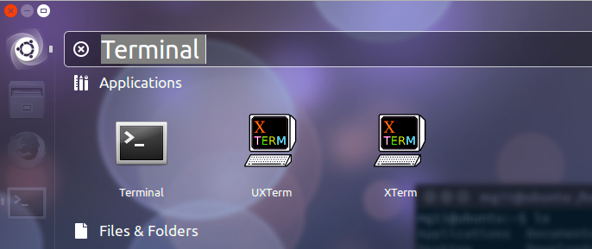
Introduction to Linux
To open a new terminal, click search your computer and online sources -> type terminal -> click on terminal.
or CTRL + ALT + T

Slide 3
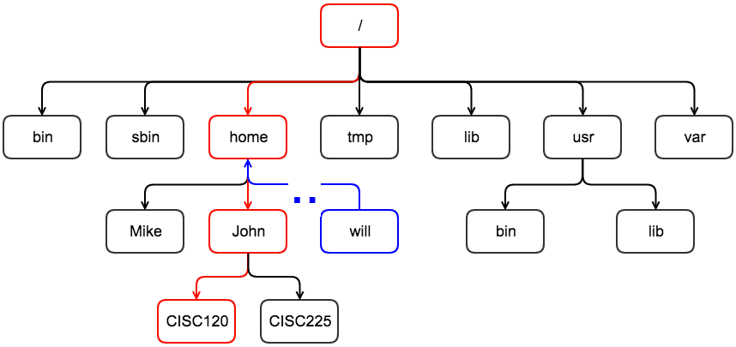
when you login to your terminal you will be in user home directory
your home directory location is //home/USER
the home directory is created automatically for every user
home directly is a standard subdirectory for root directory
the name of the user home directory is identical to the user name

Slide 4
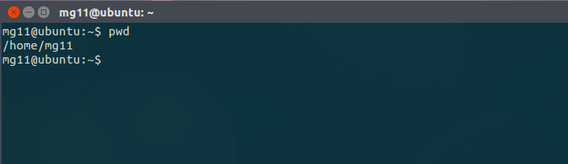
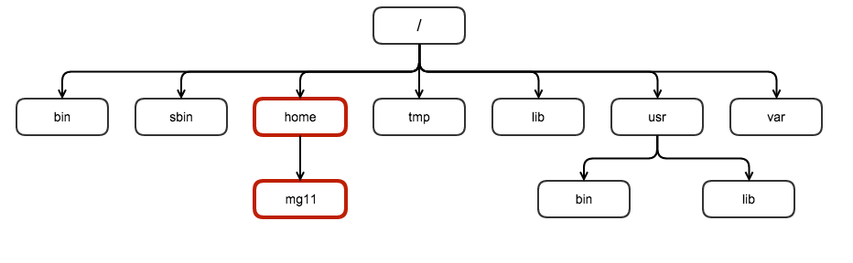
pwd
To print your current working directory you can use the command:
$ pwd

Slide 5
Exercise 1
login to your *nix.
open a new terminal
print your current directory

Slide 6
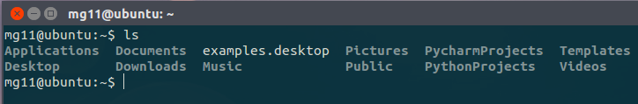
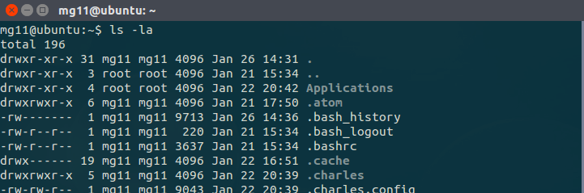
ls
ls stands for list = “list all directories and files inside the current directory”
ls –la = “list all directories, files, hidden and system files and also show information about the finding”

Slide 7
Exercise 2
list all files and directories inside your current directory
list all files, directories with information about these files

Slide 8
cd
to change your current directory use the following command
cd stands for change directory.
$ cd “ directory name”/”sub-directory”

Slide 9
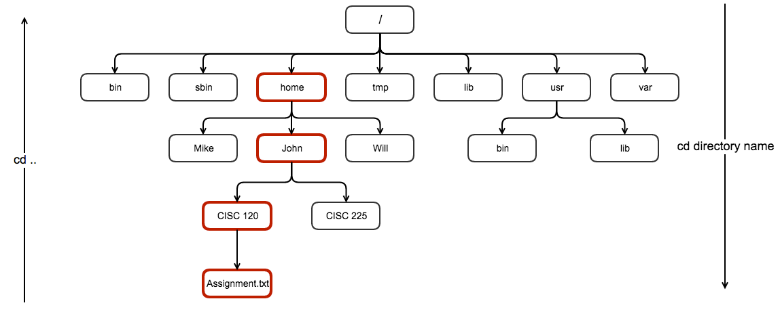
to change directories to child sub-directories use
to change sub-directory up to parent directory use
$ cd “ directory name”/”sub-directory”
$ cd “..”/”..”

Slide 10
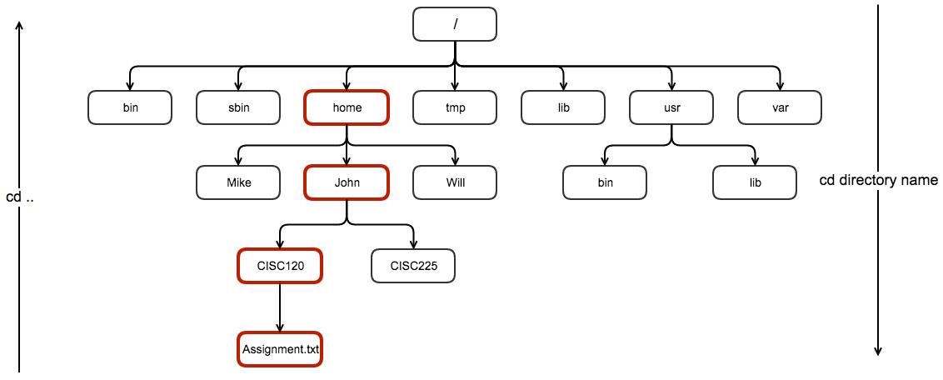
I’m currently in / - root- directory to go to CISC120 directory
john@ubuntu:/$ cd home
john@ubuntu:/home$ cd John
john@ubuntu:~$ cd CISC120
john@ubuntu:~/CISC120$

Slide 11
I’m currently in ~/CISC120 directory to go back to root directory:
john@ubuntu:~/CISC120$ cd ..
john@ubuntu:~$ cd ..
john@ubuntu:/home$ cd ..
john@ubuntu:/$

Slide 12
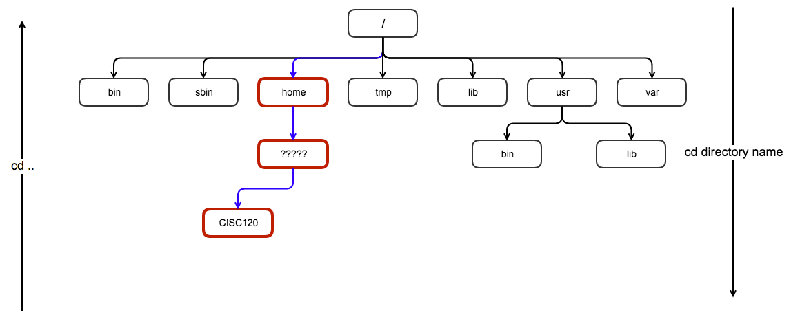
Exercise 3
from your user home directory ~ :
move to root directory : list all sub-directories
move form root to CISC120 directory: list all sub-directories with their permission

Slide 13
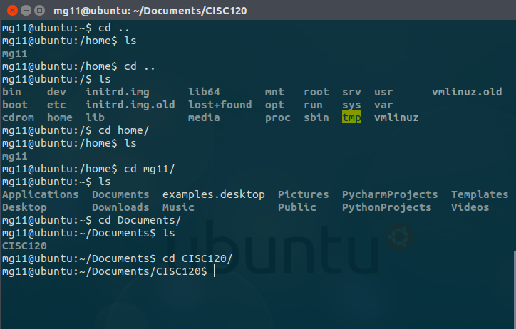
Answer

Slide 14
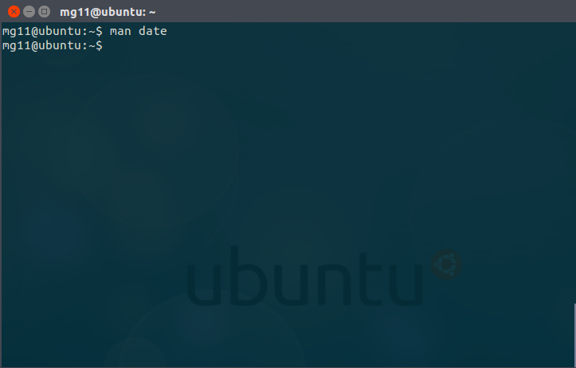
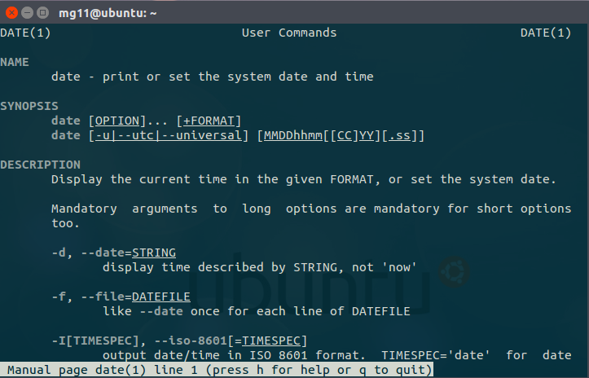
man command
in *nix man is the interface used to view the system’s reference manuals.
to quit the manual interface press “q”
$ man “command”

Slide 15
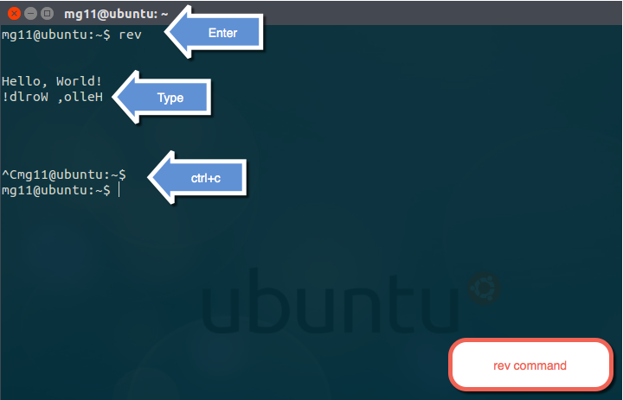
Exercise 4
use the man command to explain each of the following command role:
passwrd
ls option –c
rev

Slide 16
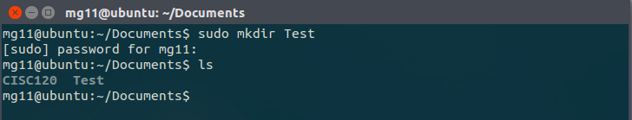
how to create directories in *nix OS?
to create a directory in Linux or any Unix like OS you can use the following command:
mk= make, dir = directory, mkdir = make directory
if you don’t have a right permission to create a sub-directory inside the current working directory you can use your super powers “sudo”.
sudo : s = super, u = user, do = do (sudo == super user do)
pronounced = sue - dough
$ mkdir “directory name”

Slide 17
Exercise 5
create two new directories inside ~/Documents :
Test1
Test2

Slide 18
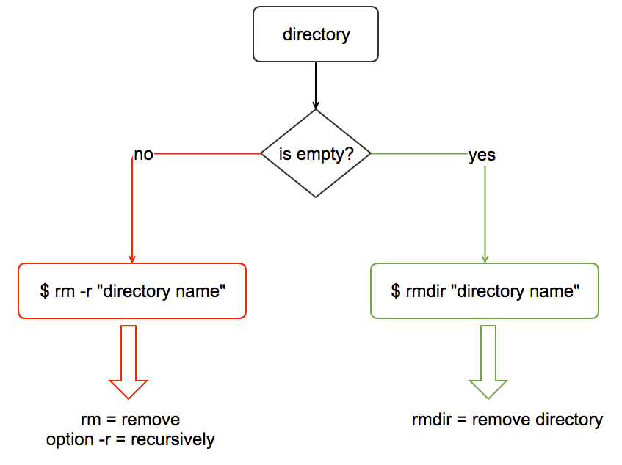
so you know how to create a directory, now how can we remove it?
you can use rm –r command with empty directories, you may need the sudo command to remove directories.

Slide 19
Exercise 6
remove ~/Documents/Test

Slide 20
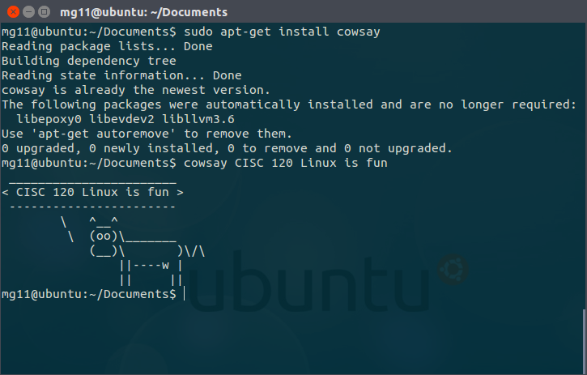
install cowsay

Slide 21
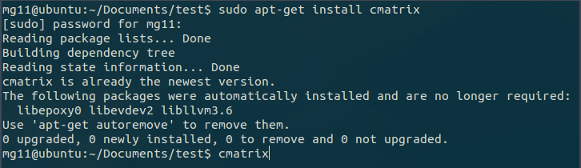
install cmatrix

Slide 22
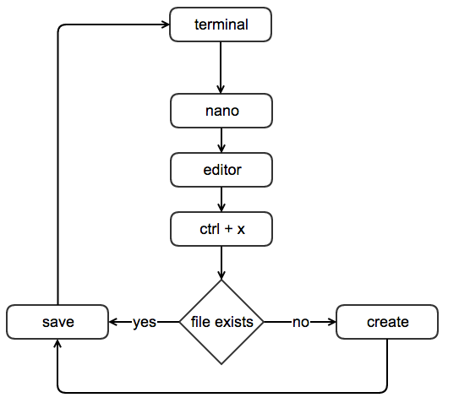
Creating files
there are too many ways of creating files in *nix, however the one that we will use in this class is :
nano is a user friendly terminal text
editor.
if file doesn’t exists nano will create
it for you.
you may need to sudo + nano
if you don’t have the right
permission
$ nano “file name + . + extension”

Slide 23

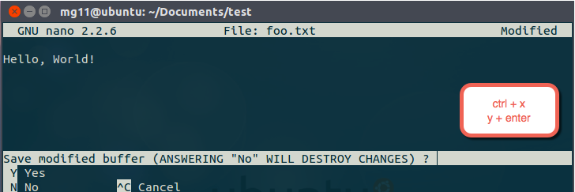
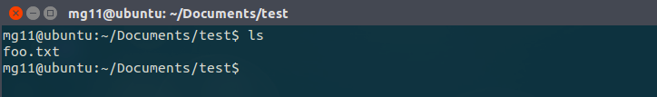
Example

Slide 24
Exercise 7
move to ~/Documents/Test2 and add a new file call it mytext.txt

Slide 25
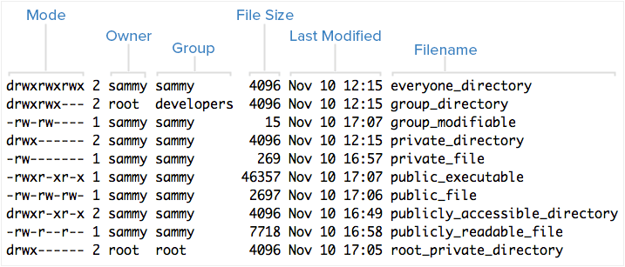
Permission
$ ls -l

Slide 26
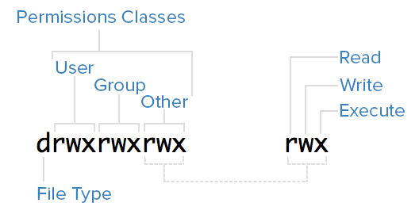
Mode
User: The owner of a file belongs to this class
Group: The members of the file's group belong to this class
Other: Any users that are not part of the user or group classes belong to this class

Slide 27
sets of three characters, or triads “tri – ads”
Read: Indicated by an r in the first position
Write: Indicated by a w in the second position
Execute: Indicated by an x in the third position. In some special cases, there may be a different character here

Slide 28
Examples:
rwx---r-- :
rwx : owner can read, write and execute
--- : group can’t read, write or execute
r-- : others can read, can’t write or execute
-wxr-x--x :
-wx : owner can’t read, owner can write and execute
r-x : group can read, can’t write and can execute
--x : others can’t read or write but can execute

Slide 29
Exercise 8
Explain each of the following permission:
rw-rw-rw-
rwxrwx---
rwxr-x---

Slide 30
chmod
to change permission of any file or directory use the following command:
$ chmod “permission” “file/directory name”

Slide 31
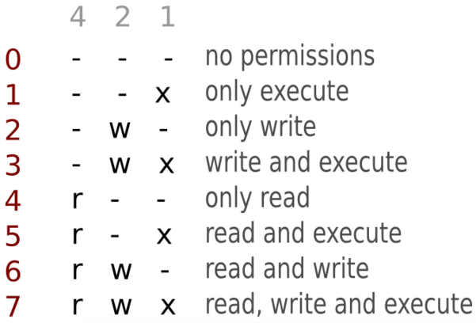
permission octal values

Slide 32
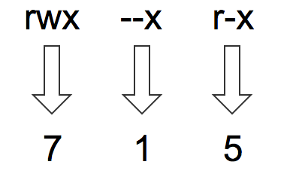
based on the permission octal table

Slide 33
Exercise 9
use the octal permission table to convert the following
permission to octal :
rw- rw- --x
--- --- ---
-wx rwx rwx
check you answer: http://permissions-calculator.org/

Slide 34
Examples
only owner can read, write and execute
→ rwx --- ---
anyone can read, write and execute
→ rwx------ → rwx rwx rwx
no one can execute this file
→ rw- rw- rw-
others: can only read, group: can only write, owner: can read, execute
→ r-x -w- r--
$ chmod 700 mytext.txt
$ chmod 777 mytext.txt
$ chmod 666 mytext.txt
$ chmod 524 mytext.txt

Slide 35
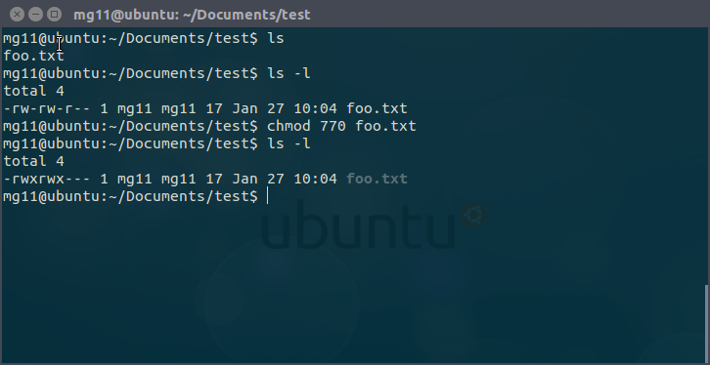
Example

Slide 36
Exercise 10
change permission of ~/Documents/Test/mytext.txt to rwx r-- --x

Slide 37
Exercise 11
remove ~/Documents/Test and everything inside this directory

