Slide 1
Systems Analysis and Design 10th Edition
Chapter 6
Object Modeling

Slide 2
Chapter Objectives
Explain how object-oriented analysis can be used to describe an information system
Define object modeling terms and concepts, including objects, attributes, methods, messages, classes, and instances
Explain relationships among objects and the concept of inheritance
Draw an object relationship diagram

Slide 3
Chapter Objectives (Cont.)
Describe Unified Modeling Language (UML) tools and techniques, including use cases, use case diagrams, class diagrams, sequence diagrams, state transition diagrams, and activity diagrams
Explain the advantages of using CASE tools in developing the object model
Explain how to organize an object model

Slide 4
Overview of Object-Oriented Analysis
Object-oriented (O-O) analysis describes an information system by identifying things called objects that represent a real person, place, event, or transaction
O-O methodology is popular because it integrates easily with object-oriented programming languages such as Java, Smalltalk, VB.Net, Python, and Perl
Programmers also like O-O code because it is modular, reusable, and easy to maintain

Slide 5
Overview of Object-Oriented Analysis (Cont.)
Object-Oriented Terms and Concepts
Unified modeling language (UML)
Method of visualizing and documenting an information system
Attributes - Characteristics that describe the object
Methods - Tasks or functions that the object performs
Message – A command to perform a method
Class - A group of similar objects
Instance - A specific member of a class

Slide 6
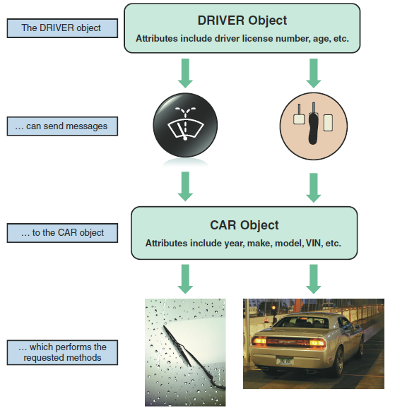
Overview of Object-Oriented Analysis (Cont.)
Objects
Represented as a rectangle with
the object name at the top, followed by the object’s attributes and methods
FIGURE 6-2 Objects have attributes, can send and receive messages, and perform actions called methods

Slide 7
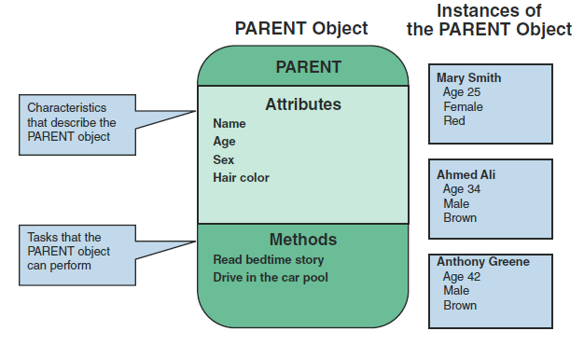
Overview of Object-Oriented Analysis (Cont.)
FIGURE 6-4 The PARENT object includes four attributes and two methods. Mary Smith, Ahmed Ali, and Anthony Greene are instances of the PARENT object

Slide 8
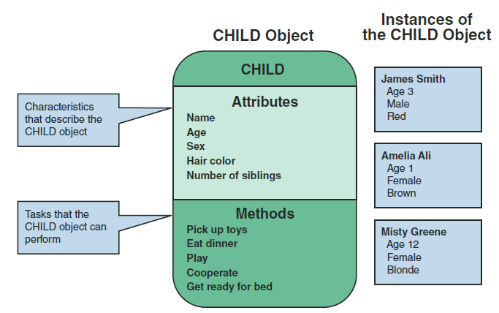
Overview of Object-Oriented Analysis (Cont.)
FIGURE 6-5 The CHILD object includes five attributes and five methods. James Smith, Amelia Ali, and Misty Greene are instances of the CHILD object

Slide 9
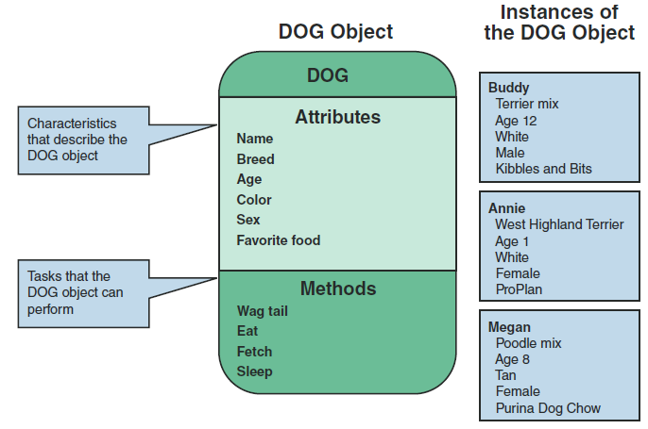
Overview of Object-Oriented Analysis (Cont.)
FIGURE 6-6 The DOG object includes six attributes and four methods. Buddy, Annie, and Megan are instances of the DOG object

Slide 10
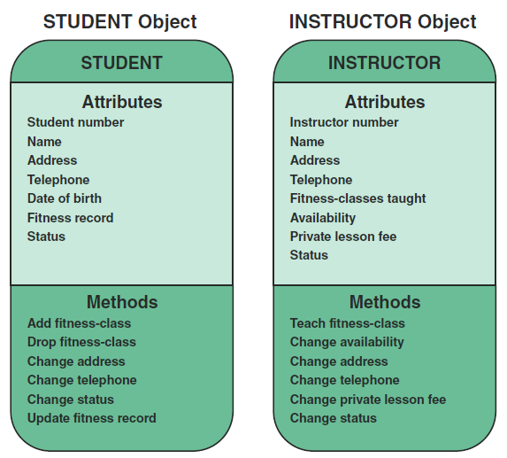
Overview of Object-Oriented Analysis (Cont.)
Attributes
Characteristics that describe the object
FIGURE 6-8 The STUDENT object includes seven attributes and six methods. The INSTRUCTOR object includes eight attributes and six methods

Slide 11
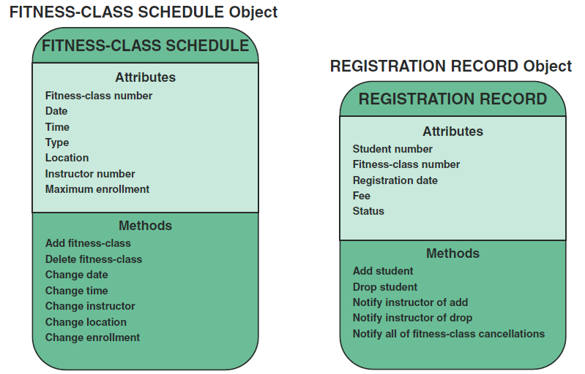
Overview of Object-Oriented Analysis (Cont.)
FIGURE 6-9 The FITNESS-CLASS SCHEDULE object includes seven attributes and seven methods
FIGURE 6-10 The REGISTRATION RECORD object includes five attributes and five methods

Slide 12
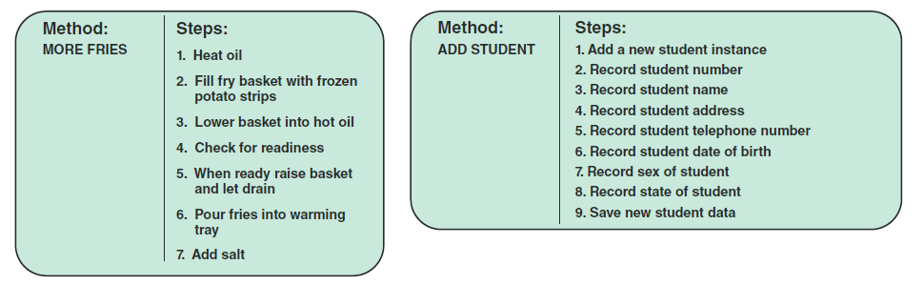
Overview of Object-Oriented Analysis (Cont.)
Methods
Specific tasks that an object can perform
FIGURE 6-12 The MORE FRIES method requires the server to perform seven specific steps
FIGURE 6-13 In the fitness center example, the ADD STUDENT method requires the STUDENT object to perform nine specific steps

Slide 13
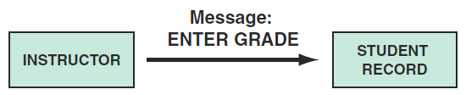
Overview of Object-Oriented Analysis (Cont.)
Messages
A command that tells an object to perform a certain method
The same message to two different objects can produce different results (polymorphism)
You can view an object as a black box, message can trigger a change in the object without specifying how the changes must be carried out
Selecting gas at a gas pump – you don’t know how it works
Encapsulation
All data and methods are self-contained
FIGURE 6-16 In a school information system, an INSTRUCTOR object sends an ENTER
GRADE message to an instance of the STUDENT RECORD class

Slide 14
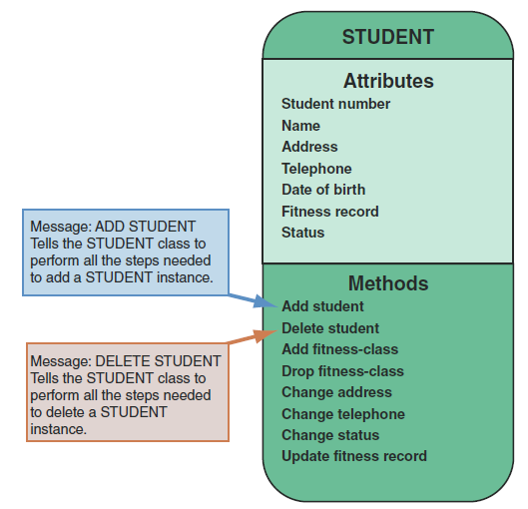
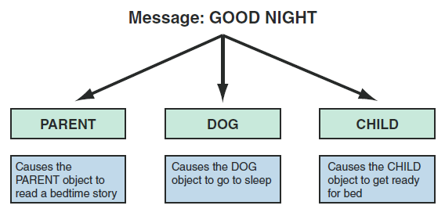
Overview of Object-Oriented Analysis (Cont.)
FIGURE 6-15 In an example of polymorphism, the message GOOD NIGHT produces different results, depending on which object receives it
FIGURE 6-14 The message ADD STUDENT signals the STUDENT class to perform the ADD STUDENT method. The message DELETE STUDENT signals the STUDENT class to perform the DELETE STUDENT method

Slide 15
Overview of Object-Oriented Analysis (Cont.)
Classes
An object belongs to a group or category called a class
All objects within a class share common attributes and methods
Subclasses - Objects within a class
TRUCK objects represent a subclass within the VEHICLE class, along with other subclasses called CAR, MINIVAN, and SCHOOL BUS
Superclass – A general category
A NOVEL class belongs to a superclass called BOOK, because all novels are books

Slide 16
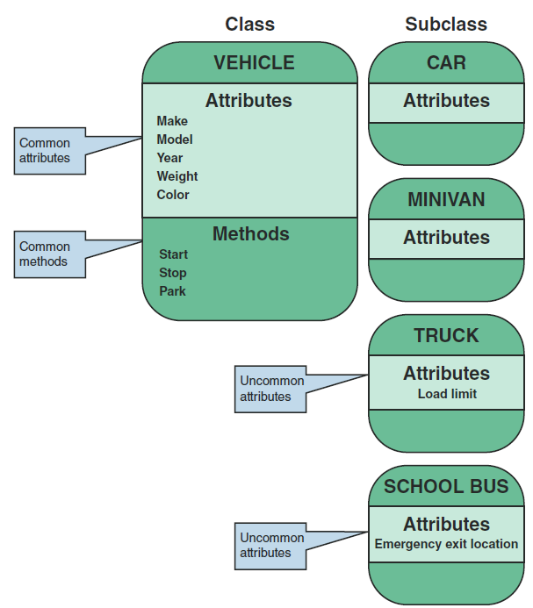
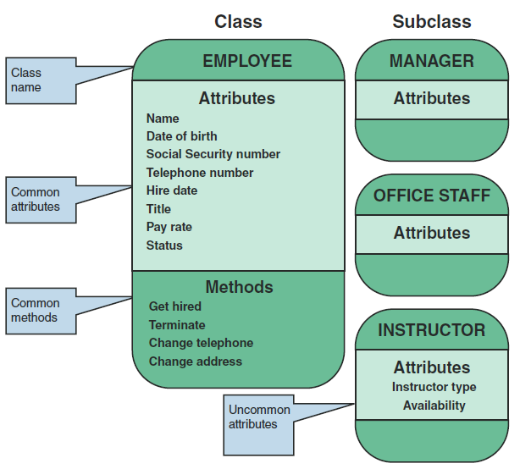
Overview of Object-Oriented Analysis (Cont.)
FIGURE 6-17 The VEHICLE class includes common attributes and methods. CAR, TRUCK, MINIVAN, and SCHOOL BUS are instances of the VEHICLE class
FIGURE 6-18 The fitness center EMPLOYEE class includes common attributes and methods. INSTRUCTOR, MANAGER, and OFFICE STAFF are subclasses within the EMPLOYEE class

Slide 17
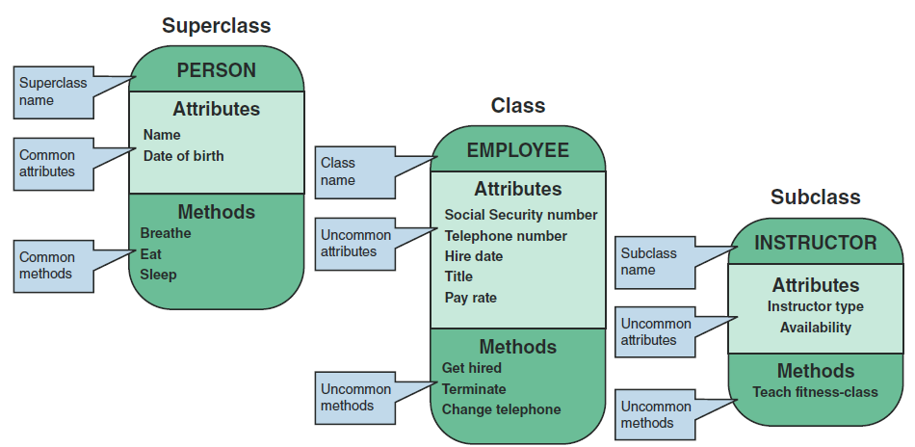
Overview of Object-Oriented Analysis (Cont.)
FIGURE 6-19 At the fitness center, the PERSON superclass includes common attributes and methods. EMPLOYEE is a class within the PERSON superclass. INSTRUCTOR is a subclass within the EMPLOYEE class

Slide 18
Relationships Among Objects and Classes
Relationships
Enable objects to communicate and interact as they perform business functions and transactions required by the system
Describe what objects need to know about each other
How objects respond to changes in other objects
Effects of membership in classes, superclasses, and subclasses
Strongest relationship is called inheritance
Inheritance enables an object, called a child, to derive one or more of its attributes from another object, called a parent

Slide 19
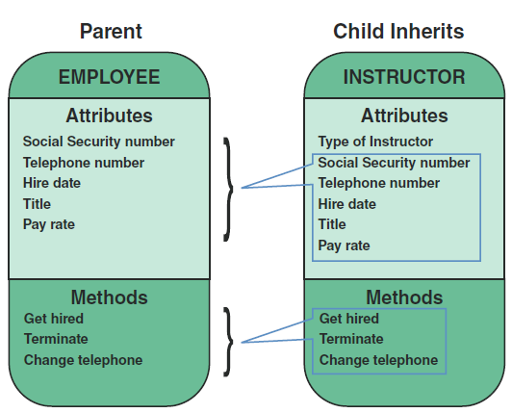
Relationships Among Objects and Classes (Cont.)
FIGURE 6-20 An inheritance relationship exists between the INSTRUCTOR and EMPLOYEE objects. The INSTRUCTOR (child) object inherits characteristics from the EMPLOYEE (parent) class and can have additional attributes of its own

Slide 20
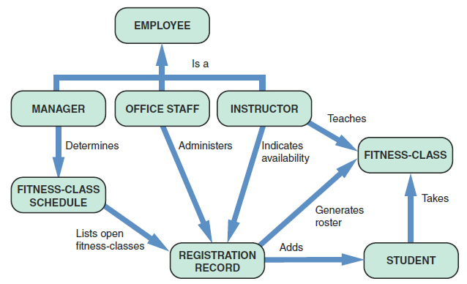
Relationships Among Objects and Classes (Cont.)
Object Relationship Diagram
Shows the objects and how they interact to perform business functions and transactions
FIGURE 6-21 Object relationship diagram for the fitness center

Slide 21
Object Modeling with the Unified Modeling Language
UML uses a set of symbols to represent graphically the various components and relationships within a system
Use Case Modeling
Steps in a specific business function or process
An external entity, called an actor, initiates a use case by requesting the system to perform a function or process

Slide 22
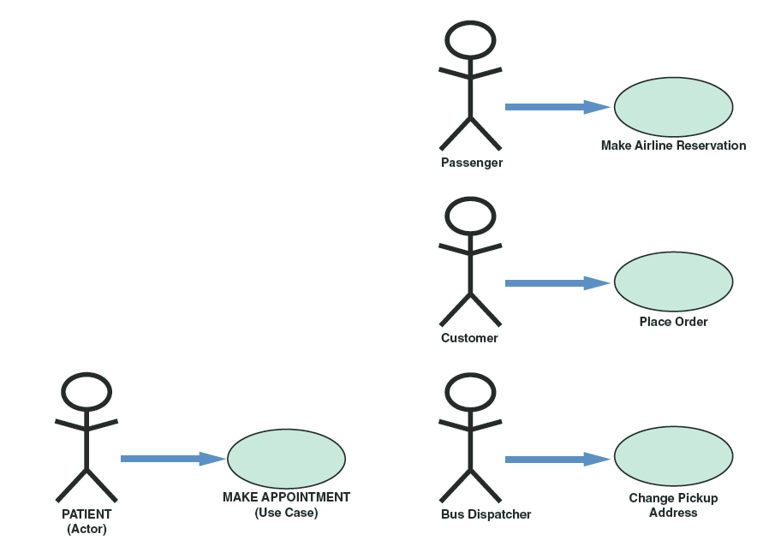
Object Modeling with the Unified Modeling Language (Cont.)
UML symbol for a use case is an oval with a label that describes the action or event
The actor is shown as a stick figure, with a label that identifies the actor’s role
FIGURE 6-22 In a medical office system, a PATIENT
(actor) can MAKE APPOINTMENT (use case)
FIGURE 6-23 Three use case examples. The UML symbol for a use case is an oval. The actor is shown as a stick figure

Slide 23
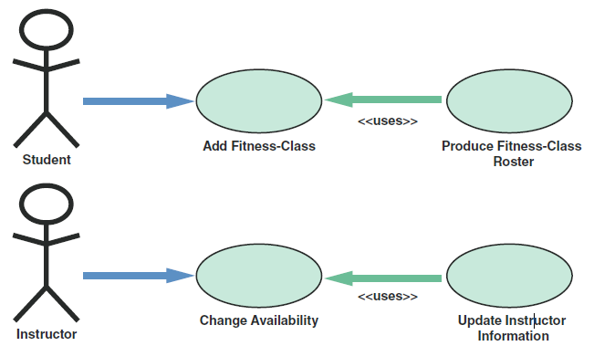
Object Modeling with the Unified Modeling Language (Cont.)
FIGURE 6-24 When a student adds a class, PRODUCE FITNESS-CLASS ROSTER uses the results of ADD CLASS to generate a new class roster. When an instructor changes his or her availability, UPDATE INSTRUCTOR INFORMATION uses the CHANGE AVAILABILITY use case to update the instructor’s information

Slide 24
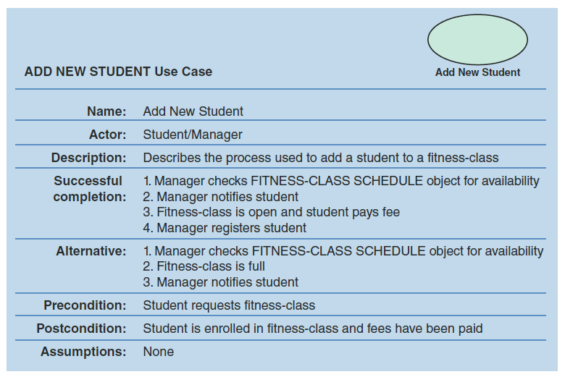
Object Modeling with the Unified Modeling Language (Cont.)
FIGURE 6-25 The ADD NEW STUDENT use case description documents the process used to add a current student into an existing class

Slide 25
Object Modeling with the Unified Modeling Language (Cont.)
Use Case Diagram
A visual summary of several related use cases within a system or subsystem
The first step is to identify the system boundary, which is represented by a rectangle
System boundary shows what is included in the system (inside the rectangle) and what is not included in the system (outside the rectangle)

Slide 26
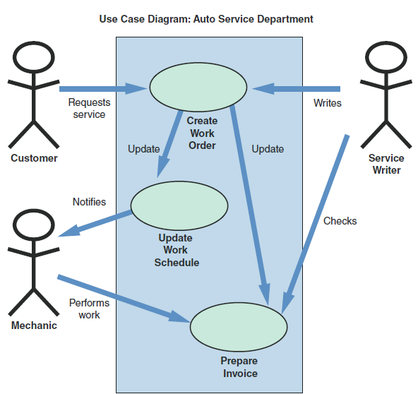
Object Modeling with the Unified Modeling Language (Cont.)
FIGURE 6-27 use case diagram to handle work at an auto service department

Slide 27
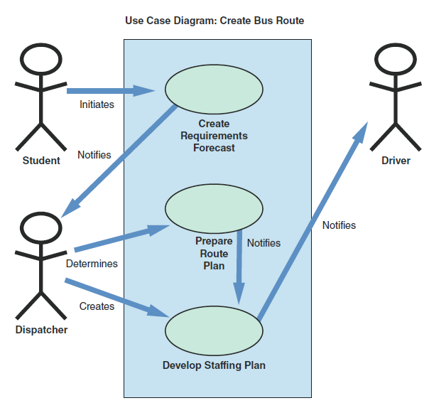
Object Modeling with the Unified Modeling Language (Cont.)
FIGURE 6-28 A use case diagram to create a school bus route

Slide 28
Object Modeling with the Unified Modeling Language (Cont.)
Class Diagrams
Shows the object classes and relationships involved in a use case
Each class appears as a rectangle, with the class name at the top, followed by the class’s attributes and methods
Lines show relationships between classes and have labels identifying the action that relates the two classes
Diagram also includes a concept called cardinality, which describes how instances of one class relate to instances of another class

Slide 29
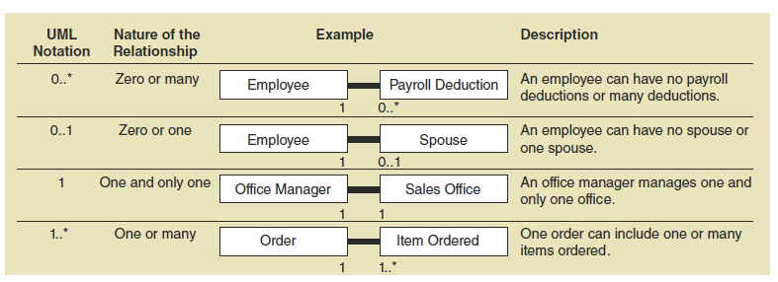
Object Modeling with the Unified Modeling Language (Cont.)
FIGURE 6-29 Examples of UML notations that indicate the nature of the relationship between instances of one class and instances of another class

Slide 30
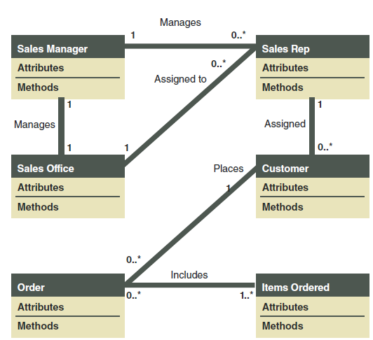
Object Modeling with the Unified Modeling Language (Cont.)
FIGURE 6-30 Class diagram for a sales order use case (attributes and methods omitted for clarity)

Slide 31
Object Modeling with the Unified Modeling Language (Cont.)
Sequence Diagrams
A dynamic model of a use case, showing the interaction among classes during a specified time period
Graphically documents the use case by showing the classes, the messages, and the timing of the messages
Include symbols that represent classes, lifelines, messages, and focuses

Slide 32
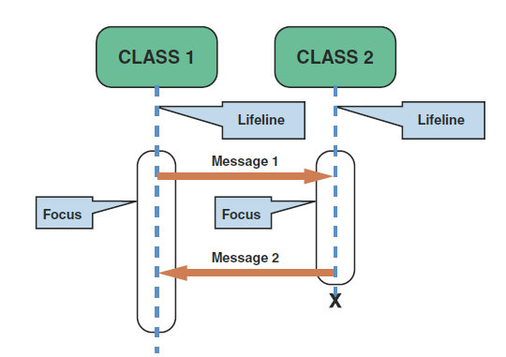
Object Modeling with the Unified Modeling Language (Cont.)
Classes
Identified by a rectangle with the name inside
Classes that send or receive messages are shown at the top of the sequence diagram
Lifelines
Identified by a dashed line
The lifeline represents the time during which the object above it is able to interact with the other objects in the use case
An X marks the end of the lifeline
Messages
Identified by a line showing direction that runs between two objects
The label shows the name of the message and can include additional information about the contents
Focuses
Identified by a narrow vertical shape that covers the lifeline
The focus indicates when an object sends or receives a message
FIGURE 6-31 A sequence diagram with two classes. Notice the X that indicates the end of the CLASS 2 lifeline. Also notice that each message is represented by a line with a label that describes the message, and that each class has a focus that shows the period when messages are sent or received

Slide 33
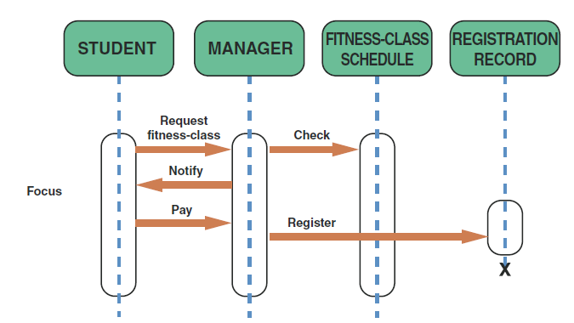
Object Modeling with the Unified Modeling Language (Cont.)
FIGURE 6-32 The sequence diagram for the ADD NEW STUDENT use case. The use case description for ADD NEW STUDENT is shown in Figure 6-25 on page 240

Slide 34
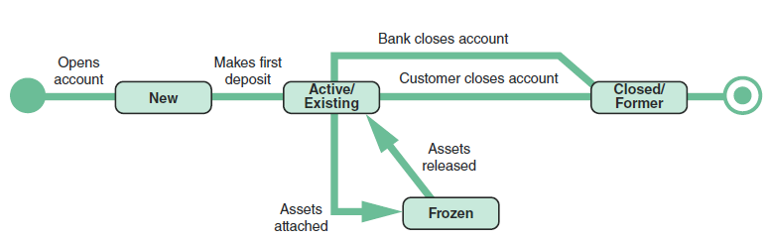
Object Modeling with the Unified Modeling Language (Cont.)
FIGURE 6-33 An example of a state transition diagram for a bank account
State Transition Diagrams
Shows how an object changes from one state to another, depending on events that affect the object
All possible states must be documented in the state transition diagram
States appear as rounded rectangles with the state names inside

Slide 35
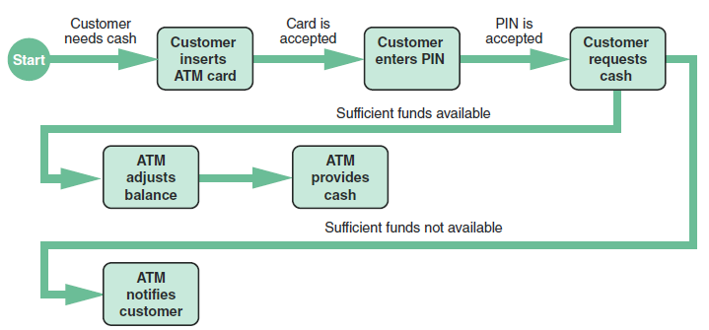
Object Modeling with the Unified Modeling Language (Cont.)
FIGURE 6-34 An activity diagram shows the actions and events involved in withdrawing cash from an ATM machine.
Activity Diagrams
Shows the actions and events as they occur
Show the order in which the actions take place and identify the outcomes

Slide 36
Object Modeling with the Unified Modeling Language (Cont.)
Business Process Modeling (BPM)
Represent the people, events, and interaction in a system
Outside rectangle is called a pool, and designated swim lanes show specific actions and events
Swim lanes can interact when certain events occur

Slide 37
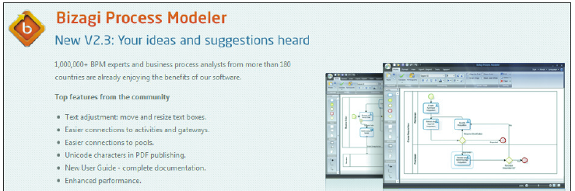
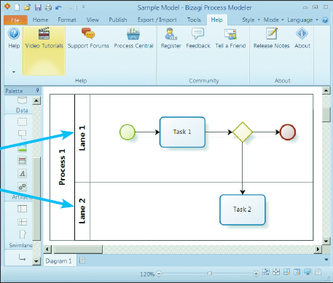
Object Modeling with the Unified Modeling Language (Cont.)
FIGURE 6-35 The Bizagi Modeler site offers free BPM software that uses a swimming pool and swim lanes to represent interactive business processes and events (Continues)

Slide 38
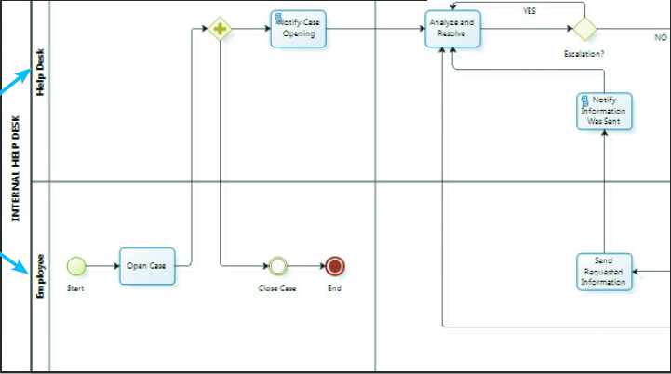
Object Modeling with the Unified Modeling Language (Cont.)
CASE Tools
Object modeling requires many types of diagrams to represent the proposed system
Creating the diagrams by hand is time consuming and tedious
CASE tools speed up the process and provide an overall framework for documenting the system components
CASE tools ensure consistency and provide common links so that once objects are described and used in one part of the design, they can be reused multiple times without further effort
FIGURE 6-35 The Bizagi Modeler site offers free BPM software that uses a swimming pool and swim lanes to represent interactive business processes and events

Slide 39
Organizing the Object Model
Develop an object relationship diagram that provides an overview of the system
Organize your use cases and use case diagrams so they can be linked to the appropriate class, state transition, sequence, and activity diagrams
It is much easier to repair a diagram now than to change the software later

Slide 40
Chapter Summary
Object modeling is a popular technique that describes a system in terms of objects
Object-oriented terms include classes, attributes, instances, messages, and methods
Objects can send messages, or commands, that require other objects to perform certain methods, or tasks

Slide 41
Chapter Summary (Cont.)
The Unified Modeling Language (UML) is a widely used method of visualizing and documenting an information system
At the end of the object modeling process, you organize your use cases and use case diagrams and create class, sequence, state transition, and activity diagrams
Use case describes a business situation initiated by an actor, who interacts with the information system

