Slide 1


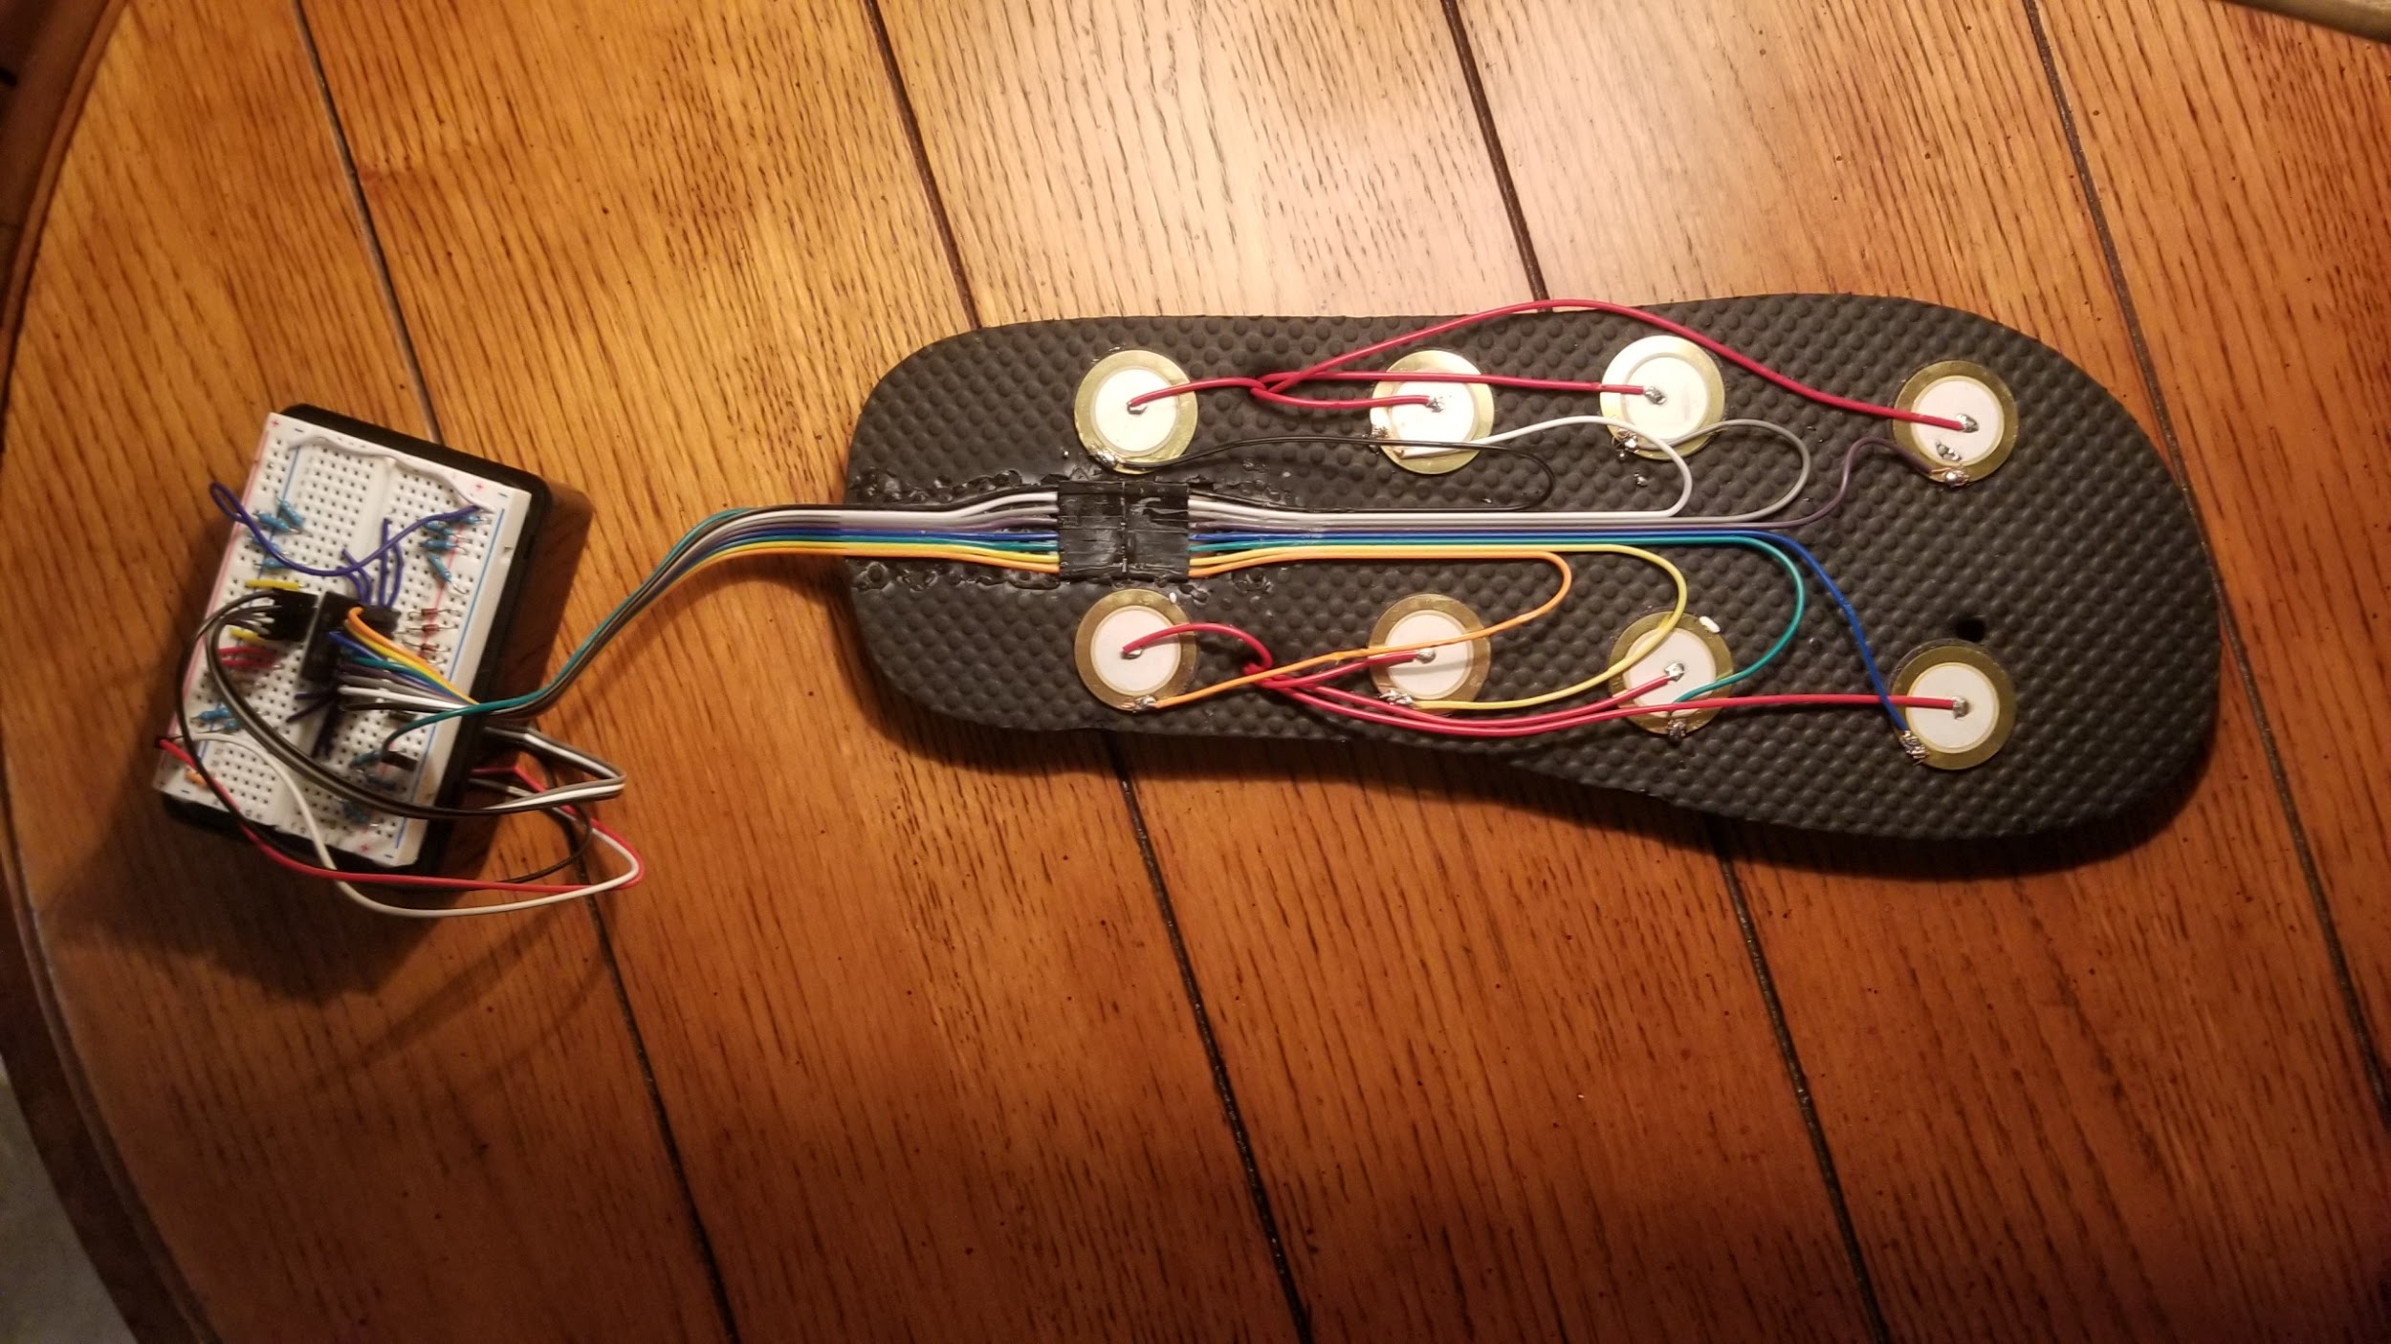
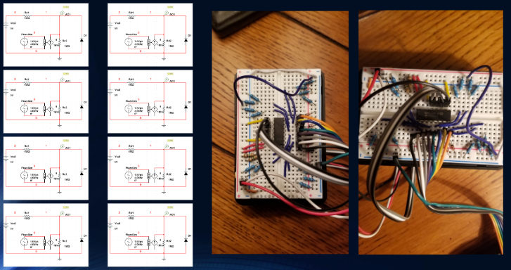
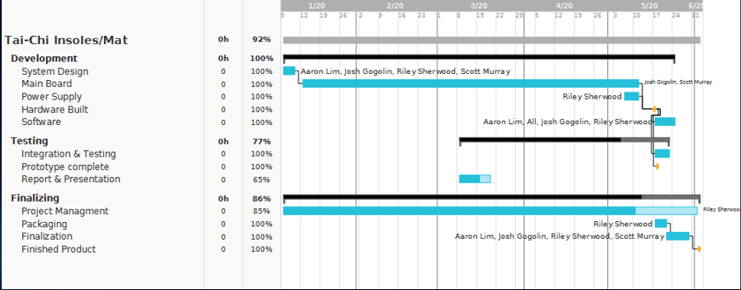
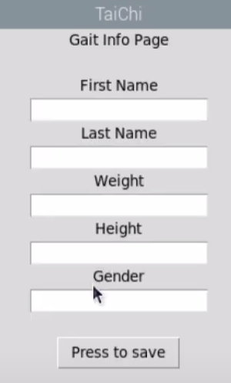
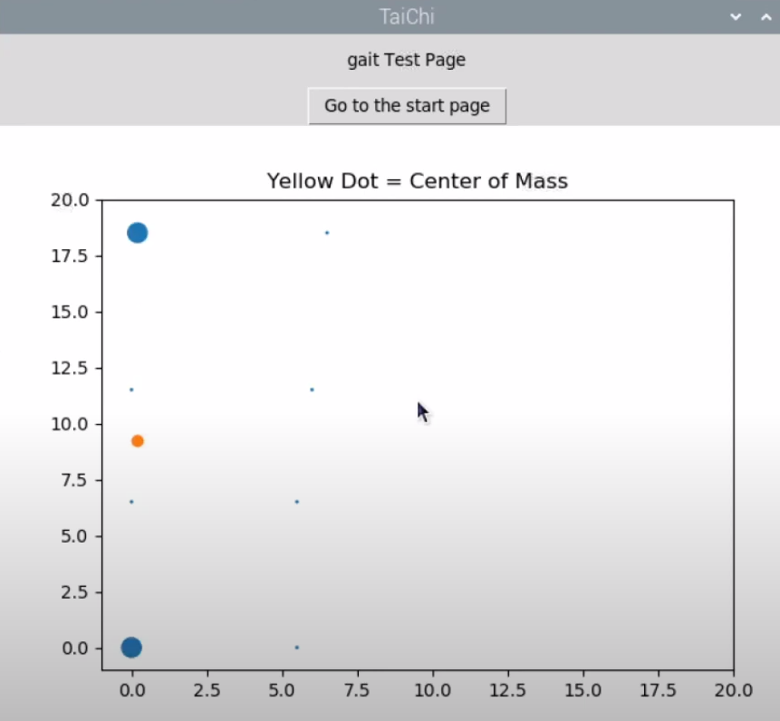
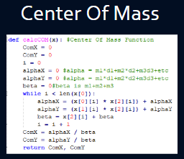
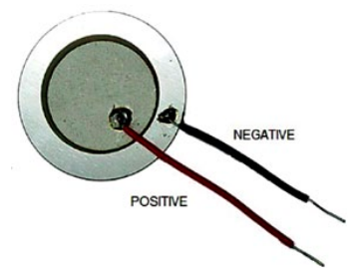
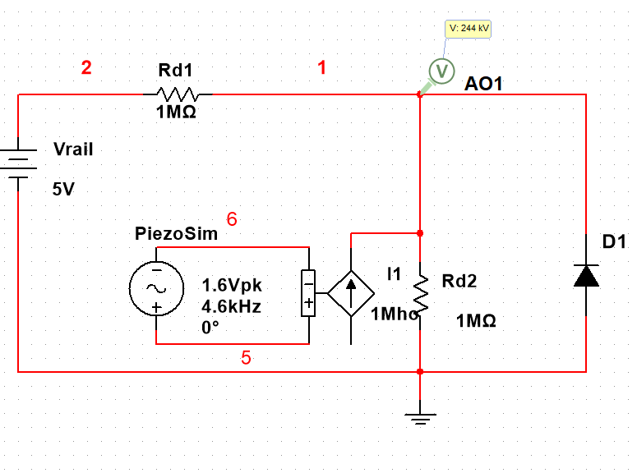
Smart Soles
Group: Tai-Chi
Team Leader: Riley Sherwood
Engineers: Josh Gogolin, Aaron Lim, Scott Murray
Spring 2020
Goal
Accurately measure gait in a performance test on a small mobile device that will provide an 80% or better accuracy as compared to the gold standard
Circuit/Current state
How long did it take?
- The sandal holds sensors around the outer edge when pressed the sensors discharge a small voltage. This discharged voltage is then measured to determine how hard the sensor was depressed.
-- The code reads each channel to determine the voltage changes on a specific sensor.
- The voltage is measured and compared to each other sensor in order to show where the most pressure is being applied.
-This data is displayed on a scatter plot displaying different sensitivities so that the user can see how pressure from the patient’s feet is being applied. This will allow the user to perform balance tests with real-time data.
- Data is displayed real-time in the Tkinter GUI and results are output into a .crv file
Text box
Piezoelectric Sensors
Piezoelectric sensors are sensors that when depressed discharge electricity.
These sensors are made from piezoelectric materials which discharge stored electricity when under duress.
We can use this effect to measure the voltage the sensors output and convert that value into a measure of pressure used for balance analysis.
Because these piezo sensors are outputting a relatively small voltage we are using high value resistors in a voltage divider this way our current is not diminished.
Design Challenges
References / Acknowledgements
Dr. Fadi Muheidat for being an amazing and caring professor
CSUSB for not cancelling the Spring2020 Quarter
Multisim
https://en.wikipedia.org/wiki/Piezoelectricity#Mechanism
“Flexible Insole Sensors with Stably Connected Electrodes for Gait Phase Detection” (Research Paper)
Christian Espsito at Tekscan(source for similar products)
Equipment Availability (Soldering kit, more sensors, laptop/mobile device)
Forced to work with what we had, as acquiring more parts became difficult.
Most components shipped from China, which post March, shipping costs and delays became astronomical.
Cost (Engineers were either furloughed or laid off)
Unable to meet as a group for hardware implementation (Social distancing)
Campus resources were unavailable
Future Design Enhancements
Database (To store old data for data comparison for clients )
Implementation of a two insole test
Implementation of a gyroscope
Implementation of a power light indicator
Cleaner, more appealing app design with a 3d printed custom sole
Better accuracy in tests (i.e. More precision)
Battery for device portability

