Slide 1

SATURNSYNC
10th grade
“Harvesting Connections”
A presentation made by Andrey Mutlu

Slide 2
Contents of the Presentation
01
02
03
04
The Team
Used Technologies
The Script
Repository

Slide 3
01
The Team

Slide 4

Team SaturnSync
Andrey Mutlu:
-Backend developer
-Frontend developer
-Designer
-Scrum Trainer

Slide 5
02
Used Technologies

Slide 6





Used Technologies

Slide 7





Used Technologies

Slide 8
03
The Script

Slide 9
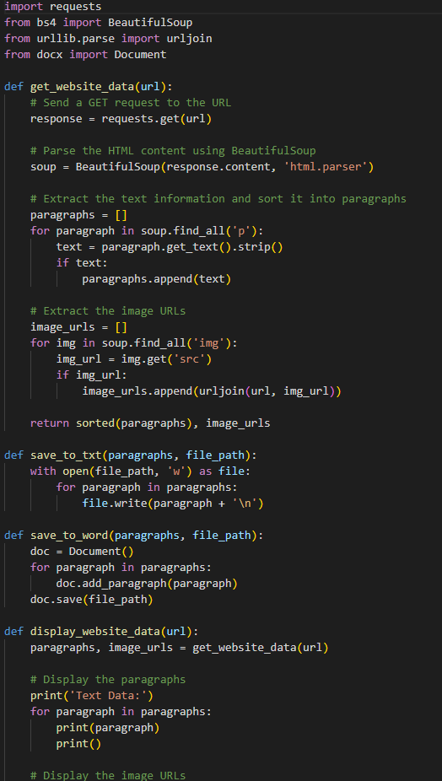
Now, lets move on to the script!

Slide 10
04
Repository

Slide 11
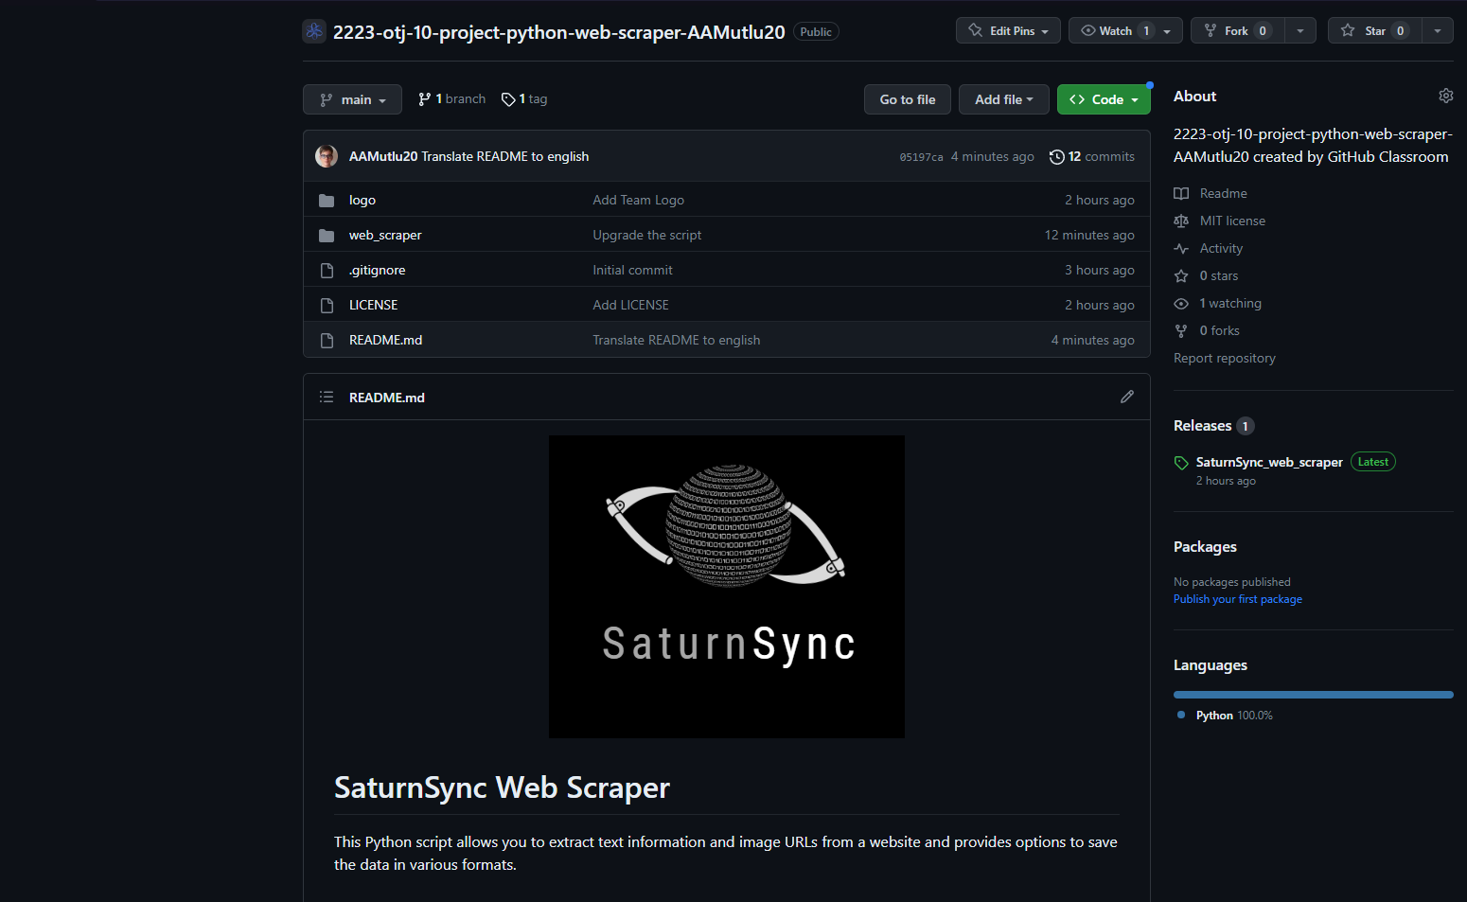
The Repository

Slide 12
THANK YOU FOR YOUR ATTENTION
Do you have any questions?

Slide 13


