Slide 1
INTRODUCTION to HTML CSS
JAVASCRIPT
A.ANITHA
24524U18008
DFD43EB1BA05FA4B0444C9DCD4116085
Karan arts and sciences college
Tiruvannamalai
Company name

Slide 2

Introduction
This presentation covers the basics of web development with a focus on HTML, CSS, and JavaScript. Learn how these technologies create the structure, style, and interactivity of websites.

Slide 3
01
Introduction to Web Development

Slide 4
Overview of Web Development
1. Web Development = building and maintaining websites.
2. Uses HTML (structure), CSS (style), JavaScript (interactivity).

Slide 5
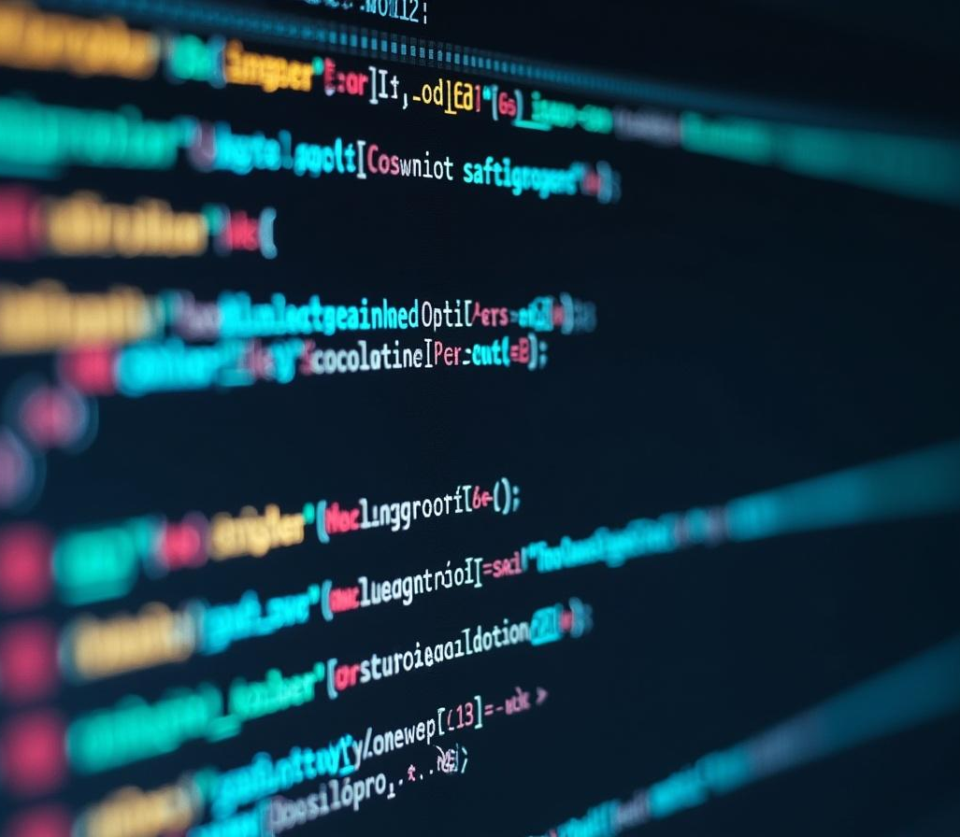
Role of HTML, CSS, and JavaScript
HTML creates the webpage structure, CSS adds visual styles, and JavaScript enables dynamic content and interaction.

Slide 6
Importance in Modern Web Applications
These core technologies power almost all websites, essential for delivering engaging and responsive user experiences online.

Slide 7
02
HTML Basics

Slide 8

Structure of an HTML Document
An HTML document starts with a doctype declaration and contains nested elements like head and body that organize content logically.

Slide 9
Common HTML Elements and Tags
Key tags include headings, paragraphs, links, images, and lists, which provide essential building blocks for website content.

Slide 10
Semantic HTML and Accessibility
Using semantic HTML improves webpage clarity for users and search engines. It also enhances accessibility for assistive technologies like screen readers.

Slide 11
03
CSS Fundamentals

Slide 12
Styling and Layout Principles
CSS manages site appearance including colors, fonts, spacing, and layout to create visually appealing and usable webpages.

Slide 13
CSS Selectors and Properties
Selectors target HTML elements, applying styles via properties like color, margin, or display to control presentation and placement.

Slide 14

Responsive Design Techniques
Responsive design uses flexible grids, images, and media queries to ensure websites adapt smoothly to different screen sizes and devices.

Slide 15
04
JavaScript Essentials

Slide 16
Basics of JavaScript Syntax
JavaScript syntax includes variables, functions, loops, and conditions enabling programming logic for web interactivity.

Slide 17
Conclusion
Mastering HTML, CSS, and JavaScript provides the foundation for building modern, accessible, and engaging websites that meet today’s digital standards.

Slide 18
Thank you….

