Slide 1
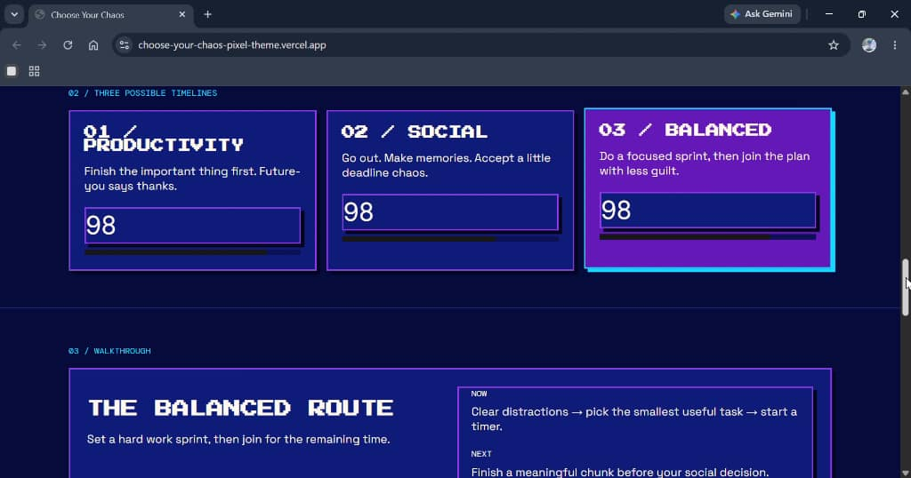
Website link: https://choose-your-chaos-pixel-theme.vercel.app/
Demo video:
Deployed via vercel

