Slide 1
PSI Transition-State Prediction
Algorithm-focused implementation review: data triplets, invariant geometry learning, EGNN coordinate
refinement, Ea regression, and inference constraints.
5,000
evaluated reactions
8.02
val Ea MAE kcal/mol
0.1609
val distance MAE A
0.804
val Ea R2
Core idea: learn the TS distance matrix from reactant/product distances, embed it into 3D, refine coordinates equivariantly, then predict Ea from the refined TS representation.
PSI Transition-State Prediction | 1

Slide 2
IMPLEMENTATION
Data Assembly and Targets
build_reaction_samples reads extracted_dataset.json once, groups filenames by reaction ID, and keeps only complete reactant/product/TS triplets.
Atom order is taken from the TS entry and reused for reactant and product tensors; samples above max_atoms are skipped before padding.
Ea target is (E_TS - max(E_R, E_P)) * 627.509 kcal/mol. Negative targets are skipped when skip_negative_ea is enabled.
The true TS target is a padded D_TS pairwise distance matrix, so supervision is invariant to global rotation and translation.
A TS-fragment geometry mask is precomputed from covalent-radius connectivity so loss ignores padding and disconnected cross-fragment distances.
16,000
raw entries
5,320
complete triplets
Split | N | Avg atoms | Range
Train | 4,000 | 13.5 | 4-21
Validation | 1,000 | 13.6 | 6-21
All | 5,000 | 13.5 | 4-21
This slide replaces broad motivation with the actual target definition and sample filtering logic used by the code.
PSI Transition-State Prediction | 2

Slide 3
IMPLEMENTATION
Feature Tensor Construction
ReactionDataset optionally adds Gaussian coordinate noise only to R/P coordinates during training; validation uses clean coordinates.
D_R, D_P, and D_I are built from pairwise Euclidean distances. D_I is the midpoint distance matrix used as a stable geometric prior.
atom_ids feed a learned embedding; atom_phys adds normalized electronegativity, atomic number, and atomic mass.
energy_feats is a normalized 20D vector: composition, signed reaction energy, displacement statistics, and bond-angle statistics.
Normalization statistics are computed only on training indices to prevent validation leakage.
Tensor | Shape | Role
D_R | [B,30,30] | Reactant distances
D_I | [B,30,30] | Midpoint/interpolation prior
D_P | [B,30,30] | Product distances
mask | [B,30] | Real atoms vs padding
geom_mask | [B,30,30] | Pairs included in geometry loss
energy_feats | [B,20] | Global chemistry descriptor
D_R = pairwise(c_R) D_P = pairwise(c_P) D_I = 0.5 * (D_R + D_P) Ea_norm = (Ea - mean_train) / std_train
PSI Transition-State Prediction | 3

Slide 4
WORKFLOW
End-to-End Algorithm
1. Logs
Gaussian R/P/TS energies and coordinates
2. Triplets
Complete reaction samples with fixed atom order
3. Tensors
D_R, D_I, D_P, masks, atom and energy features
4. PSI core
Temporal R/I/P encoding plus atom attention
5. Geometry
Alpha interpolation and clamped pair delta
6. 3D/Ea
MDS, EGNN refinement, learned barrier head
Training path: predict D_TS, embed to coordinates, refine with EGNN, compute geometry losses, and add Ea loss after warmup.
Evaluation path: post-process the predicted distance matrix, recover fragment-aware coordinates, score geometry and Ea, and store detailed_analysis.json.
Inference path: reuse the same normalization metadata from the checkpoint, then write JSON plus optional XYZ for quantum-chemistry follow-up.
The model is not a direct coordinate regressor: it learns invariant distances first, then converts to coordinates only after the pairwise geometry is stable.
PSI Transition-State Prediction | 4

Slide 5
ARCHITECTURE
PSI Core Encoder
Each atom row sees all pairwise distances to the other 30 padded positions through 32 Gaussian radial basis channels.
For every atom, the model builds three state embeddings: reactant, midpoint, and product. Each state also includes atom embedding and physical descriptors.
A 2-layer bidirectional GRU runs over the R -> I -> P sequence per atom; the midpoint hidden state becomes the atom context.
Three pre-norm Transformer encoder layers then let atoms exchange global context through self-attention while honoring the padding mask.
The output is a per-atom latent vector used by the pairwise geometry head.
GaussianEmbedding
32 radial basis channels from 0.4-6.0 A
BiGRU
2 layers, hidden=128, reads R/I/P as a short geometry trajectory
Transformer
3 layers, 8 heads, ff_dim=512
state_seq = [emb_R, emb_I, emb_P] context = BiGRU(state_seq)[:, midpoint] node_feats = Transformer(context, pad_mask)
PSI Transition-State Prediction | 5

Slide 6
ARCHITECTURE
Pairwise Geometry Head
For each atom pair (i,j), the head concatenates node context for i and j, atom features for i and j, and raw distances D_R, D_I, D_P.
The MLP predicts alpha_logit and delta. alpha = sigmoid(alpha_logit) forces interpolation weight into [0,1].
The initial final layer is zeroed, so the first prediction starts at the endpoint midpoint with no learned correction.
delta is clipped before addition, which prevents a single pairwise prediction from creating an extreme unphysical distance.
The matrix is symmetrized, diagonal-zeroed, non-negative clamped, and multiplied by the valid atom mask.
DISTANCE FORMULA
alpha = sigmoid(alpha_logit) delta = clamp(delta, -3.0, +3.0) D_base = alpha*D_R + (1-alpha)*D_P D_TS = symmetrize(clamp(D_base + delta, 0))
Part | Implementation
Input | node_i, node_j, atom_i, atom_j, D_R, D_I, D_P
Output | coarse TS distance matrix
Aux loss | Huber(coarse D_TS, true D_TS)
PSI Transition-State Prediction | 6

Slide 7
ARCHITECTURE
MDS and EGNN Refinement
torch_mds_coords turns the coarse distance matrix into 3D coordinates using masked classical MDS and the top three non-negative eigen-components.
The EGNN consumes atom chemical features plus the initial MDS coordinates. Messages depend on squared pairwise distances, so feature updates remain invariant.
Coordinate updates are equivariant: if the input geometry is rotated or translated, the output rotates or translates consistently.
Each EGNN layer clips coordinate displacement messages and normalizes by node degree, preventing unstable geometry jumps.
The final training distance matrix is recomputed from refined coordinates, so the main geometry loss supervises the actual 3D refinement.
1. Coarse D_TS
Pairwise output from geometry head
2. Classical MDS
Double-center D^2 and keep top 3 components
3. EGNN layers
4 layers, hidden=128, coord clamp=2.0 A
4. Refined D_TS
Recomputed from x_TS for loss, metrics, and Ea
This is the technical reason the pipeline can learn geometry without depending on an arbitrary Cartesian frame.
PSI Transition-State Prediction | 7

Slide 8
ARCHITECTURE
Activation Energy Modeling
EaHead uses EGNN-refined per-atom features, masked mean pooling, z-scored signed reaction energy, and normalized 20D energy features.
The head predicts normalized Ea. Reporting denormalizes with ea_mean and ea_std saved inside the checkpoint metadata.
Ea loss starts after ea_warmup_epochs so early poor geometries do not dominate the shared EGNN representation.
A Marcus/Hammond/OLS physics baseline is fit after geometry prediction and saved for comparison, not used as the primary prediction when the neural head exists.
The baseline features include geometric reorganization energy, Hammond index, signed reaction energy, and a fitted intercept.
Component | Value | Role
Neural Ea head | Val MAE 8.02 | Primary output
Physics baseline | Val MAE 16.02 | Comparator/sanity check
Warmup | 200 epochs | Geometry first
Selection weight | 0.25 | Blends Ea into checkpoint score
mol = masked_mean(h_ts) feat = concat(mol, de_rxn_norm, energy_feats) Ea = ea_head(feat) * ea_std + ea_mean
PSI Transition-State Prediction | 8

Slide 9
TRAINING
Training Objective
Main geometry loss: Huber(delta=0.5) between EGNN-refined predicted distances and true TS distances over valid non-diagonal atom pairs.
Coarse auxiliary loss: same Huber loss on the pre-EGNN distance head, weighted by geom_coarse_weight, so the MDS seed improves directly.
Spectator physics term: pairs with abs(D_R - D_P) below the threshold are pulled toward D_I because those distances should remain nearly unchanged.
Active-pair bounds term: penalizes predicted distances outside the endpoint interval plus a 0.2 A margin using squared ReLU violations.
Ea term: SmoothL1 on normalized Ea, added after warmup, with gradient flowing through the shared EGNN features.
L_main = Huber(D_refined, D_TS) L_coarse = Huber(D_coarse, D_TS) L_spec = MSE(D_refined, D_I) on spectator pairs L_bounds = ReLU(endpoint interval violation)^2 L = L_main + w_coarse*L_coarse + 0.2*(L_spec + 0.5*L_bounds) if epoch > ea_warmup: L += w_ea*SmoothL1(Ea_norm)
Parameter | Value
geom_coarse_weight | 0.5
spectator_threshold | 0.15 A
ea_loss_weight | 1.0
grad_clip | 1.0
PSI Transition-State Prediction | 9

Slide 10
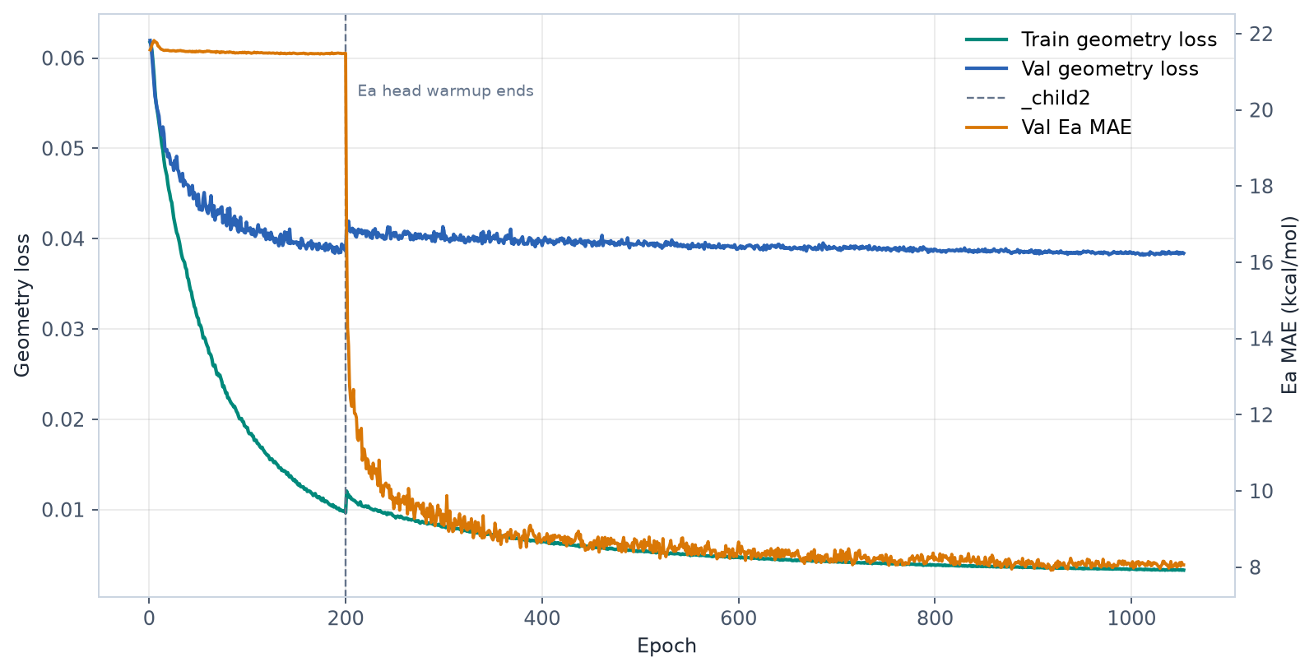
TRAINING
Training Configuration and Dynamics
Setting | Value
Target reactions | 5,000
Train / validation | 4,000 / 1,000
Batch size | 32
Learning rate | 0.00015
Weight decay | 0.002
Epoch cap | 1500
Patience | 120
AMP | True
Best validation geometry: epoch 1012 with loss 0.03817.
Best validation Ea: epoch 918 with MAE 7.92 kcal/mol.
Final recorded validation geometry loss: 0.03838; final validation Ea MAE: 8.06 kcal/mol.
PSI Transition-State Prediction | 10

Slide 11
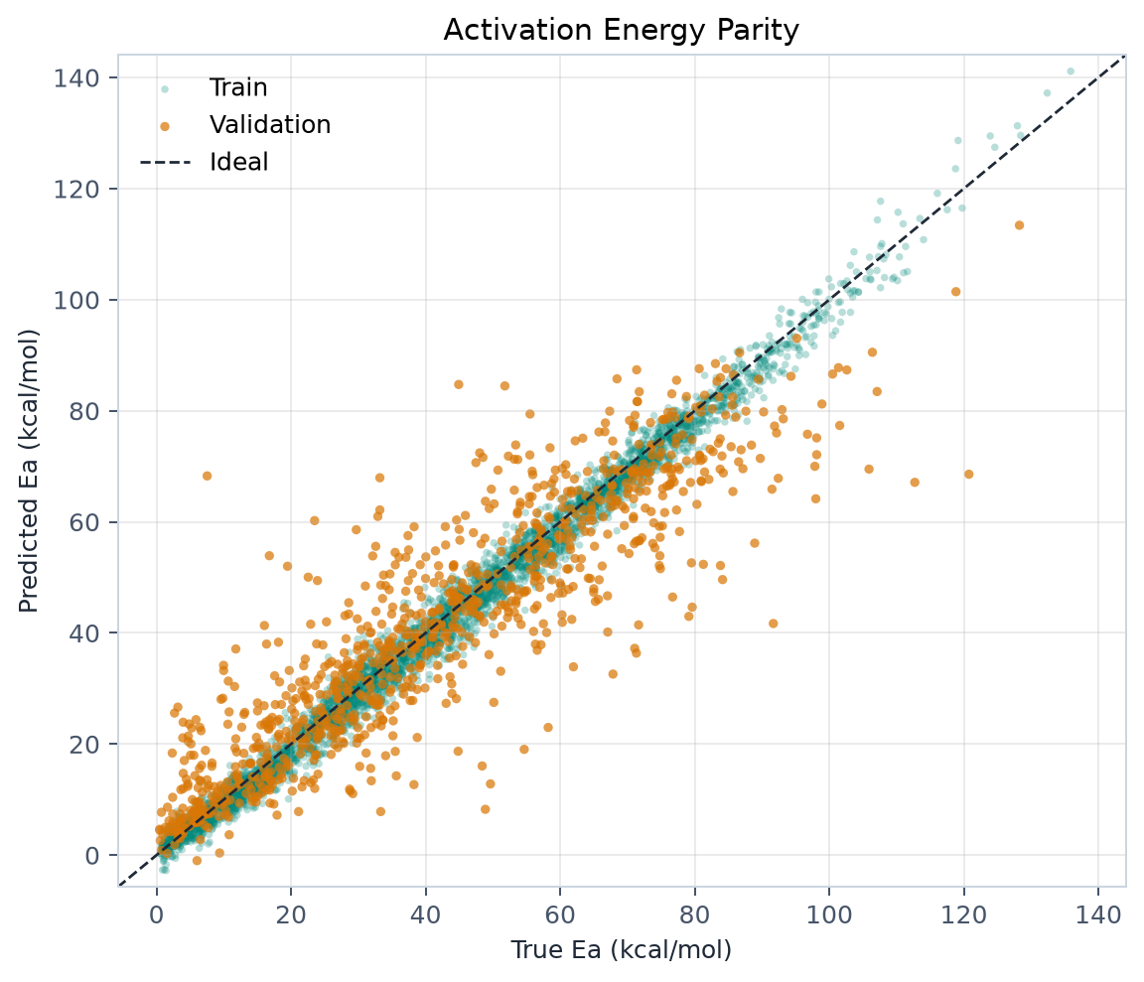
RESULTS
Evaluation Readout
Split | N | Ea MAE | Ea RMSE | Ea R2 | Pearson | Dist MAE A
Train | 4,000 | 2.17 | 2.78 | 0.989 | 0.995 | 0.0394
Validation | 1,000 | 8.02 | 11.26 | 0.804 | 0.897 | 0.1609
All | 5,000 | 3.34 | 5.62 | 0.953 | 0.977 | 0.0637
Validation Ea MAE is 8.02 kcal/mol with R2=0.804; validation distance MAE is 0.1609 A.
Train/validation Ea gap: 2.17 vs 8.02 kcal/mol, so generalization analysis is still required.
The evaluation file keeps both D_true and D_pred, so geometry errors can be diagnosed pair-by-pair instead of only through scalar summaries.
PSI Transition-State Prediction | 11

Slide 12
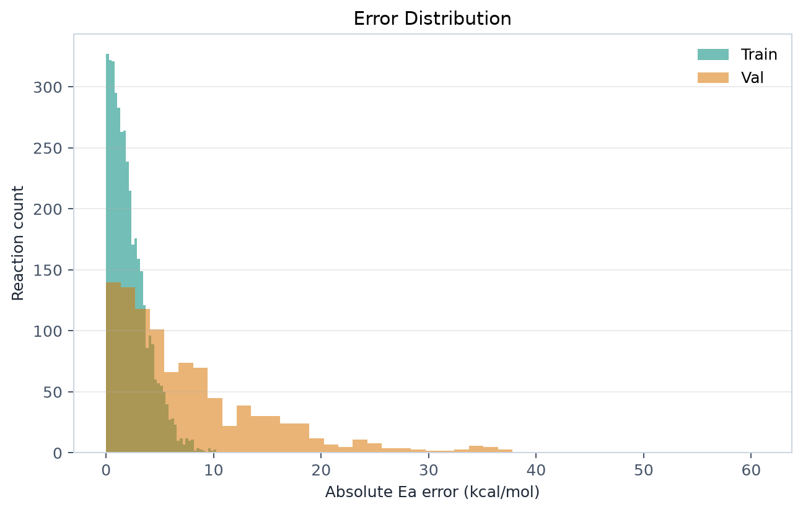
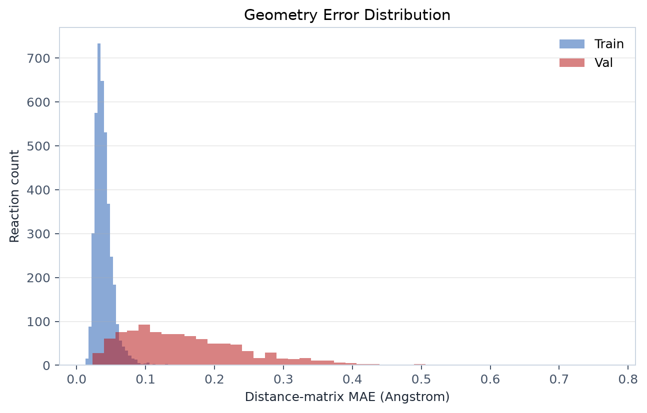
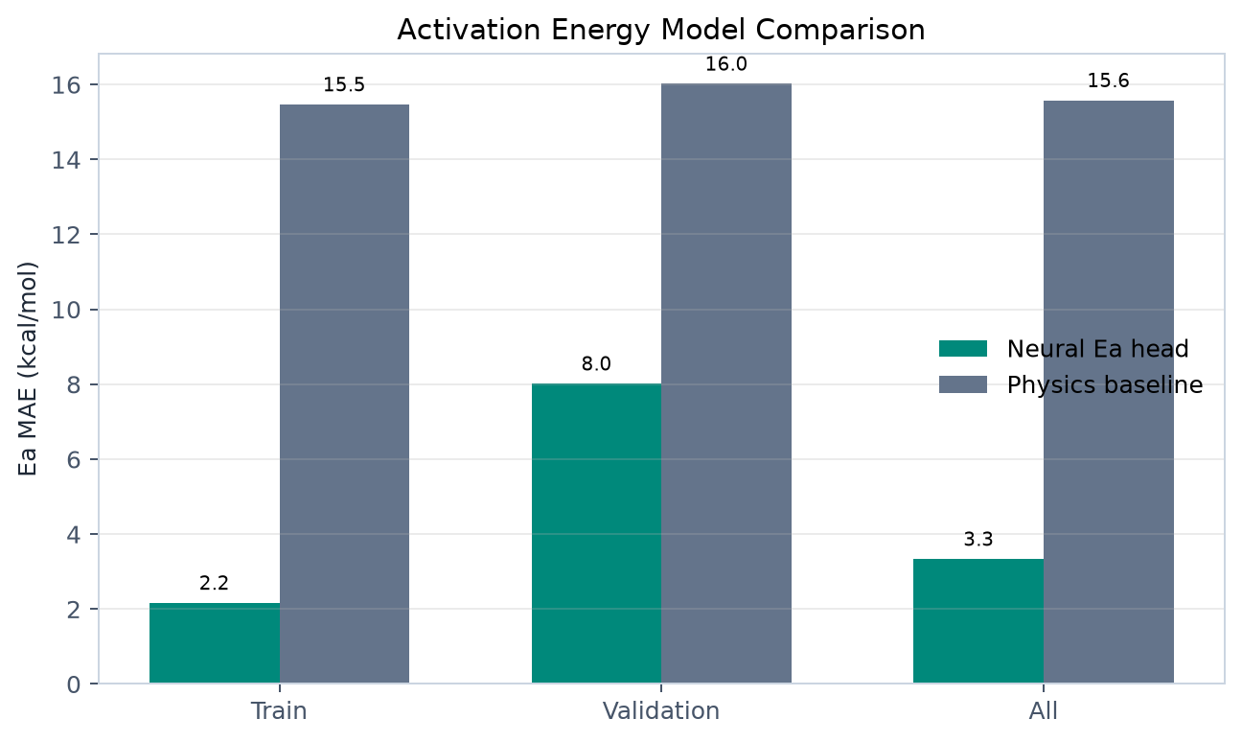
RESULTS
Error Structure and Baseline
Statistic | Value
Val Ea p90 | 17.65 kcal/mol
Val dist p90 | 0.2875 A
Neural val MAE | 8.02 kcal/mol
Physics val MAE | 16.02 kcal/mol
Energy and geometry errors are complementary diagnostics: a barrier can look acceptable while the predicted TS structure is poor.
The physics baseline is intentionally simple; it is useful because it exposes whether the learned head is doing more than fitting reaction energy trends.
The p90 metrics highlight the tail cases that should drive the next round of stratified evaluation.
PSI Transition-State Prediction | 12

Slide 13
USAGE
Inference Path
predict_transition_state loads reactant and product Gaussian logs, then checks atom count and atom type/order consistency.
It rebuilds D_R, D_I, D_P, atom physical features, signed reaction energy, and energy_feats using the checkpoint's saved normalization statistics.
The model outputs a predicted distance matrix and normalized neural Ea; Ea is denormalized from checkpoint metadata.
Post-processing applies spectator clamps, triangle inequality checks, fragment-aware MDS, and optional XYZ export.
The JSON output includes Ea_pred, Ea_pred_physics, Ea_source, D_pred, validation issues, geom_mask, and predicted coordinates.
python psi_cloud_pipeline.py predict \ -r reactant.log \ -p product.log \ -o prediction.json \ --xyz predicted_ts.xyz
Same feature path
Inference reuses training-time tensor construction and normalization.
Downstream use
predicted_ts.xyz is an initial guess, not a replacement for quantum validation.
PSI Transition-State Prediction | 13

Slide 14
TECHNIQUE
Post-Processing Constraints
Spectator pairs are distances with little endpoint change: abs(D_R - D_P) < spectator_threshold. In inference they are clamped near the endpoint midpoint.
Steric floor prevents atom overlap by enforcing a covalent-radius lower bound for non-diagonal pairs.
Triangle inequality is enforced within fragments by shortening impossible direct distances to the best two-edge shortcut.
Fragment-aware MDS reconstructs disconnected systems block-by-block and Kabsch-aligns fragments to the midpoint reference.
validate_ts_geometry reports suspicious active-bond lengths and spectator violations so bad predictions are visible to the caller.
spectator = abs(D_R - D_P) < threshold D_ref = 0.5 * (D_R + D_P) D[spectator] = clip(D, D_ref*(1-tol), D_ref*(1+tol)) if D[i,j] > D[i,k] + D[k,j] + tri_tol: D[i,j] = D[i,k] + D[k,j]
Constraint | Value
Spectator threshold | 0.15 A
Spectator tolerance | 5%
Triangle tolerance | 0.05 A
Fragment bond scale | 1.45
PSI Transition-State Prediction | 14

Slide 15
TECHNIQUE
Kabsch Alignment and Fragments
Connectivity is inferred with covalent radii and fragment_bond_scale. The fragment set is chosen from the side with more fragments so association/dissociation cases remain separated.
For each fragment, reactant coordinates are rigidly aligned onto product coordinates before building midpoint references for energy features and coordinate recovery.
Kabsch alignment centers both point sets, decomposes the covariance matrix with SVD, fixes reflection if det(VW) < 0, and applies the rotation plus product centroid.
Single-atom fragments are copied directly because rotation is undefined for one point.
This preserves internal geometry while removing arbitrary global orientation before midpoint and MDS alignment steps.
P0 = P - mean(P) Q0 = Q - mean(Q) C = P0.T @ Q0 V, S, W = svd(C) if det(V @ W) < 0: V[:, -1] *= -1 R = V @ W P_aligned = P0 @ R + mean(Q)
This is a rigid transform, so it changes coordinate frame but not reactant fragment bond lengths.
PSI Transition-State Prediction | 15

Slide 16
TECHNICAL RATIONALE
Part 1: Data Contract and Target Semantics
The code uses complete reactant/product/TS triplets because supervised TS learning needs endpoint inputs and a true TS target for the same reaction ID.
Atom ordering is treated as already matched across R, P, and TS. This keeps tensor construction simple, but it makes atom mapping an input contract.
The current Ea target is E_TS minus the higher-energy endpoint, not always the forward barrier from the reactant. This avoids requiring an explicit reaction direction label, but the semantics must be stated clearly.
Negative barriers are skipped when skip_negative_ea is enabled because they usually signal extraction, labeling, or endpoint-definition problems for this training objective.
Only C/H/N/O are present in the evaluated checkpoint, so the trained atom vocabulary is intentionally narrow.
Choice | Implementation | Why
Triplet grouping | Require R, P, and TS logs | Gives one supervised sample per reaction
Atom order | Reuse TS order for tensors | Avoids solving atom mapping inside training
Ea target | E_TS - max(E_R,E_P) | Direction-free high-side barrier used by this run
Filtering | max_atoms and negative Ea checks | Keeps padded tensors bounded and labels sane
Vocabulary | C/H/N/O | Checkpoint cannot handle unseen atom types
This is the slide to use when someone asks what the labels mean and what assumptions the dataset makes.
PSI Transition-State Prediction | 16

Slide 17
TECHNICAL RATIONALE
Part 2: Why Distances, Masks, and Fragments
The supervised geometry target is D_TS, a pairwise distance matrix, because distances do not change under global translation or rotation.
The 30-atom padded tensor shape keeps batching simple; atom masks prevent padded rows and columns from contributing to attention, loss, or metrics.
The geometry mask is derived from TS fragments so disconnected cross-fragment distances do not dominate the loss with arbitrary relative placement.
Fragment-aware processing matters for association and dissociation reactions: one global rigid alignment can create a false midpoint for separated species.
D_I is a midpoint prior between endpoints, giving the model a chemically plausible starting distance scale instead of asking it to predict from scratch.
D_R = pairwise(c_R) D_P = pairwise(c_P) D_I = 0.5 * (D_R + D_P) loss = loss * geom_mask * valid_atom_mask
Mechanism | Reason
Distance target | Removes frame dependence
Atom mask | Ignores zero-padding
Fragment mask | Ignores arbitrary disconnected placement
Midpoint prior | Stabilizes early geometry prediction
The model learns reaction geometry, not coordinate-frame bookkeeping.
PSI Transition-State Prediction | 17

Slide 18
TECHNICAL RATIONALE
Part 3: Why the R -> I -> P Encoder
For each atom, the model reads three distance-based states: reactant, midpoint, and product.
Gaussian radial basis features turn raw distances into smooth local channels, so small distance changes produce smooth feature changes.
The bidirectional GRU treats R/I/P as a short reaction-coordinate sequence and extracts the midpoint context after seeing both endpoints.
Transformer layers then let all atoms exchange information globally, which is needed because a bond change in one region can shift the TS geometry elsewhere.
Pre-norm residual Transformer layers make deep attention blocks easier to optimize under long training.
Gaussian RBF
32 channels over 0.4-6.0 A
BiGRU
Reads R, I, and P as a 3-step path
Transformer
Global atom-to-atom context with padding mask
emb = [RBF(D_R), RBF(D_I), RBF(D_P)] h_mid = BiGRU(emb)[:, midpoint] node = Transformer(h_mid)
This is why the architecture sees both endpoints before predicting the TS.
PSI Transition-State Prediction | 18

Slide 19
TECHNICAL RATIONALE
Part 4: Why Alpha Interpolation Plus Delta
The geometry head does not directly emit arbitrary distances. It starts from an endpoint interpolation and learns a bounded correction.
alpha is passed through sigmoid, so each pair starts between reactant-like and product-like distances.
The final layer is initialized to zero, making alpha=0.5 and delta=0 at initialization. The first prediction is therefore the endpoint midpoint.
delta is clamped to +/-3.0 A so a single bad pairwise output cannot create a huge unphysical distance.
A coarse auxiliary loss supervises this pre-EGNN distance matrix directly, which gives MDS and EGNN a better seed.
alpha = sigmoid(alpha_logit) delta = clamp(delta, -3.0, +3.0) D_base = alpha*D_R + (1-alpha)*D_P D_TS = symmetrize(clamp(D_base + delta, 0))
Design | Why
Midpoint init | Stable first epoch behavior
Sigmoid alpha | Pairwise TS position is endpoint-bounded
Clamped delta | Allows chemistry-specific correction without explosions
Symmetry/diagonal | Keeps output a valid distance matrix shape
This turns geometry prediction into correction of a physical prior.
PSI Transition-State Prediction | 19

Slide 20
TECHNICAL RATIONALE
Part 5: Why MDS Then EGNN
MDS converts the predicted distance matrix into a concrete 3D seed, which is necessary before a coordinate refiner can operate.
The MDS seed is detached in the forward pass. This avoids relying on the unstable backward path through eigendecomposition.
The code runs eigendecomposition on CPU with float64 and diagonal jitter because padded molecules create repeated zero eigenvalues.
EGNN refinement then updates coordinates with E(n)-equivariant message passing, so rotations and translations are handled consistently.
The final distance loss is computed after EGNN refinement, meaning the supervised geometry is the actual refined TS structure.
Coarse D_TS
Distance head output
Masked MDS
Double-center D^2; keep top 3 components
EGNN
4 equivariant layers, clipped coordinate updates
Refined D_TS
Recomputed from coordinates for loss and Ea
MDS provides a coordinate seed; EGNN makes chemically local adjustments without breaking rigid-motion consistency.
PSI Transition-State Prediction | 20

Slide 21
TECHNICAL RATIONALE
Part 6: Why the Energy Head Is Warmed Up
The learned Ea head depends on EGNN-refined TS features, so early geometry mistakes would otherwise dominate the shared representation.
The training loop monitors Ea every epoch but adds Ea loss only after the warmup period.
Ea is z-scored for training because raw kcal/mol targets are much larger than geometry losses and would otherwise dominate optimization.
The head also receives signed reaction energy and a 20D descriptor vector so it can learn BEP-like trends and composition/displacement context.
The Marcus/Hammond/OLS calculation remains a baseline, giving a sanity check against a simpler chemistry-inspired model.
Part | Implementation | Why
Geometry warmup | 200 epochs | Avoids learning energy from poor early TS guesses
Ea target | z-scored kcal/mol | Keeps scale compatible with geometry losses
Inputs | pooled EGNN + de_rxn + 20D features | Combines local TS environment with global reaction context
Baseline | Marcus/Hammond/OLS | Tests whether learned head adds value
if epoch > ea_warmup: loss += w_ea * SmoothL1(Ea_norm) Ea = Ea_norm * ea_std + ea_mean
The head is deliberately downstream of geometry quality.
PSI Transition-State Prediction | 21

Slide 22
TECHNICAL RATIONALE
Part 7: Why the Physics Loss Terms Exist
Huber geometry loss is less sensitive than MSE to a few difficult atom pairs while still rewarding small-distance accuracy.
The coarse loss trains the pairwise head even though the final loss is measured after EGNN refinement.
Spectator loss encodes the assumption that pairs with little endpoint change should stay near the endpoint midpoint.
Active-pair bounds allow bond-forming and bond-breaking distances to move, but penalize values far outside the endpoint range plus margin.
Gradient clipping keeps rare bad batches from producing a large optimizer step during long training.
L = Huber(D_refined, D_true) + w_coarse * Huber(D_coarse, D_true) + 0.2 * (L_spectator + 0.5*L_bounds) clip_grad_norm_(model.parameters(), 1.0)
Setting | Value
spectator_threshold | 0.15 A
bounds margin | 0.2 A
geom_coarse_weight | 0.5
grad_clip | 1.0
The loss mixes supervised data fit with simple chemistry constraints.
PSI Transition-State Prediction | 22

Slide 23
TECHNICAL RATIONALE
Part 8: Artifact Contract and Reproducibility
The checkpoint is more than weights: it stores atom vocabulary and normalization statistics that inference must reuse exactly.
Training/validation splits use split_seed, and normalization statistics are computed only from train indices to avoid validation leakage.
Coordinate augmentation improves robustness, but the current dataset noise path uses random sampling and should be seeded per worker for exact reproducibility.
The current source expects physics_ea_coeffs for prediction-time physics baseline; older checkpoints may not contain that metadata and should be regenerated or guarded.
Post-processing should be centralized because training evaluation and prediction currently apply slightly different constraint sequences.
Artifact | Why it matters
atom_vocab | Maps atom symbols to model IDs
aphys/efeat stats | Recreates training normalization at inference
ea_mean/ea_std | Denormalizes learned Ea output
config_snapshot | Records key architecture and training settings
physics_ea_coeffs | Needed by current predict baseline path
Practical rule: a prediction run must use the same feature construction, normalization, and post-processing contract as training.
This is the main engineering risk to fix before benchmark claims.
PSI Transition-State Prediction | 23

Slide 24
ASSESSMENT
Known Limits and Next Technical Work
Area | Current behavior | Technique-focused next step
Generalization | Train/validation gap remains large | Stratify by reaction family and molecular size
Target definition | Ea is TS minus higher-energy endpoint | Clarify forward/reverse barrier semantics
Inference assumption | Requires matched atom ordering | Add atom-mapping validation or mapping step
Chemistry scope | Observed atom types: C/H/N/O | Expand data and validate larger vocabularies
Post-processing drift | Training/eval/inference constraints differ | Centralize one shared post-processing function
Calibration | Negative Ea predictions can occur | Add calibrated non-negative handling if required
The next highest-value work is not another summary figure; it is correctness alignment, stratified validation, and uncertainty/calibration around the learned Ea head.
PSI Transition-State Prediction | 24

