Slide 1
reactant + product
→ transition state
→ activation energy
PROJECT PSI · RESEARCH REVIEW · JULY 2026
Machine-Learned Transition States
Predicting reaction geometries and activation energies from reactants and products — how far we have come, and how far we can go.
Notes:
Set the frame: this is a status talk on the PSI transition-state model — where the project stands today and where it can realistically go. Two threads: geometry prediction and activation-energy prediction.

Slide 2
THE PROBLEM
Transition states are the bottleneck of reaction modeling
The transition state (TS) is the highest-energy point on the path from reactant to product. Its geometry and energy set the reaction rate.
Finding it by DFT saddle-point search is slow, needs a good initial guess, and often fails to converge for complex rearrangements.
CLASSICAL
PSI
Guess TS → optimize saddle → verify frequencies → often restart
Read R and P geometries → predict TS geometry and E _{a} directly
PSI · TRANSITION-STATE PREDICTION
02
Notes:
The transition state is the bottleneck of a reaction. Locating it with DFT saddle-point search is expensive and fragile — many restarts, frequent failures. We want to skip straight to the answer.

Slide 3
TASK DEFINITION
Two geometries in, one geometry and one energy out
INPUT
OUTPUT
Reactant X _{R}
TS geometry X_{TS}
PSI MODEL
→
EGNN + Ea head
→
OUTPUT
Activation energy E _{a}
INPUT
Product X_{P}
PSI · TRANSITION-STATE PREDICTION
03
Notes:
State the task precisely. Inputs are the two padded 3D structures. Outputs are the predicted TS distance matrix (reconstructed to coordinates) and the scalar activation energy in kcal/mol. Everything downstream serves these two heads.

Slide 4
PIPELINE OVERVIEW
A ten-stage path from log files to predictions
01
02
03
04
05
Parse
Group
Featurize
Split
Normalize
Coordinates + energies from logs
R / P / TS triplets
Distances, masks, atom features
Stratified, leakage-checked
Train-only z-scores
06
07
08
09
10
Geometry
Energy
Train
Evaluate
Predict
GRU + Transformer + EGNN
Cross-attention E_{a} head
Multi-term loss + SWA
Metrics + dashboard
New reaction → JSON / XYZ
PSI · TRANSITION-STATE PREDICTION
04
Notes:
Ten stages, end to end. Point out that everything from parsing to normalization is deterministic data engineering; the learned model is stages 6 and 7. The split is stratified and leakage-checked — flag that we will return to it.

Slide 5
DATASET EVOLUTION
From a small extraction to the full RGD1 dataset
EARLY — b97d3
CURRENT — RGD1
16,292
→
40,000
reactions · Ea mean 42 kcal/mol
reactions · Ea mean 74 kcal/mol
C, H, N, O · ≤ 30 atoms
max barrier 179 kcal/mol · 97% risk-flagged
PSI · TRANSITION-STATE PREDICTION
05
Notes:
We moved off the early b97d3 extraction and onto RGD1 — a much larger, more varied transition-state dataset. The move roughly tripled usable reactions and shifted the barrier distribution upward, which is what exposed the high-barrier weakness.

Slide 6
THE 40K-REACTION SPLIT
Stratified, and proven free of leakage
34,000
6,000
INTEGRITY CHECKS
TRAIN
VALIDATION
Duplicate rxn ids
0
Leaked rxn ids
0
Stratified on four axes — barrier bin, atom count, bond-change complexity, and risk flag — so train and validation share the same distribution.
Coverage
100%
PSI · TRANSITION-STATE PREDICTION
06
Notes:
The split is stratified on barrier, size, complexity and risk — so validation looks like training. Crucially, no reaction id leaks across the boundary. This clean split is what makes the metrics trustworthy; it was not always the case, as we will see.

Slide 7
REPRESENTATION
The model reasons over distances, not coordinates
Each structure becomes a pairwise distance matrix. Distances are invariant to rotation and translation, so no arbitrary alignment is ever required.
WHY IT MATTERS
SE(3) invariance is built in, not learned from data augmentation
Equivariant coordinate updates: rotate the input, rotate the output
No Z-matrix or reference-frame bookkeeping
D_{ij}(X) = ‖X_{i} − X_{j}‖
D_{I} = (D_{R} + D_{P}) / 2
The reactant–product midpoint matrix D_{I} is the model's structural prior for the transition state.
PSI · TRANSITION-STATE PREDICTION
07
Notes:
The key modeling decision: the network never sees raw coordinates. It works in pairwise distance space, which is invariant to rotation and translation. Coordinate updates in the EGNN are equivariant. So rotating the input rotates the output exactly — no arbitrary alignment needed.

Slide 8
MODEL ARCHITECTURE
A hybrid sequence-to-geometry network
Output A — refined TS distance matrix D̂_{TS}
Output B — activation energy from EGNN node features
PSI · TRANSITION-STATE PREDICTION
08
Notes:
Walk the forward pass left to right. Distances get a Gaussian radial-basis embedding, a GRU reads each atom's R-to-I-to-P sequence, a Transformer mixes atoms, we predict a coarse TS distance matrix, embed it to 3D via MDS, then eight EGNN layers refine the geometry. The refined node features feed the energy head.

Slide 9
THE EGNN GEOMETRY BACKBONE
Equivariant message passing on the atom graph
NODE FEATURES
COORDINATE UPDATE
m_{ij} = φ( h_{i}, h_{j}, ‖x_{i}−x_{j}‖² )
Atomic number Z_{i}
x_{i} ← x_{i} + Σ_{j} (x_{i}−x_{j}) · ψ(m_{ij})
Pauling electronegativity χ_{i}
Updating along relative displacement vectors is what makes the layer equivariant to rotation and translation.
Covalent radius r_{i}
Learned atom embedding u_{i}
PSI · TRANSITION-STATE PREDICTION
09
Notes:
The backbone is the geometry engine. Message passing uses invariant pairwise distances and node features — atomic number, electronegativity, covalent radius. Coordinates update as a weighted sum of relative displacement vectors, which is what guarantees equivariance.

Slide 10
THE ACTIVATION-ENERGY HEAD
A decoupled cross-attention regressor
HOW IT PREDICTS
THE DETACH TRICK
Cross-attends over EGNN node features to weight reaction-center atoms
Geometry features enter the head as h.detach() . Geometry and energy have conflicting gradients — detaching lets the head specialize without melting the graph.
Pools with a 20-D energy descriptor (ΔE_{rxn} , bond-angle change, sizes)
ZPE-corrected barrier target, in kcal/mol
PSI · TRANSITION-STATE PREDICTION
10
Notes:
The energy head is deliberately decoupled. During warmup the geometry features are detached before entering the head, so energy training never distorts the graph. The head cross-attends over node features to find the reaction center that dominates the barrier.

Slide 11
THE LOSS FUNCTION
One objective, five physics-informed terms
L = L_{geom} + L_{coarse} + L_{triangle} + L_{risk} + λ · L_{Ea}
Huber geometry
Inverse-distance weight
Triangle
Active-site risk
Energy (Ea)
Smooth L1 — no outlier gradient spikes
Keeps the distance matrix embeddable
Amplifies changing N–N, N–O, O–O bonds
Tail-weighted, warmup-gated
1 / (D_{TS} +1) prioritizes short bonds
PSI · TRANSITION-STATE PREDICTION
11
Notes:
The objective is multi-term and physics-informed. Huber replaced MSE and Gaussian NLL to kill outlier spikes and variance collapse. Inverse-distance weighting fixes fragment melting. A triangle term enforces metric consistency, and a risk term forces attention onto the bonds that actually change.

Slide 12
FAILURE MODE
Fragment melting and the "Clever Hans" energy head
THE SCALE IMBALANCE
THE FIX
A 10% error on a 10 Å inter-fragment gap produces a huge gradient; the same 10% on a 1.5 Å chemical bond produces almost none.
w_{ij} = 1 / (D_{TS,ij} + 1)
Inverse-distance weighting equalizes gradients across scales, forcing the network to respect short-range chemistry. A structural fix, not a metric patch.
Consequence: fragments land in the right region, but local bonds melt — and the energy head quietly regresses off ΔE _{rxn} instead of the broken geometry.
PSI · TRANSITION-STATE PREDICTION
12
Notes:
This is the most instructive failure. Uniform loss over the distance matrix means a 10% error on a 10-angstrom inter-fragment distance dominates a 10% error on a 1.5-angstrom bond. The network places fragments correctly but melts local structure — and the energy head cheats off the thermodynamic scalar. Inverse-distance weighting equalizes the gradients.

Slide 13
BUG FIXED
Evaluation was scoring on leaked training data
BEFORE
AFTER
Random torch.randperm shuffle at eval time
Same stratified split used for training
→
Validation flooded with ~90% training reactions. Metrics looked strong for the wrong reason.
Zero leaked reaction ids. Every metric on the following slides is measured on genuinely held-out reactions.
PSI · TRANSITION-STATE PREDICTION
13
Notes:
A blunt but critical fix. Evaluation had been using a random shuffle instead of the training split, so up to 90% of training reactions leaked into the reported validation set — flattering every metric. Switching evaluation to the same stratified sampler restored an honest number.

Slide 14
RUN TIMELINE
The runs that got us here — including the failures
DOOMED
Gaussian NLL run — variance collapse, hyper-confident errors
abandoned
CORRUPTED
Checkpoint corruption — run archived, not recoverable
lost
07-13
NLL variant, 800 epochs — worse tail, Ea MAE 5.50
superseded
07-15
Restart died at epoch 3 — config error caught early
crashed
PRE-28d
Huber + tail weighting, 1094 epochs — Ea MAE 4.86
baseline
CURRENT
RGD1 40k, warm-start Ea schedule — live at epoch 216 / 800
running
PSI · TRANSITION-STATE PREDICTION
14
Notes:
Be honest about the path. Several runs failed productively: a doomed NLL run collapsed its variance, one checkpoint corrupted, a July 15 restart died at three epochs. The pre-28d run and the current RGD1 run are the ones that matter. Each failure taught a specific fix now baked into the loss.

Slide 15
METRIC PROGRESS
Steady gains on progressively harder data
PHYSICS BASELINE
b97d3 MODEL
RGD1 — LIVE
15.5
5.01
4.80
Ea MAE kcal/mol · R² 0.44
Ea MAE · R² 0.90 · geom 0.113 Å
Ea MAE · geom 0.167 Å · still training
The live run matches the smaller-dataset accuracy while carrying a barrier distribution nearly twice as high (mean 74 vs 42 kcal/mol) — a genuine gain in difficulty, not just in number.
PSI · TRANSITION-STATE PREDICTION
15
Notes:
The headline comparison. Where we started with the physics baseline, where the completed b97d3 model landed, and where the live RGD1 run is now — on a harder, larger, higher-barrier dataset. Note the current run is still improving.

Slide 16
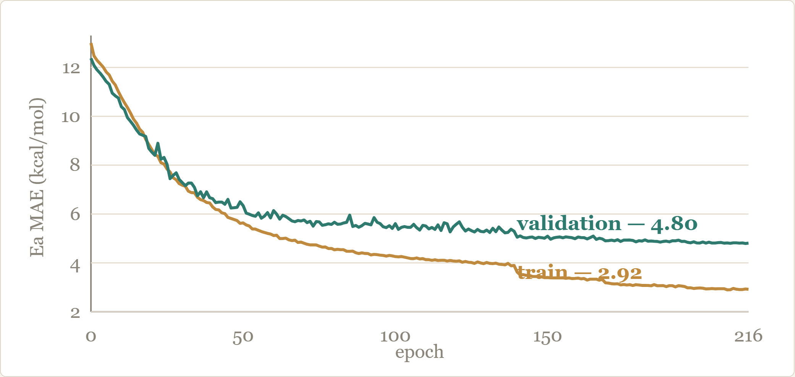
CURRENT RUN · ENERGY
Activation-energy error is still falling
12.4 → 4.8
validation Ea MAE, kcal/mol, epoch 1 → 216
Train at 2.9 kcal/mol, validation at 4.8 — a controlled gap under the detach-warmup + tail-weighting schedule.
PSI · TRANSITION-STATE PREDICTION
16
Notes:
This is the live energy-learning curve for the current run. Validation Ea MAE falls from 12.4 at epoch 1 to 4.8 and is still trending down. The train-validation gap is modest — the tail-weighted, detach-warmup schedule is holding generalization.

Slide 17
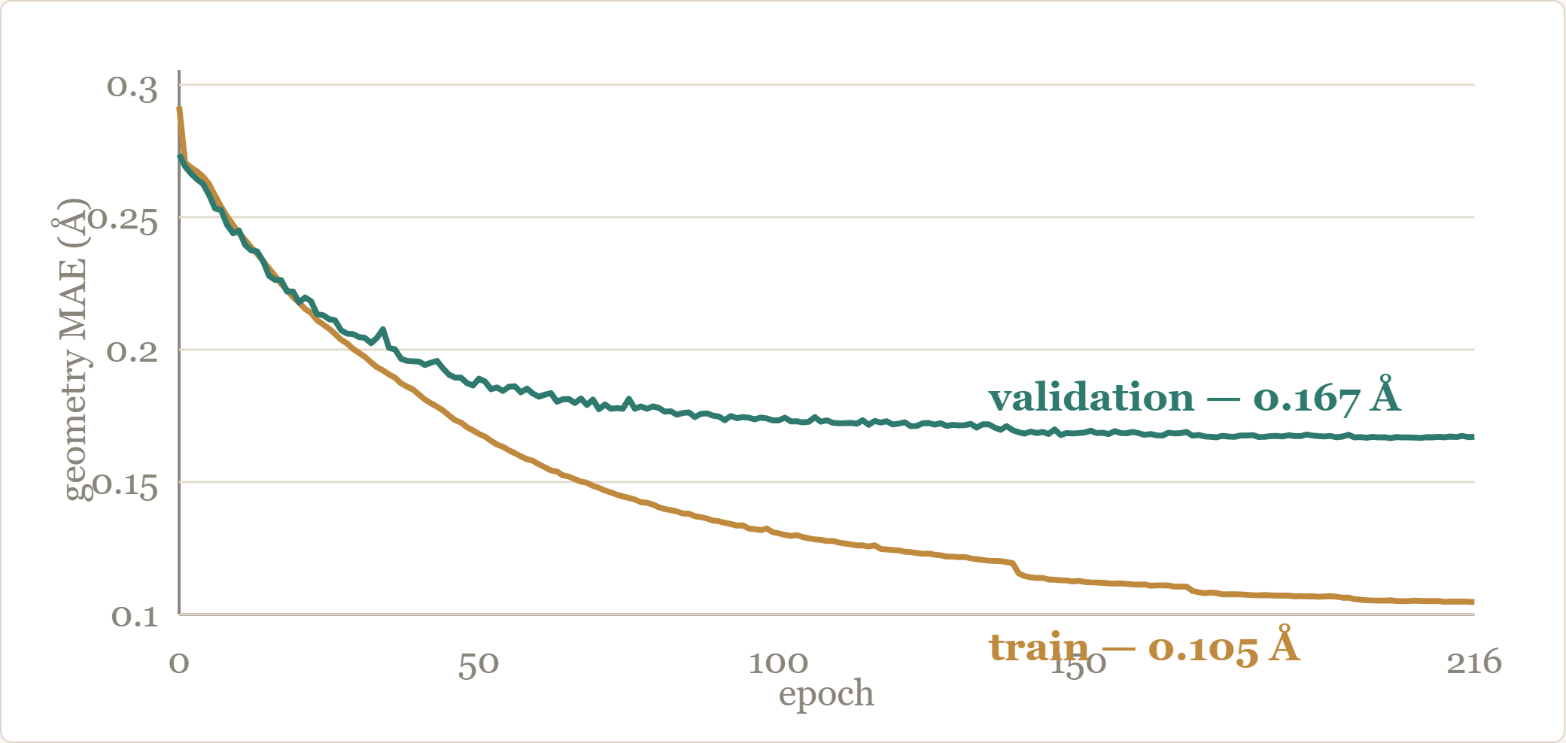
CURRENT RUN · GEOMETRY
Transition-state geometry converging near 0.17 Å
0.167 Å
validation TS distance MAE
Higher than the 0.113 Å b97d3 result because RGD1 structures are larger and more strained — the target for the intra-fragment penalty on the roadmap.
PSI · TRANSITION-STATE PREDICTION
17
Notes:
The geometry curve for the same run. Validation TS distance MAE sits around 0.167 angstrom. It is above the smaller-dataset 0.113 because RGD1 reactions are larger and more complex — this is the number the intra-fragment penalty in the roadmap is meant to push down.

Slide 18
NEURAL VS. PHYSICS
The learned head roughly triples on the physics model
Ea MAE
RMSE
R²
Physics baseline
15.5
19.5
0.44
Neural Ea head
5.01
8.30
0.90
Measured on the same held-out b97d3 validation set. The physics model (Marcus / Hammond / OLS) is kept only as a fallback for legacy checkpoints.
PSI · TRANSITION-STATE PREDICTION
18
Notes:
Quantify the value of learning over physics. On the same validation set, the neural head cuts Ea MAE by roughly 3x and more than doubles R². The physics model is retained only as a fallback for legacy checkpoints.

Slide 19
REMAINING ERROR
Error concentrates in the high-barrier tail
Ea MAE BY TRUE BARRIER (kcal/mol)
34.9
THE PATTERN
17.9
Reliable below ~80 kcal/mol. Above it, the model regresses rare high barriers toward the mean — the 120+ bin is underpredicted every time.
5.3
6.9
3.2
These ~2% of cases dominate RMSE and are the top target for tail weighting.
0–20
40–60
80–100
100–120
120+
PSI · TRANSITION-STATE PREDICTION
19
Notes:
Where the error actually lives. The model is reliable up to about 80 kcal/mol, then grows increasingly conservative — it regresses rare high barriers toward the common range. The 120-plus bin is underpredicted every time. This tail dominates RMSE and is the primary target.

Slide 20
GEOMETRY–ENERGY COUPLING
Better geometry is also an energy fix
Ea MAE BY GEOMETRY MAE BIN (Å)
15.0
7.6
IMPLICATION
6.0
Ea error scales directly with geometry error — from 2.7 to 15.0 kcal/mol across the geometry range.
3.8
2.7
So the high-error tail is not purely an energy-head problem. Tightening geometry pays off twice.
<0.05
0.05–0.10
0.10–0.20
0.20–0.30
≥0.30
PSI · TRANSITION-STATE PREDICTION
20
Notes:
Energy error is not a pure energy-head problem. When TS geometry is good, sub 0.05 angstrom, Ea MAE is 2.7. When geometry exceeds 0.30 angstrom, Ea MAE blows up to 15. Better geometry supervision is therefore also an energy fix — the two heads are coupled.

Slide 21
HOW FAR CAN WE GO
The target is chemical accuracy — 1 kcal/mol
4.8
1.0
→
where we are today — kcal/mol
chemical accuracy — the goal
The gap is a well-characterized tail, not a broad failure — which is exactly the kind of problem the roadmap is built to close.
PSI · TRANSITION-STATE PREDICTION
21
Notes:
Set the north star. Chemical accuracy is 1 kcal/mol. We are at 4.8 on a hard dataset. The gap is real but the trajectory is favorable, and most of the remaining error is a well-characterized tail rather than a broad failure.

Slide 22
ROADMAP
Four phases to close the tail
Ea tail weighting
ACTIVE
Reaction-class loss
PHASE 3
Piecewise sample weights above 80 / 100 / 120 kcal/mol pull the high-barrier tail up.
Up-weight the hard families — C–C skeletal, C–N / N–N rich rearrangements.
Intra-fragment penalty
PHASE 2b
Error-tail focus
PHASE 4
Explicit Huber term on in-fragment bonds keeps rigid fragments intact.
Per-sample geometry-error tracking reweights the worst residuals during training.
PSI · TRANSITION-STATE PREDICTION
22
Notes:
Four concrete, code-scoped phases. Tail weighting is already active. Reaction-class weighting targets the hard C-C skeletal and C-N/N-N families. The intra-fragment penalty attacks geometry directly. Error-tail focus reweights the worst residuals. Each phase produces a saved history and summary before the next.

Slide 23
IMPROVING THE CODE · PHASE 3
Weight the energy loss by reaction class
Reuse the formed/broken bond counts and risky bond types we already compute — apply moderate class weights inside the Ea loss only , keeping geometry loss stable.
ACCEPTANCE TARGETS
C–C skeletal MAE
< 6.0
Heteroatom rearr. MAE
< 5.5
C–N / N–N bias
→ 0
IN run_epoch
w = class_weight[bond_signature]
Overall MAE regression
≤ 0.2
l_ea = weighted_mean(l_ea_i, w)
PSI · TRANSITION-STATE PREDICTION
23
Notes:
First concrete code change to make once the run finishes. We already store formed/broken bond counts and risky bond types per reaction — reuse them as class weights inside the Ea loss only, leaving geometry loss untouched. Target the families that stay underpredicted: C-C skeletal and heteroatom rearrangements.

Slide 24
IMPROVING THE CODE · PHASE 4
Attack the geometry tail directly
WHAT TO CHANGE
Increase geometry weight on active / risk pairs
Add targeted weight for complex bond-change reactions
Select checkpoints on P90 / P95, not mean geometry MAE
Track the ≥0.30 Å bin as its own signal
ACCEPTANCE TARGETS
Geometry P95
< 0.259 Å
≥0.30 Å bin count
< 35
Ea MAE in ≥0.30 Å bin
< 12
PSI · TRANSITION-STATE PREDICTION
24
Notes:
The geometry-coupling slide told us where to push. Cases with geometry MAE above 0.30 angstrom carry Ea MAE of 15; under 0.05 they carry 2.7. So Phase 4 spends its effort on geometry, not energy: heavier weight on active and risk pairs, complex-reaction geometry weighting, and checkpoint selection that watches P90/P95 rather than the mean.

Slide 25
IMPROVING THE CODE · FALLBACK
If melting persists, add an explicit fragment penalty
Inverse-distance weighting is the first line of defense. If any >0.30 Å geometries remain, add a hard Huber penalty on intra-fragment bonds — using the geom_mask already constructed from the true TS fragments.
EXPLICIT geom_mask PENALTY
m = geom_mask # in-fragment bonds
l_frag = 5.0 * huber(
D_pred[m], D_ts[m])
L += l_frag
Expected outcome: total elimination of >0.30 Å transition-state geometries.
PSI · TRANSITION-STATE PREDICTION
25
Notes:
The escalation, only if inverse-distance weighting alone leaves melted geometries. Add an explicit, heavily-weighted Huber term on intra-fragment bonds using the geometry mask we already build. It forces rigid fragments to stay intact while the network translates and rotates them. Expected outcome: no TS geometry above 0.30 angstrom survives.

Slide 26
IMPROVING THE CODE · DISCIPLINE
Keep or reject — the guardrails
KEEP — IF ANY ONE HOLDS
REJECT — IF ANY ONE HOLDS
Validation Ea MAE improves ≥ 0.2 kcal/mol
High-Ea 80+ MAE improves ≥ 10%
Severe underpredictions drop ≥ 25%
Gain comes only from overfitting train Ea
Validation geometry worsens materially
High-Ea underprediction is unchanged
Low-Ea cases become badly overpredicted
…and geometry stays ≤ 0.115 Å, bias not more negative, P95 not worse.
PSI · TRANSITION-STATE PREDICTION
26
Notes:
How we decide whether any of these changes stays in. Keep it if it clears one improvement bar and breaks none of the guardrails — geometry must not regress past 0.115 angstrom, bias must not get more negative, P95 must not worsen. Reject it if the gain is just train-Ea overfitting or if it damages geometry. This discipline is what kept the doomed runs from becoming the baseline.

Slide 27
SCALING DIRECTIONS
Three levers beyond the loss function
DATA
COMPUTE
MODEL
More reactions, more elements
Cloud training pipeline
Swarm mixture-of-experts
Lift the local CPU-featurization and batch-size ceiling; the cloud variant already exists.
Extend past C/H/N/O and 30-atom cap toward larger, more diverse chemistry.
Specialize experts per reaction family to attack the hard classes directly.
PSI · TRANSITION-STATE PREDICTION
27
Notes:
Beyond the loss, three scaling levers. More and more varied reaction data. Cloud training to lift the CPU featurization and batch-size ceiling we hit locally. And a Swarm mixture-of-experts direction to specialize experts per reaction family. Each is scoped in the code today.

