Slide 1
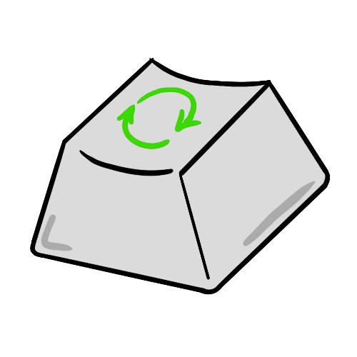
EcoKey
Table of Content
1.Team
3.The Main Goal
5.Used Programs
2.The Main Idea
4.Stages of Development

Slide 2
EcoKey
The Team
Table of Content
1.
Scrum Trainer: Arina Popova-9a
1.Team
3.The Main Goal
5.Used Programs
2.
Desinger: Mariq Bakumceva-9a
2.The Main Idea
4.Stages of Development
Front-end Developer 1: Nikolaj Kalashnik-9a
3.
Front-end Developer 2: Polina Dineva-9a
4.

Slide 3
The Team
1.
Scrum Trainer: Arina Popova-9a
Eco Key is creating the future of technology devices by introducing keyboards made from carefully recycled plastic.
2.
Desinger: Mariq Bakumceva-9a
Front-end Developer 1: Nikolaj Kalashnik-9a
3.
Eco Key is creating the future of technology devices by introducing keyboards made from carefully recycled plastic.
Front-end Developer 2: Polina Dineva-9a
4.
The Main Idea

Slide 4
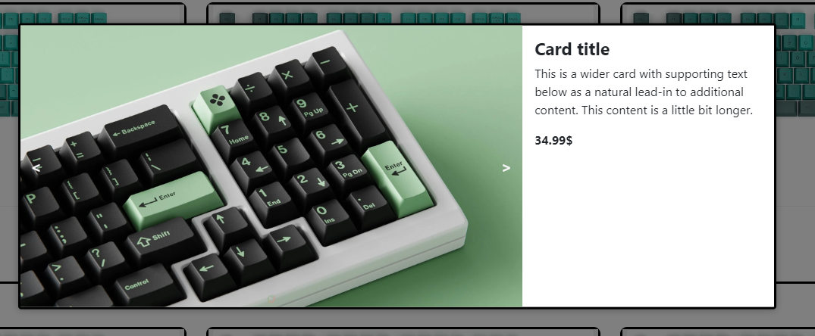

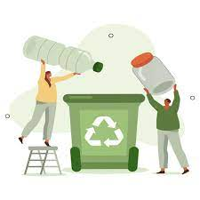
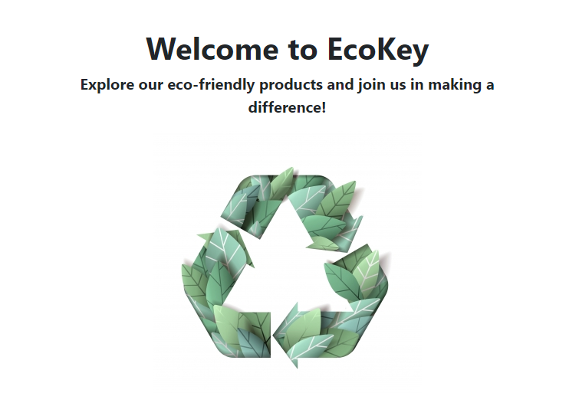
The Main Goal
The Main Idea
Eco Key is creating the future of technology devices by introducing keyboards made from carefully recycled plastic.
Our mission is to combine writing precision with a commitment to sustainability, creating products that not only enrich the user experience, but also contribute to environmental protection.
Eco Key is creating the future of technology devices by introducing keyboards made from carefully recycled plastic.

Slide 5
"Eco Key's main goal is to lead the way in technological device innovation by providing high performance keyboards made from recycled plastic."
The Main Goal
Our mission is to combine writing precision with a commitment to sustainability, creating products that not only enrich the user experience, but also contribute to environmental protection.

Slide 6
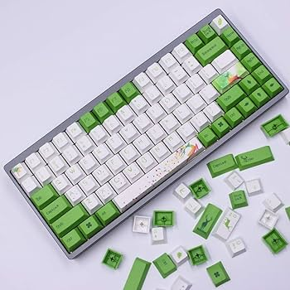
Stages of Development
1.
Planning and Research:
The team leader organized team meetings in the Discord app and together with the team determined the topic, following the strictly defined requirements described in the project documentation. They made the logo together and commented on the stage of work.
"Eco Key's main goal is to lead the way in technological device innovation by providing high performance keyboards made from recycled plastic."
2.
Design:
The desinger took care of defining the color scheme, working closely with the team and commenting on the author's elements with the team. Determine the font and color norms of the site. Select the content of the site, dealing directly with the topic.

Slide 7
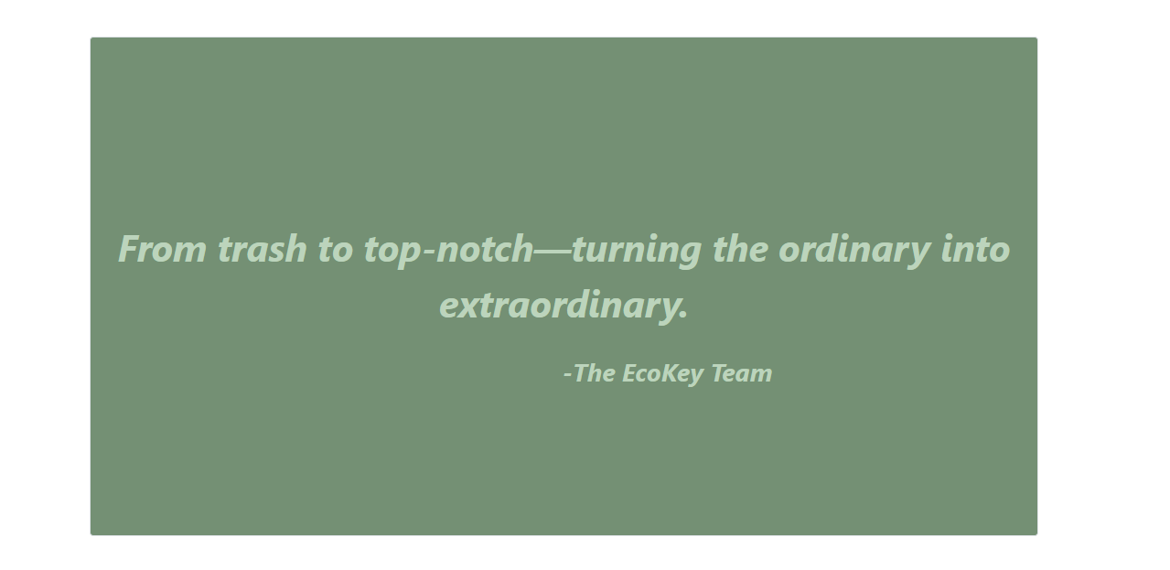
Stages of Development
1.
Planning and Research:
The Scrum Trainer organized team meetings in the Discord app and together with the team determined the topic, following the strictly defined requirements described in the project documentation. They made the logo together and commented on the stage of work.
3.
2.
Design:
The desinger took care of defining the color scheme, working closely with the team and commenting on the author's elements with the team. Determine the font and color norms of the site. Select the content of the site, dealing directly with the topic.
Code Development (Front-End):
The two developers made a brief plan and divided up their duties, communicating through Discord throughout the process. They created a responsive site by brainstorming the design with their team.

Slide 8





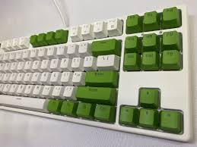
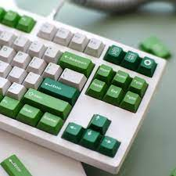





Stages of Development
3.
Code Development (Front-End):
The two developers made a brief plan and divided up their duties, communicating through Discord throughout the process. They created a responsive site by brainstorming the design with their team.
Used Programs
4.
Testing and Analysis:
The team made sure of the perfect functionality of the site by checking every detail of it. They tested the site in different browsers.

Slide 9
Used Programs

