Slide 1

EcoKey
Table of Content
1.Team
3.The Main Goal
5.Used Programs
2.The Main Idea
4.Stages of Development

Slide 2
EcoKey
The Team
Table of Content
1.
Scrum Trainer: Arina Popova-9a
1.Team
3.The Main Goal
5.Used Programs
2.
Desinger: Mariq Bakumceva-9a
2.The Main Idea
4.Stages of Development
Front-end Developer 1: Nikolaj Kalashnik-9a
3.
Front-end Developer 2: Polina Dineva-9a
4.

Slide 3
The Team
1.
Scrum Trainer: Arina Popova-9a
Eco Key is creating the future of technology devices by introducing keyboards made from carefully recycled plastic.
2.
Desinger: Mariq Bakumceva-9a
Front-end Developer 1: Nikolaj Kalashnik-9a
3.
Eco Key is creating the future of technology devices by introducing keyboards made from carefully recycled plastic.
Front-end Developer 2: Polina Dineva-9a
4.
The Main Idea

Slide 4
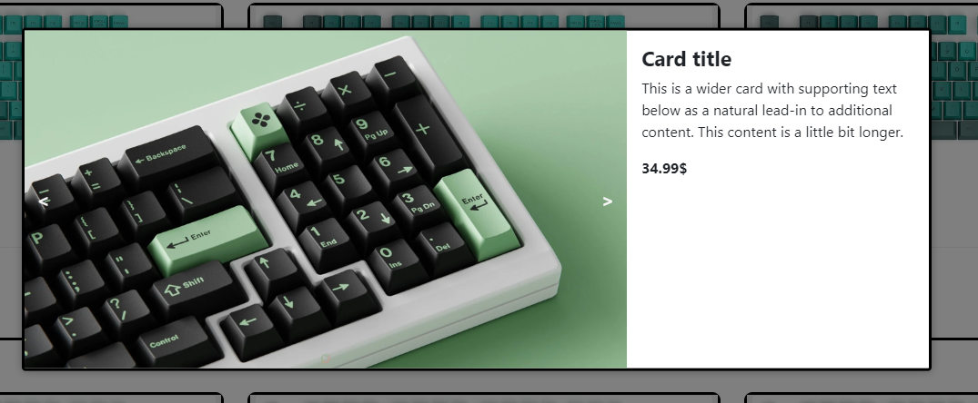


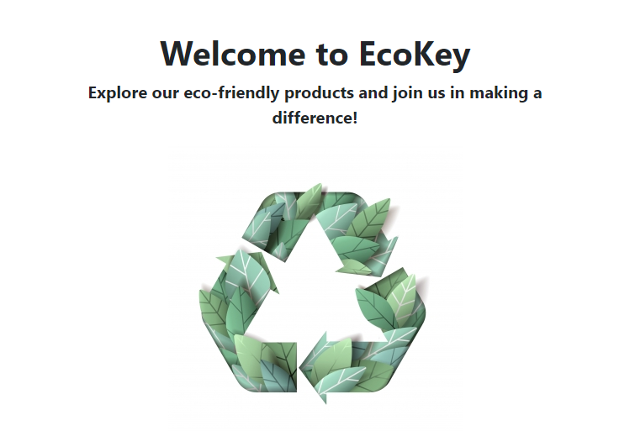
The Main Goal
The Main Idea
Eco Key is creating the future of technology devices by introducing keyboards made from carefully recycled plastic.
Our mission is to combine writing precision with a commitment to sustainability, creating products that not only enrich the user experience, but also contribute to environmental protection.
Eco Key is creating the future of technology devices by introducing keyboards made from carefully recycled plastic.

Slide 5
"Eco Key's main goal is to lead the way in technological device innovation by providing high performance keyboards made from recycled plastic."
The Main Goal
Our mission is to combine writing precision with a commitment to sustainability, creating products that not only enrich the user experience, but also contribute to environmental protection.

Slide 6
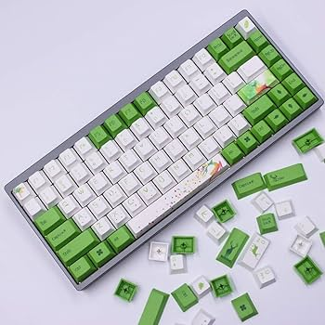
Stages of Development
1.
Planning and Research:
Defining the goals of the website - to inform, inspire and mobilize users.
Exploring the most effective ways to present environmental information.
"Eco Key's main goal is to lead the way in technological device innovation by providing high performance keyboards made from recycled plastic."
2.
Design:
Using tools like Figma to create an aesthetic and user-friendly design. The designer shares design information with teammates.

Slide 7
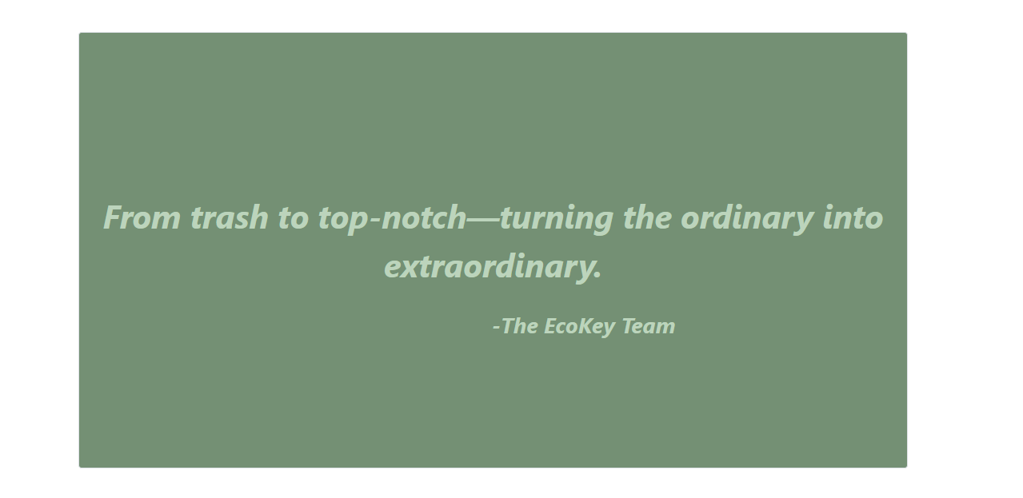
Stages of Development
3.
1.
Planning and Research:
Defining the goals of the website - to inform, inspire and mobilize users.
Exploring the most effective ways to present environmental information.
2.
Design:
Using tools like Figma to create an aesthetic and user-friendly design. The designer shares design information with teammates.
Code Development (Front-End):
The process of creating HTML and CSS code for the visual part of a website is a challenge that requires attention to detail and a constant pursuit of perfection.

Slide 8



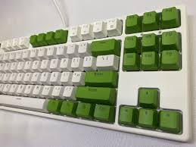
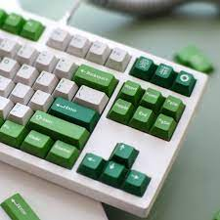



Stages of Development
Used Programs
3.
Code Development (Front-End):
The process of creating HTML and CSS code for the visual part of a website is a challenge that requires attention to detail and a constant pursuit of perfection.
4.
Testing and Analysis:
Using tools like Figma to create an aesthetic and user-friendly design. The designer shares design information with teammates.

Slide 9
Used Programs

