Slide 1






DataGuard AI
Visual Telemetry Fingerprinting and Risk-Governed Agentic Data-Quality Incident Response
Telemetry
Detect
Fingerprint
Explain
Guard
Verify
Tishya Jha | Aarna Kumar
Rajiv Gandhi Institute of Petroleum Technology
Notes:
One-line pitch: a local-first system that detects data-quality incidents, explains them, acts under guard and verifies the fix.

Slide 2







Problem: green pipelines, wrong data
01 PROBLEM
Silent failures we target
Gaps in today's practice
Null surges
Manual correlation of telemetry, schema, lineage, history
Duplicate keys
Explanations without evidence or cited playbooks
Row-count drops
Fixes applied without approval or re-checking
Schema drift
Need: preserve evidence, control actions, verify outcomes
Distribution shift
Notes:
A pipeline can finish successfully and still ship null surges, duplicates, row-count drops, schema drift or distribution shift. Operators correlate evidence manually, and actions are rarely gated or verified.

Slide 3
Solution: detect, explain, act, verify
02 PROPOSED SOLUTION
DETECT
SEE · DIP
EXPLAIN
ACT SAFELY
Rules + Isolation Forest
DQF + classical DIP
Evidence-grounded RCA
Guarded tools + verify
Six quality-check classes
Anomaly score per run
Telemetry → fingerprint → regions mapped to source runs
Ranked causes + runbooks
INCONCLUSIVE if unsure
Approval for high risk
Re-check after action
What is new
DIP maps pixels to runs
Classical DIP: adaptive vs global
One orchestrator, typed tools
Notes:
Four pillars in one local Python modular monolith. Structured rules stay authoritative; the visual fingerprint is corroborating evidence.

Slide 4





Architecture: one closed loop at a glance
03 HOW IT WORKS
1 OBSERVE
Telemetry +
run snapshot
Quality rules +
features
DIP regions → mapped run/metric evidence
2 INVESTIGATE
Isolation Forest
detection
RCA: lineage,
schema, history
Runbook RAG
+ typed plan
3 GUARD & ACT
Risk policy +
approval
Typed tools
(simulated)
Verify + audit
+ persist
Orchestrator states: NEW › INVESTIGATING › PROPOSED › APPROVAL › EXECUTING › VERIFYING › RESOLVED | ESCALATED | FAILED
Notes:
Three stages: observe and perceive, investigate and plan, guard-act-verify. Typed tools only; approvals checked server-side; every transition audited in SQLite.

Slide 5




DIP turns telemetry into mapped visual evidence
04 TECHNICAL APPROACH
DATA QUALITY FINGERPRINT · 30 × 12
d = min(1, |x - m| / (k*s + e)) I = round(255 * d)
m = healthy median · s = robust MAD · missingness uses a separate mask
DIP-B0 global baseline
DQF image
Otsu
threshold
Connected
components
Regions
DIP-P1 adaptive + morphology
DQF image
Adaptive
(11, -2)
3x3 closing
Components
Run/metric
map
Rows = runs · columns = metrics · grey = missing
Mapped regions are evidence—not causes
Notes:
Rows are runs, columns are field-metric channels; intensity is calibrated deviation; a validity mask keeps missing data distinct. DIP-P1 (adaptive threshold, 3x3 elliptical opening, connected components) is compared with the Otsu baseline. Grid shown is a schematic; evaluated DQF is 30 x 18.

Slide 6
05 IMPLEMENTED PROTOTYPE
Implemented system: end-to-end local workflow
DATA + QUALITY
VISUAL EVIDENCE
360 synthetic runs
Strict JSONL schema + lineage
Six centralized quality rule classes
DQF encoder + OpenCV processor
30 × 12 run/channel fingerprints
Masks, overlays, regions + mappings
INVESTIGATION
GUARDED ACTIONS
Isolation Forest + rule baseline
Evidence-ranked RCA
Local TF-IDF runbook retrieval
Single orchestrator + typed tools
Approval checked on the server
Simulated repair, verification + audit
Python modular monolith · FastAPI · Streamlit · SQLite · NumPy · OpenCV · scikit-learn · Joblib
Built-in TF-IDF retrieval; no sentence-transformer, SQLAlchemy, Docker, or external provider is used.
Notes:
Implementation inventory checked against pyproject.toml and src/datagard, dashboard/app.py, and tests. The attached SIH deck listed planned dependencies; those stale claims have been removed.

Slide 7
06 EVALUATION
Measured results on reproducible synthetic data
Held-out incident detection (72 runs: 42 positive / 30 negative)
Method
TP / FP / FN / TN
F1
AP
Severity rules
28 / 0 / 14 / 30
0.800
—
Isolation Forest · structured
41 / 29 / 1 / 1
0.732
0.591
Structured + DQF · matched n=43
28 / 9 / 0 / 6
0.862
0.673
DIP SEGMENTATION · 1,024 valid pixels · 3 held-out fingerprints
DIP-B0 · Otsu: F1 0.779 · IoU 0.638 · 90/90 positives · 51 FP · 0.325 ms/image
DIP-P1 · adaptive + close: F1 0.324 · IoU 0.194 · 90/90 positives · 375 FP · 0.180 ms/image
Operational checks: RCA top-1 4/5, top-3 5/5 · retrieval hit@3 6/7, MRR 0.857 · policy probes rejected 3/3
Synthetic labels; small fixed operational sets. DQF result excludes 18/108 held-out runs outside selected windows. No streaming MTTD measured.
Notes:
Sources: artifacts/evaluation/detection/detection_metrics.csv; artifacts/evaluation/dip/dip_metrics.json and dip_region_metrics.csv; artifacts/evaluation/operations/operational_metrics.json. DIP-P1 is a worse segmentation alternative; DQF improves matched thresholded F1 but decreases AP.

Slide 8
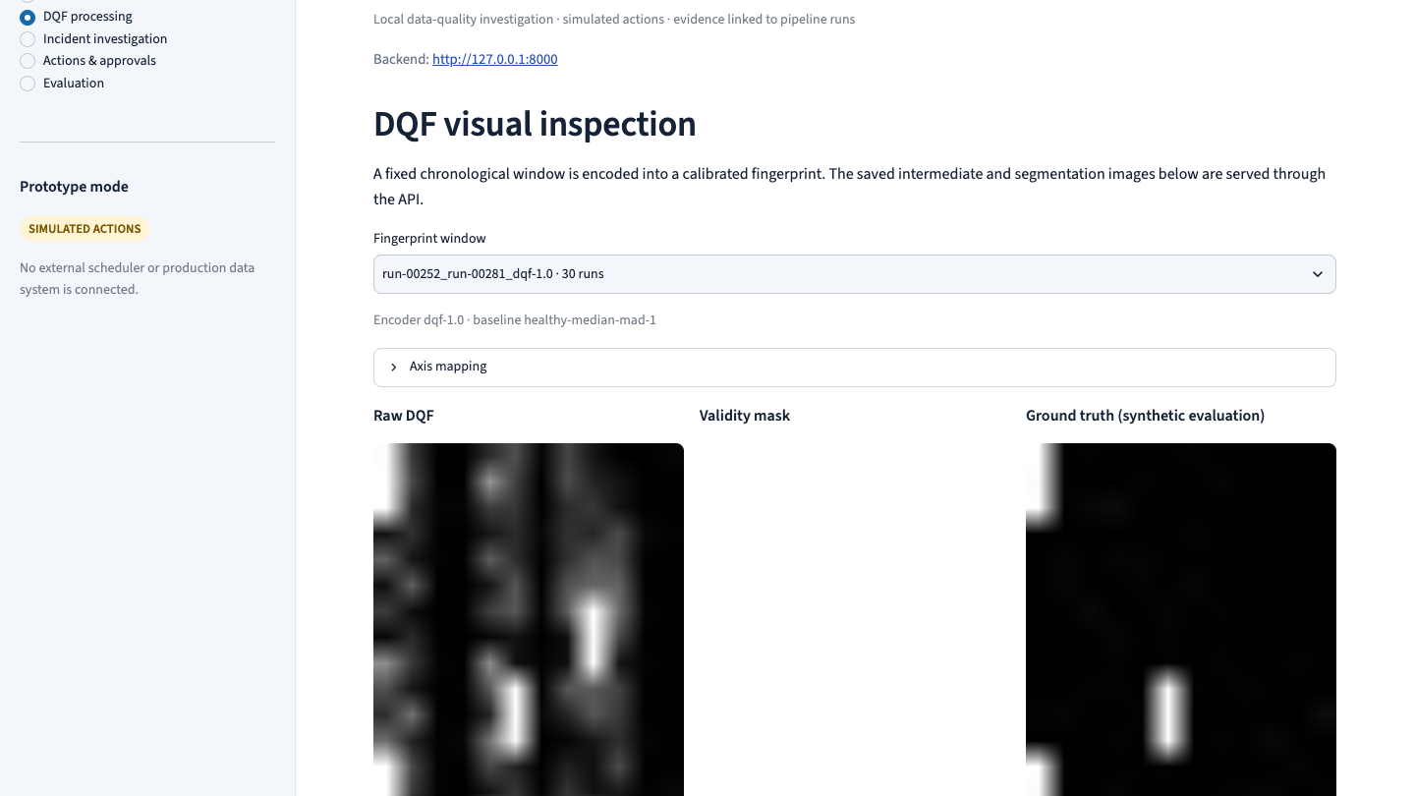
07 WORKING DASHBOARD
DQF processing stages
Genuine browser capture: fingerprint, mask, overlays, component regions, run/metric mapping, and synthetic ground truth.
Notes:
Source: genuine screenshot captured from the running local DataGuard AI Streamlit dashboard. Genuine browser capture: fingerprint, mask, overlays, component regions, run/metric mapping, and synthetic ground truth.

Slide 9
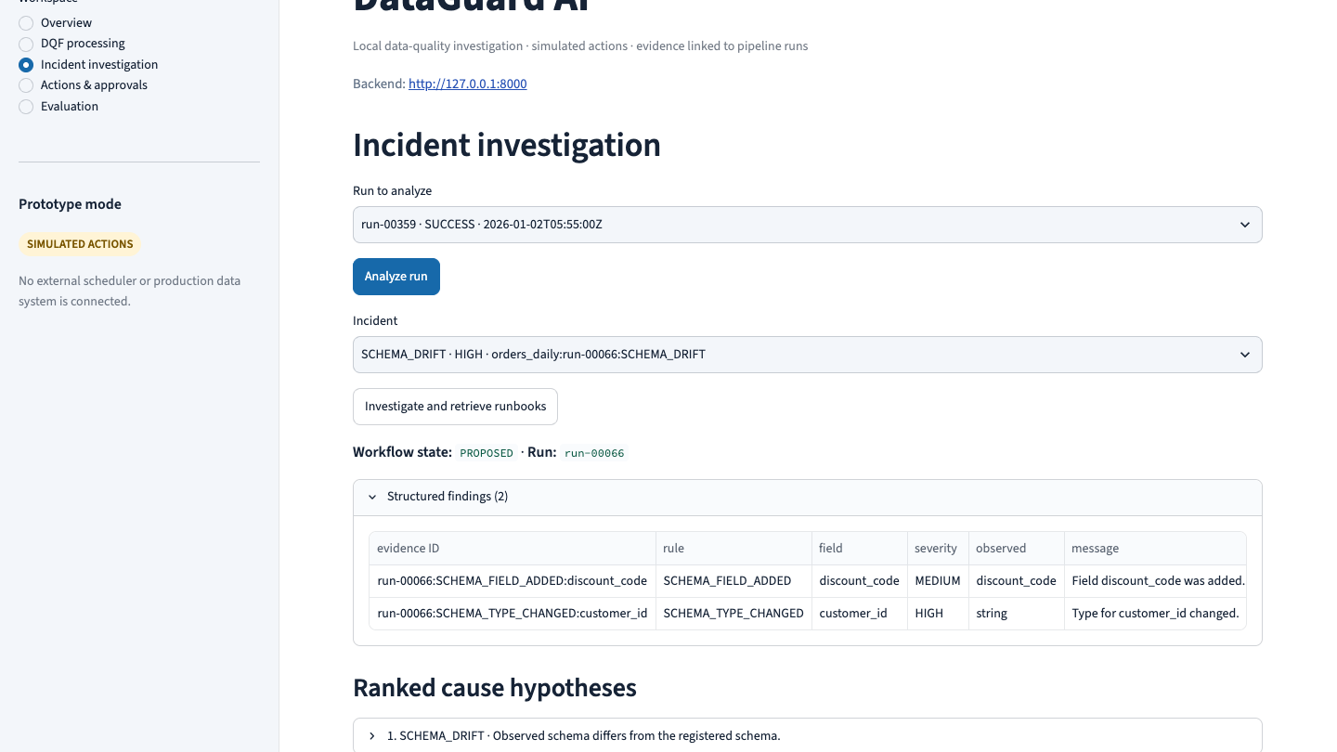
08 WORKING DASHBOARD
Incident investigation
Genuine browser capture: persisted incident, quality evidence, ranked RCA hypotheses, and cited runbook retrieval.
Notes:
Source: genuine screenshot captured from the running local DataGuard AI Streamlit dashboard. Genuine browser capture: persisted incident, quality evidence, ranked RCA hypotheses, and cited runbook retrieval.

Slide 10
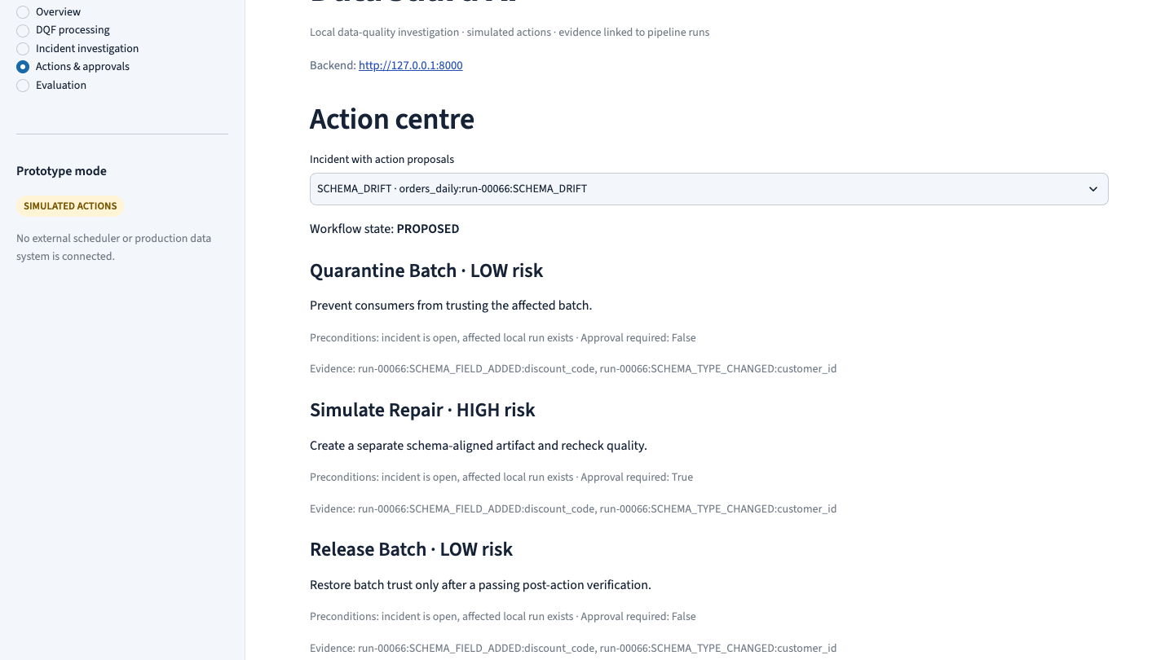
09 WORKING DASHBOARD
Actions and approvals
Genuine browser capture: quarantine, high-risk repair approval, release preconditions, and verification status.
Notes:
Source: genuine screenshot captured from the running local DataGuard AI Streamlit dashboard. Genuine browser capture: quarantine, high-risk repair approval, release preconditions, and verification status.

Slide 11
10 LIMITS & NEXT
What the evidence supports—and what remains
DEMONSTRATED
MEASURED
Integrated local workflow across detection, visual evidence, RCA, retrieval, guarded simulated action, verification, persistence, API and dashboard.
Grouped synthetic detector holdout; pixel and region masks; small fixed retrieval/RCA/safety sets; per-image DIP timings.
LIMITATIONS
NEXT EVALUATION
No real incidents or production connector; small operational judgment sets; no streaming MTTD; matched DQF ablation lowers AP; adaptive DIP has many false positives.
Broaden incident scenarios and masks, report repeated-seed uncertainty, profile stage latency, and validate with approved real data.
Judge remediation by verified outcomes, not attempted actions.
Notes:
This closing slide deliberately replaces the attached deck’s stale “next steps” claims. Existing local artifacts and evaluation protocol are the source for all reported results.

