Slide 1
Setting the stage

Slide 2
Why are we here ?
”Plus ca change, plus c'est la meme chose”
”There is nothing new under the sun”
Our goals:
  Take a critical look at our methods
  Understand that we are not alone
  Identify and disrupt bad habits
  Do the same things better

Slide 3
Old issues in maintaining computing infrastructures
Service Configuration
  Drift
    it was working yesterday !
  Reproducibility
    Something happened...
  Semantics
    I did the thing, and then the thing happened
  Maintenance
    Not my problem
  Portability
    Now make it work over there

Slide 4
Old issues in maintaining computing infrastructures
Monitoring
  Service X went down - get it back to it's previous state asap
    Ok, what was that previous state ?! (See: Drift)
    What tasks need to be executed ?
Disaster Recovery
  Everything broke, fix it.
    What's everything ?
    How do we move from broken hardware to fixed hardware ?

Slide 5
”Newer” issues in computing infrastructures
Complexity
  Services depend on each other (recursively)
Scale
  Scale in services
  Scale in teams
Security
  How can we test service hardening without breaking the services ?
  … every time a service configuration is changed … ?

Slide 6















An example – the science gateway
Federated User
Science Gateway
October 4th, 2013
Riccardo Rotondo
Pretoria 2013

Slide 7
The issue in newer computing infrastructure
Abstraction
  What are we even running on ?
  Does it even matter ?
What is an ”application” ?
  The Science Gateway is an ”application” of the cloud or grid infrastructure.

Slide 8
Here's the thing :
Everything is code - Treat it like code !
  Change control
  Unit tests
  Continuous Integration
Code is developed and tested
Services and configurations are put into Operation
Enter DevOps

Slide 9

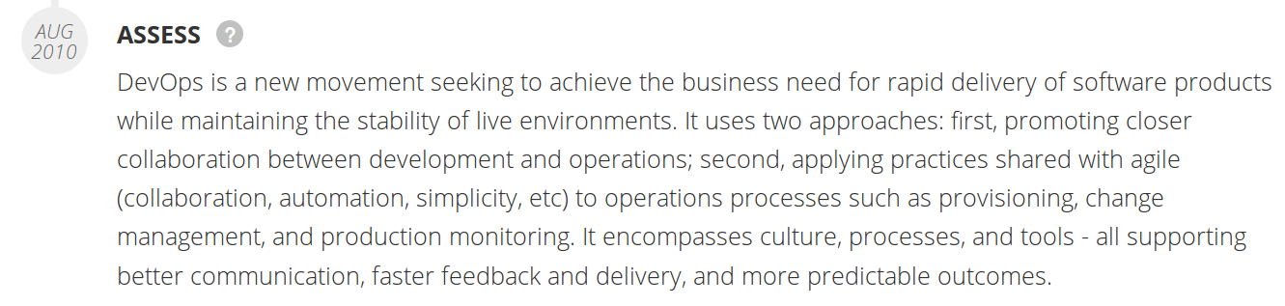
What is DevOps ?
https://www.thoughtworks.com/radar/techniques/devops

Slide 10
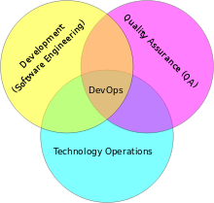
What is DevOps
https://en.wikipedia.org/wiki/DevOps

Slide 11
What is DevOps ?

Slide 12
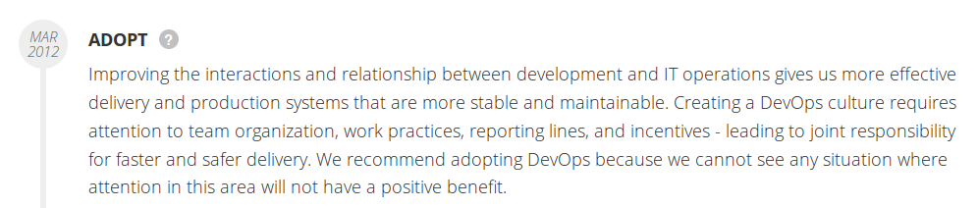
What is DevOps ?
https://www.thoughtworks.com/radar/techniques/devops

Slide 13

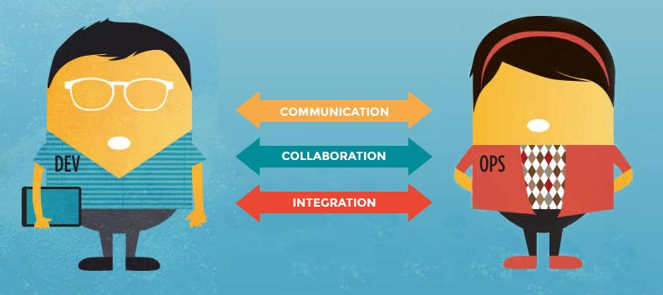
How is this different to what I'm already doing ?
http://newrelic.com/devops/lifecycle
Culture
Automation
Lean
Measurement
Sharing
http://newrelic.com/devops/what-is-devops

Slide 14
This is Not DevOps
A particular tool
  There are lots : http://newrelic.com/devops/toolset
A specific team or person
  It's a culture of collaboration and transparency

Slide 15
Culture is learned – but can't be taught
We'll be focussing on Ansible – one of the new tools in your toolbox
Remember Maslow's Law !
  https://en.wikipedia.org/wiki/Law_of_the_instrument
  It's only going to be useful if used appropriately
  It's just one tool

Slide 16




Things you'll need
Languages : Markdown, Yaml, Jinja, JSON (Python)
Change control : Git
Containerisation tools (Docker)
Test and Build services (Jenkins, Travis)
Situational Awareness

Slide 17
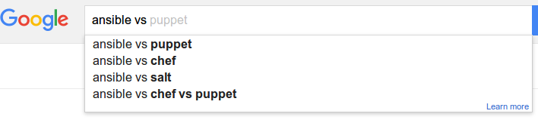
”Kung fu has many schools, so does DevOps.”
https://www.chef.io/solutions/devops/

Slide 18


Slide 19

”When people talk about fighting schools they say that Kung Fu, or Karate, or this other style is the best.
That is silly, and the problem becomes that the fighting style then becomes set in stone with no growth, and no adaptation, because what works well with me might not work for you.”
- Bruce Lee

Slide 20
Why Ansible ?
There are many options available for developing better infrastructure
  All of them are much better than none at all
  There is no right tool – sometimes not even the right tool for the job
  Sometimes you need to use the right tool for you

Slide 21
Ansible vs …
The contenders
  Ansible vs shell scripts
  Ansible vs Puppet
  Ansible vs Chef
  Ansible vs SaltStack ← I don't know enough

Slide 22
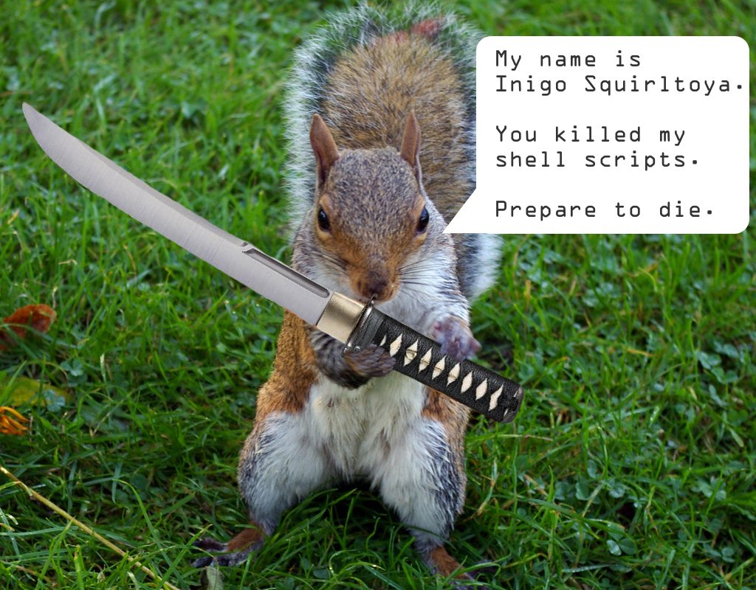
Ansible vs Shell scripts
https://valdhaus.co/writings/ansible-vs-shell-scripts/

Slide 23
Ansible vs Shell scripts
Which method is most likely to end up in source control?
Which method can be run multiple times safely with confidence?
Which method can easily be run against multiple servers?
Which method actually verifies (tests) your server for correctness?
Which method can target certain servers easily (web, db, etc)?
Which method supports easily templating your configuration files?
Which method will grow to easily support your whole stack?

Slide 24
Remember the science gateway ?
Federated User
Science Gateway
You can do all of this with a shell script – but should you ?

Slide 25
Ansible : 1
Shell Scripts : 0
Shell script is still better than nothing though

Slide 26
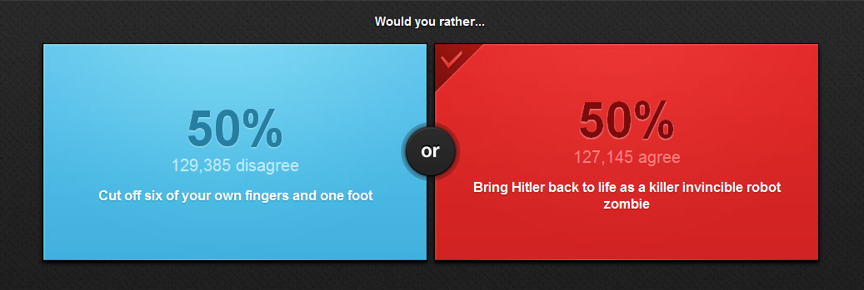
The last easy decision you'll make

Slide 27
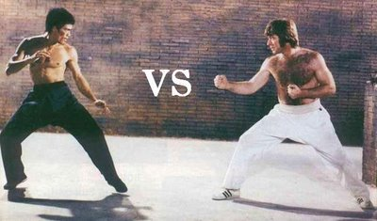
Remember
From here on, everything is opinion and context matters.
There is no canonical comparison between the tools
No use arguing :
YOU STILL HAVE EITHER BRUCE LEE OR CHUCK NORRIS ON YOUR SIDE !!!

Slide 28

Puppet
https://puppetlabs.com/
https://github.com/puppetlabs
Puppet :
  Old kid on the block
  Ruby-based
  Domain-Specific Language for internals
  Master-client model
  Model-Driven
    Task and state dependencies computed by server
  Agent-based

Slide 29
Pros Cons
Well-established support community through Puppet Labs.
Most mature interface and runs on nearly every OS.
Simple installation and initial setup.
Most complete Web UI in this space.
Strong reporting capabilities.
For more advanced tasks, you will need to use the Ruby-based CLI, (you’ll have to understand Ruby).
Support for pure-Ruby versions (rather than those using Puppet’s customized DSL) is being scaled back.
Because of the DSL and a design that does not focus on simplicity, the Puppet code base can grow large, unwieldy, and hard to pick up for new people in your organization at higher scale.
Model-driven approach means less control compared to code-driven approaches.

Slide 30
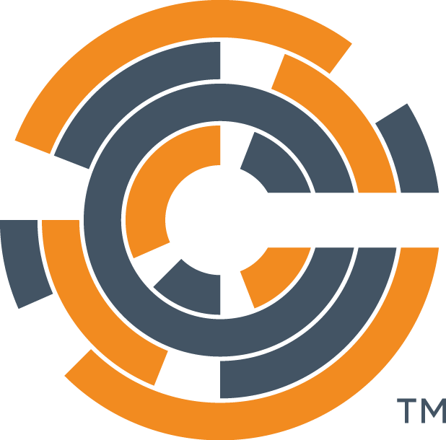
Chef
http://chef.io
https://github.com/chef
Chef :
  Also old kid on the block (2009)
  Heavily dependent on Git (configuration)
  Internals in Ruby
  Master-client model
  Procedural
    Task and state dependencies computed by server
  Mode ”Development” focussed than Puppet (?)

Slide 31
Pros Cons
Rich collection of modules and configuration recipes.
Code-driven approach gives you more control and flexibility over your configurations.
Strong version control capabilities.
'Knife’ tool (uses SSH for deploying agents from workstation) eases installation burdens.
Steep learning curve if you’re not already familiar with Ruby and procedural coding.
Complex tool - can lead to large code bases and complicated environments.
Doesn’t support push functionality.

Slide 32

Take another look around
A short diversion

Slide 33
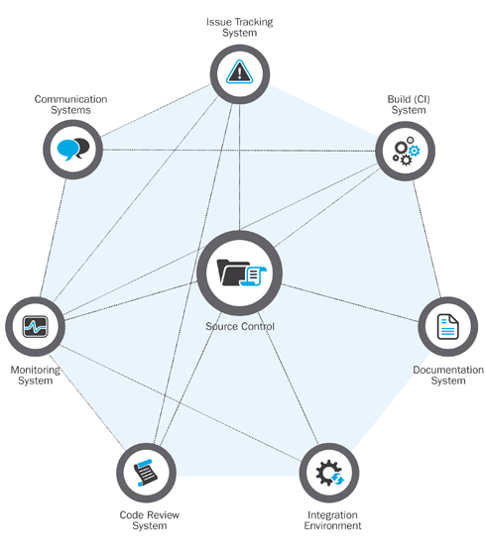
http://insights.sei.cmu.edu/sei_blog/2014/06/a-generalized-model-for-automated-devops.html

Slide 34
Development, Collaboration and Testing
Any tool will build garbage if you tell it to !
Benefits of DevOps tools : treat everything as code – you can apply software engineering principles to it:
  Change control, versioning
  Automated unit tests
  Automated Integration
Paradigm so widely adopted that everything is already available

Slide 35
Containers changed everything
We don't have time to go into it now, but most of the testing and training will be done in Docker containers.
Containers make it much easier to test and develop infrastructure code
Very good for training
Probably not great for production infrastructure (security)

Slide 36

Hands-on session
Install Docker

Slide 37
Docker
Installation
  See https://docs.docker.com/installation/
Containers at https://hub.docker.com/u/aaroc

Slide 38
What have we learned
The same old issues and problems are now being addressed by frameworks instead of genius
A shift in culture from top-down to flat can improve life for systems administrators, developers and users
Sound software engineering principles can be applied to entire infrastructures
A good knowledge of all the tools and a good situational awareness allows one to choose the right tools for the job

Slide 39
End

