Slide 1


Setting the stage

Slide 2
Why are we here ?
“Plus ca change, plus c'est la meme chose”
“There is nothing new under the sun”
Our goals:
  Take a critical look at our methods
  Understand that we are not alone
  Identify and disrupt bad habits
  Do the same things better
  Learn !

Slide 3
To paraphrase von Moltke
“No battle plan survives contact with the enemy.”

Slide 4
Remember why I am here
I am not here to teach you – you are here to learn. Different thing…
I am here to :
  Spot issues, errors, inconsistencies
  make this bootcamp better – expand, mould it.
  put whoever steps up into a position of running it themselves.
  find new uses, and tools, and build better infrastructure

Slide 5

Also, we publish this stuff !
Bruce Becker, Chris Rohrer, & Marco Fargetta. (2017, January). AAROC/AnsibleBootCamp: Ansible BootCamp - Entebbe. Zenodo. http://doi.org/10.5281/zenodo.242394
Contributors (accepted pull requests) are co-authors
http://orcid.org/0000-0002-6607-7145

Slide 6
If you see something, say something
Actual error with the actual slides or hands-on :
  Open an issue: https://gihub.com/AAROC/AnsibleBootCamp/issues/new
Almost everything else, start a topic: https://discourse.sci-gaia.eu/c/devops
  Something not clear in the hands-on
  General question about DevOps, any of the tools.
  Feel like a rant, go for it.
Want to contribute to the bootcamp – fork https://github.com/AAROC/AnsibleBootCamp and send pull request
Want to hack with us – fork https://github.com/AAROC/DevOps and send pull request

Slide 7
So, let’s get into it...

Slide 8
Old issues in maintaining computing infrastructures
Service Configuration
  Drift
    it was working yesterday !
  Reproducibility
    Something happened...
  Semantics
    I did the thing, and then the thing happened
  Maintenance
    Not my problem
  Portability
    Now make it work over there

Slide 9
Old issues in maintaining computing infrastructures
Monitoring
  Service X went down - get it back to it's previous state
    Ok, what was that previous state ?! (See: Drift)
    What tasks need to be executed ?
Disaster Recovery
  Everything broke, fix it.
    What do you mean by “everything” ?
    How do we move from broken hardware to fixed hardware ?

Slide 10
“Newer” issues in computing infrastructures
Complexity
  Services depend on each other (recursively)
Scale
  Scale in services
  Scale in teams
Security
  How can we test service hardening without breaking the services ?
  … every time a service configuration is changed … ?

Slide 11















An example – the science gateway
Federated User
Science Gateway
Image credit : Riccardo Rotondo (2013)

Slide 12






Example : Identity Provider

Slide 13



Example : HPC cluster

Slide 14
Example : N HPC clusters

Slide 15
The issue in newer computing infrastructure
Abstraction
  What are we even running on ?
  Does it even matter ?
What is an “application” ?
  The Science Gateway is an multi-component “application” of the cloud or grid infrastructure.
  An HPC cluster can be spun up on lots of different hardware
  Where do applications separate from infrastructure ?

Slide 16
Here's the thing :
Everything is code - Treat it like code !
  Change control
  Unit tests
  Continuous Integration and Delivery
Code is Developed and tested
Services and configurations are tested before being put into Operation
Enter DevOps – a fluid way to move from Dev to Ops.

Slide 17

DevOps, c’est quoi ?

Slide 18

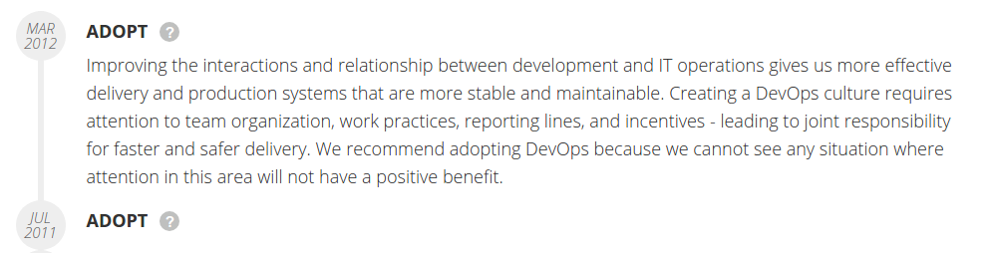
What is DevOps ?
www.thoughtworks.com/radar/techniques/devops

Slide 19
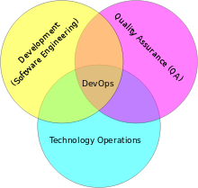
What is DevOps
https://en.wikipedia.org/wiki/DevOps

Slide 20
What is DevOps ?
Depends who you ask !
  IBM - https://youtu.be/CSrKwP1QrjE
  Rackspace - https://youtu.be/_I94-tJlovg
  AWS - https://aws.amazon.com/devops/
  GCP https://cloud.google.com/solutions/devops/

Slide 21
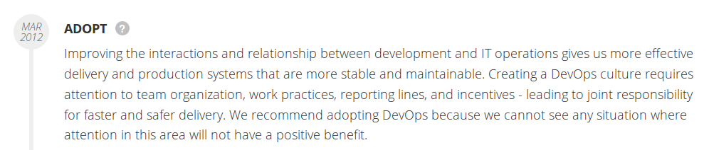
What is DevOps ?
https://www.thoughtworks.com/radar/techniques/devops

Slide 22

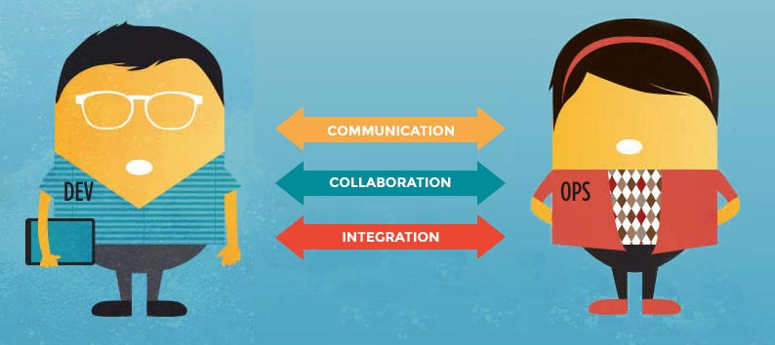
How is this different to what I'm already doing ?
http://newrelic.com/devops/lifecycle
Culture
Automation
Lean
Measurement
Sharing
http://newrelic.com/devops/what-is-devops

Slide 23
This is Not DevOps
A particular tool
  There are lots :
    http://newrelic.com/devops/toolset
    https://github.com/showcases/devops-tools
A specific team or person
  It's a culture of collaboration and transparency

Slide 24
Culture is learned – but can't be taught
We'll be focussing on Ansible – one of the new tools in your toolbox
Remember Maslow's Law !
  https://en.wikipedia.org/wiki/Law_of_the_instrument
  It's only going to be useful if used appropriately
  It's just one tool

Slide 25
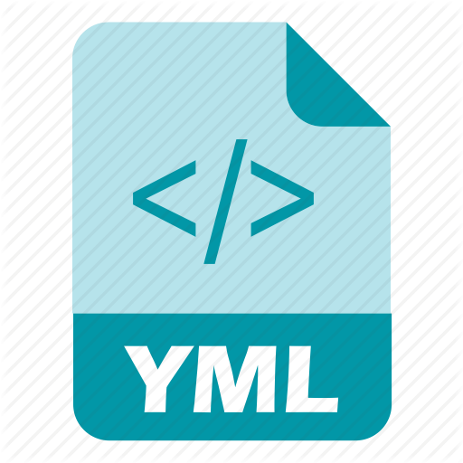






Things you'll need
Languages :
  For humans : Markdown, YAML...
  And machines : Python, Ruby, DSL’s...
Data exchange : JSON, REST
Change control : git
Container/Virtualisation tools : Docker, Kube, OpenShift, Vagrant...
Test and Build services : (Jenkins, Travis)
Situational Awareness : ChatOps

Slide 26
But wait ! It gets much, much worse !

Slide 27
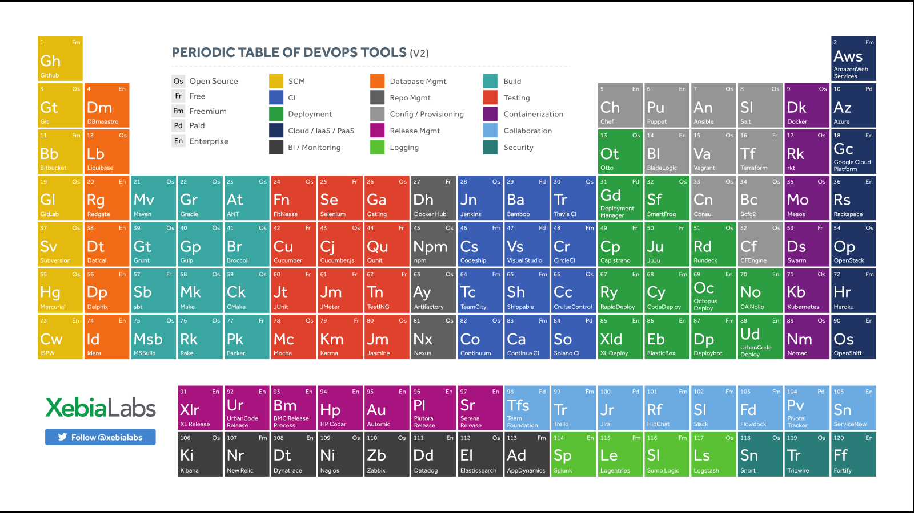

Slide 28

Want out yet ?

Slide 29
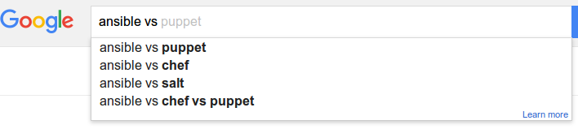
“Kung fu has many schools, so does DevOps.”
https://www.chef.io/solutions/devops/

Slide 30


Slide 31

”When people talk about fighting schools they say that Kung Fu, or Karate, or this other style is the best.
That is silly, and the problem becomes that the fighting style then becomes set in stone with no growth, and no adaptation, because what works well with me might not work for you.”
- Bruce Lee

Slide 32
Why Ansible ?
There are many options available for developing better infrastructure
  All of them are much better than none at all
  There is no right tool – sometimes not even the right tool for the job
  Sometimes you need to use the right tool for you

Slide 33
Ansible vs …
The contenders
  Ansible vs doing things manually
  Ansible vs shell scripts
  Ansible vs Puppet
  Ansible vs Chef
  Ansible vs SaltStack ← I don't know enough
  Ansible vs Hashicorp ← I don't know enough
  Ansible vs MuchBetterTool ← Sounds great ! Send Pull request...

Slide 34
Ansible vs doing things manually

Slide 35

Oh, you were serious...
Ok… If you can answer this, I will take you seriously :
  What changes did you make to a particular system under your control 6 months ago ?
    git diff HEAD "@{6 months ago}"
  What effect did those changes have ? What you going to grep in your log now ?
Ok… now tell someone else to do exactly what you did
  Sleeping well yet ?
Now, meet ChaosMonkey, and weep

Slide 37
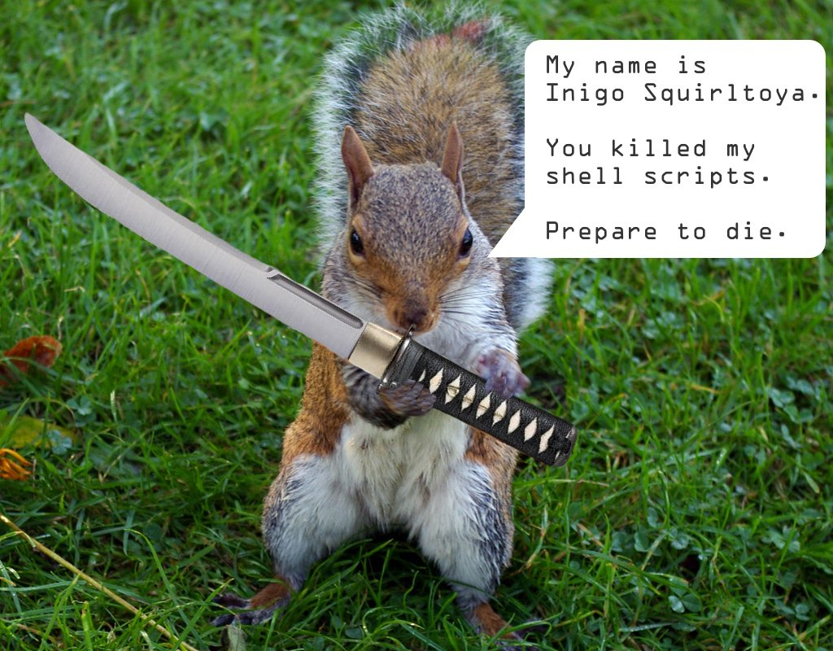
Ansible vs Shell scripts
https://valdhaus.co/writings/ansible-vs-shell-scripts/

Slide 38
Ansible vs Shell scripts
Which method is most likely to end up in source control?
Which method can be run multiple times safely with confidence?
Which method can easily be run against multiple servers?
Which method actually verifies (tests) your server for correctness?
Which method can target certain servers easily (web, db, etc)?
Which method supports easily templating your configuration files?
Which method will grow to easily support your whole stack?

Slide 39
Remember the science gateway ?
Science Gateway
You can do all of this with a shell script – but should you ?

Slide 40
Ansible : 1
Shell Scripts : 0
Shell script is still better than nothing though

Slide 41
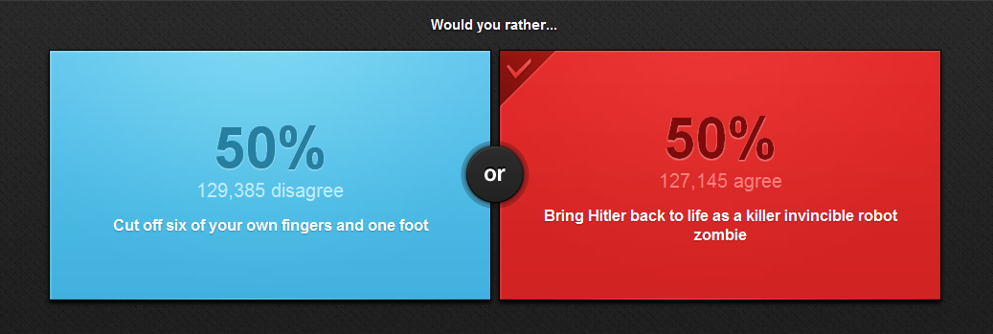
The last easy decision you'll make

Slide 42

Remember
From here on, everything is opinion and context matters.
There is no canonical comparison between the tools
No use arguing :
YOU STILL HAVE EITHER BRUCE LEE OR CHUCK NORRIS ON YOUR SIDE !!!

Slide 43

Puppet
https://puppetlabs.com/
https://github.com/puppetlabs
Puppet :
  Old kid on the block
  Ruby-based
  Domain-Specific Language for internals
  Master-client model
  Model-Driven
    Task and state dependencies computed by server
  Agent-based

Slide 44
Pros Cons
Well-established support community through Puppet Labs.
Most mature interface and runs on nearly every OS.
Simple installation and initial setup.
Most complete Web UI in this space.
Strong reporting capabilities.
For more advanced tasks, you will need to use the Ruby-based CLI, (you’ll have to understand Ruby).
Support for pure-Ruby versions (rather than those using Puppet’s customized DSL) is being scaled back.
Because of the DSL and a design that does not focus on simplicity, the Puppet code base can grow large, unwieldy, and hard to pick up for new people in your organization at higher scale.
Model-driven approach means less control compared to code-driven approaches.

Slide 45

Chef
http://chef.io
https://github.com/chef
Chef :
  Also old kid on the block (2009)
  Heavily dependent on Git (configuration)
  Internals in Ruby
  Master-client model
  Procedural
    Task and state dependencies computed by server
  More “Development” focussed than Puppet (?)

Slide 46
Pros Cons
Rich collection of modules and configuration recipes.
Code-driven approach gives you more control and flexibility over your configurations.
Strong version control capabilities.
'Knife’ tool (uses SSH for deploying agents from workstation) eases installation burdens.
Steep learning curve if you’re not already familiar with Ruby and procedural coding.
Complex tool - can lead to large code bases and complicated environments.
Doesn’t support push functionality.

Slide 47

Take another look around

Slide 48
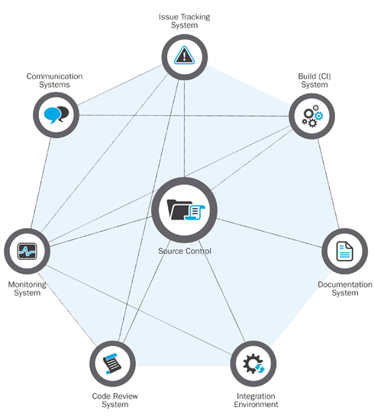
http://insights.sei.cmu.edu/sei_blog/2014/06/a-generalized-model-for-automated-devops.html

Slide 49
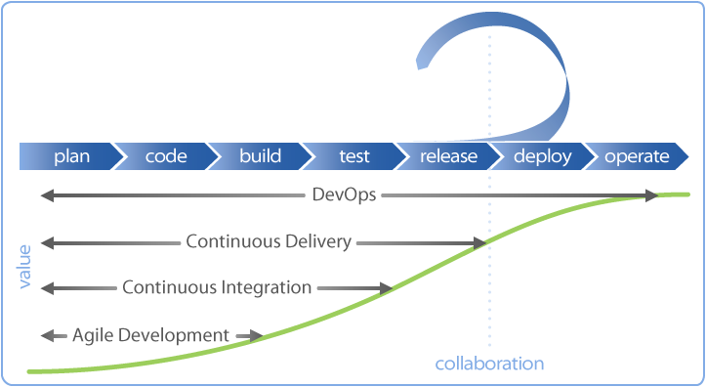
DevOps and Agile

Slide 50
Development, Collaboration and Testing
Any tool will build garbage if you tell it to !
Benefits of DevOps tools : treat everything as code – you can apply software engineering principles to it:
  Change control, versioning
  Automated unit tests
  Automated Integration
Paradigm so widely adopted that everything is already available

Slide 51
What have we learned
The same old issues and problems are now being addressed by frameworks instead of genius
A shift in culture from top-down to flat can improve life for systems administrators, developers and users
Sound software engineering principles can be applied to entire infrastructures
A good knowledge of all the tools and a good situational awareness allows one to choose the right tools for the job

Slide 52
Next: Introduction to Ansible

Slide 53

Ready ?

