Slide 1
Neo4j vs. GraphDB
Unraveling the Key Differences in Graph Databases using RDF Data
Group 10
Aaron Yang, Aravinda Vijayaram Kumar, Luhuan Wang

Slide 2
INTRODUCTION
Comparing fundamental characteristics of GraphDB and with Neo4j, particularly focusing on processing RDF data.
Why Comparison?
This research can guide decision-makers in making better choices when selecting a graph database for their specific needs.

Slide 3
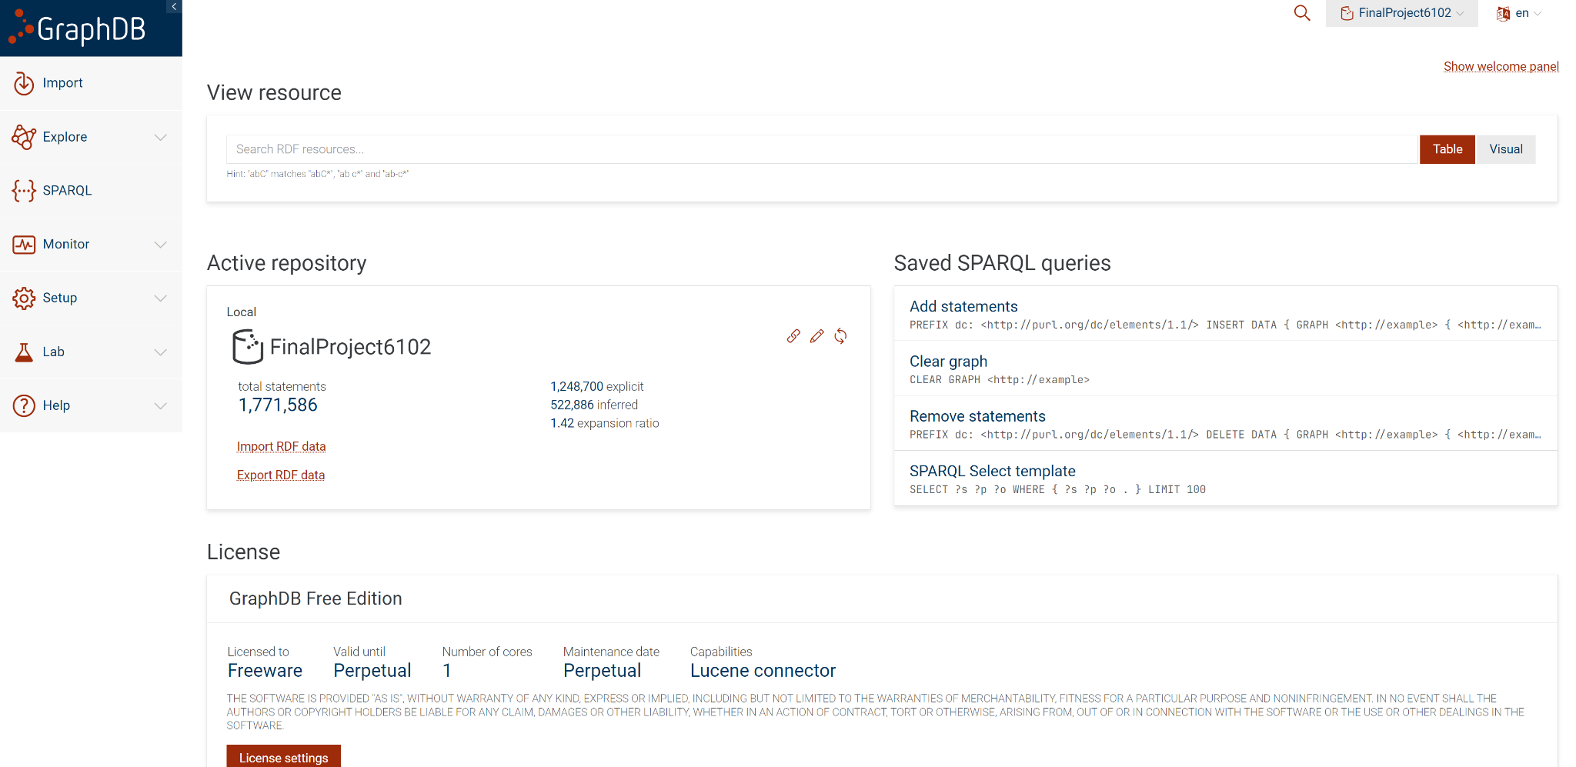
INTRODUCTION
Ontotext GraphDB is a graph database management system that focuses on semantic data storage, supports semantic query and reasoning operations, and is high-performance, scalable and open.

Slide 4
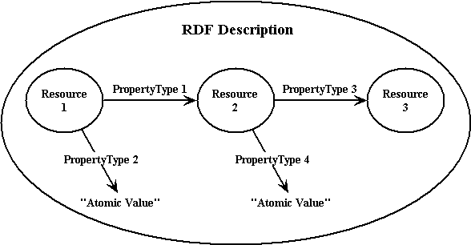
What is RDF?
RDF stands for Resource Description Framework.
Key components:
Triples: RDF data is represented in triples, which consist of subject-predicate-object statements.
Resource Identification: RDF uses URIs (Uniform Resource Identifiers) to uniquely identify resources.
Graph-Based Structure: RDF data forms a graph structure where nodes represent resources, and edges (or arcs) between nodes represent the relationships or properties.
Extensibility: It allows for extensibility and flexibility in modeling relationships and describing data.

Slide 5
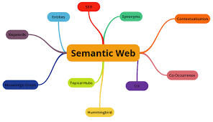
What is Semantic Web graphs?
A semantic web graph is the interconnected data structures that exist in the semantic web(a concept proposed by Tim Berners-Lee).
Standardized formats and protocols
Achieved by using technologies such as RDF (Resource Description Framework), OWL (Web Ontology Language), and SPARQL (SPARQL Protocol and RDF Query Language)

Slide 6
GraphDB Vs. Neo4j
DBs | GraphDB | Neo4j
Query Language | SPARQL | Cypher
Data Models | RDF | a property graph model
Licensing and Cost | Free and commercial versions | Community edition for free and commercial Enterprise editions with advanced features
Community | largely focused on semantic web and linked data | a large, active community with extensive support and resources

Slide 7
Dataset
2 datasets- ddw/ontology and The Medical Subject Headings (MeSH) RDF dataset
The ddw/ontology dataset contains the core set of entities that data.world matches against and everything in this dataset is managed by data.world and is constantly being expanded and improved.
The Medical Subject Headings (MeSH) RDF is a linked data representation of the MeSH biomedical vocabulary produced by the National Library of Medicine. It has a total of 15,439,946.

Slide 8
METHODOLOGY USED
Connected GraphDB and Neo4j databases in Python through VS Code using the Sparqlwrapper and neo4j drivers.
Executing our queries and a Windows Operating system with 16GB RAM
Executed Queries and measured their execution times using the time library in python.
Notes:
Connected GraphDB and Neo4j databases in Python using the Sparqlwrapper and neo4j drivers.
Used VS Code IDE to execute our queries and a Windows Operating system with 16GB RAM
Executed Queries and measured their execution times using the time library in python.

Slide 9
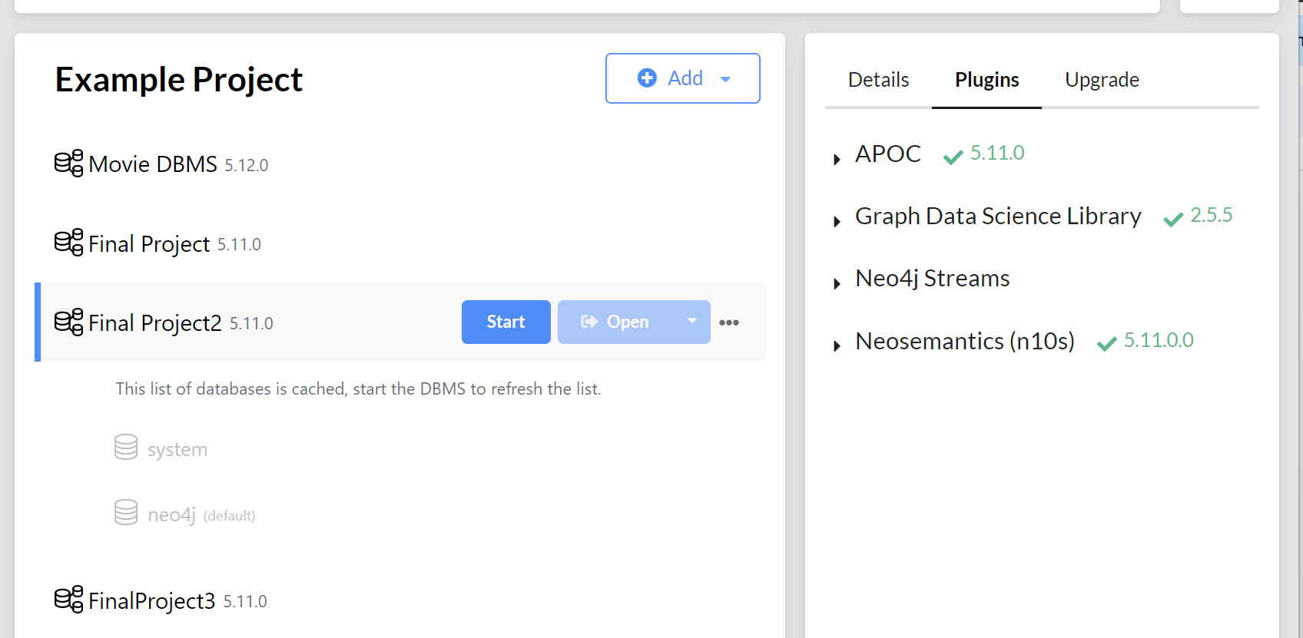
Neo4j Setup (5.11.0)

Slide 10
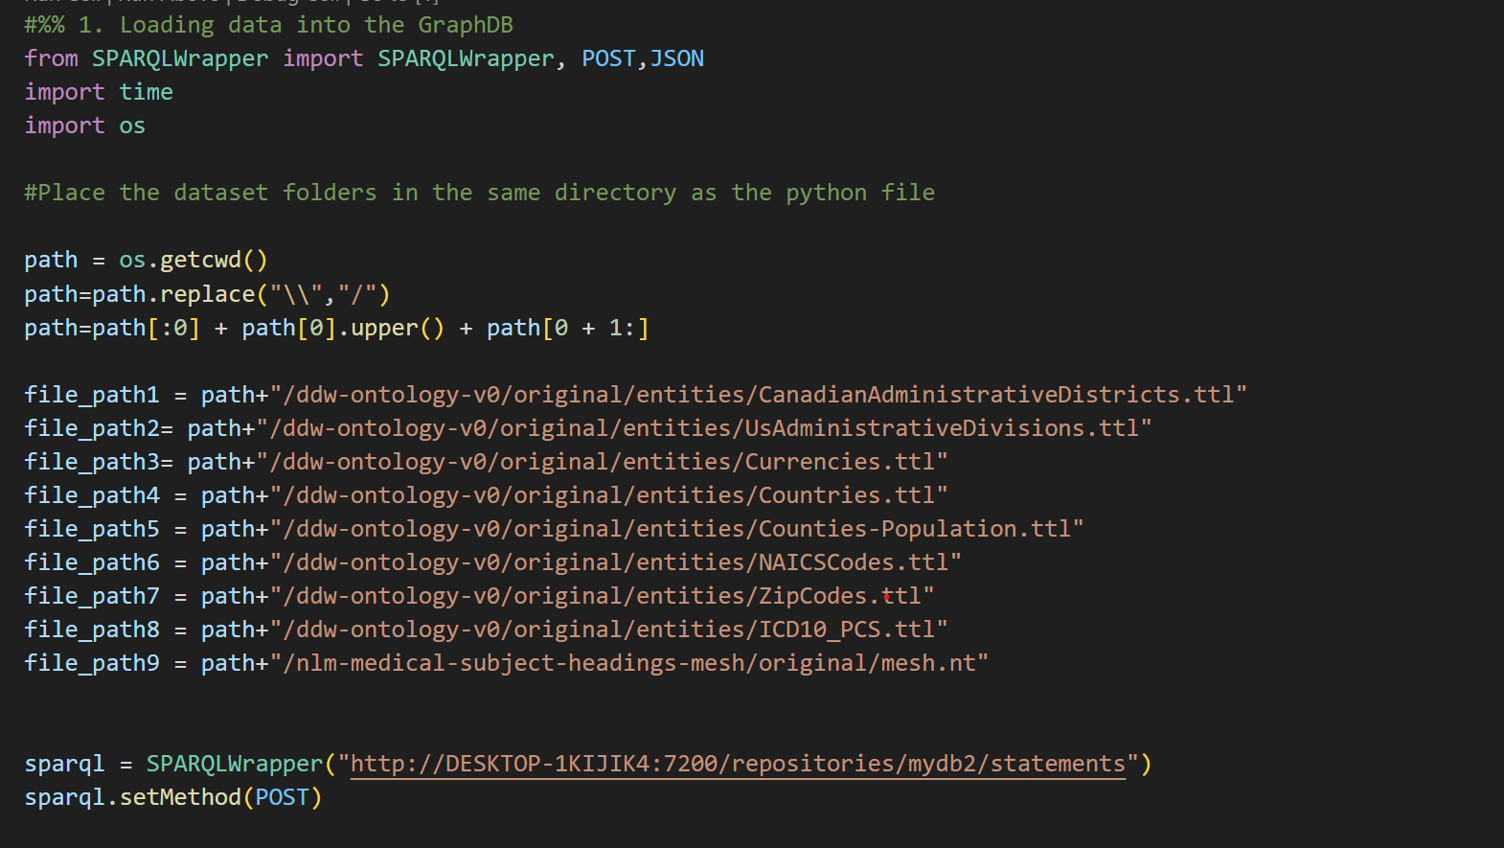
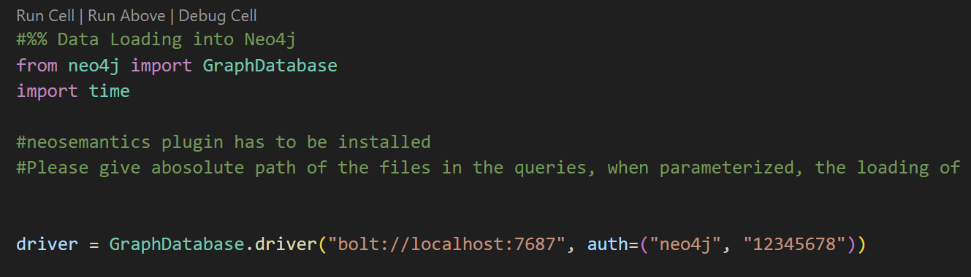

Slide 11
Types of Queries Executed
Tested the performances of both DBs with different operations-
The types of scenarios considered were
Loading the Data into the Databases
Basic querying the data using Select and Match
Traversals such as Depth First Search and Breadth First search, Best Path, Full Text Search, and Pattern Matching.
Deletion of the Data from the Databases.
Executing Traversal with ID vs URI property in Neo4J
Notes:
Depth First Search (DFS) is a graph traversal algorithm that starts from a specified node and explores as far as possible along each branch before backtracking to explore other branches, effectively diving deep into a graph's structure before moving to neighboring nodes.
Breadth First Search (BFS) is a graph traversal algorithm that starts from a specified node and explores all its neighboring nodes before moving on to the next level of nodes, effectively exploring a graph layer by layer, in a breadthward manner.
The "best path" refers to the most optimal route or sequence of steps that achieves a specific goal, often based on criteria like shortest distance, fastest time, lowest cost, or highest quality, depending on the context of the problem.
Full text search is a technique used to search and retrieve documents or records containing specific words or phrases within their entire content, enabling comprehensive and context-aware searches in databases or textual data.
Pattern matching is a process of searching for specific patterns or sequences of characters within a text or data to identify occurrences that match a given template or criteria.

Slide 12
Result1: Loading data into the Databases
GraphDB | Neo4J
LOAD <file:///{file_path1}> | CALL n10s.graphconfig.init (Neo4j graph configuration for handling RDF) 2. CREATE CONSTRAINT n10s_unique_uri FOR (r:Resource) REQUIRE r.uri IS UNIQUE (creates a unique constraint in the Neo4j database) 3. CALL n10s.rdf.import.fetch("file://--path--","Turtle");
Notes:
1. CALL n10s.graphconfig.init
(This initializes the Neo4j graph configuration for handling RDF (Resource Description Framework) data. It sets up the necessary settings to work with RDF in the Neo4j database.)
2. CREATE CONSTRAINT n10s_unique_uri FOR (r:Resource) REQUIRE r.uri IS UNIQUE
(This line creates a unique constraint in the Neo4j database. It ensures that each `Resource` node in the graph has a unique URI (Uniform Resource Identifier), preventing duplicate entries.)
3. CALL n10s.rdf.import.fetch("file://--path--","Turtle");
（This command imports RDF data into the Neo4j database. The data is located at the specified file path (`--path--`) and is in the Turtle format, a common format for storing RDF data. This line reads the data from the file and adds it to the Neo4j graph database.）

Slide 13
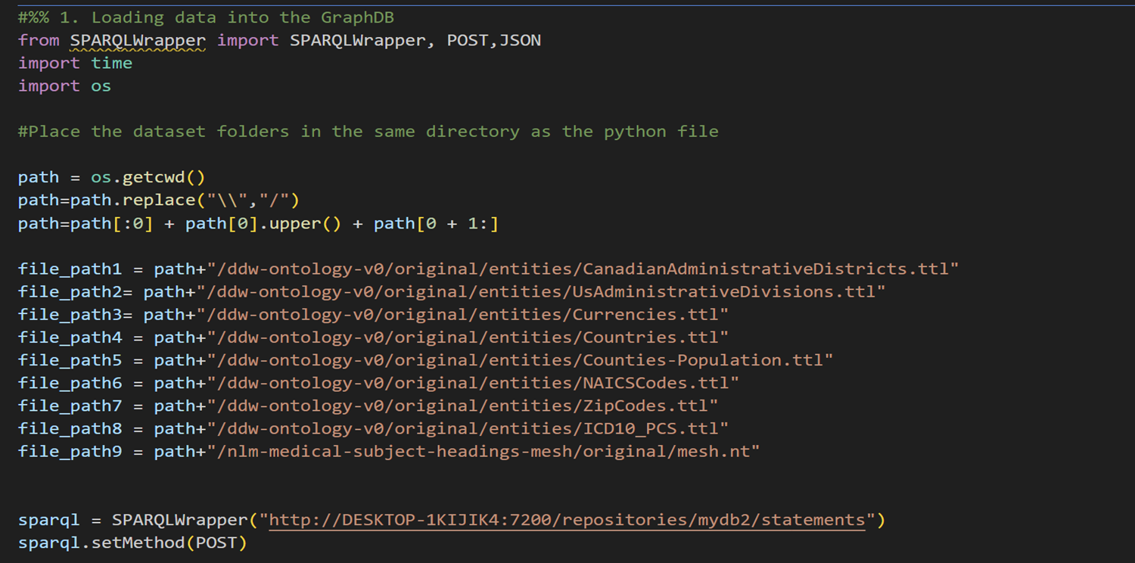
Result1: Loading data into the Databases

Slide 14
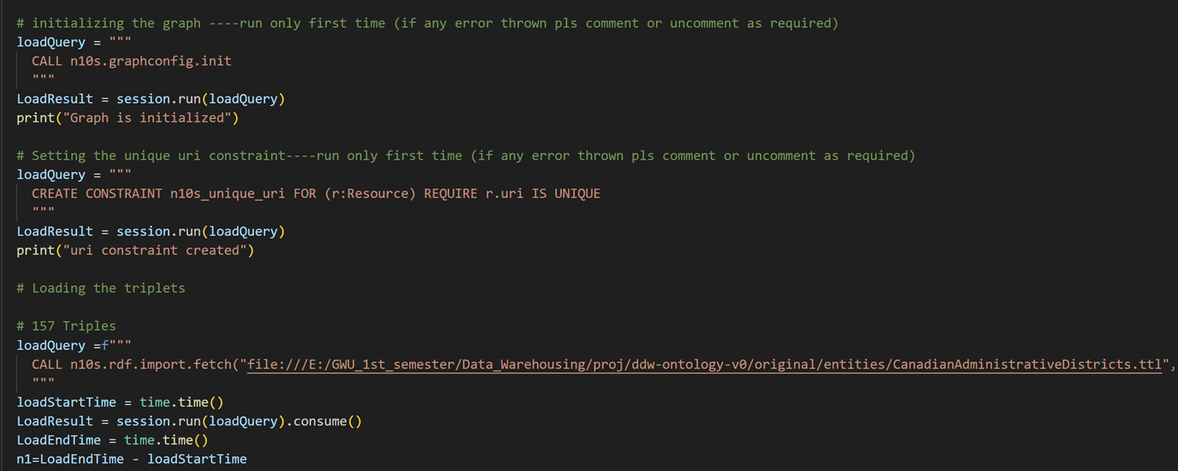
Result1: Loading data into the Databases

Slide 15
Execution Performance-
Triplet Count | GraphDB | Neo4J
157 | 0.847975492477417 seconds | 0.1910383701324463 seconds
579 | 0.7824344635009766 seconds | 0.1515660285949707 seconds
1433 | 0.23038530349731445 seconds | 0.2263948917388916 seconds
7481 | 0.7272355556488037 seconds | 1.1153607368469238 seconds
15705 | 1.2057037353515625 seconds | 0.27726054191589355 seconds
46479 | 1.2367780208587646 seconds | 1.055119514465332 seconds
305779 | 6.211588621139526 seconds | 5.927391052246094 seconds
477366 | 8.40849256515503 | 2.750755548477173 seconds
15439946 | 310.032653093338 seconds | 250.40910816192627 seconds

Slide 16
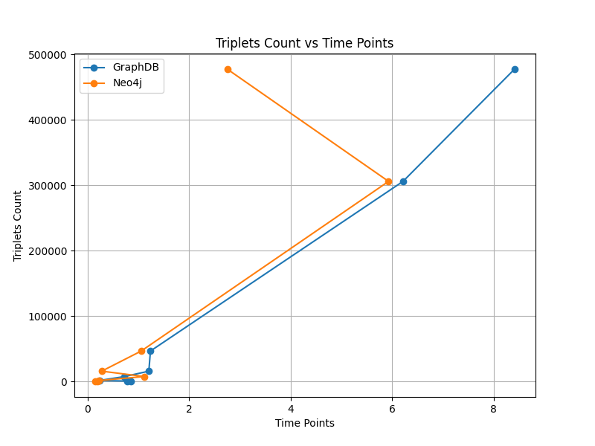
Performance Plot-
Notes:
There's a point where Neo4j's triplet count increases dramatically compared to GraphDB, which could indicate a faster rate of data insertion or relationship creation in Neo4j.
At the last time point, GraphDB surpasses Neo4j in the number of triplets, indicating a higher final count of triplets.
Neo4j is noT A RDF DB BUT STILL FOR HIGH DATA IT STILL LOADS FASTER

Slide 17
Result2: Basic Select/Match Operations
GraphDB | Neo4J
select * where { ?s ?p ?o . } limit 1000 | MATCH (n) RETURN n LIMIT 1000

Slide 18
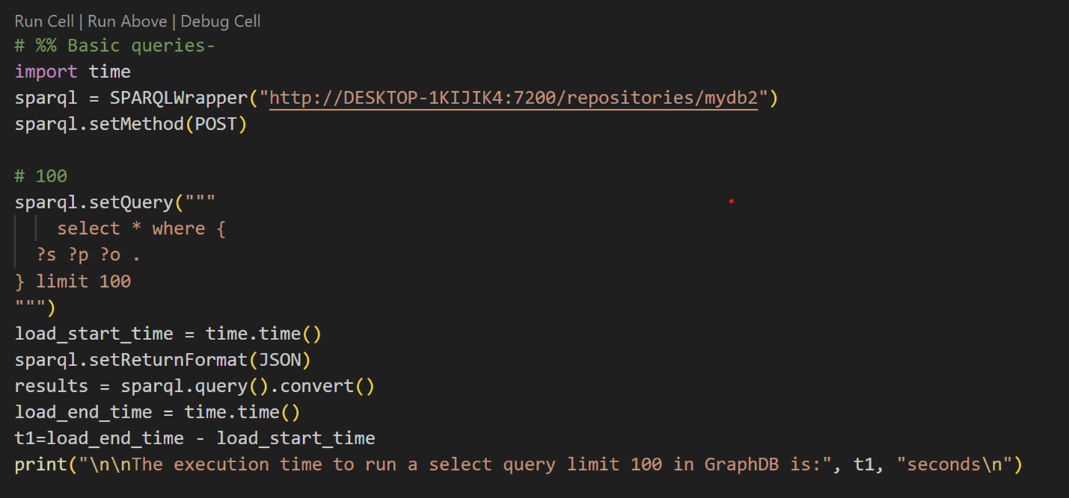
Result2: Basic Select/Match Operations

Slide 19
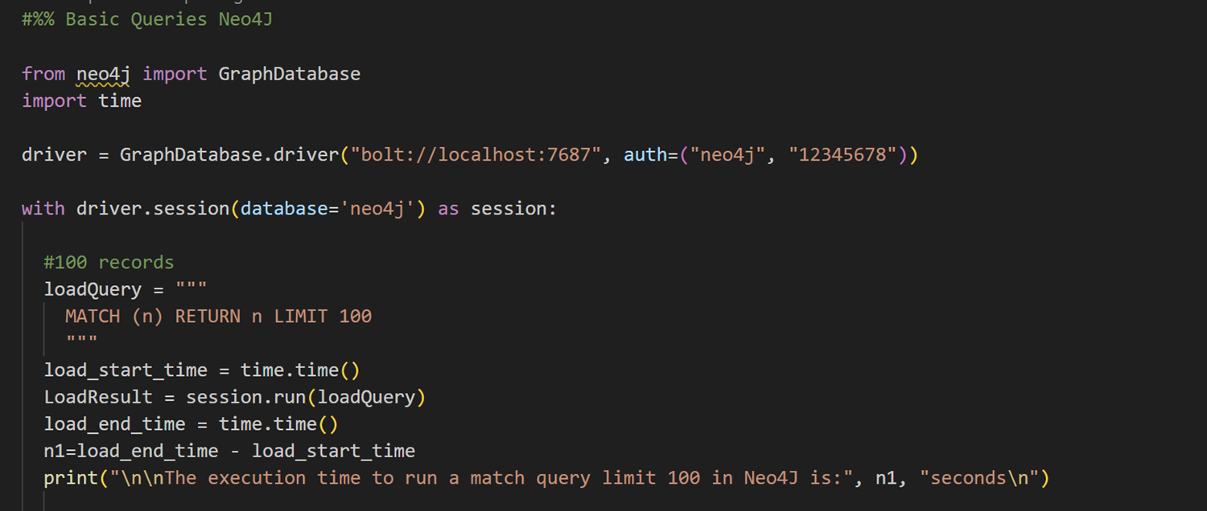
Result2: Basic Select/Match Operations

Slide 20
Basic Select | GraphDB | Neo4J
LIMIT 100 | 0.01995110511779785 seconds | 2.0970842838287354 seconds
LIMIT 1000 | 0.03729748725891113 seconds | 0.034908294677734375 seconds
LIMIT 10000 | 0.16156792640686035 seconds | 0.07380294799804688 seconds
LIMIT 10000 | 1.1192455291748047 seconds | 1.0791707038879395 seconds
LIMIT 1000000: | 10.309787273406982 seconds | 5.585696220397949 seconds

Slide 21
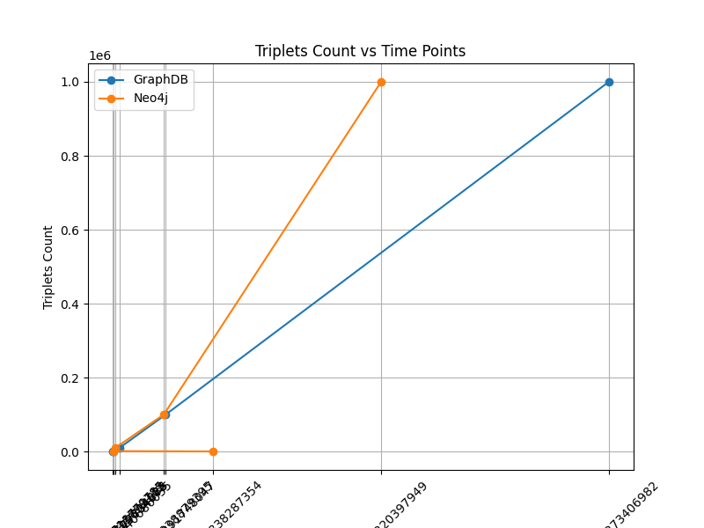
Notes:
Both databases start with a very small number of triplets, as indicated by the scale.
The triplet count for both databases increases exponentially over time.
At the final point on the right, GraphDB has a higher triplet count than Neo4j, suggesting a larger overall volume of triplets.

Slide 22
Result3: Data Deletion
GraphDB | Neo4J
DELETE { ?subject ?predicate ?object . } WHERE { { SELECT * WHERE { ?subject ?predicate ?object . } LIMIT 100 } } | MATCH (n) WITH n LIMIT 100 DETACH DELETE n;

Slide 23
Basic Select | GraphDB | Neo4J
100 Triplets | 0.1386 seconds | 2.1626 seconds
1000 Triplets | 0.1626 seconds | 0.4136 seconds
10000 Triplets | 0.4568 seconds | 0.5808 seconds
1000000 Triplets | 2.5747 seconds | 0.9787 second

Slide 24
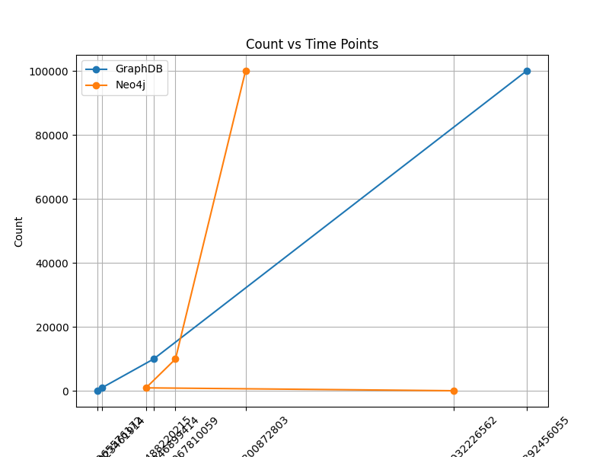

Results3: Data Deletion
Neo4j is relatively more stable as data grows,
GraphDB performs better than Neo4j on various query types and is also faster when dealing with small databases.

Slide 25
Result4：Basic Data traversal/Search
Breadth-First Traversal and Depth-First Traversal
PREFIX dwo: <https://ontology.data.world/v0#>
PREFIX geo: <http://www.w3.org/2003/01/geo/wgs84_pos#>
PREFIX skos: <http://www.w3.org/2004/02/skos/core#>
PREFIX rdfs: <http://www.w3.org/2000/01/rdf-schema#>
SELECT ?stateLabel ?geonameID
WHERE {
?state a dwo:UsState ;
rdfs:label ?stateLabel ;
geo:lat ?lat ;
geo:long ?long ;
dwo:geonameId ?geonameID .
}
DFT- MATCH path = (startNode)-[*]->(endNode) WHERE endNode.uri 'https://entities.data.world/usstate_alabama' RETURN path;
BFT-
MATCH path = (startNode)-[*1..]->(endNode) WHERE endNode.uri = 'https://entities.data.world/usstate_alabama' RETURN path;

Slide 26
b. Best Path
PREFIX dwo: <https://ontology.data.world/v0#> PREFIX geo: <http://www.w3.org/2003/01/geo/wgs84_pos#> PREFIX skos: <http://www.w3.org/2004/02/skos/core#> SELECT ?state1Label ?state2Label WHERE { ?state1 a dwo:UsState ; rdfs:label ?state1Label . ?state2 a dwo:UsState ; rdfs:label ?state2Label . FILTER(?state1 != ?state2) }
MATCH path = shortestPath((startNode)-[*]-(endNode)) WHERE startNode.uri = 'https://entities.data.world/usstate_alabama' AND endNode.uri = 'https://en.wikipedia.org/wiki/Maine' RETURN path;

Slide 27
c. Pattern Matching
PREFIX dwo: <https://ontology.data.world/v0#> PREFIX geo: <http://www.w3.org/2003/01/geo/wgs84_pos#> PREFIX skos: <http://www.w3.org/2004/02/skos/core#> CONSTRUCT { ?state a dwo:UsState ; rdfs:label ?stateLabel ; geo:lat ?lat ; geo:long ?long ; dwo:geonameId ?geonameID . } WHERE { ?state a dwo:UsState ; rdfs:label ?stateLabel ; geo:lat ?lat ; geo:long ?long ; dwo:geonameId ?geonameID . }
MATCH (subject)-[*]->(object) WHERE subject.uri = 'https://entities.data.world/usstate_colorado' RETURN subject, object;
Notes:
Constructing US State RDF Triples

Slide 28
d. Full Text Search
PREFIX dwo: <https://ontology.data.world/v0#> PREFIX skos: <http://www.w3.org/2004/02/skos/core#> SELECT ?stateLabel WHERE { ?state a dwo:UsState ; rdfs:label ?stateLabel . FILTER(CONTAINS(LCASE(?stateLabel), "new")) }
MATCH (node) WHERE node.rdfs__label CONTAINS 'Colorado' RETURN node

Slide 29
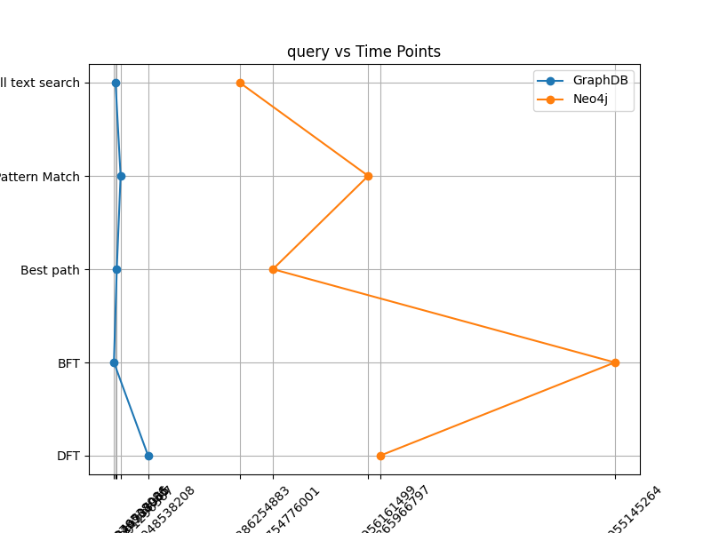
Query | GraphDB | Neo4J
DFT | 0.282304048538208 seconds | 2.1563243865966797 seconds
BFT | 0.00589 seconds | 4.054851055145264 seconds
BestPath | 0.02892279624938965 seconds | 1.290935754776001 seconds
Pattern Matching | 0.05983996391296387 seconds | 2.060992956161499 seconds
Full Text Search | 0.01889944076538086 seconds | 1.0228090286254883 seconds

Slide 30
Result5: Executing Traversal with ID vs URI property in Neo4J
MATCH path = (startNode)-[*]->(endNode) WHERE ID(startNode) = 159 AND ID(endNode) = 13 RETURN path;
MATCH path = (startNode)-[*]->(endNode) WHERE startNode.uri = 'https://entities.data.world/county_bath_county_virginia' AND endNode.uri = 'https://entities.data.world/census_division_south_atlantic' RETURN path;
Notes:
Delete the part of comparing Traversal be

Slide 31
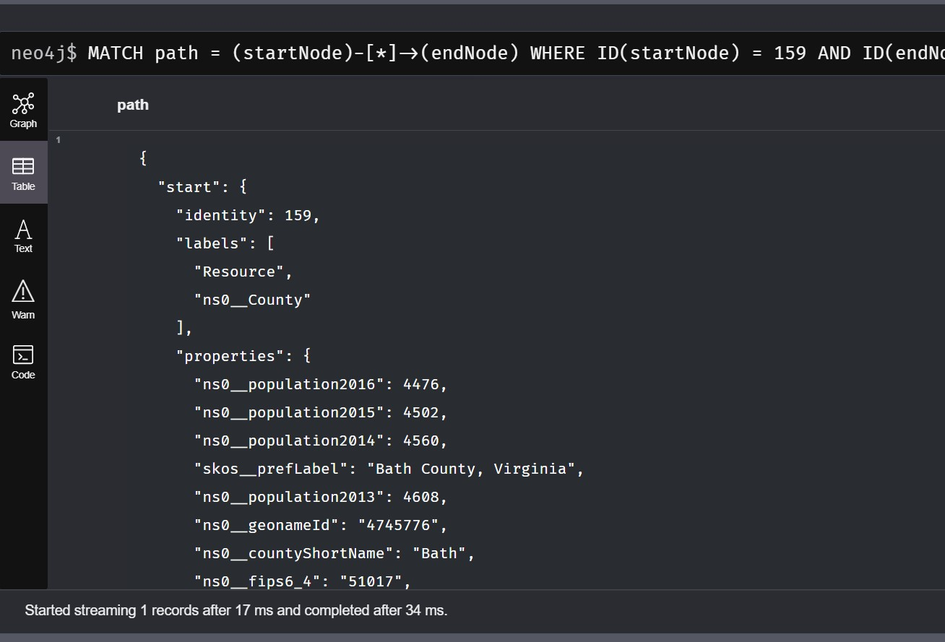
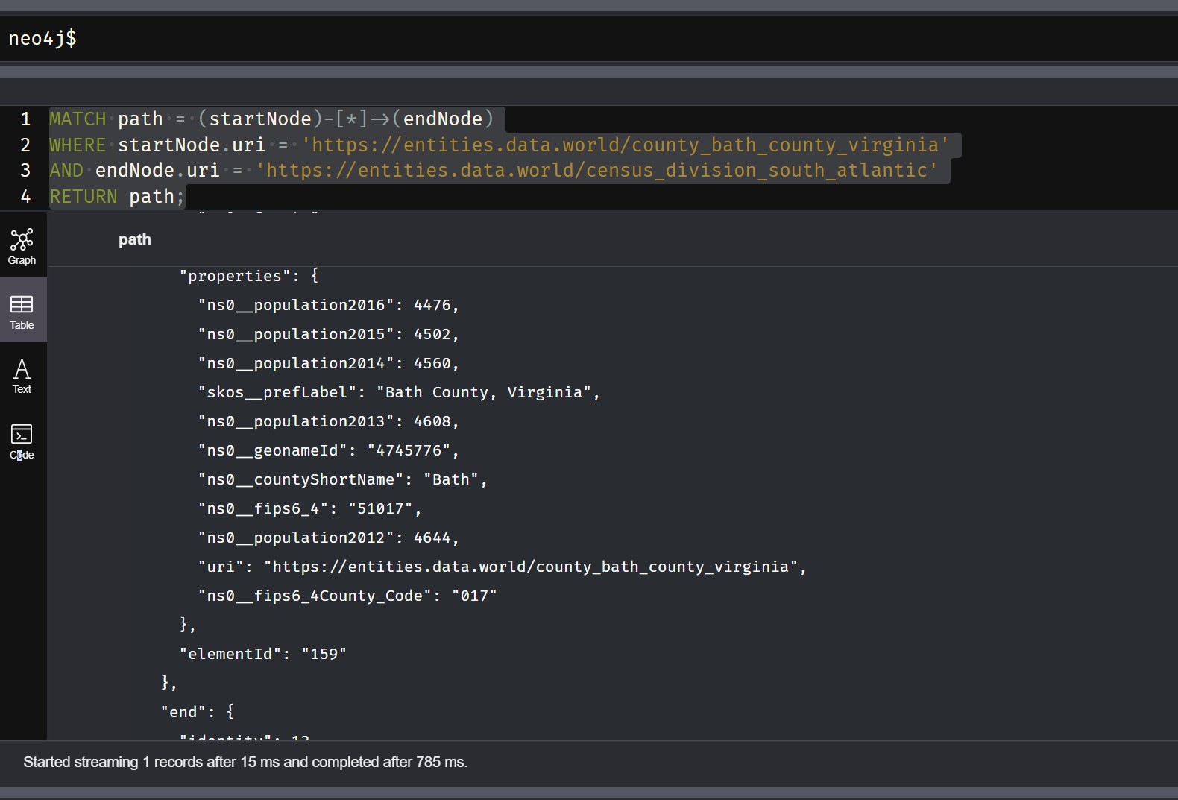
the query is executed faster when ID is given rather than the URI

Slide 32
CONCLUSION
Our thorough comparison of Ontotext GraphDB and Neo4j covering data loading, search queries, traversal algorithms, and data deletion has revealed subtle differences in the functionality and performance of these two well-known graph database systems.
Even though it is a Property graph database, Neo4j showed great performance in handling RDF data, especially in loading, searching, and deletion. Neo4j performed better than GraphDB at handling higher data size. The GraphDB excelled at traversals and searches, of RDF data outperforming the Neo4j.
Neo4j is relatively more stable as data grows, while GraphDB performs better than Neo4j on various query types and is faster when dealing with small databases.
Notes:
Neo4J is a database which is good for traversals and while GraphDB is good for managing semantic graph data. It is particularly well-suited for use cases that involve complex relationships, semantic modeling, and knowledge representation.

Slide 33
Thank you!
Group 10
Aaron Yang, Aravinda Vijayaram Kumar, Luhuan Wang

