Slide 1
Employee Data Analysis using Excel
STUDENT NAME: S.Aarthhi
REGISTER NO: 312209253
NAAN MUDHALVAN ID : asunm1353312209253
DEPARTMENT: B.com general
COLLEGE : Anna Adarsh College for Women

Slide 2
PROJECT TITLE
Employee Data cvs

Slide 3


AGENDA
Problem Statement
Project Overview
End Users
Our Solution and Proposition
Dataset Description
Modelling Approach
Results and Discussion
Conclusion
3/21/2024 Annual Review

Slide 4

PROBLEM STATEMENT
To Classified the employment data of the excel by using the pivot table and chart to analyze various employee performance and their ratings

Slide 5

PROJECT OVERVIEW
.
Using the employee details of the organization we can classifies the various information Using pivot table and making an analysis out of it and representing it using chart. It make them highlight to the information using colors

Slide 6

WHO ARE THE END USERS?
The end users are the common people and organizations who uses this technique in excel to classified and compare various things material and their cost.
In this project we use the pivot table to identify the employee out of their performance and classified them using the ratings it helps the superior to give them the promotion who doing best out of it and training for the employee who wants training

Slide 7

OUR SOLUTION AND ITS VALUE PROPOSITION
The pivotal table is used to
Classifies the data and chart is used to analyze the data In excel we want go to insert option and pivot option and we can choose the employee details and we can set them in rows and columns and in chart option we can insert chat and easily we can make analyze out of it

Slide 8
Dataset Description
In data description I have taken the data in employee data excel and comparing the performance of each employee
Employee ID
Employee first name
Employee last name
Department
Performance Score
Current employee rating

Slide 9
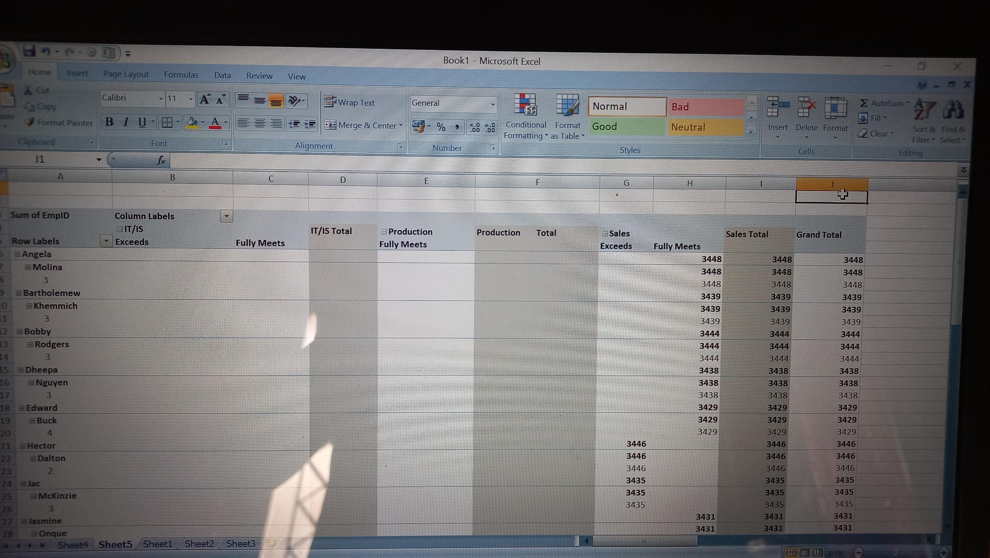

THE "WOW" IN OUR SOLUTION
Pivot table using excel
3/21/2024 Annual Review
9

Slide 10
MODELLING
My project is about the the classification and representing the employee performance using pivot table and chart
The employee details are taken from the website kaggle and download the excel from it
Then insert the pivot table in insert menu the we can decide the rows and columns of that employee details and we can insert the table in next sheet
Using the pivot table we can insert the chart
And we can make analyze out of it
10

Slide 11
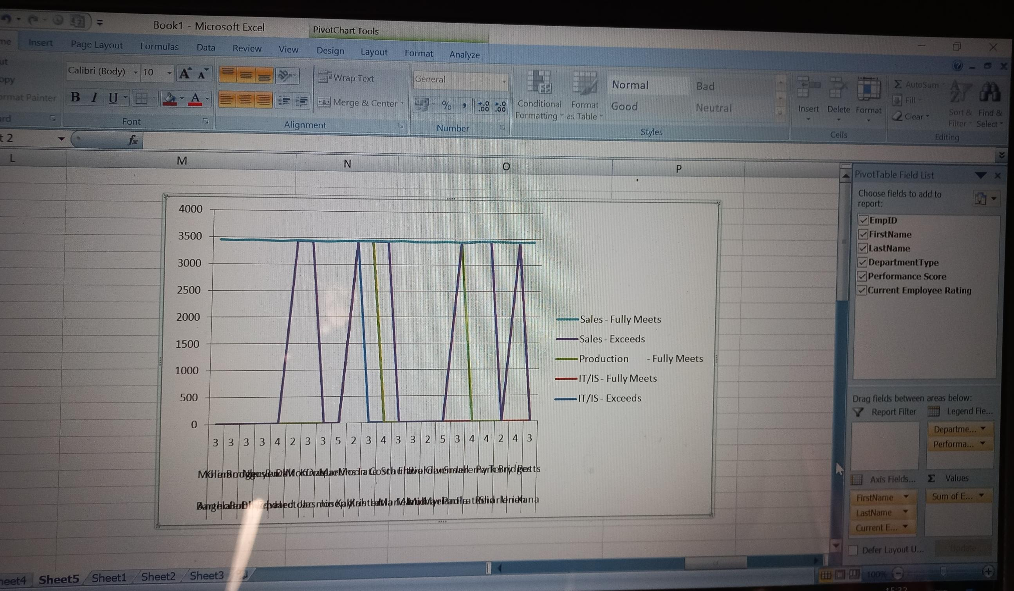
RESULTS
11

Slide 12
conclusion
We can conclude that using Excel we can make pivot table and chart to analyze the data of employees We can make compare out of it
The employees can be difference in their performance and make the organizations to easily classifies it

