Slide 1
ObfUX: The Cursed Data Format
Winter Hackathon 2025

Slide 2
Hackathon Brief
Take a normal input.json and make it *unrecognisable*.
Design a catastrophic format with both encoder and decoder.
Aim for humour and intentional confusion.
No documentation (but we made some anyway for posterity!).

Slide 3
ObfUX Overview
Outer wrapper: the object is book‑ended with the 💫 emoji.
Pairs separated by 🧟 and fields by 🐉.
Keys encoded via bit reversal & base‑36.
Type tags: S, N, B, L, O, U for strings, numbers, booleans, lists, objects and null.

Slide 4
Value Encoding
Strings: shift character codes, convert to base‑32 and reverse order.
Numbers: convert to string, hex‑encode shifted codes, reverse order.
Booleans: 👍 for True, 👎 for False.
Lists: each element carries its own type tag and encoding, joined by |.
Objects: recursively encoded mini‑ObfUX strings (no outer 💫).
Null: represented by the sleep emoji 💤.

Slide 5
Encoding Example
Input JSON:
  {"name": "Tyrion Lannister", "age": 24, "tldr": "Drinks and knows things"}
Encoded ObfUX:
  💫3a.3q.52.4m🐉S🐉41-3j-41-3v-3k-3o-3n-39-2j-16-3j-3j-3c-3k-3q-2k
  🧟3q.6e.4m🐉N🐉33&32
  🧟1a.1i.12.26🐉S🐉49-3s-42-3s-3q-45-1g-42-45-3s-3q-3m-1a-3d-3m-38-16-3o-3f-3h-3b-3j-24💫

Slide 6
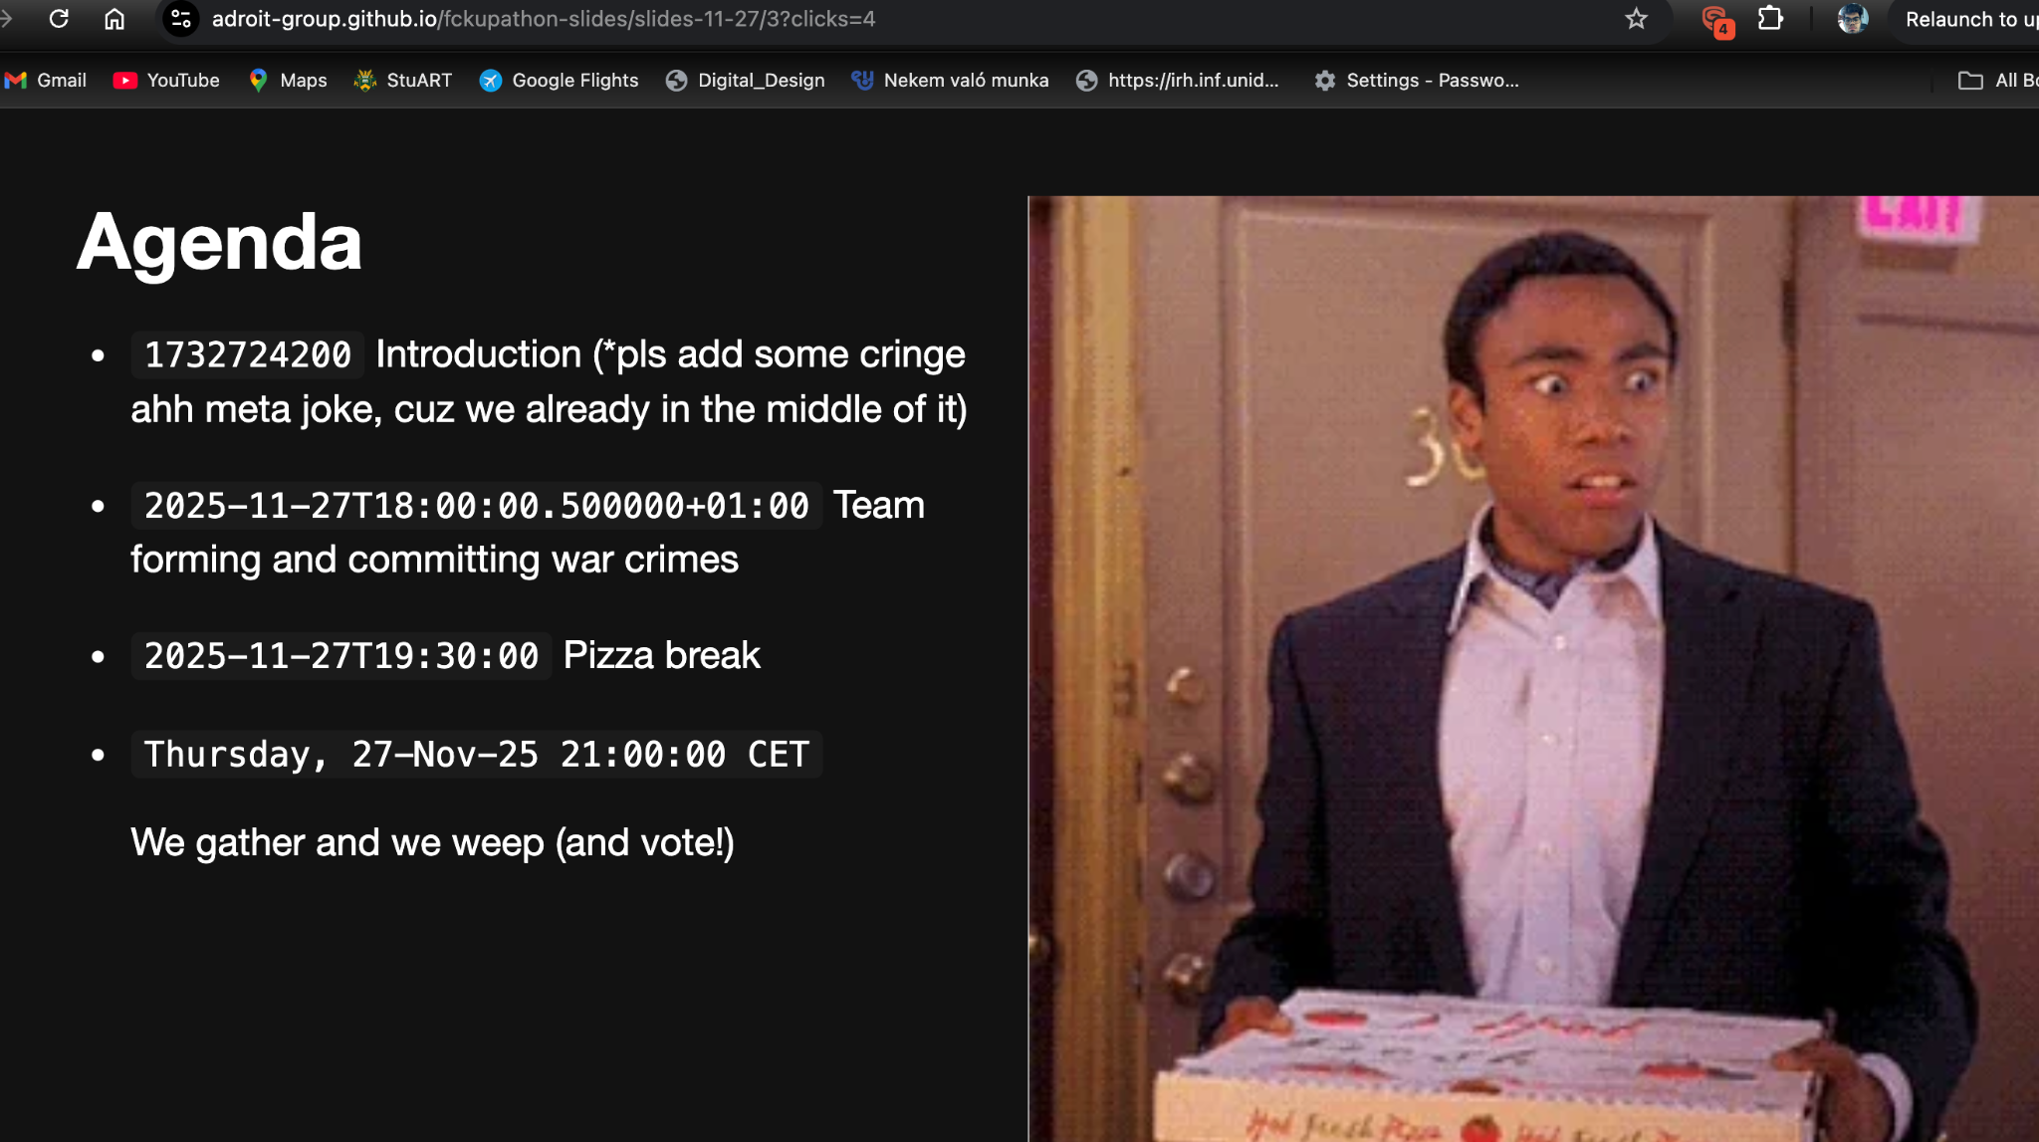
When your teammates see ObfUX

