Slide 1


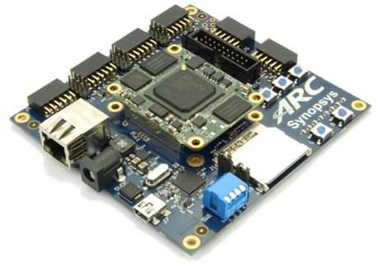
2019 Synopsys ARC AIoT Design Contest

Slide 2
Project Name – Online Driver State Monitoring
Smart & Safe Vehicle
Arun Singhal, Rishab Ravi and Aditya Nad
13th June, 2019

Slide 3
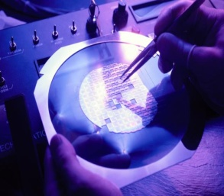
Agenda
Project Abstract
Project Challenge and Creativity
Design Description
System Analysis and Testability
Block Diagram
Circuit Diagram with connections to IOT kit
MQ3 sensor (signal conditioning, placement & range, working)
Calibration and Measurement (MQ3 sensor)
Face Detection Algorithm
Summary

Slide 4
Project Abstract
“Every year in the U.S. alone, drunk driving claims approximately 10,000 lives and costs approximately $194 billion”. And it’s estimated to be high in India. The city traffic police would monitor for drunken driving by inspection. But they can not solve the problem specially in countries like India where enforcement isn’t very strong. Thus a system like this would eradicate the problem right from the roots.
This project presents a system to develop a driver alcohol monitoring system, by measuring the various parameters like driver’s breath and IRIS condition (colour). The system is further extended to control specific ECUs of the vehicle based on condition of the driver.
The complete process is repeated after every defined time, to have continuous monitoring of driver for safe driving. In case the limit exceeds a predefined value the alarm is initiated and also the vehicle would come to a halt gradually. Upon violation of rules, a report shall be sent to concerned authorities via SMS/WhatsApp etc.

Slide 5
Project Challenge and Creativity
Creativity
Online monitoring
Multi sensor multi parameter measurement
Challenges
Positioning of sensors
Placement of camera
Control of ECU

Slide 6
Design Description
Requirements:
a) Hardware:
1) DesignWare ARC IoT Development Kit
2) MQ3 alcohol sensor
3) Camera
4) Basic circuit design components (resistors, capacitors)
5) Alarms
6) Battery pack
7) 16x2 LCD
8) DC Motors
9) Chassis
10) Wheels
b) Software:
1) embARC Open Source Platform
2) MetaWare Development Toolkit & GNU Toolchain

Slide 7
Working in-brief:-
The MQ-3 alcohol sensor(breath analyzer sensor) checks (in accordance with the standards of the country) if the driver has consumed alcohol or not and depending on the output of the sensor, brings the vehicle to a gradual halt (taking in consideration the speed of the vehicle so that it’s not an inconvenience to other drivers). The system also informs the police of the offense via a messaging service.
This project shall make use of the engine immobilizer in the car via the ECU in order to not allow the car to start if it is detected that the driver is drunk.
A camera with an image processing algorithm is used to detect for driver change. It also checks the colour of the iris to conclude for driving under influence.

Slide 8
System Analysis and Testability
For pilot study a model is designed with breath analyzer and image processing, by making use of a home assembled toy car with DC motors for motion.
A cap full of alcohol will be used to provide input to the gas sensor.
The camera uses facial recognition and computer vision to detect change in the colour of the subject’s iris and change in the subject as well.
A green LED will glow on detecting the driver to be normal. An orange LED (indicators in a real car) will glow on detecting the driver to be under the influence.
A 16x2 LCD is used to display whether alcohol is detected in the bloodstream or not.
An alarm is used to give an audio warning in case of a positive test case.

Slide 9
BLOCK DIAGRAM
START
Driver’s BAC is determined when he/she blows into the sensor
Wait for 5 mins
Is BAC<Legal Limit
INNOCENT
YES
Turn on parking signals
Start the alcohol over limit indicator & trigger the alarm
Gradually decrease car speed to 0km/h
Restrict engine ignition
NO
DRUNK
YES
Is Vehicle moving
NO
No alarm is triggered
Engine can be ignited
No speed limit is set
Location, car details, driver details and time are sent to the registered contacts
Turn off the engine
Restrict the engine ignition
Limit car speed to 0km/h
Start the over-limit indicator
Turn on the alarm
END

Slide 10
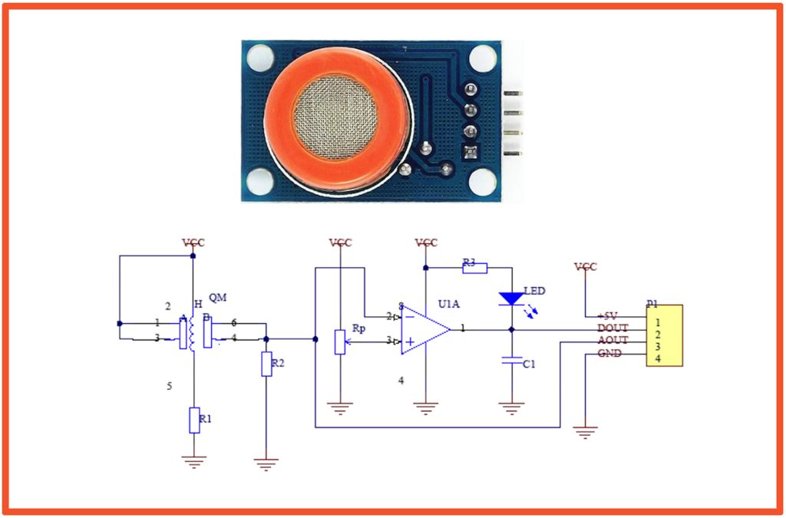
Circuit Diagram
MQ-3 Sensor
courtesy: https://www.instructables.com/id/HackerBox-0035-ElectroChemistry/

Slide 11
MQ3 sensor
The MQ-3 alcohol gas sensor would be placed on the steering wheel. The distance between the sensor and the driver would be 30-50cm. The MQ-3 sensor can sense presence of alcohol gases at concentrations from 0.05mg/L to 10mg/L. It’s conductivity increases as the concentration of alcohol gases increases. It has high sensitivity to alcohol and has a good resistance to disturbances due to smoke, vapor and gasoline. This module provides both digital and analog outputs. It has a high sensitivity and fast response time. Sensor provides an analog resistive output based on alcohol concentration.
Why MQ3?
5V operation
Simple to use
LEDs for output and power
Output sensitivity is adjustable
Analog output 0V to 5V – can be calibrated to indicate level of BAC of driver
Digital output 0V or 5V – 0V means no alcohol detected while 5V means alcohol detected(in whatever amount)
Low cost
Fast response
Stable and long life
Good sensitivity to alcohol gas
Both digital and analog outputs
On-board LED indicator

Slide 12
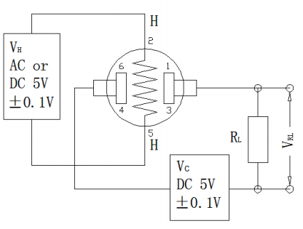
The above fig is the basic test circuit of MQ-3.The sensor requires two voltage inputs: heater voltage (VH) and circuit voltage (VC). VH is used to supply standard working temperature to the sensor and it can adopt DC or AC power, while VRL is the voltage of load resistance RL which is in series with sensor. Vc supplies the detect voltage to load resistance RL and it should adopt DC power.

Slide 13
Calibrating the MQ3 Sensor
The MQ3 sensor will be calibrated by correlating the sensor readings with “computed” BAC based on body weight, amount of alcohol consumed, and elapsed time. A number of online charts and calculators that tell you your approximate BAC based on these inputs are available. The source (publication from VT) of the values cited in the Wikipedia BAC page seemed most reliable to us and thus we have chosen to first use that for our project before looking for other options.

Slide 14
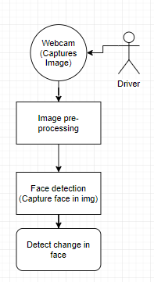
Face Detection
The webcam mounted on the steering wheel captures the image of the driver. This image is then converted to grayscale and scaled by a suitable factor. Face detection in this image is then implemented and its vector value is stored. To check for driver change, the subsequent vector value is compared with the initially stored value.
To help determine the state of the driver (drunk/not), the captured image is also processed so as to make ratio estimates of pupil size and overall face size. This is compared with train data to predict the state of the driver.s

Slide 15
Summary
To sum it up, the proposed project will aim at addressing an increasingly evil menace to society – drunk driving. When a person is drunk, it is not just his/her life at stake but also of the hundreds of innocent pedestrians and people on the road. Since this project will combine data from multiple sources, inferences drawn would be highly reliable.
Drunk driving is a menace to the society and we are living in a world where we can leverage technology to ameliorate the menace. Combining sensing mechanisms, electronics and modern-day technologies like ML and AI, a solid system can be built to detect drunk-driving.

