Slide 1
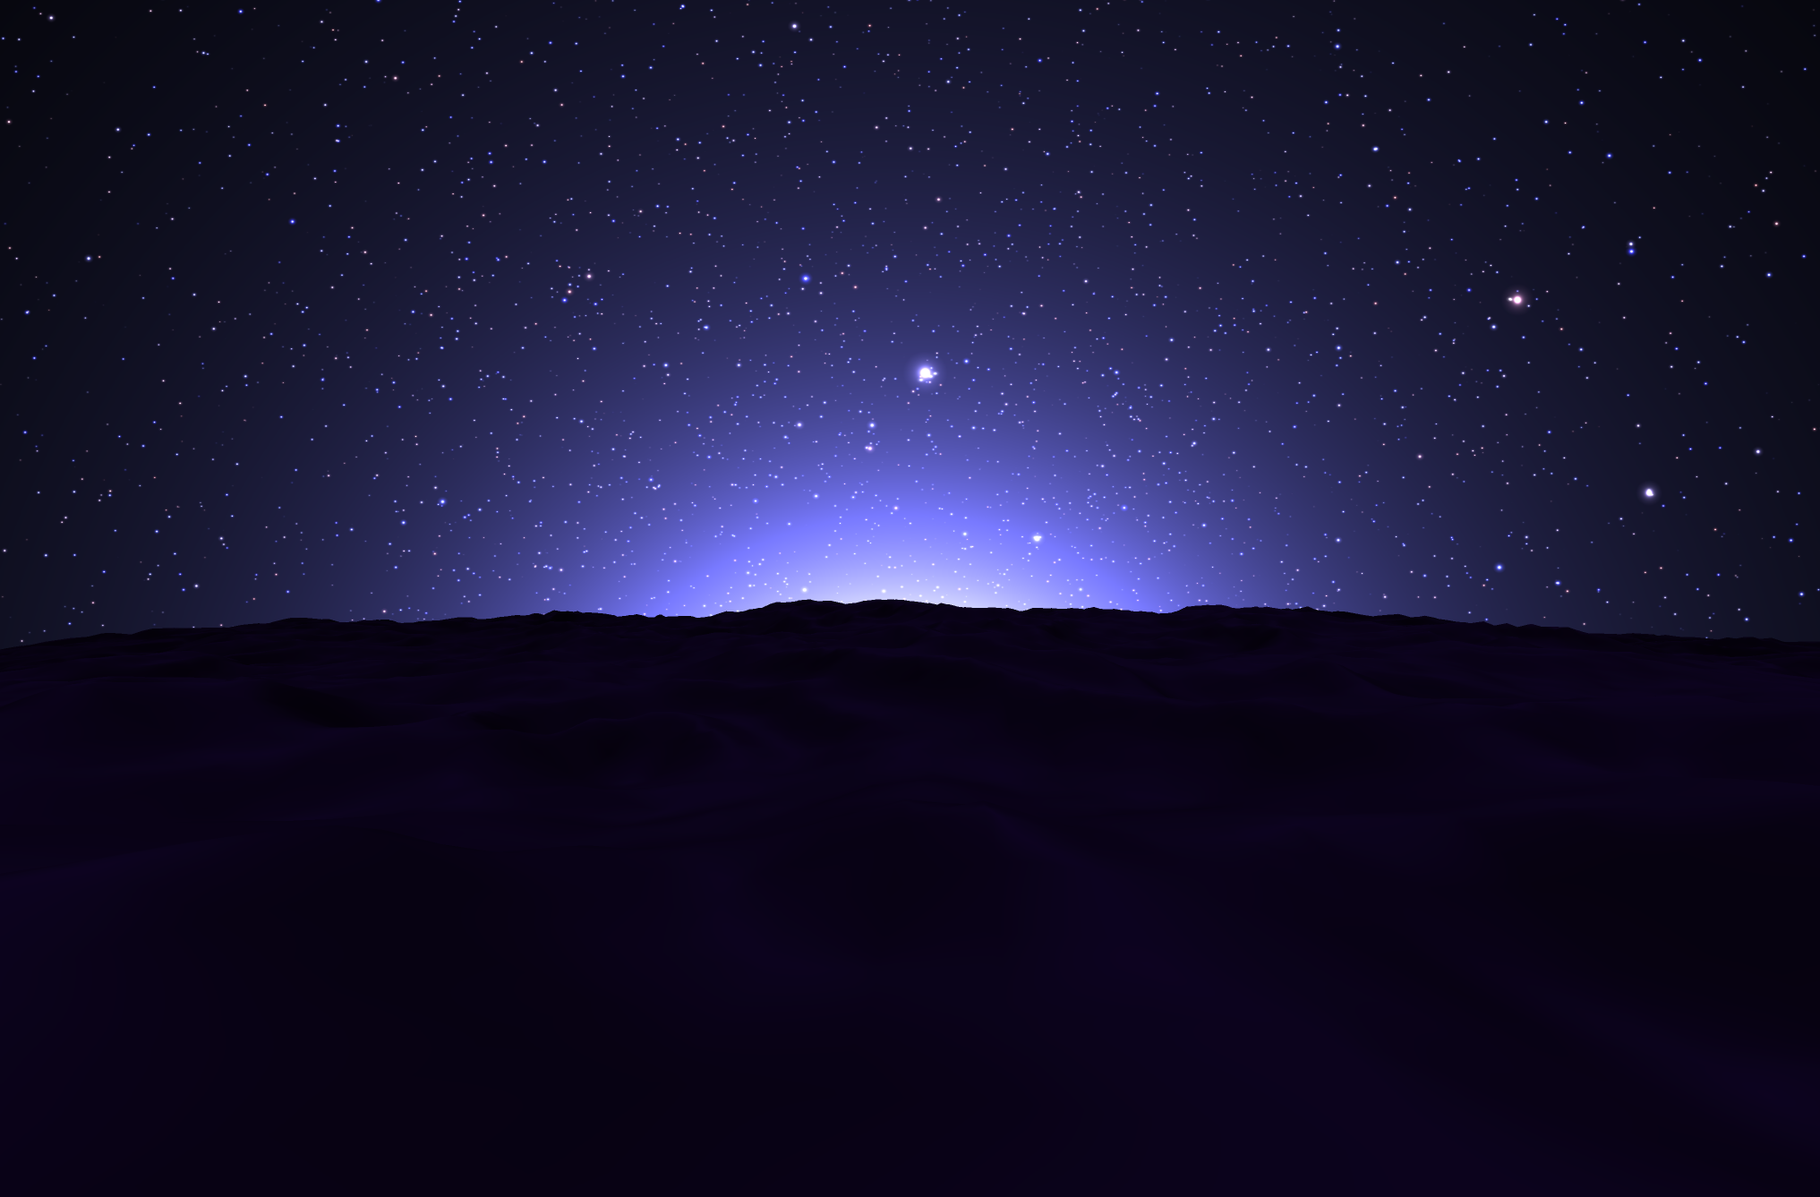
Kosmos – A universe in your browser.
“Reality leaves a lot to the imagination.” – John Lennon

