Slide 1
Deep Learning Basics
3: Backpropagation
Francis Steen and Xinyu You
Red Hen Lab
August 2019

Slide 2
Understanding neural networks
At its core, every neural network represents a single mathematical function
Because these functions are often monstrously complex, we use graphs to represent them rather than the standard formula notation
The graphs help us organize our thinking about the functions we set out to build and it turns out some graphs work much better than others for particular tasks

Slide 3
Graph architecture
A lot of research and development in the neural network space is about inventing new architectures for these graphs, rather than inventing brand new algorithms
The graphs allow us to think clearly and imagine new network topologies
A graph is a user interface to a mathematical function
So what is a computational graph and how are they used by neural networks?

Slide 4
A. Computational Graphs

Slide 5
Definitions
Deep Neural Networks (DNNs) are a special kind of graph, a “computational graph”
A computational graph is a way to represent a math function in the language of graph theory

Slide 6
Graph Theory
Nodes are connected by edges, and everything in the graph is either a node or an edge
In a computational graph, nodes are either input values or functions for combining values
Edges receive their weights as the data flows through the graph
Outbound edges from an input node are weighted with that input value
Outbound nodes from a function node are weighted by combining the weights of the inbound edges using that function

Slide 7

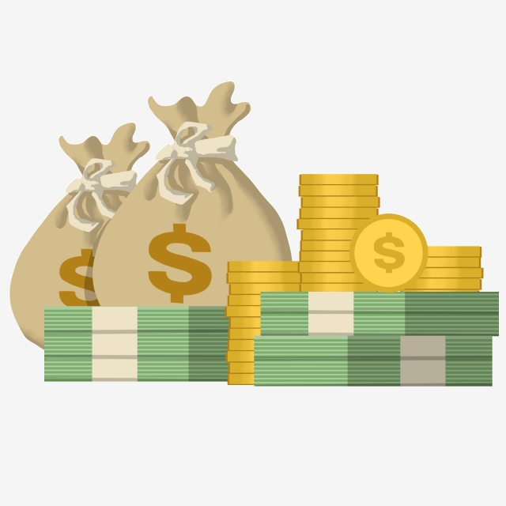
Use a graph to compute
Question: You are going to buy 3 apples. An apple’s price is 10, plus 5% consumption tax. How much should you pay?
10
30
31.5
X
x
3
1.05
Number of apples
Consumption tax
Notes:
This is a simple compute graph.
Reference:
deep learning from Scratch
CS231s

Slide 8
Operational Nodes
10
30
31.5
X
x
3
1.05
Number of apple
Consumption tax
Multiplication
Notes:
Reference:
deep learning form Scratch
CS231s

Slide 9
Multiple inputs
Question: You are going to buy 2 apples and 1 watermelon. An apple’s price is 10 plus 5% consumption tax. A watermelon’s price is 30 plus 5% consumption tax. How much should you pay?
10
x
Add operation
2
+
x
Number of apples
30
x
1.05
1
Number of watermelons
Consumption tax
Notes:
We compute the graph from left to right in the direction of the arrow.
Reference:
deep learning form Scratch
CS231s

Slide 10
Compute sums and products
We compute the graph from left to right in the direction of the arrow.
10
x
20
2
+
50
x
52.5
Number of apples
30
30
x
1.05
1
Number of watermelons
Consumption tax
Notes:
We compute the graph from left to right in the direction of the arrow.
Reference:
deep learning form Scratch
CS231s

Slide 11
Local Compute
We don’t have to care about how the result calculates.
We just use it as a input to add with watermelon’s result.
A lot of other things
Local
790
+
820
x
861
30
30
x
1.05
1
Number of watermelon
Consumption tax
Notes:
Reference:
deep learning form Scratch
CS231s

Slide 12
f(x, y, z) = (x + y) * z
f(x, y, z) = h(g(x, y) , z)
g(i, j) = i + j
h(p, q) = p*q
f(1, 2, 3) = h(g(1, 2), 3)
g(1, 2) = 1 + 2 = 3
f(1, 2, 3) = h(3, 3)
h(3, 3) = 3*3 = 9
f(1, 2, 3) = 9
Notes:
Even simple function expressions can be more elegantly represented in a graph

Slide 13
Imagine scaling up
Even relatively simple deep neural networks have hundreds of thousands of nodes and edges
It’s quite common for a neural network to have more than one million edges
The function expressions for such networks are unwieldy
Computational graphs allow us to think at a useful level of abstraction

Slide 14
Composing neural networks
When we define the architecture of a neural network, we’re laying out the series of sub-functions and specifying how they should be composed
When we train the neural network we’re experimenting with the parameters of these sub-functions
The tunable parameters are weights and biases

Slide 15
Deep Neural Networks
DNNs are made up of a series of “fully connected” layers of nodes
“Fully connected” means that the output from each node in the first layer becomes one of the inputs for every node in the second layer

Slide 16
Activation Function
The function performed by each node in the neural net is called a transfer or activation function
First, all of the input values are combined in some way, usually this is a weighted sum
Second, a nonlinear function is applied to that sum; this second function might change from layer to layer within a single neural network
Popular non-linear functions include tanh, log, max(0, x) (called Rectified Linear Unit, or ReLU), and the sigmoid function

Slide 17
Notes:
Deep Neural Networks As Computational Graphs https://medium.com/tebs-lab/deep-neural-networks-as-computational-graphs-867fcaa56c9

Slide 18
Compute Graph Advantage
All the intermediate results can be saved using the compute graph.
We can calculate derivatives efficiently by propagating backwards. (We will cover this later)
10
30
31.5
X
x
2.1
1.05
1
2
1.05
Number of apple
Consumption tax
Notes:
This is a simple compute graph.
Reference:
deep learning form Scratch
CS231s

Slide 19
A simple neural network
Say we define a neural net to predict binary classification — in or not in a relationship — with 2 hidden layers each with 512 nodes and an input vector with 20 features
It will have 20*512 + 512*512 + 512*2 = 273,408 weights that we can fine tune plus 1024 biases — one for each node in the hidden layers
Even slightly more complex networks will have several million tunable weights and biases

Slide 20
Casting a wide net
This extraordinary flexibility is what allows neural nets to find and model complex relationships
It’s also why they require lots of data to train
Using gradient descent, we can change the millions of weights until the output becomes more correct
Because we’re doing calculations involving millions of variables, it takes a lot of time and a lot of data to find the right combination of weights and biases

Slide 21
Tuning massive neural nets
The result of the fine tuning is that rich complexities between different components of the input can be plucked out of the noise
Because the machine learning process is automated, we don’t know how the network picks out the patterns
Instead of building a hierarchically ordered knowledge structure, the neural network creates a one-off tangle customized for only that particular training dataset

Slide 22
B. The Chain Rule

Slide 23
Gradient descent
We’ve already discussed the basic structure of forward propagation, the calculation of the loss function, and the process of training the network by changing the weights and biases in the process of gradient descent
At the heart of the gradient descent process is the backpropagation algorithm
This algorithm has a very close relationship with the derivative chain rule in mathematics
Current popular network structures such as LeNet, AlexNet, GoogLeNet, VGG, and ResNet in computer vision all make use of this rule

Slide 24
Differentiation
Differentiation is the action of computing a derivative
The derivative of a function y = f(x) of a variable x is a measure of the rate at which the value y of the function changes with respect to the change of the variable x
It is called the derivative of f with respect to x

Slide 25
Composite functions
In calculus, the chain rule is a formula for computing the derivative of the composition of two or more functions
Suppose we have two functions f and g, as in z=f(y) and y=g(x).
Composing them means we first compute y=g(x), and then use y to compute z=f(y)
These steps can be combined — a composite function is a function which maps z to f(g(x))

Slide 26
The Chain Rule
The derivative of the composite function is the inner function g within the derivative of the outer function f’, multiplied by the derivative of the inner function g’

Slide 27
The Chain Rule
$$\frac{∂f}{∂x}=\frac{∂f}{∂g}\frac{∂g}{∂x}$$
$$\frac{∂f}{∂x}=\frac{∂f}{∂g}\frac{∂g}{∂x}$$
Notes:
https://www.khanacademy.org/math/ap-calculus-ab/ab-differentiation-2-new/ab-3-1a/v/chain-rule-introduction
https://www.youtube.com/watch?v=CRXmjW5RSbU — explaining the chain rule

Slide 28
Example
$$f=g^{2}$$
$$\frac{∂f}{∂g}=2g$$
$$\frac{∂g}{∂x}=1$$
$$g=x+y$$
$$\frac{∂f}{∂x}=\frac{∂f}{∂g}\frac{∂g}{∂x}=2g*1$$
$$\frac{∂f}{∂x}=2(x+y)$$
Notes:
Compute the derivatives of each function

Slide 29
Compute graph & Chain Rule
Use the compute graph to represent the function calculations
$$x$$
$$g$$
$$f$$
+
**2
$$y$$
$$f=g^{2}$$
$$g=x+y$$

Slide 30
Compute graph &Chain Rule
Use the chain rule for back propagation
$$x$$
$$\frac{∂f}{∂x}=\frac{∂f}{∂f}\frac{∂f}{∂g}\frac{∂g}{∂x}$$
$$f$$
+
$$g$$
**2
$$\frac{∂f}{∂g}=\frac{∂f}{∂f}\frac{∂f}{∂g}$$
$$\frac{∂f}{∂f}$$
$$y$$
$$\frac{∂f}{∂y}=\frac{∂f}{∂f}\frac{∂f}{∂g}\frac{∂g}{∂y}$$

Slide 31
Compute graph &Chain Rule
Use the chain rule for backpropagation
$$x$$
$$\frac{∂f}{∂f}\frac{∂f}{∂g}\frac{∂g}{∂x}=2(x+y)*1$$
$$g$$
$$f$$
+
**2
$$y$$
$$\frac{∂f}{∂f}\frac{∂f}{∂g}=2(x+y)$$
$$\frac{∂f}{∂f}=1$$
$$\frac{∂f}{∂f}\frac{∂f}{∂g}\frac{∂g}{∂y}=2(x+y)*1$$

Slide 32
Compute graph &Chain Rule
Let x = 1, y = 2, we can calculate each gradient.
$$x$$
$$6*1=6$$
$$f$$
+
$$g$$
**2
$$y$$
$$2(x+y)=6$$
$$1$$
$$6*1=6$$

Slide 33
C. Backpropagation

Slide 34
Backpropagation of addition nodes
Partial derivatives of x and y
$$\frac{∂g}{∂x}=1,$$
$$\frac{∂g}{∂y}=1$$
$$g=2(x+y)$$
$$x$$
$$\frac{∂f}{∂g}*1$$
+
$$g$$
+
$$\frac{∂f}{∂g}$$
$$y$$
$$\frac{∂f}{∂g}*1$$
forward propagation
back propagation

Slide 35
Back propagation of addition nodes
The back propagation of the addition node outputs the value of the upstream directly to the downstream
$$x$$
$$\frac{∂f}{∂g}*1$$
+
$$g$$
+
$$\frac{∂f}{∂g}$$
$$y$$
$$\frac{∂f}{∂g}*1$$
forward propagation
back propagation

Slide 36
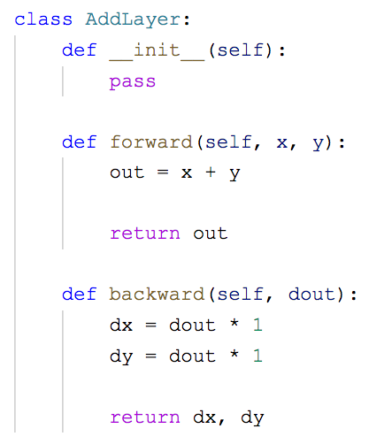
Code

Slide 37
Back propagation of multiplication nodes
Partial derivatives of x and y
$$\frac{∂g}{∂x}=y,$$
$$\frac{∂g}{∂y}=x$$
$$g=xy$$
$$x$$
$$\frac{∂f}{∂g}*y$$
x
$$g$$
x
$$\frac{∂f}{∂g}$$
$$y$$
$$\frac{∂f}{∂g}*x$$
forward propagation
back propagation

Slide 38
Back propagation of multiplication nodes
The back propagation of the multiplication is multiplied by the flip value of the input signal
$$x$$
$$\frac{∂f}{∂g}*y$$
x
$$g$$
x
$$\frac{∂f}{∂g}$$
$$y$$
$$\frac{∂f}{∂g}*x$$
forward propagation
back propagation

Slide 39
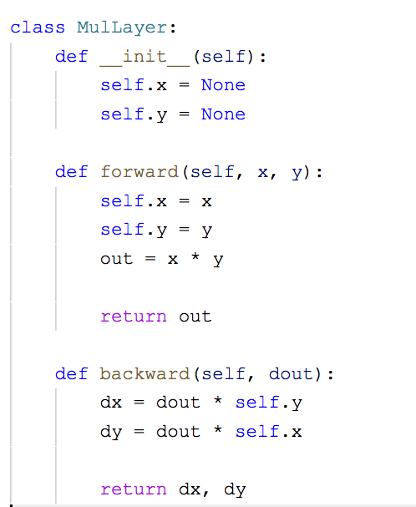
Code

Slide 40
Back propagation of Sigmoid function
Partial derivatives of x
$$σ(x)=\frac{1}{1+e^{-x}}$$
$$\frac{∂σ(x)}{∂x}=σ(x)(1-σ(x))$$
$$x$$
$$g$$
$$σ$$
$$\frac{∂f}{∂g}σ(x)(1-σ(x))$$
$$\frac{∂f}{∂g}$$

Slide 41
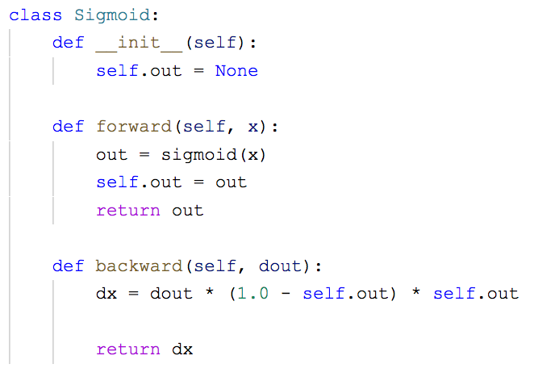
Applying the sigmoid mask

Slide 42
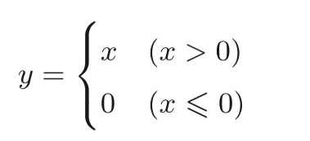
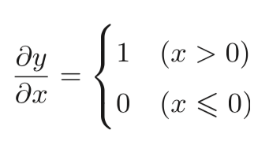
Back propagation of ReLU
Partial derivatives of x
$$x>0$$
$$x⩽0$$
$$x$$
ReLU
$$g$$
$$x$$
ReLU
$$g$$
$$\frac{∂f}{∂g}$$
$$\frac{∂f}{∂g}$$
$$\frac{∂f}{∂g}$$
$$0$$

Slide 43
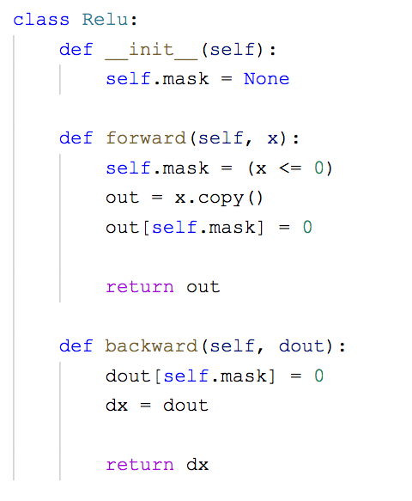
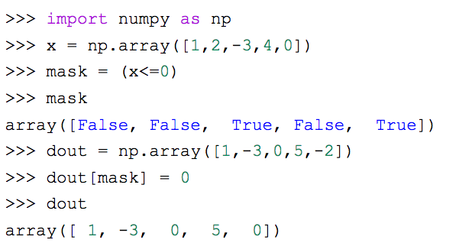
Applying the reLU mask
How the mask works

Slide 44
D. Application

Slide 45
Exercise 1
Using compute graph to calculate gradient. (5-10 minutes)
10
x
20
?
2
+
50
x
52.5
Number of apple
?
30
?
30
1
x
?
?
1.05
1
?
Number of watermelon
?
Consumption tax
Notes:
Take 5 Minutes to do exercise

Slide 46
Exercise 1
Using compute graph to calculate gradient. (5-10minutes)
10
x
20
2.1
2
1.05
50
52.5
+
x
Number of apple
10.5
30
1.05
30
1
x
1.05
1.05
1.05
1
50
Number of watermelon
31.5
Consumption tax
Notes:
Take 5 Minutes to do exercise

Slide 47
Exercise 2
2
x
bias
2
$$output=σ(b+w_{1}x_{1}+w_{2}x_{2})$$
1
1
3
5
3
0.95
x
+
w1
$$σ$$
?
1
2
-4
x1
-4
x
w2
x2
1

Slide 48
2
x
bias
$$output=σ(b+w_{1}x_{1}+w_{2}x_{2})$$
2
1
1
3
5
3
0.95
x
+
w1
$$σ$$
?
1
2
-4
x1
-4
x
w2
x2
1

Slide 49
2
x
bias
$$output=σ(b+w_{1}x_{1}+w_{2}x_{2})$$
2
1
1
3
5
3
0.95
x
+
w1
$$σ$$
?
1
1*0.95*(1-0.95)= 0.0475
2
-4
x1
-4
x
w2
$$x$$
$$g$$
$$σ$$
1
$$\frac{∂f}{∂g}σ(x)(1-σ(x))$$
$$\frac{∂f}{∂g}$$
x2

Slide 50
2
x
bias
$$output=σ(b+w_{1}x_{1}+w_{2}x_{2})$$
2
1
1
3
5
3
0.95
x
+
w1
$$σ$$
0.0475
1
2
-4
x1
-4
x
w2
x2
1

Slide 51
2
x
bias
$$output=σ(b+w_{1}x_{1}+w_{2}x_{2})$$
2
1
1
?
3
5
3
0.95
x
+
w1
$$σ$$
?
0.0475
1
2
-4
x1
?
-4
x
w2
x2
1

Slide 52
2
x
bias
$$output=σ(b+w_{1}x_{1}+w_{2}x_{2})$$
2
1
1
?
3
5
3
0.95
x
+
w1
$$σ$$
?
0.0475
1
2
-4
x1
?
-4
x
w2
$$\frac{∂f}{∂g}*1$$
+
$$\frac{∂f}{∂g}$$
x2
1
$$\frac{∂f}{∂g}*1$$

Slide 53
2
x
bias
$$output=σ(b+w_{1}x_{1}+w_{2}x_{2})$$
2
1
0.0475
1
3
5
3
0.95
x
+
w1
$$σ$$
0.0475
0.0475
1
2
-4
x1
0.0475
-4
x
w2
$$\frac{∂f}{∂g}*1$$
+
$$\frac{∂f}{∂g}$$
x2
1
$$\frac{∂f}{∂g}*1$$

Slide 54
2
2
x
bias
$$output=σ(b+w_{1}x_{1}+w_{2}x_{2})$$
?
2
1
0.0475
1
3
5
3
0.95
x
+
w1
$$σ$$
0.0475
0.0475
1
2
-4
x1
0.0475
-4
x
w2
$$\frac{∂f}{∂g}*y$$
x
$$\frac{∂f}{∂g}$$
x2
1
$$\frac{∂f}{∂g}*x$$

Slide 55
2
2
x
bias
$$output=σ(b+w_{1}x_{1}+w_{2}x_{2})$$
0.475*1=0.475
2
1
0.0475
1
3
5
3
0.95
x
+
w1
$$σ$$
0.0475
0.0475
1
2
-4
x1
0.0475
-4
x
w2
$$\frac{∂f}{∂g}*y$$
x
$$\frac{∂f}{∂g}$$
x2
1
$$\frac{∂f}{∂g}*x$$

Slide 56
2
2
x
bias
$$output=σ(b+w_{1}x_{1}+w_{2}x_{2})$$
0.475
2
1
0.0475
1
3
5
3
0.95
x
+
w1
$$σ$$
0.0475
0.0475
?
1
2
-4
x1
?
0.0475
-4
x
w2
$$\frac{∂f}{∂g}*y$$
x
$$\frac{∂f}{∂g}$$
x2
1
$$\frac{∂f}{∂g}*x$$

Slide 57
2
2
x
bias
$$output=σ(b+w_{1}x_{1}+w_{2}x_{2})$$
0.0475
2
1
0.0475
1
3
5
3
0.95
x
+
w1
$$σ$$
0.0475*2 = 0.095
0.0475
0.0475
1
2
-4
x1
0.0475*3 = 0.1425
0.0475
-4
x
w2
$$\frac{∂f}{∂g}*y$$
x
$$\frac{∂f}{∂g}$$
x2
1
$$\frac{∂f}{∂g}*x$$

Slide 58
2
2
x
bias
$$output=σ(b+w_{1}x_{1}+w_{2}x_{2})$$
0.0475
2
1
0.0475
1
3
5
3
0.95
x
+
w1
$$σ$$
0.095
0.0475
0.0475
1
2
-4
x1
0.1425
0.0475
-4
x
w2
$$\frac{∂f}{∂g}*y$$
x
$$\frac{∂f}{∂g}$$
x2
1
$$\frac{∂f}{∂g}*x$$

Slide 59
2
2
x
bias
$$output=σ(b+w_{1}x_{1}+w_{2}x_{2})$$
0.0475
2
1
0.0475
1
3
5
3
0.95
x
+
w1
$$σ$$
0.095
0.0475
0.0475
1
2
-4
x1
0.1425
0.0475
-4
x
w2
$$\frac{∂f}{∂g}*y$$
x
?
$$\frac{∂f}{∂g}$$
x2
1
?
$$\frac{∂f}{∂g}*x$$

Slide 60
2
2
x
bias
$$output=σ(b+w_{1}x_{1}+w_{2}x_{2})$$
0.0475
2
1
0.0475
1
3
5
3
0.95
x
+
w1
$$σ$$
0.095
0.0475
0.0475
1
2
-4
x1
0.1425
0.0475
-4
x
w2
$$\frac{∂f}{∂g}*y$$
0.0475*1
x
$$\frac{∂f}{∂g}$$
x2
1
$$\frac{∂f}{∂g}*x$$
0.0475*(-4)= -0.19

Slide 61
2
2
x
bias
$$output=σ(b+w_{1}x_{1}+w_{2}x_{2})$$
0.0475
2
1
0.0475
1
3
5
3
0.95
x
+
w1
$$σ$$
0.095
0.0475
0.0475
1
2
-4
x1
0.1425
0.0475
-4
x
w2
0.0475
x2
1
-0.19

Slide 62
2
2
x
bias
$$output=σ(b+w_{1}x_{1}+w_{2}x_{2})$$
0.0475
2
1
0.0475
1
3
5
3
0.95
x
+
w1
$$σ$$
0.095
0.0475
0.0475
1
2
-4
Learning rate
x1
0.1425
0.0475
-4
x
w2
$$w_{1}=w_{1}-η*0.095$$
0.0475
$$w_{2}=w_{2}-η*0.0475$$
x2
1
-0.19

Slide 63
Summary
Step 0. Initialize weights and biases
Step 1. Forward propagation
Step 2. Compute Loss
Step 3. Compute gradient using back propagation
Step 4. Update weights and biases
Repeat Step 1- Step 4 several times.

Slide 64
Thanks!

