Slide 1
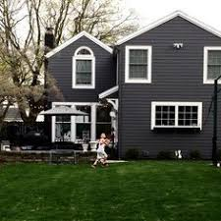
HOUSING PRICE PREDICTION MODEL
Under the supervision of:
Dr.Arti Jain
Presented by:
Saurabh Kumar Gupta
(9917103236)
Aastha Juneja
(9917103239)
Ashutosh Baghel
(9917103255)
Himankur Goyal
(9917103266)

Slide 2
PROBLEM STATEMENT
Computerized prediction model is important in predicting the real estate value which is of great significance for economic index of a country.
There is no standardized ways to measure the housing prices.
The evaluators determining the assessed value of the property are biased due to the extra interest they gain from buyers and sellers.
Less experienced customers don’t understand whether the property rates are overrated or underrated.

Slide 3
STATE OF THE ART AND LIMITATIONS
At present , for regression model , SVR with Gaussian kernel gives the outstanding output.
LIMITATION : Visualization for SVR is difficult due to its high-dimensionality.
Generally, Decision tree gives a very high accuracy in case of regression model.
LIMITATION : There is a risk of OVERFITTING of data in case of decision tree.
TO OVERCOME THE PROBLEM OF OVERFITTING, RANDOM FOREST REGRESSION MODEL IS USED.

Slide 4
OBJECTIVES AND WORK DISTRIBUTION
Our primary objective is to create a prediction model which is well advanced to accurately estimate the price of the house so that we can help out the investors.
The other most important objective is that, this prediction model will also help us all to maintain the balance in economy in the real-estate business as housing prices are an important reflection of the economy.
We have implemented our project on JUPYTER Notebook which is an open source web application.
We have used NUMPY library for Numerical simulation. For data visualization and plotting, we have used MATPLOT and SEABORN. For data manipulation and analysis we have used PANDAS. To implement machine learning algorithms, we have used the most useful and efficient python library known as SCIKIT-LEARN.
We have applied linear regression, decision tree regression and random forest regression.

Slide 5
PROPOSED DESIGN AND IMPLEMENTATION
Housing prices is influenced by various constraints in the economy and society , hence we have multiple predictor variable which will use multiple regression.
We have applied our features to various machine learning algorithm in order to predict the prices.
As continuous house prices, they will be predicted with various regression techniques including linear regression, decision tree and random forest.
We are firstly going to plot the residual plot which is the graph that shows the residuals on the vertical axis and the independent variable on the horizontal axis followed by the graph between the prices and the features affecting prices.
The price will be predicted according to the implementation of different algorithm with their accuracy and RMSE values for single and multiple features.
We have split our data into 80% of train data and rest 20% of test data.

Slide 6
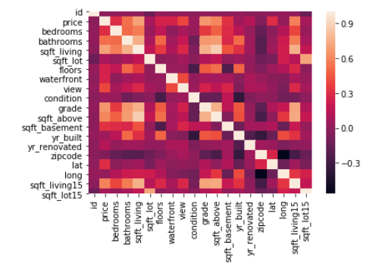
Proposed design and Implementation
This Heatmap is a graphical representation of dataset where the individual values contain in a matrix are represented as colours which help us to find out the important features from dataset.
We can see from the given Heatmap that the most important features are the size of the living area(sqft_living), the grade and the year of construction, with older houses being worth less than newer builds.

Slide 7
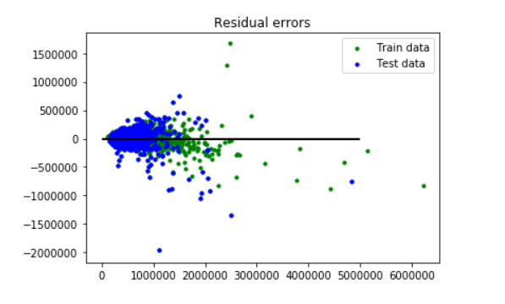
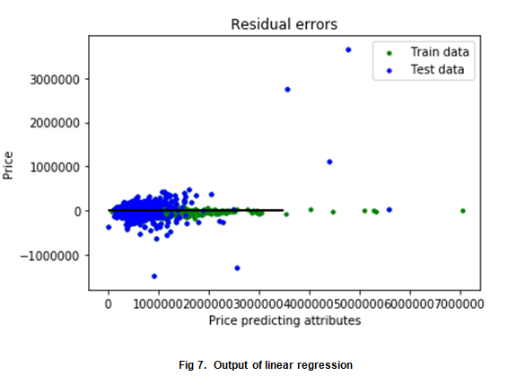
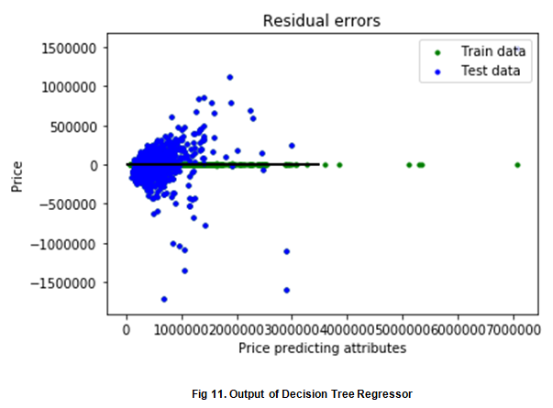
Proposed design and implementation
This plot shows the residual error for linear regression , decision tree and random forest.

Slide 8
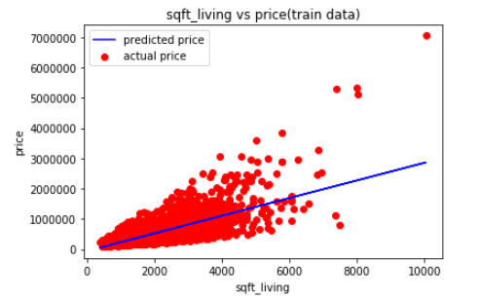
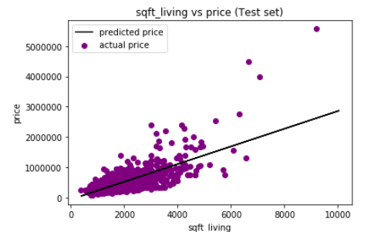
Linear regression
These graph shows the predicted price of train data and test data repectively given a single feature as sqft_living.
Accuracy of multivariatelinear regression is 60%.
The RMSE value comes to be 226443.48.

Slide 9
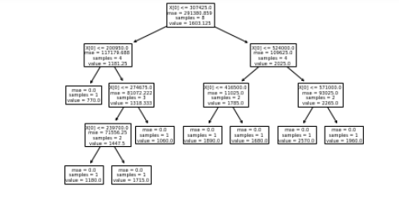
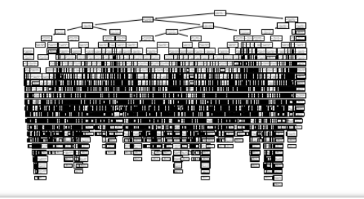
Decision tree Regressor
The first graph shows the decision tree of 10 rows data and one feature sqft_living.
The second graph shows the decision tree on our complete refined data.
The accuracy of decision tree comes to be 72% which is better than linear reression.
The root mean square erroe comes to be 205137.39.​

Slide 10
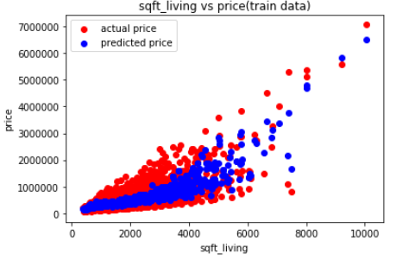
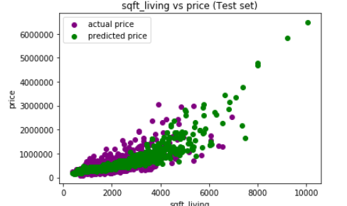
Random forest Regressor
These graph shows the predicted price of train data and test data repectively given a single feature as sqft_living.
The accuracy of random forest comes to be 97% which is better best among the three models.
The RMSE value comes to be least in this case which is only 63658.09​.

Slide 11
CONCLUSION AND FUTURE WORK
In this report several tests have been performed using Various Algorithms (Linear regressor, Decision tree regressor & Random forest Regressor) to perform house price prediction. We achieved maximum accuracy with Random forest regressor algorithm i.e., 96%. Also the RMSE(root mean squared error) value in Random forest is minimum which proves the efficiency of algorithm.
This accuracy & efficiency of algorithm will help the real estate business to achieve correct price of the desired house in future. For Future work ,we will implement a working model with the help of website that predicts the house price on the basis of desired requirements given by investors.

Slide 12
Thank You

