Slide 1
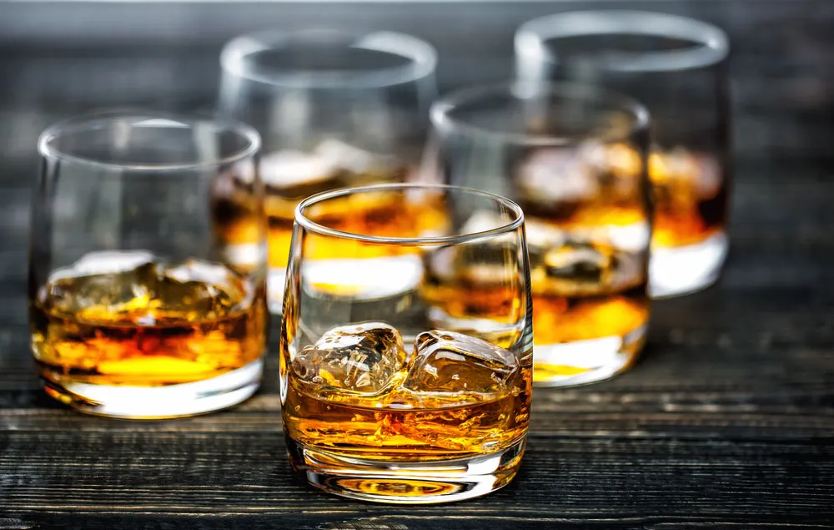
Whiskey Sales Analysis For Iowa In 2014
Created by: Antwaushea Sago
4/30/2026

Slide 2
I am a Data Analyst who works for the Iowa ABD this is a state agency responsible for managing liquor distribution and sales across Iowa. I have been given the task to analyze the Iowa liquor sales data with a focus on whiskey.

Slide 3


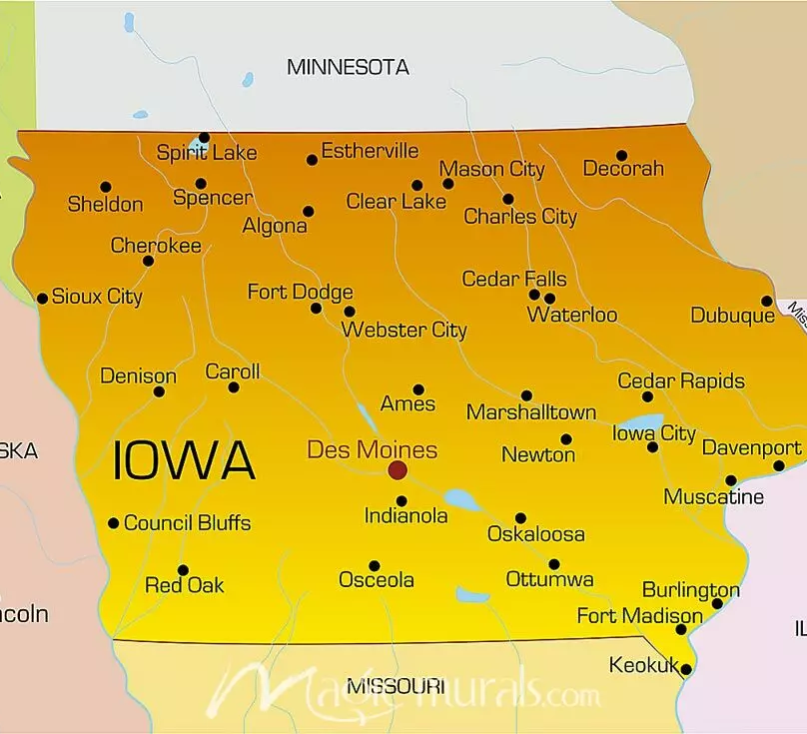
STATS
State full population 3,046,352
Total whiskey rev for state 19.3 million
Bottle prices range from 3$ to 56 with the average price being 16.53$
Whiskey sales make up about 14% of the states whole liquor sales

Slide 4
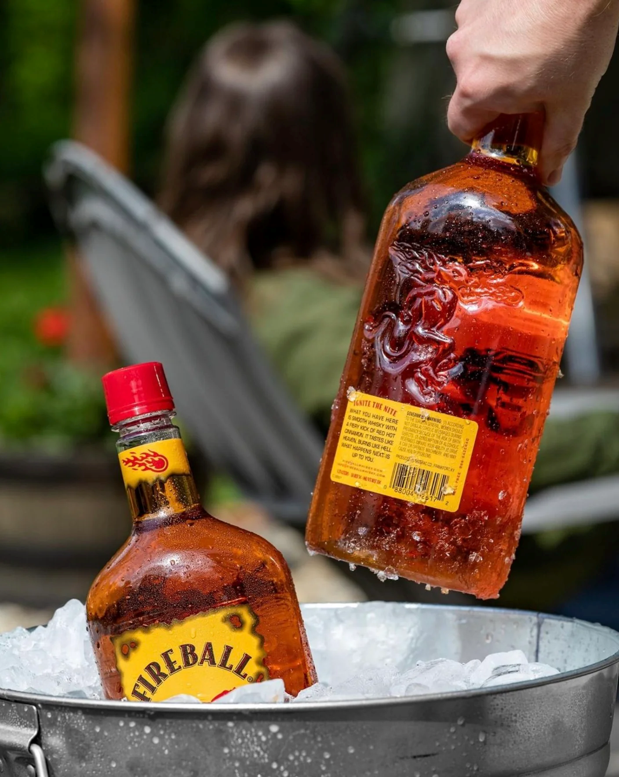
Top 5 whiskey flavors bought in Q4 of 2014

Slide 5
Top 2 Sold Products

Slide 6
Top Selling Counties

Slide 7
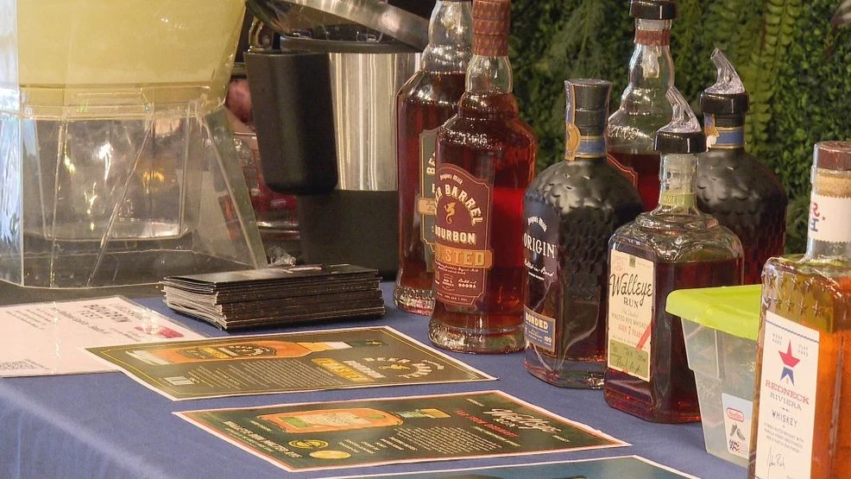
Lowest selling vendors

Slide 8
Lowest Bought Products

Slide 9
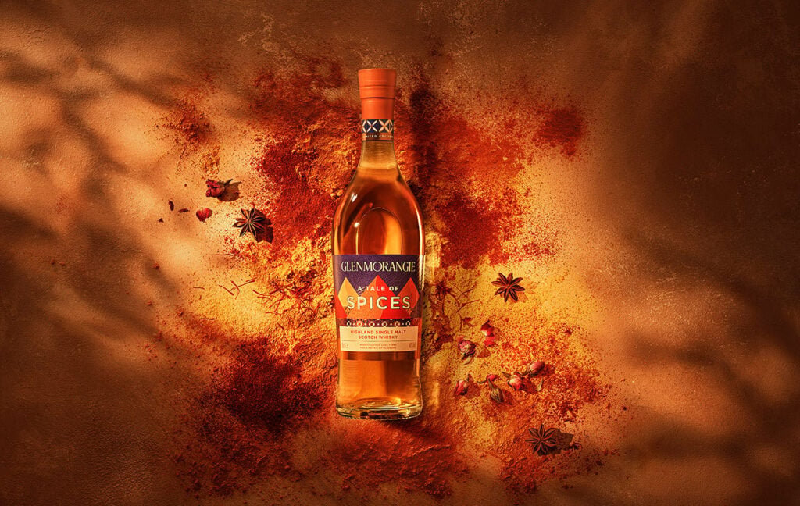
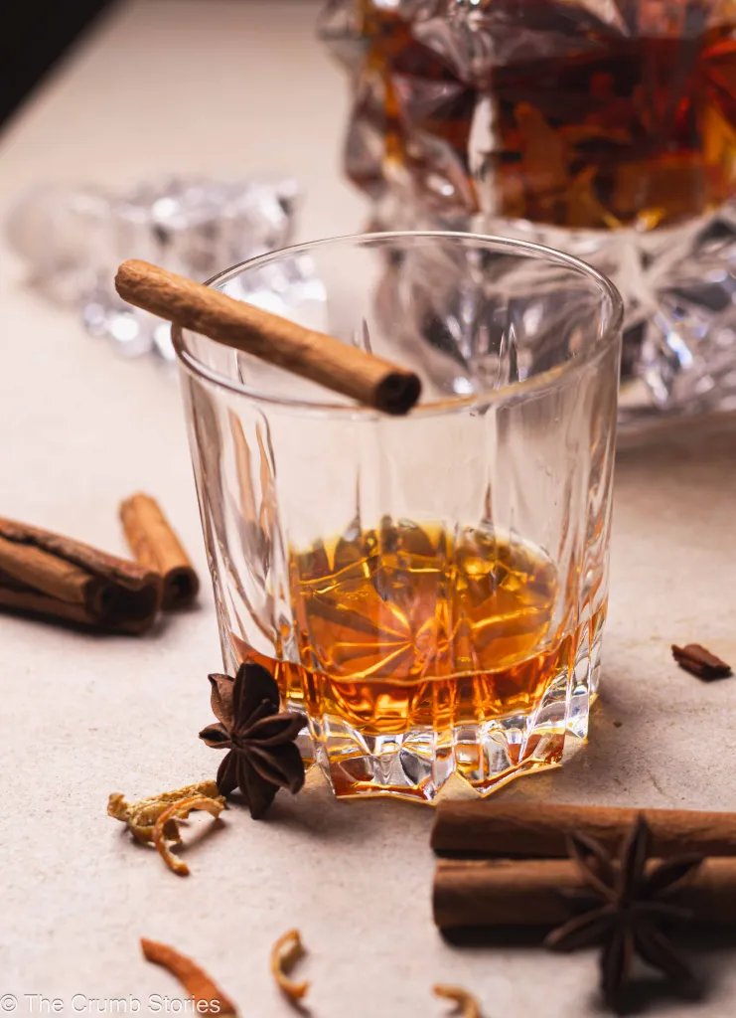
Top 4 Spiced Whiskies Sold
Notes:
9

Slide 10
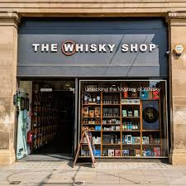
Top 5 Selling stores Vs Bottom 5

Slide 11
Summary/Recommendations
Overall, this analysis highlights both strong growth areas and weaker points in the Iowa whiskey market. Based on these findings I recommend the expansion of flavor whiskey offerings building on the success of products like Fireball Cinnamon Whiskey and offering more spiced options with greater promotion during seasonal sales times. Also taking a closer look at vendor partnerships by focusing on higher performing brands and maybe reassessing the lower performing vendors. Possibly improve or reduce inventory based on lower selling brands and focus more on demand patterns for each county.

Slide 12
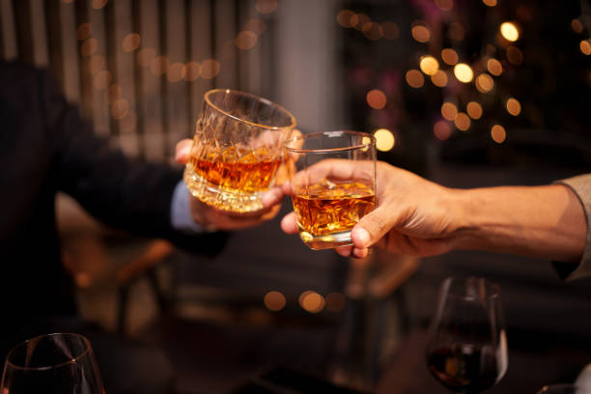
THANK YOU !

