Slide 1
Programmering 5
19-09-2024
Iterative kontrolstrukturer

Slide 2
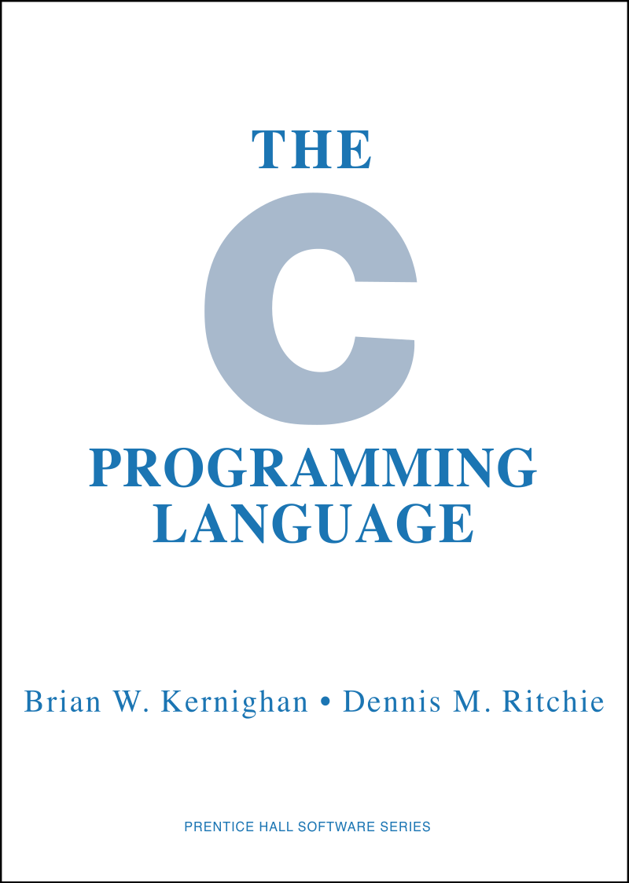
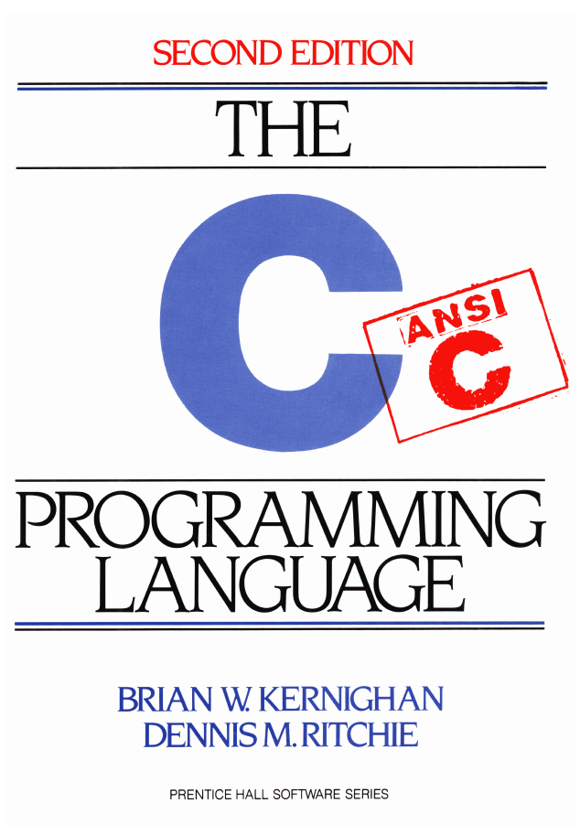
Forslag til lærebog
Der findes et utal af online bøger og ligeledes online kursus materiale, der understøtter indlæringen af C.
Vi vil anvende flere af disse undervejs og der vil være sider at læse til de fleste kursusgange.
Resources:
https://cplusplus.com/reference/clibrary/
https://manual.cs50.io/
https://www.gnu.org/software/gnu-c-manual/gnu-c-manual.pdf
https://en.cppreference.com/w/c
  https://www.programiz.com/
Ekstra Opgaver:
https://www.w3schools.com/c/index.php
https://www.programiz.com/c-programming/
Online Compiler:
https://onecompiler.com/c
Arduino Reference:
https://www.arduino.cc/reference/en/

Slide 3
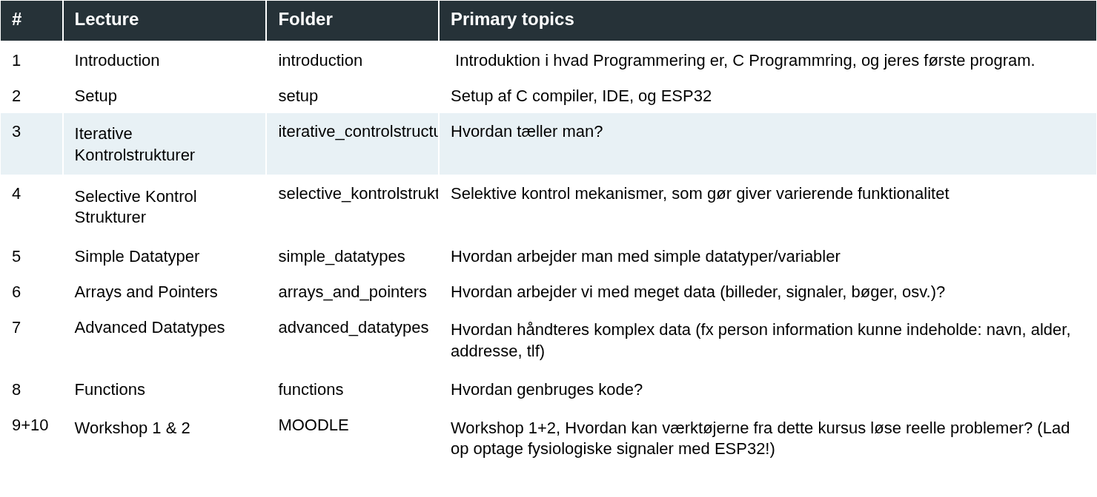

Slide 4
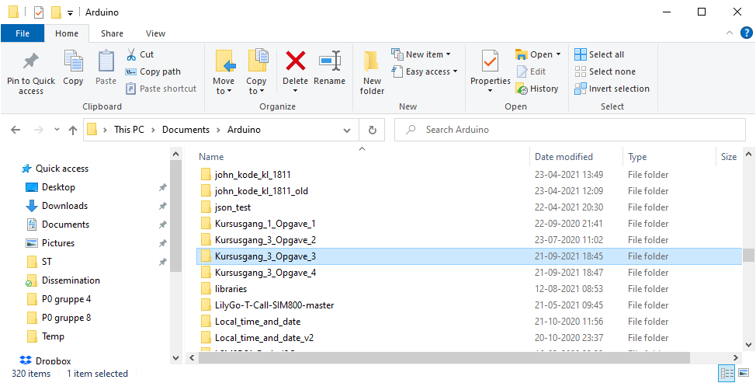
Know where your code and solutions are

Slide 5
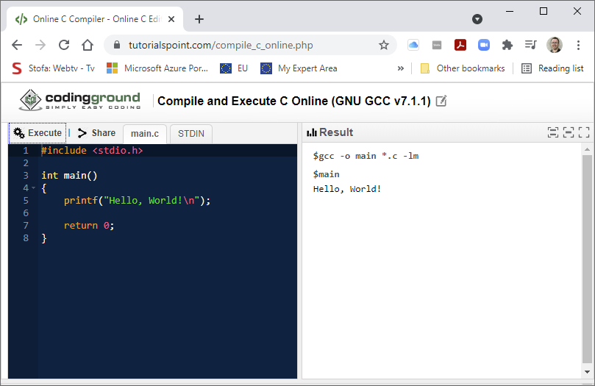
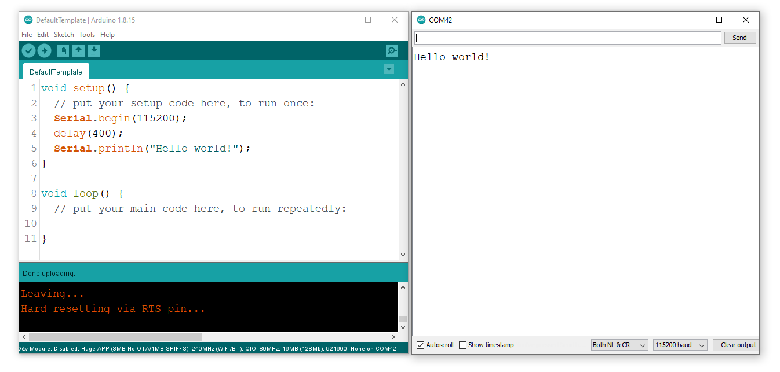
Få styr på jeres default kode template

Slide 6

Læringsmål idag
Viden om de iterative kontrol strukturer
Viden om iterator
Kan anvende de iterative kontrol strukturer
Kan anvende iterative kontrol strukturer til at som et led i en algoritme
Kan bruge en iterativ kontrol struktur til at modificerer data

Slide 7

Iteration or loop statements
Iteration or loop
for
while
Nested loops
Selvstudie: do-while

Slide 8
for loop
#include <stdio.h>
int main()
{
for (int i = 0; i < 5; i++)
{
printf("%i\n", i);
}
}
[Output]
0
1
2
3
4
Huskeseddel (mig): Skriv program i VS Code
Huskeseddel (mig): debug loop!

Slide 9
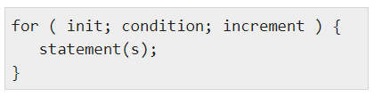
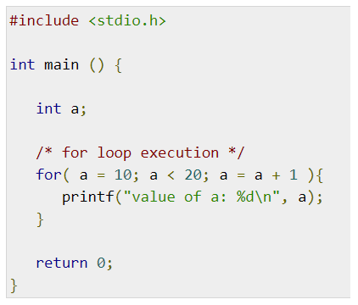
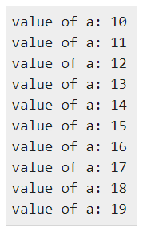
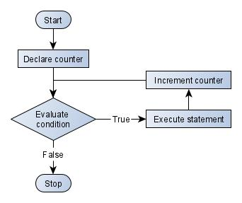

for loop
A loop is a repetition construct structure to efficiently execute a code block a specific number of times
(0.) init: is executed first and only once
  Then, jump to condition (1)
(1.) condition: The condition step is evaluated.
  If true, jump to the statements (2)
  otherwise, exit loop
(2.) statements {...}: Code body in the for loop is executed.
  Then, jump to the increment (3) (there can also be a decrement!).
(3.) increment: Updates the conditional argument.
  Then, jumps to condition (1)
    (Advanceret note, gennemgår jeg ikke) man behøver ikke have i steps 0-3
      i.e. for ( ; ; ) er det samme som while(...){}
0 1 2
3

Slide 10
Opgave: Hello For Loop
Lav et program som printer 4 tabellen ud i terminalen op til det sidste tal før 100.
Fremgangsmåde:
Åben VS Code, og åben en ny project_mappe, kald den hvad I vil
  (Dette er sidste gang jeg skriver dette)
Lav en fil hello_for_loop.c
Lav main funktionen
  Hint: Hvis I har glemt hvordan så se på alle andre opgaver
Lav et loop, som tæller 0, 4, 8, ..., op til 99 (i<100, altså firtabellen)
Indeni Kodeblocken { ……… } printer man tallet i ud i terminalen
  Hint: Dette er ikke nyt længere.
Kør programmet, og sikre dig at det virker
#include <stdio.h>
int main() {
for (int a = 10; a <= 20; a++) {
printf("value of a: %d\n", a);
}
return 0;
}

Slide 11
Iteration or loop statements
Iteration or loop
for
While
Nested loops

Slide 12
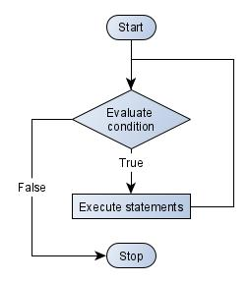
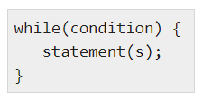
while loop
#include <stdio.h>
int main(void)
{
int a = 10;
printf("Test WHILE loop>>\n");
while (a)
{
printf("value of a is %i.\n",a);
a--; // same as a = a - 1; and a-=1;
}
}
A while loop will execute a block of statements for ever, if a given condition remains true true.
If condition starts with false the block is not executed at all.
while(1){}

Slide 13
Opgave: loops1
Omskriv programmet herunder (eller find filen ‘loops1.c’), så det benytter en while loop i stedet for et for loop.
Output skal forblive uændret
Hvad er første og sidste værdi den printer ud?
Fremgangsmåde:
Definer int a = 10 udenfor loopet
Flyt interations-steppet sidst i codeblocken (a++)
Kør programmet
#include <stdio.h>
int main() {
for (int a = 10; a <= 20; a++) {
printf("value of a: %d\n", a);
}
return 0;
}

Slide 14
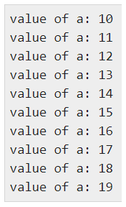
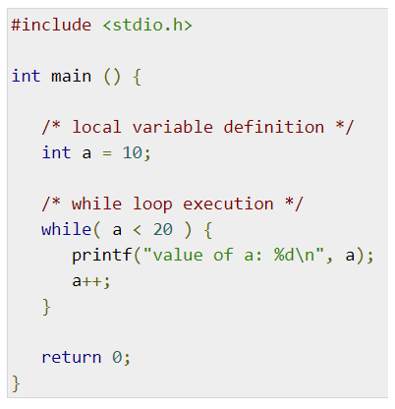
while loop
A while loop in C programming repeatedly executes a block of statements as long as a given condition is true.
If condition starts with false the block is not executed at all.

Slide 15
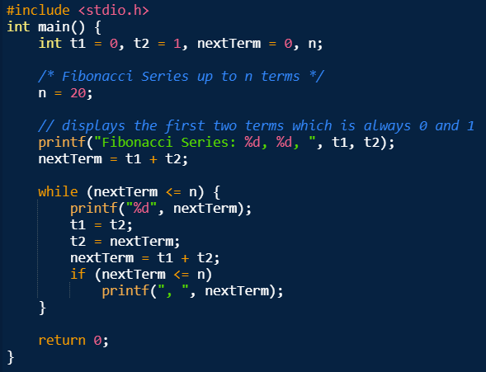
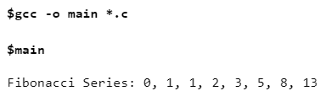
Fibunacci sequence using while
This is an example of using a while loop. The calculation of the Fibonacci sequence must stop when the result exceeds 20 in this case.
The inserted if condition ensures that only a comma is printed if a new Fibonacci number must still be calculated.

Slide 16
Iteration or loop statements
Iteration or loop
  for
  While
  Nested loops

Slide 17
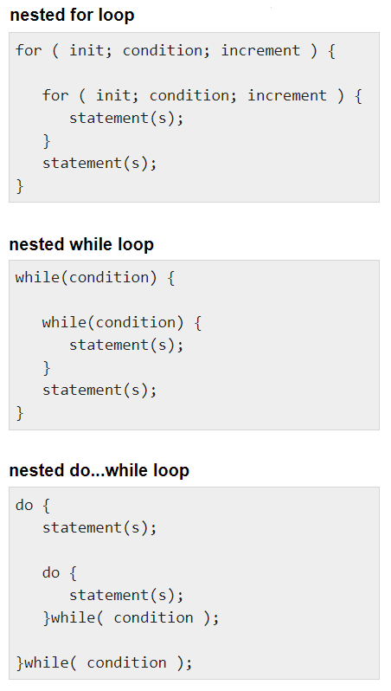
Nested loops
A loop can be nested inside another loop (hence the name nested loops).
You can place any type of loop inside any other type of loop.
For example, a while loop can be inside a do … while loop or vice versa.
Note: conditions in the different loops are of course not identical.
for (int i = 0; i < count; i++)
{
for (int j = i * count; j < i * count + count; j++)
{
printf("%2i ", j);
}
printf("\n");
}

Slide 18
Argc, argv
Dette laver jeg som et eksempel

Slide 19
Hvad er int argc, char const *argv[]?
Inputs til program
Man kan bruge inputs til sin main funktion, som placeres i argv (se programmet til højre).
  Alle inputs i argv er strings, som kan læses via argv[i], hvor i er et tal.
opg a: Hvad fortæller argc?
  gcc p05_loops4.c -o p05_loops4
  ./p05_loops4.exe
  ./p05_loops4.exe 1 2 3
  ./p05_loops4.exe 1 2 3 hej
opg b: argv[0] giver string element 0 (man tæller fra 0), men hvad er værdien af argv[0]?
  Brug en printf til at printe dette til terminalen.
opg c: lav en printf af alle argv elementer
  hint: lav et loop som går gennem alle elementer af argv
  hint: https://manual.cs50.io/ læs omkring printf
int main(int argc, char const *argv[])
{
/* code */
return 0;
}

Slide 20
Opgaver
files/iterative_controlstructures_questions

Slide 21
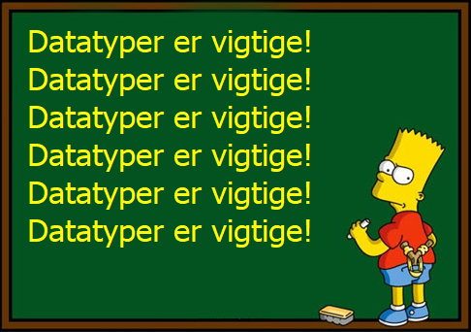
Next Up…
Emnet: Functions
Litteratur: Se moodle.

Slide 22
Gennemgang af opgaveløsning fra sidste kursusgang
Skriv et program, der initialiserer 4 variabler:
char name[] = ”Joe”
char gender = Male
char age = 40
float weight = 87.0
float height = 1.82
Skriv to defines: #define Male 1
#define Female 0
Skriv en if-else sætning der på baggrund af overstående variabler printer følgende besked:
”Joe is a male, age 40 and he has a BMI of 26.3”
Omskriv programmet, så der initialiserer 4 nye variabler:
char name[] = ”Jane”
char gender = Female
char age = 32
float weight = 65.0
float height = 1.70
Samme if-else sætning skal nu printe:
”Jane is a female, age 32 and she has a BMI of 22.5”
Hjælp: C library function - printf()
http://tpcg.io/B2O1FQ

Slide 23
Gennemgang af opgaveløsning fra sidste kursusgang
Skriv et program, der bruger BMI til at printe vægt-klassifikationen:
BMI < 18.5: underweight
BMI = 18.5 – 24.9: normal weight
BMI = 25-29.9: overweight
BMI = 30-34.9: class I obesity
BMI = 35-39.9: class II obesity
BMI > 40: class III obesity
1: Start med at deklarere to variable: vægt og højde
2: Beregn BMI
3: Brug en række if-statements til at printe vægt-klassifikationen
Hjælp: C library function - printf()
http://tpcg.io/VA5G7O

Slide 24
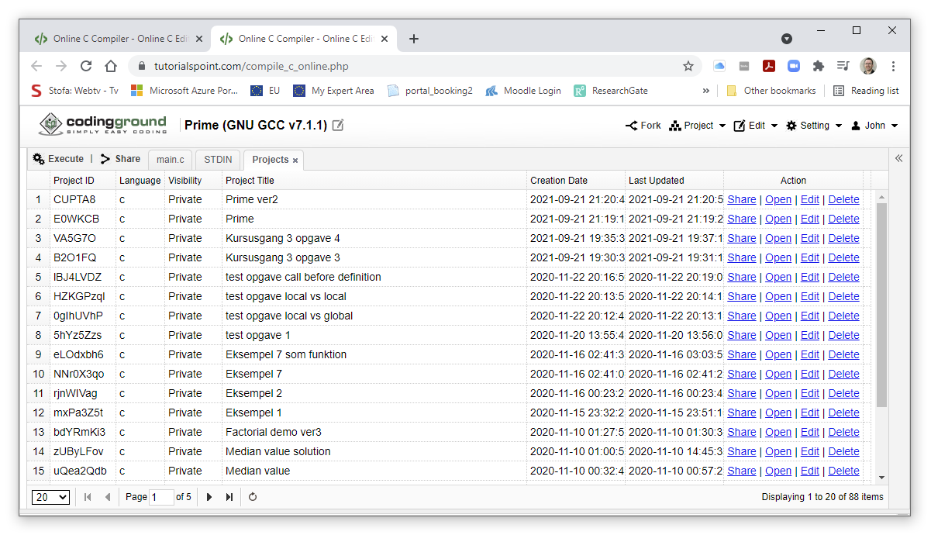
Know where your code and solutions are

Slide 25
Opgave – for to while-do
Rewrite the for loop, to be a do..while loop
  output must be the same

Slide 26
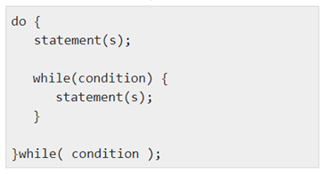
Nested loops
C programming allows one loop to be nested inside another loop (hence the name nested loops).
One final note about nesting loops is that you can place any type of loop inside any other type of loop. For example, a while loop can be inside a do … while loop or vice versa.
Note: conditions in the different loops are of course not identical.

Slide 27
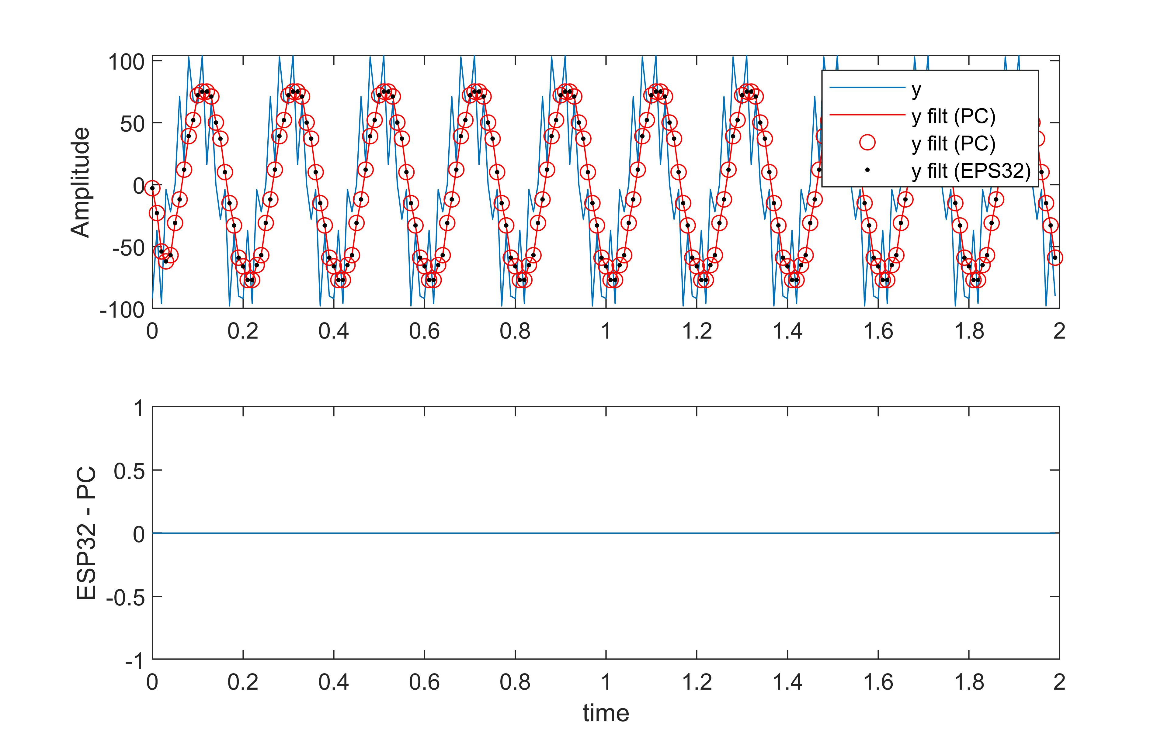
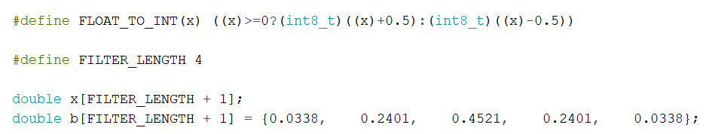
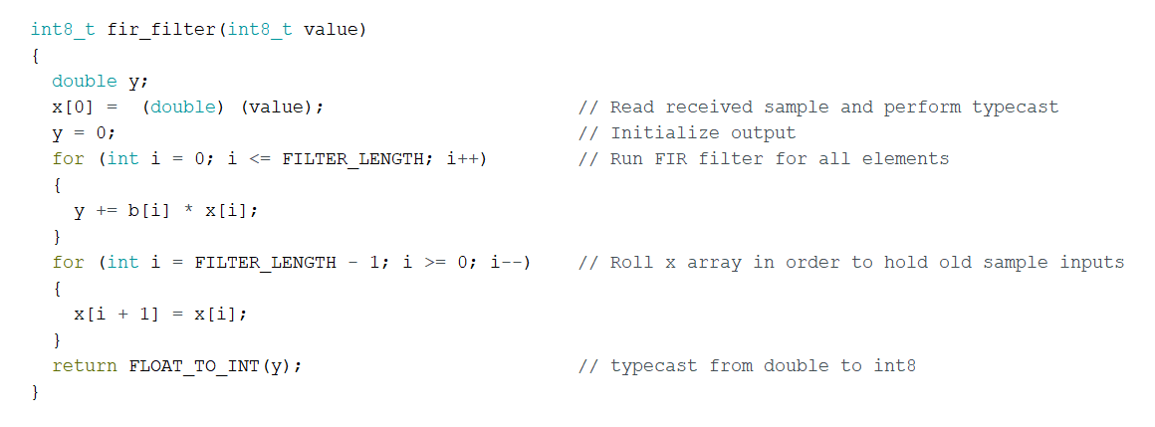
for-loop
Notes:
Får de studerende til at fortælle hvad der sker

Slide 28
for loop, again!
#include <stdio.h>
#include <stdlib.h>
#define _USE_MATH_DEFINES /* giver adgang til M_PI i math.h */
#include <math.h> /* M_PI */
int main()
{
for (;;)
{
printf("%f\n", M_PI);
}
return EXIT_SUCCESS; // EXIT_SUCCESS from stdlib.h
}

Slide 29
Iteration or loop statements
Iteration or loop
for
while
do-while
Nested loops

Slide 30
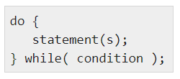
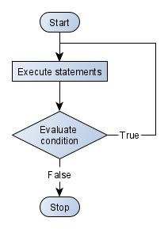
do … while
Unlike for loops and while loops, which test the condition at the top of the loop, the do ... while loop checks its condition at the bottom of the loop.
A do ... while is similar to a while loop, except for the fact that the loop's statement is guaranteed to execute at least once

Slide 31
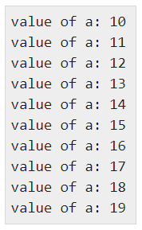
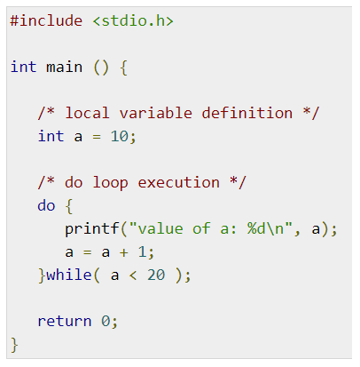
do … while
Unlike for loops and while loops, which test the condition at the top of the loop, the do ... while loop checks its condition at the bottom of the loop.
A do ... while is similar to a while loop, except for the fact that the loop's statement is guaranteed to execute at least once

