Slide 1
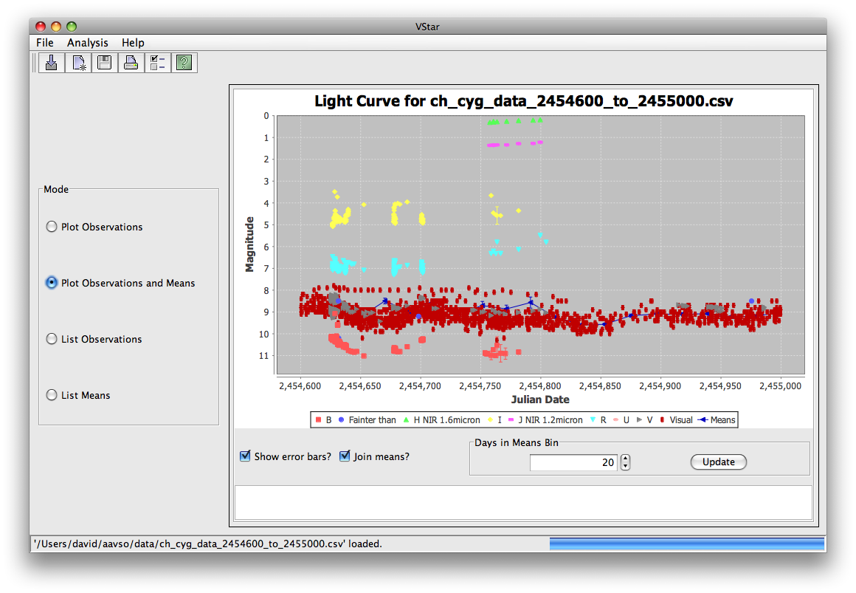
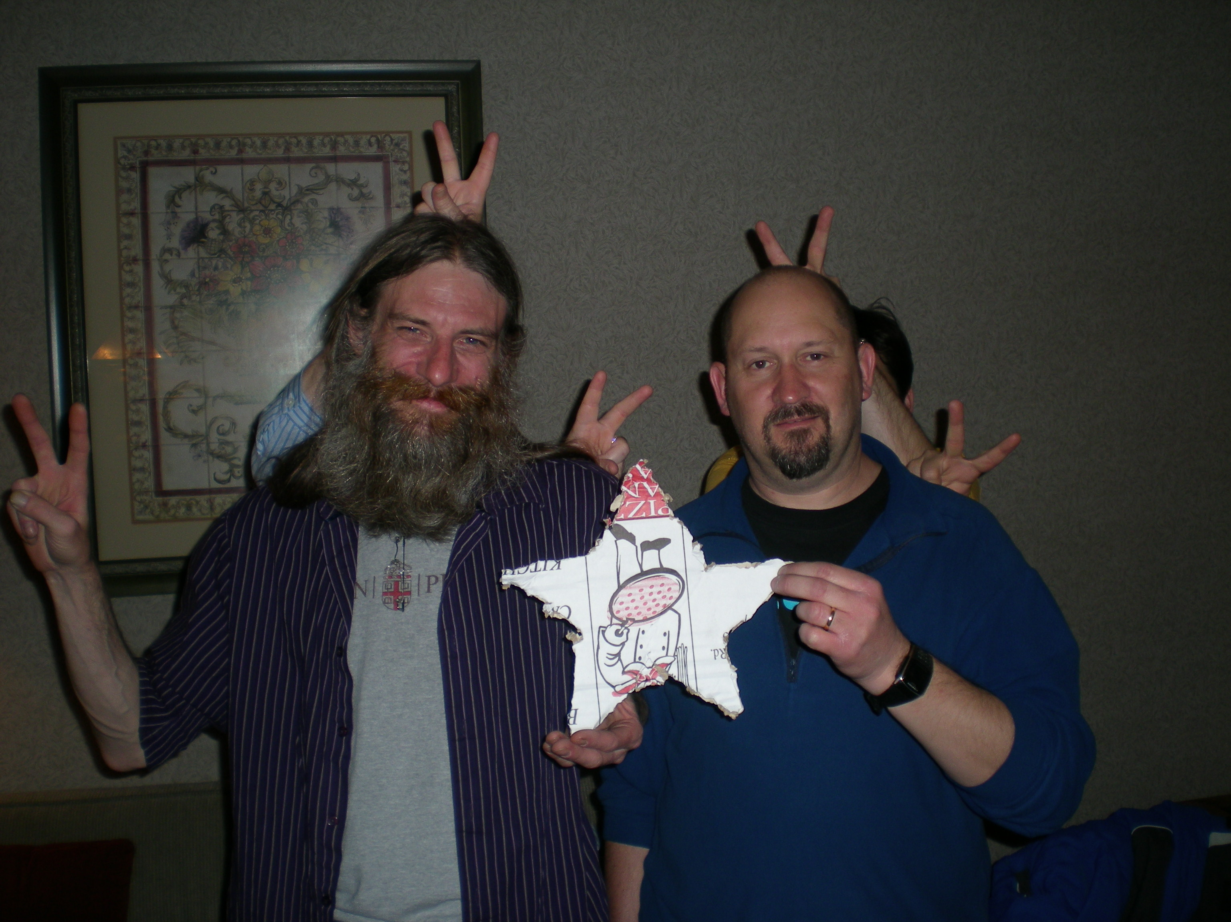

VStar Begins
Michael
Umbricht
David
Benn

Slide 2
VStar is…
intended to be an easy-to-use variable star data visualization and analysis tool;
a SourceForge project;
still in progress;
being implemented in multiple phases;
in need of more testers (the more the merrier, especially with respect to platforms);
no formal releases yet, but downloadble (please do; see Links slide).

Slide 3
Key Features
Now
Takes input from files and AAVSO database
Light curve with optional error bars
Mean plot plus light curve with optional error bars
Data related to each of these plots in tables
Series visibility change, with effect upon mean plot
Inspection of individual observations
Saving & printing
Next
Phase plots
Period analysis algorithm implementation
Bug fixes based upon feedback so far

Slide 4
Who?
David Benn
Development
Michael Umbricht
Testing, encouragement, ideas
AAVSO Staff
Sara Beck, Arne Henden, Elizabeth Waagen, Aaron Price, Rebecca Turner, Matt Templeton
Oversight, liason, analysis, testing, encouragement
You?
We need more testers

Slide 5
Links
VStar SourceForge site
http://sourceforge.net/projects/vstar/
Download latest Vstar archive (tarball)
http://vstar.svn.sourceforge.net/viewvc/vstar/trunk/
Click “Download GNU tarball”
See ReadMe.txt in top-level directory
Download latest VStar via Subversion
svn co https://vstar.svn.sourceforge.net/svnroot/vstar/trunk vstar

