Slide 1


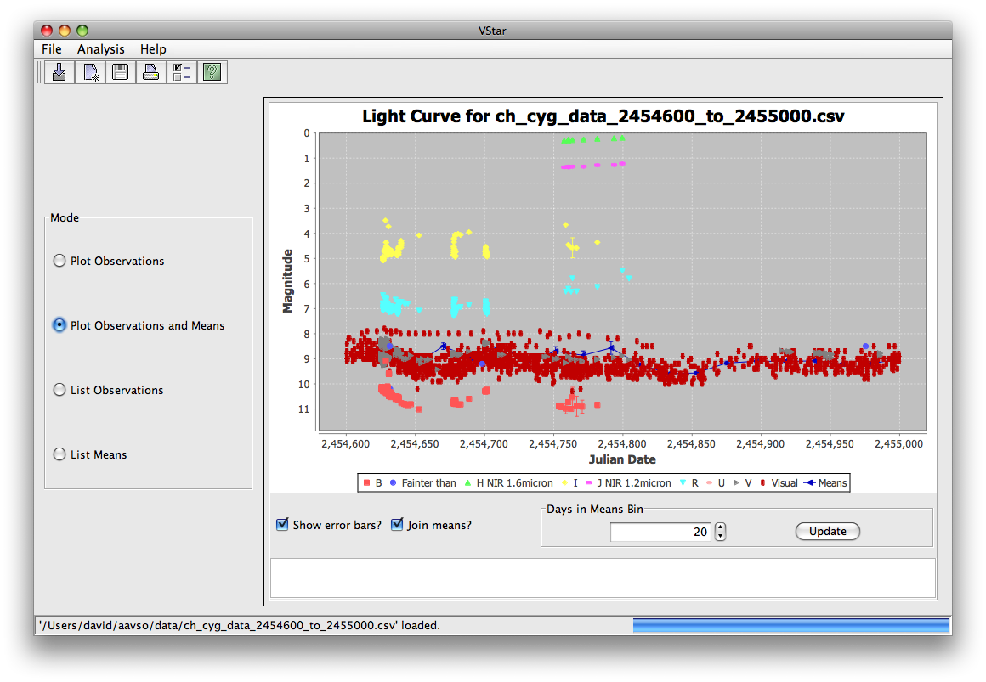
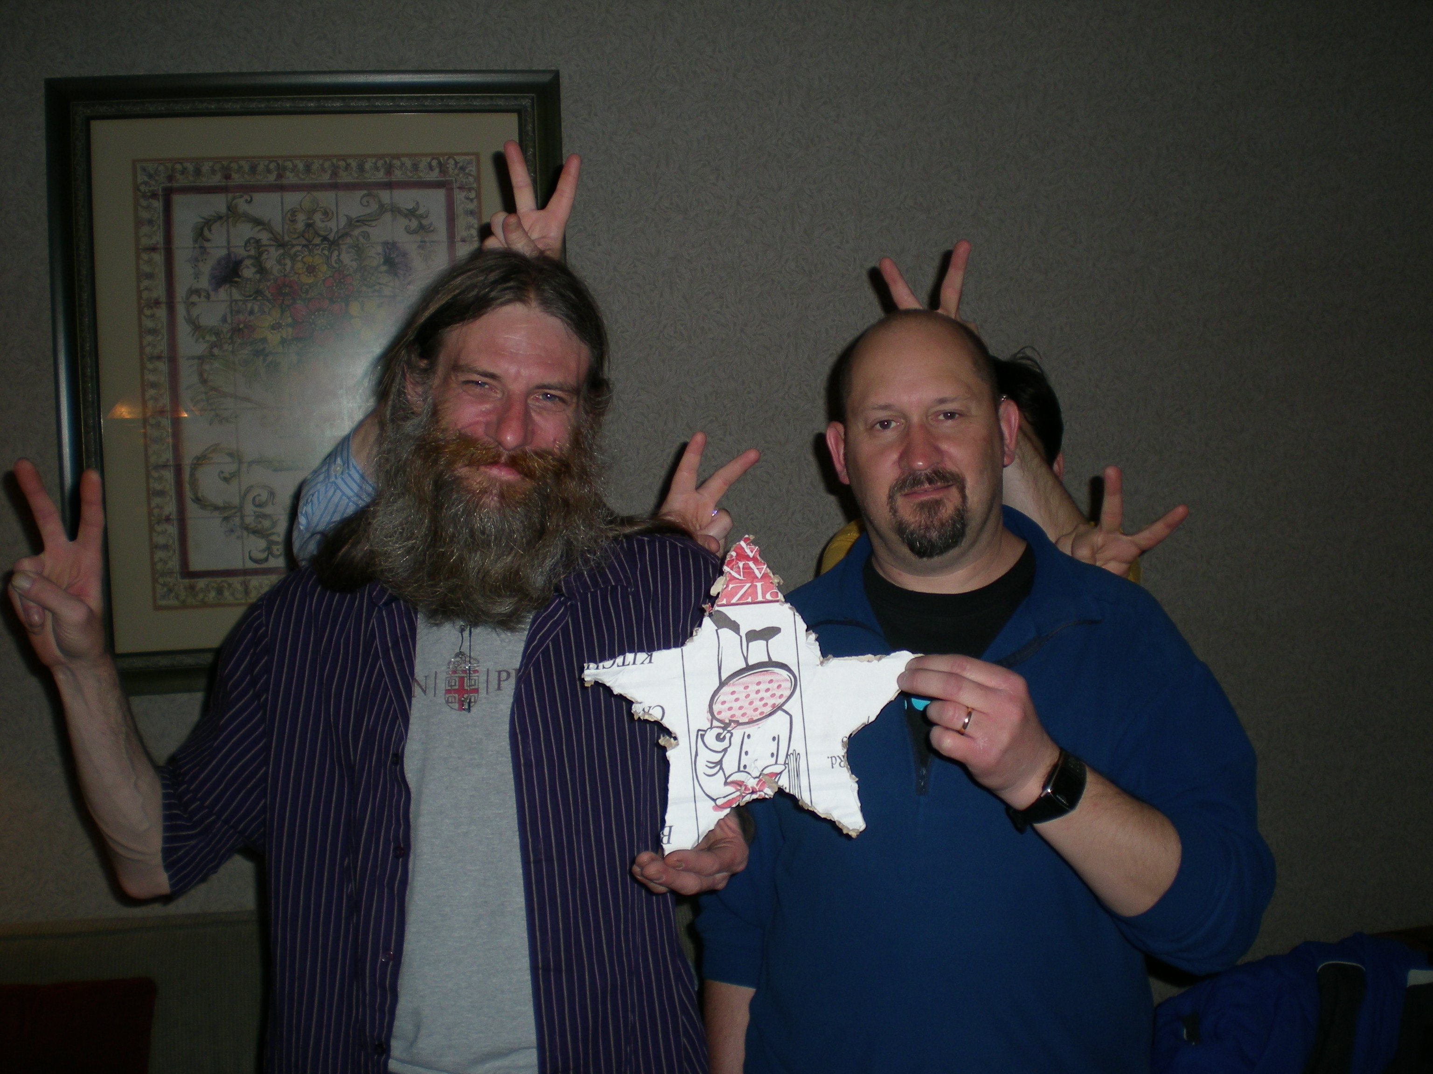

Michael
Umbricht
David
Benn

Slide 2

intended to be an easy-to-use variable star data visualization and analysis tool;
a SourceForge project;
still in progress;
being implemented in multiple phases;
in need of more testers (the more the merrier, especially with respect to platforms);
no formal releases yet, but downloadble (please do; see Links slide).

Slide 3

Now
  Takes input from files and AAVSO database
  Light curve with optional error bars
  Mean plot plus light curve with optional error bars
  Data related to each of these plots in tables
  Series visibility change, with effect upon mean plot
  Inspection of individual observations
  Saving & printing
Next
  Phase plots
  Period analysis algorithm implementation
  Bug fixes based upon feedback so far

Slide 4

David Benn
  Development
Michael Umbricht
  Testing, encouragement, ideas
AAVSO Staff
  Sara Beck, Arne Henden, Elizabeth Waagen, Aaron Price, Rebecca Turner, Matt Templeton
    Oversight, liason, analysis, testing, encouragement
You?

Slide 5

VStar SourceForge site
  http://sourceforge.net/projects/vstar/
Download latest Vstar archive (tarball)
  http://vstar.svn.sourceforge.net/viewvc/vstar/trunk/
  Click “Download GNU tarball”
  See ReadMe.txt in top-level directory
Download latest VStar via Subversion
  svn co https://vstar.svn.sourceforge.net/svnroot/vstar/trunk vstar

